Slide 1

Women in
Business Council:
From Campus to Career: Building Your Brand with PGIM
WIBC Body Meeting #3
9/29

Slide 2
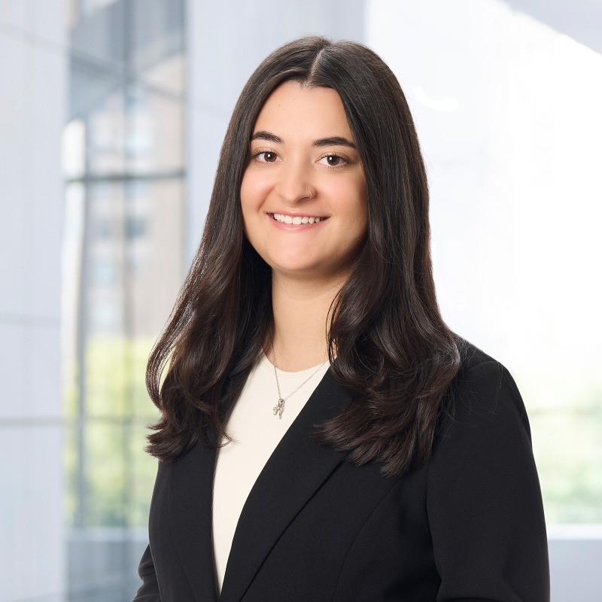
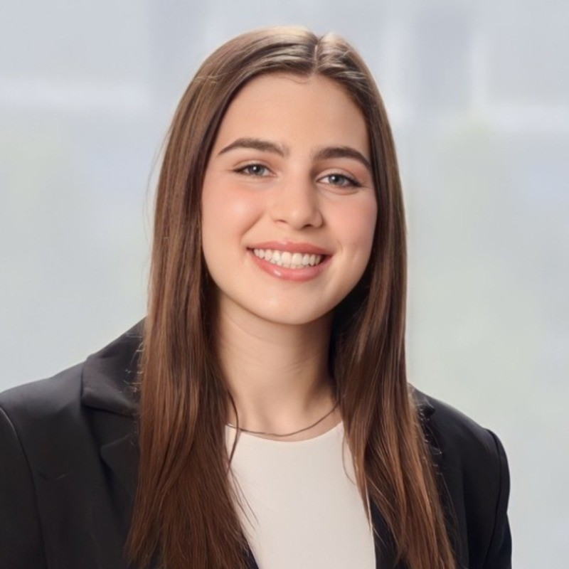
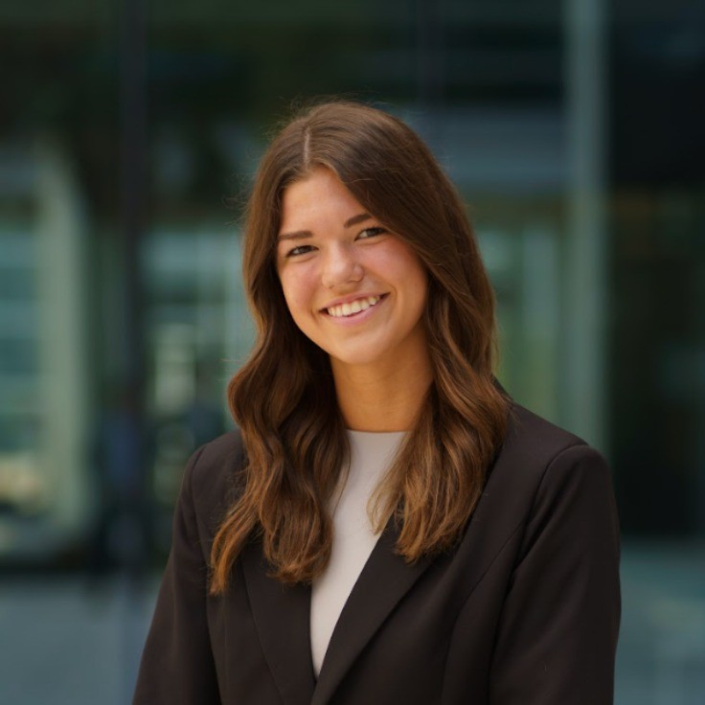
PGIM
Julia Manetti
Gina Geraci
Emma Fitzsimons

Slide 3
WIBternship
What is it and why is it required?
WIBternship is our new member program for freshmen and sophomores (although any WIB member is welcome to attend any workshops).
We lay down the basics of employability in a low stakes environment, focused on learning and development.
Our speakers and contacts want to hire our members, so it is important to employ our members with the necessary skills.
What is the time commitment of WIBternship?
Every other Tuesday at 7:30PM* (opposite weeks as the body meetings)
Is WIBternship a competitive/rush process?
No! All we ask is that you show up, are engaged, and do your best!

Slide 4
WIBternship Requirement
Tuesdays at 7:30PM
Location: mostly Jones 210 (if not, Currell 107)
Email: uscwibternship@gmail.com
We ask you make you best effort to attend all meetings as they will each teach an important skill! However, we understand life happens, so one (1) workshop absence is allowed. The case competition is required.
Once you complete the program - you’re an official WIBC member!

Slide 5
Next WIBternship
Next Tuesday, October 6th
Time & Location: 7:30 at Jones 210
Meeting Content: Committee Panel, LinkedIn, & Headshots
Dress code: Business casual (Business professional if you want a headshot)
Please bring a laptop!!!
Next Social Event:
Wednesday, October 7th
Paint & Sip with Mentorship
7-9 in Russell 302
Limited sign ups

Slide 6
Social Event Policy
Policy to Social Events:
Members who register & don’t attend events (or cancel without warning) will receive a penalty.
Penalties:
1st Offense: Reminder & Warning
2nd Offense: 1 point removed
3rd Offense: Restriction of events sign-up/registration

Slide 7
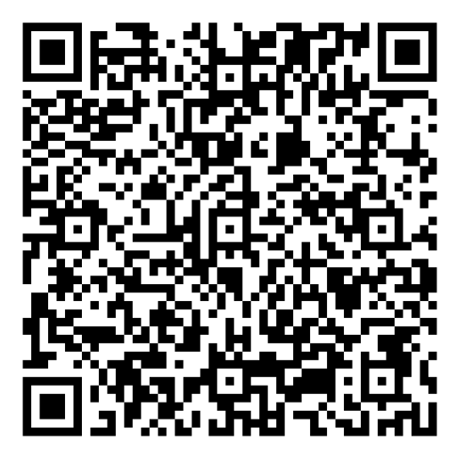

Outreach/R&R
WIBC x Her Campus Mingling Night
Join us for a mingling night with Her Campus! We’ll have light refreshments, networking, and a short professional development workshop while getting to know members from both organizations.
**Bring your laptop!
Where: DMSB Room 133
When: Thursday, 10/8 @6 PM

Slide 8

Outreach/R&R
PLAYA BOWLS PERCENT
Benefiting the Hive!
Where: Playa Bowls at 737 Gadsden St.
When: Friday, 10/9 @2-9PM

Slide 9

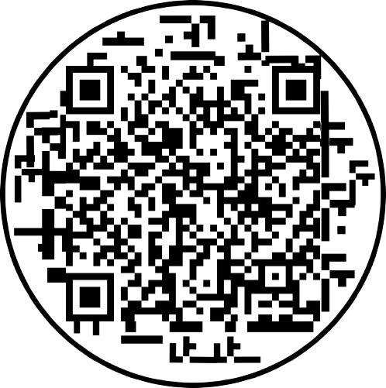
Outreach/R&R
HOTWORX Workout Class
Come get your sweat on with WIB x HOTWORX! Scan the QR code to claim your FREE class for October 12 or 13 anytime between 11AM - 6:30PM
Enter your info, select “Not Ready to Book,” and let the HOTWORX team know you’re with Women in Business when they reach out to schedule!
Where: 4464 Devine St Suite G
When: 10/12 and 10/13, anytime between 11-6:30PM

Slide 10
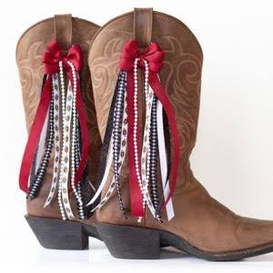


Outreach/R&R
Boots, Bows, and Canal Coffee
Get ready for game day by sprucing up the side of your boots with some cute ribbon!
You bring the boots, we will provide the coffee and supplies! Feel free to bring any extra ribbon you’d like but we will provide ribbon if not.
Where: 205 in Russell
When: 10/20, anytime between 9AM -11AM
Sign up: Will be sent out shortly in group me

Slide 11

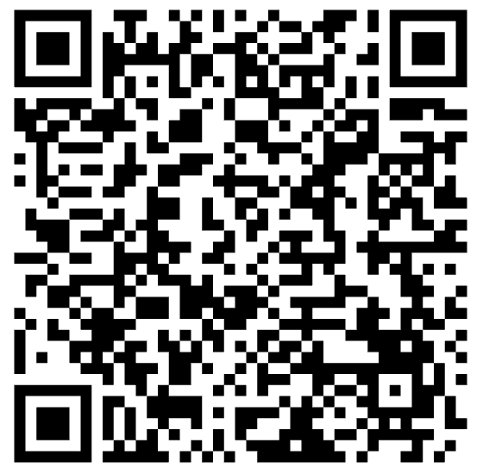
Mentorship
Mentor-Mentee pairings were sent out via email to Mentors a few weeks ago. Mentees please contact me (lenahanl@email.sc.edu) if you have not heard from your mentor yet.
Reminders for meetings:
Try to meet with your mentor/mentee three times this semester. Fill out the Google form every time you meet- the link was included with the email to mentors!
Sign Up Sheet

Slide 12
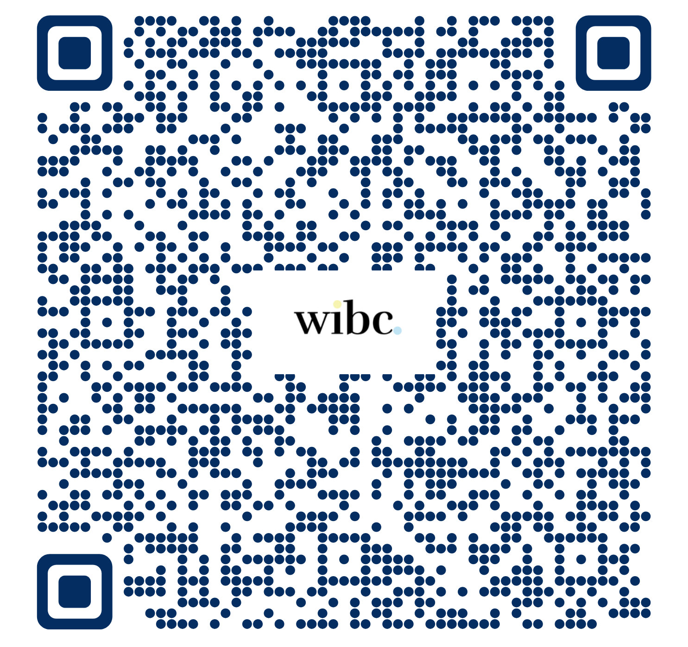
Marketing
Member Spotlight Form
Please fill out this form if you would like to be featured on the Instagram!

Slide 13

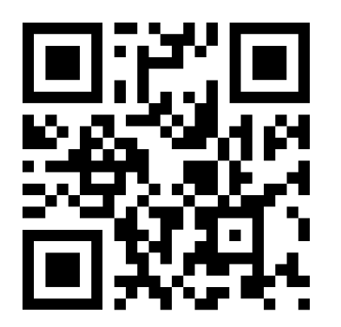
Moore Marketing Summit
This Thursday from 10 AM - 4 PM
Drop-in style
Registration is required
Several alumni…great networking!

Slide 14
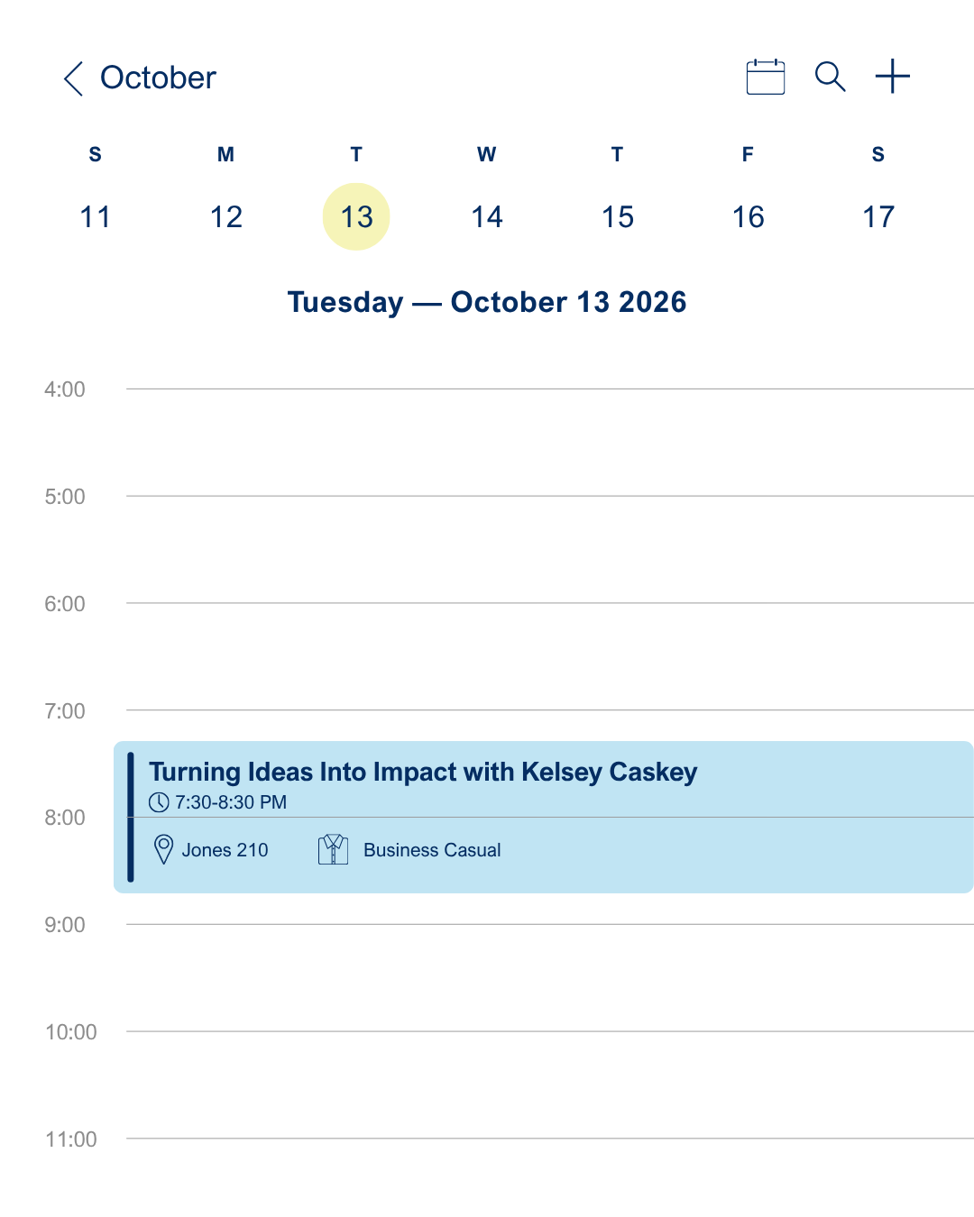
Next Body Meeting
Meeting Etiquette:
During body meetings (virtual & in-person), please be as respectful as possible to our speakers and your peers.
This includes: showing up on time & staying engaged throughout the meeting

Slide 15
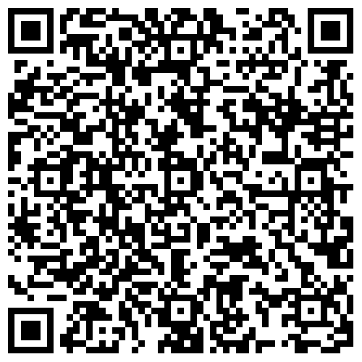
WIBC Emails
If you have paid your dues and are NOT receiving body meeting reminder/recap emails from “WIBC Exec Team”, please fill out this form!
Note: Check your junk/spam folder first!

Slide 16
Structure- Points System
New Members
Must obtain 16 total points
Attend at least 4 out of 5 WIBternship meetings
Attend at least 2 WIBternship/Mentorship social events
Participate in at least 1 event outside of body meetings
Returning Members
Must obtain 16 total points
Participate in at least 1 event outside of body meetings
All Members
Must attend at least 4 out of 7 body meetings
Free t-shirt at 16 points
  Top 3 point earners will receive a gift card at the end of the semester

Slide 17
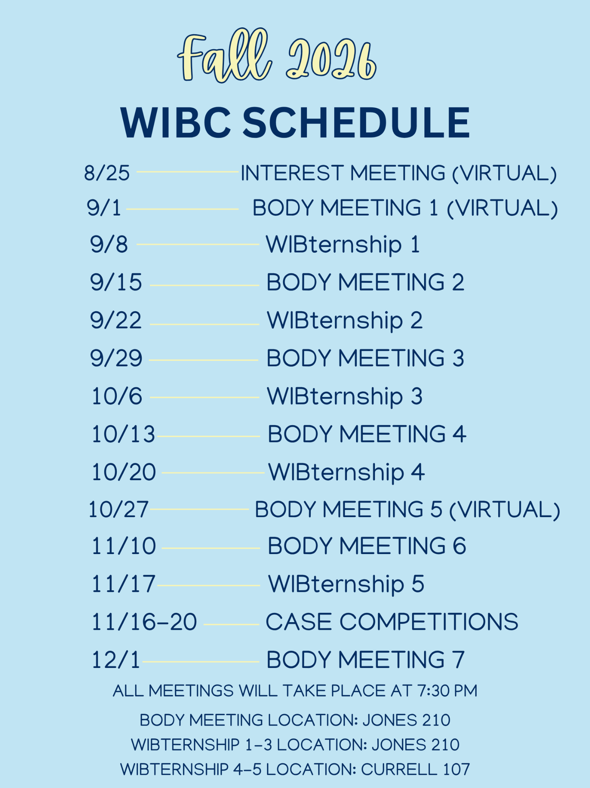
Fall 2026 WIBC Schedule

Slide 18

GroupMe - WIBC

Slide 19
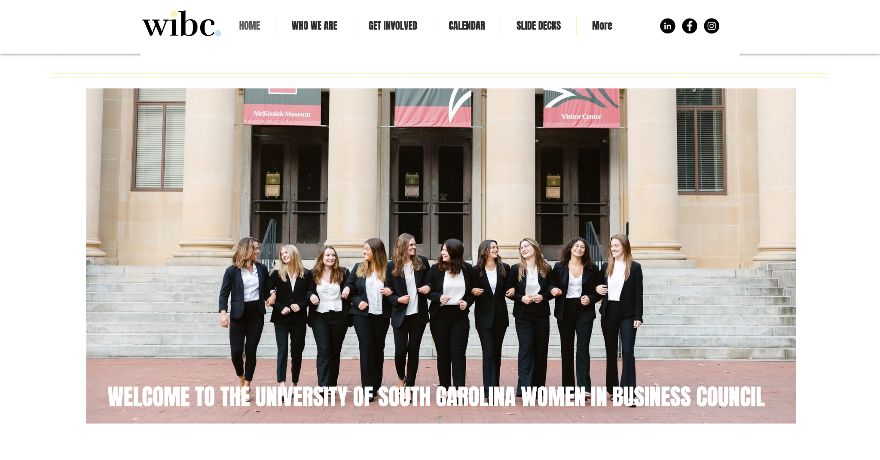
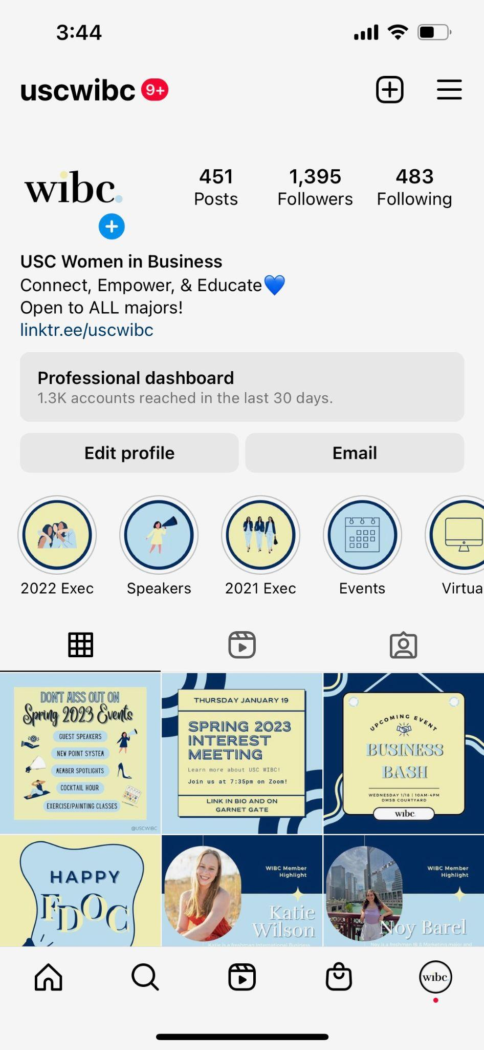
Where to Find Information
uscwibc.com
@uscwibc

Slide 20
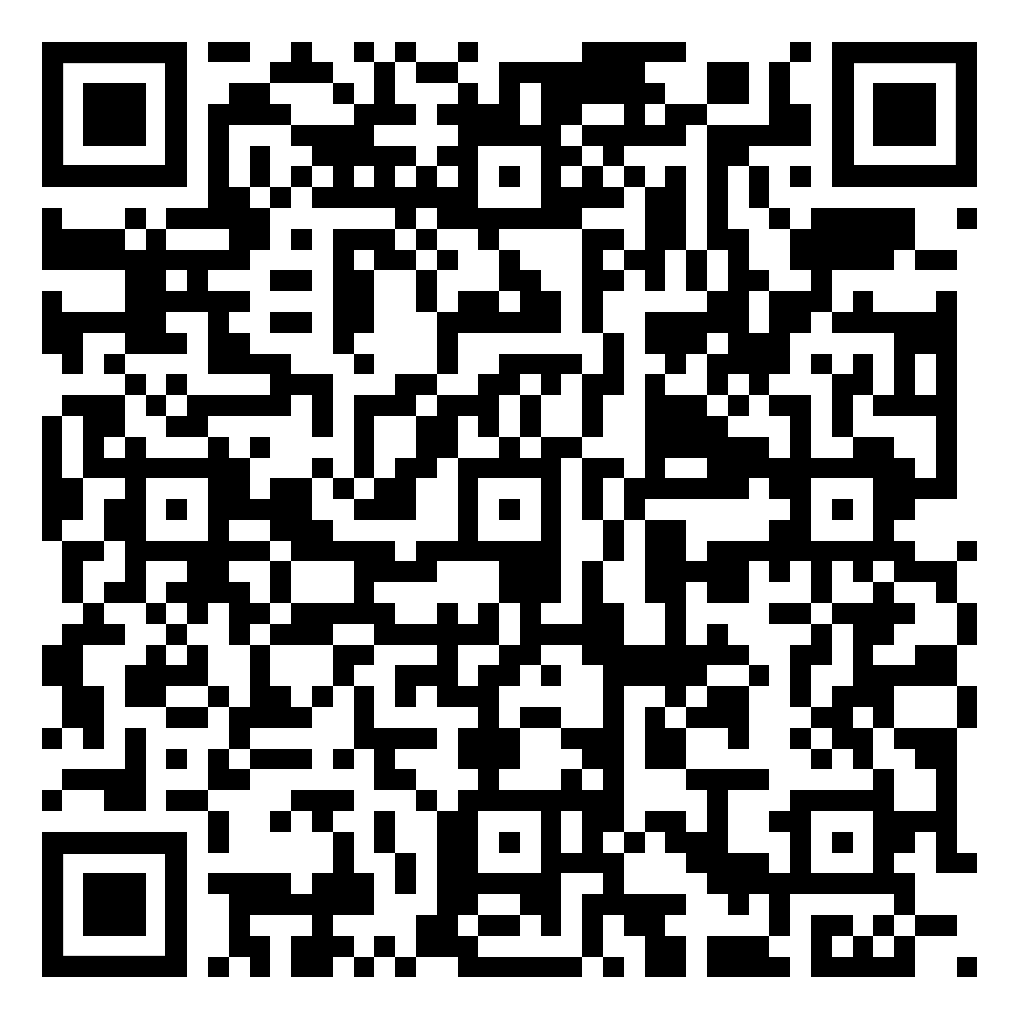
Attendance!

Slide 21
Thank you!

