Slide 1

Second Meeting | Sept 22, 2026
Notes:
Director

Slide 2
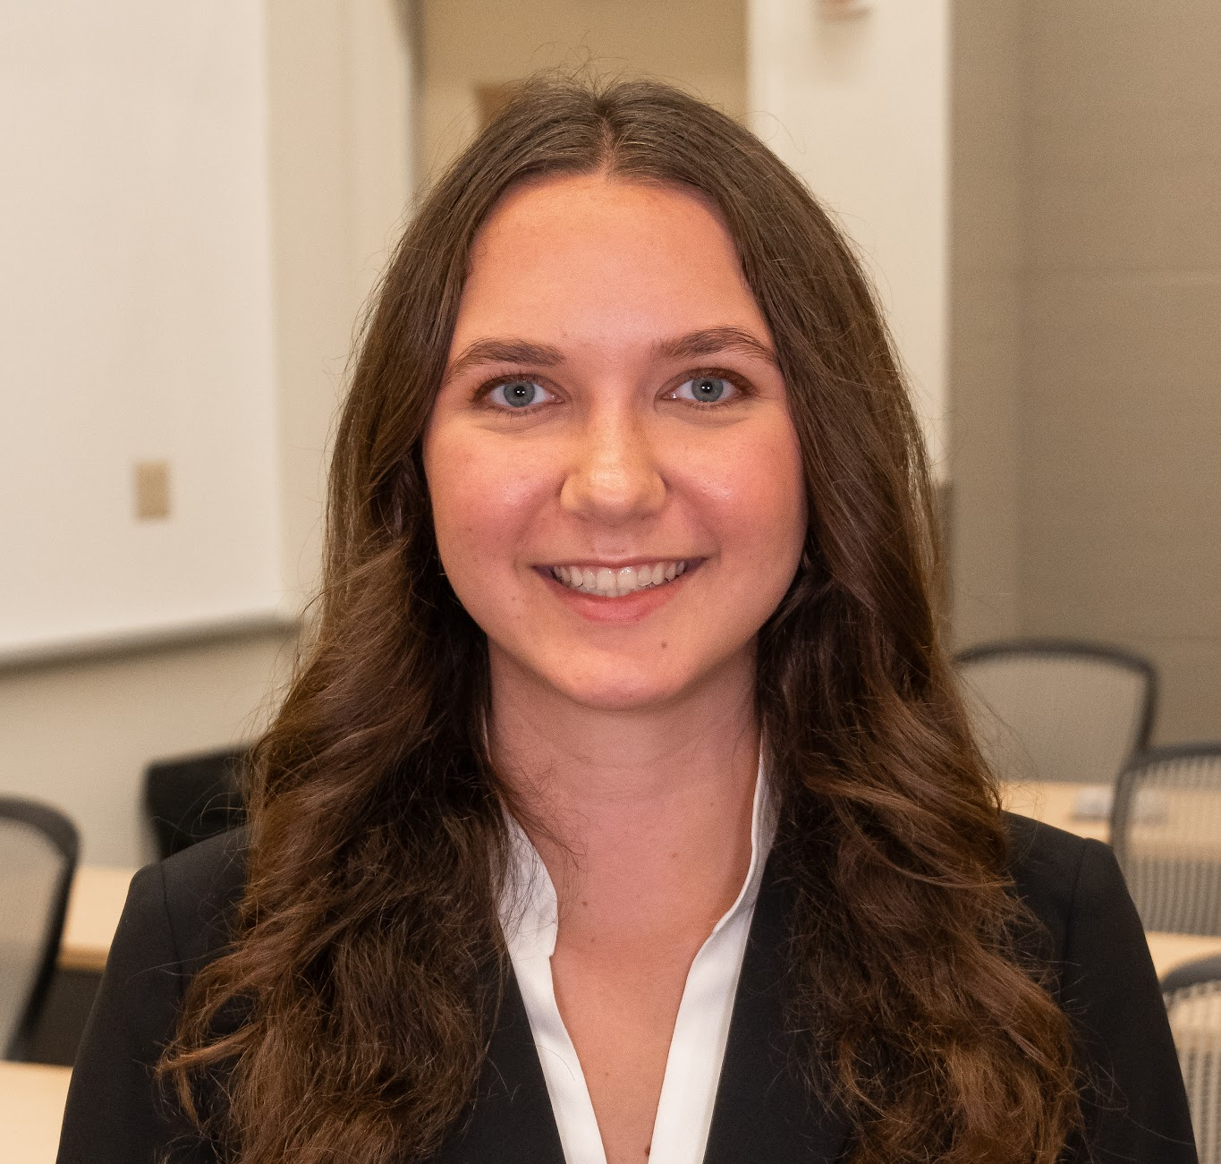
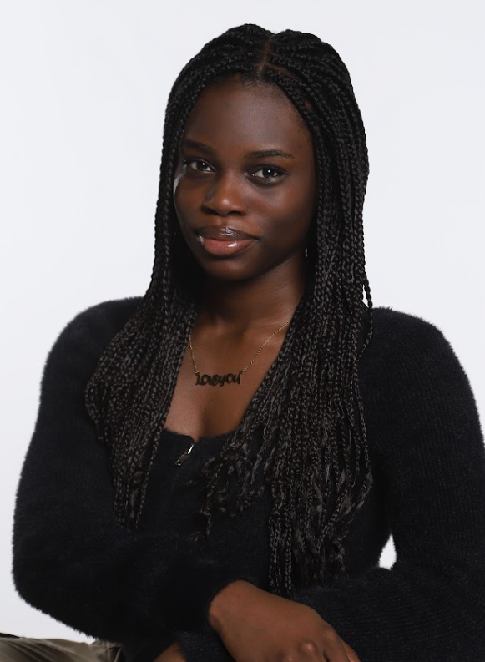
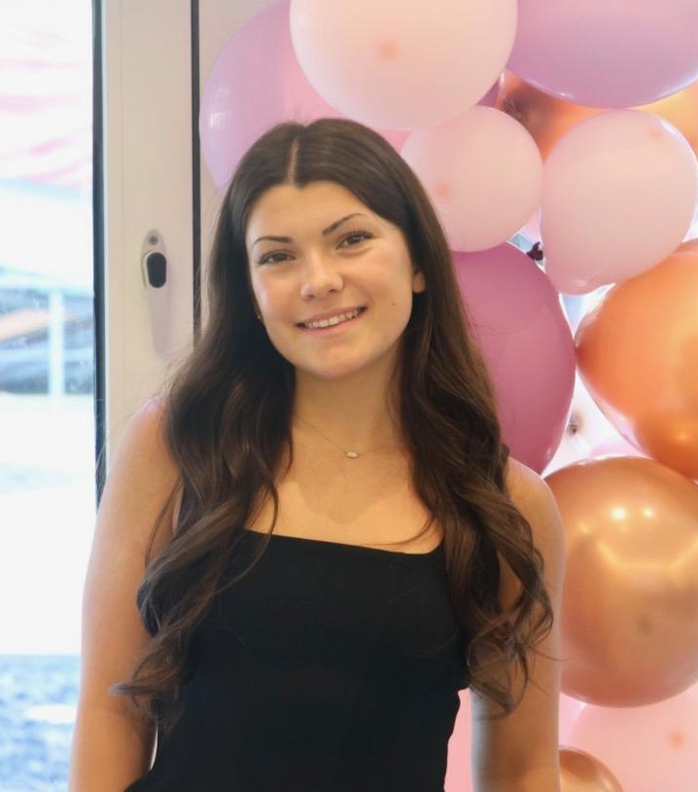
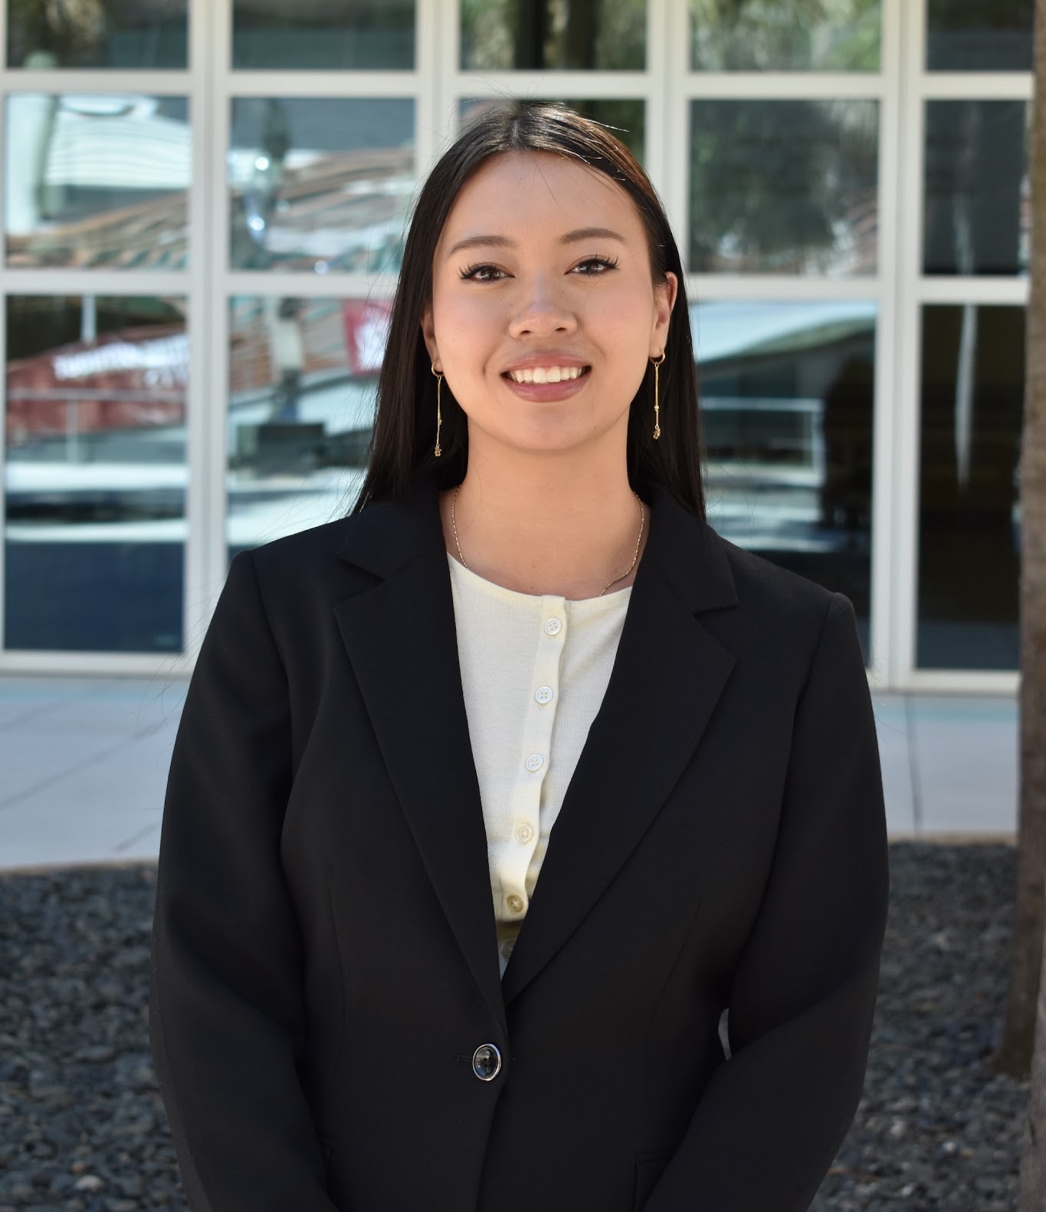
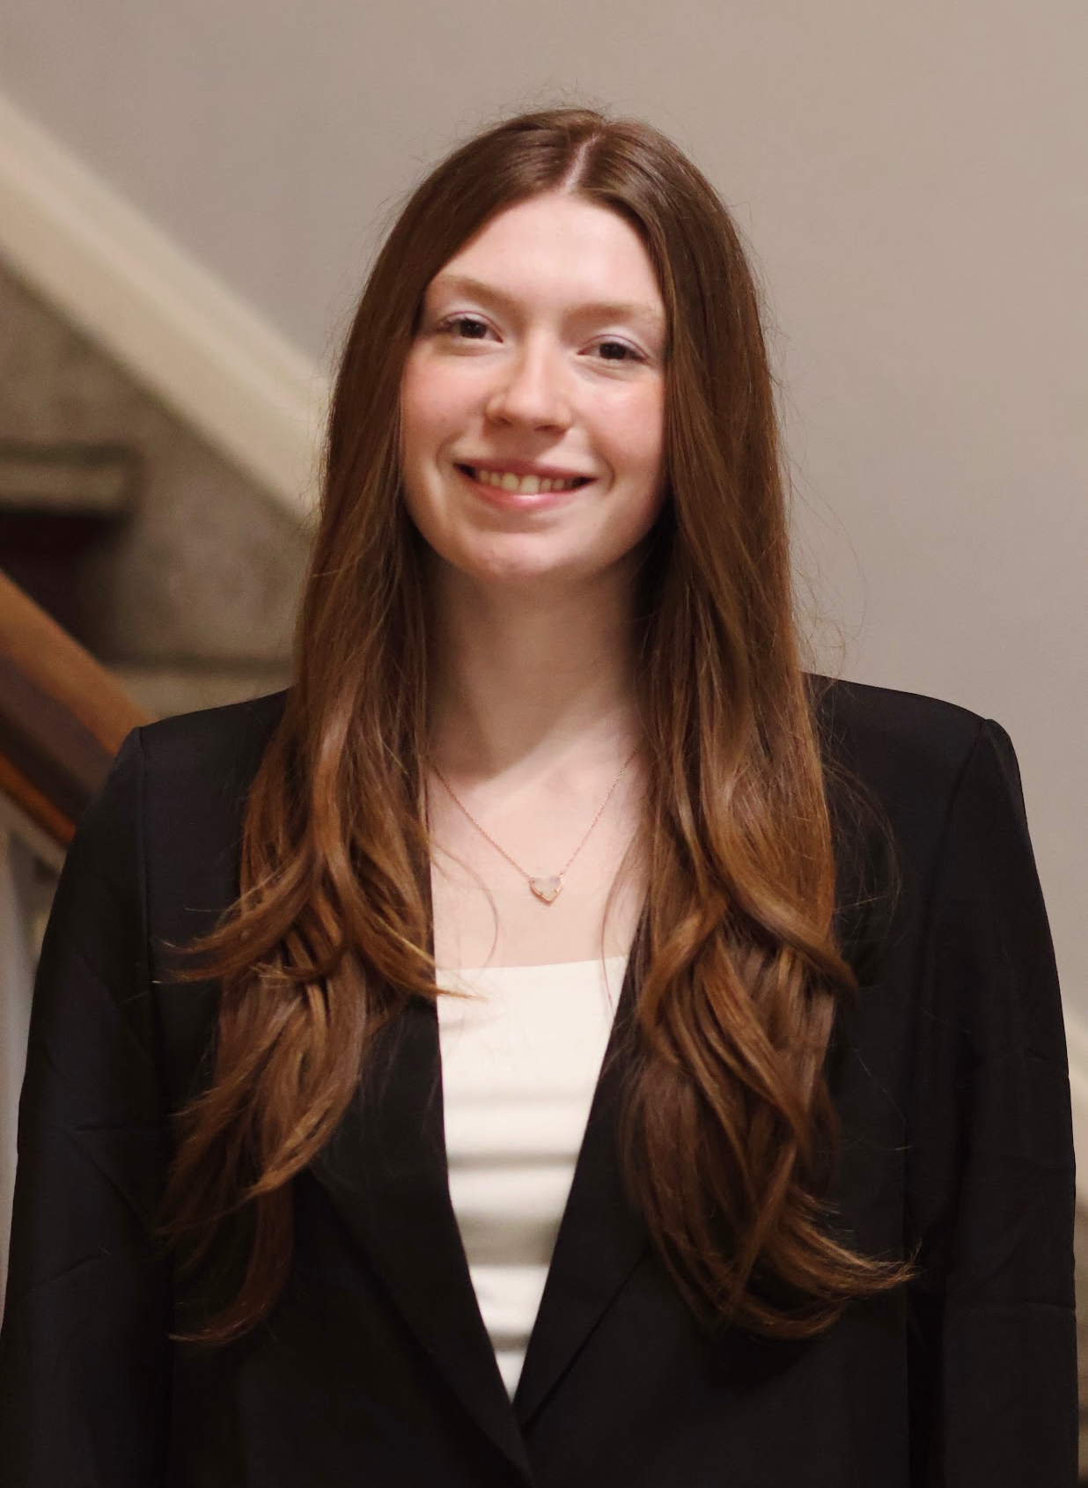
WIBternship Team
Katie
Anna
Cassie
Cynthia
Madison
Notes:
Everyone says name, position, grade, major

Slide 3
Schedule
Week of 11/16/2026
9/8/2026
9/22/2026
10/6/2026
10/20/2026
11/17/2026
Professional Dress
Networking
Interview
Resume
Committee Panel
LinkedIn
Headshots
Case Competition Tips
Major Exploration
Internship Search
Case Competition
Notes:
Director

Slide 4
Agenda
Interviews
Resources
Resumes
Announcements
Notes:
Director

Slide 5
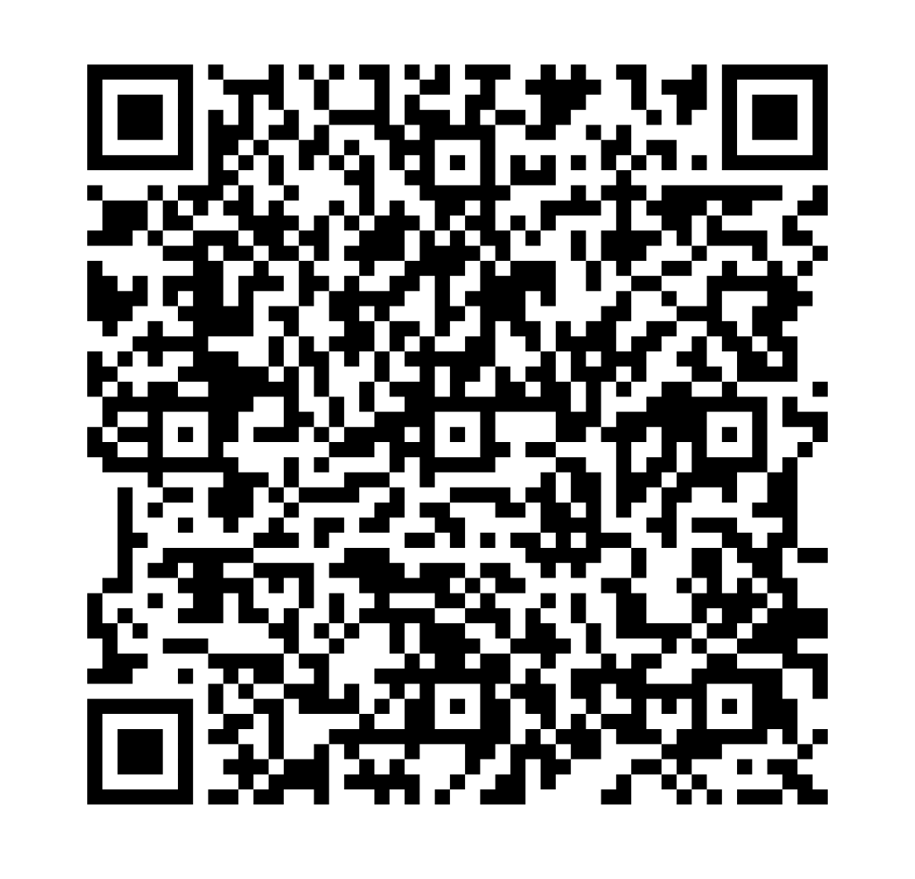

HARVARD CONFERENCE!
Each year, we send a group of members to attend the Harvard Women in Business Conference in Boston, MA. WIB pays for the flights, hotels, and tickets for each remember selected.
When: 11/6-11/8
***MUST miss Friday 11/6
This application is due on September 22nd at 11:59PM. TONIGHT!!!

Slide 6
Interviewing

Slide 7
Before the Interview
Research the company and what values/skills are important to them.
  This can help you tailor your pitch/resumé to what they’re looking for.
Look over the job description/position profile.
  Will give you a better understanding of what the role is.
Prepare questions/answers to common interview questions.
Dress appropriately, and in something that makes you feel confident!
PRACTICE, PRACTICE, PRACTICE!
  Mock interviews with peers, professors, OCM, and WIBC.

Slide 8

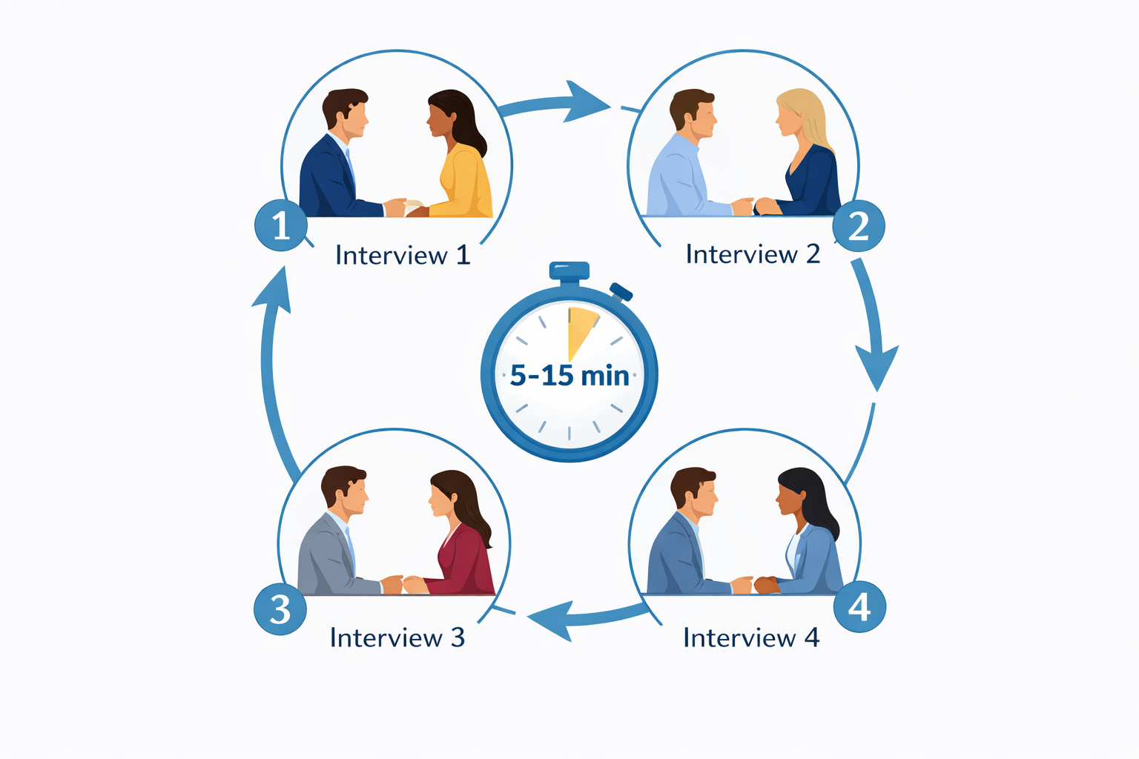
Speed Dating Style Interviews
Talking to multiple interviewers for shorter periods of time
  Around 5-15 minutes per person
Allows more people in the organization or business to get to know you
Common when joining organizations in the Business School
Notes:
Business fraternities
Accounting Scholars

Slide 9
“Tell Me About Yourself”
I am a (profession/year/major)...
With expertise in (key functions/skills/capabilities)...
I have worked for/with (relevant orgs and industries)...
My strengths include (professional qualities)...
A couple of my core values are…
For fun I like to…
Give a practice personal statement with the person next to you!
Don’t be afraid to give your partner critiques or pointers.
Notes:
Turn and talk to the person beside them, talk for maybe 3-4 minutes.

Slide 10
Behavioral Interviewing
What Is Behavioral Interviewing?
Behavioral interviewing is based on the idea that past behavior predicts future performance.
Employers ask candidates to provide real examples of how they handled situations in the past.
Commonly Asked Questions:
“Tell me about a time you handled a difficult situation.”
“Give me an example of a time you worked with a difficult teammate.”
“Tell me about a mistake you made and what you learned from it.”
“Describe a time you had to adjust to change quickly.”

Slide 11
“Tell Me About a Time You…”
STAR method for answering questions:
Situation: Specific situation you encountered
Task: Explain the task you had to complete
Action: Actions you took, steps followed, obstacles
Results: Outcomes, accomplishments, lessons learned
Use the STAR Method in your interviews to answer
difficult questions.

Slide 12
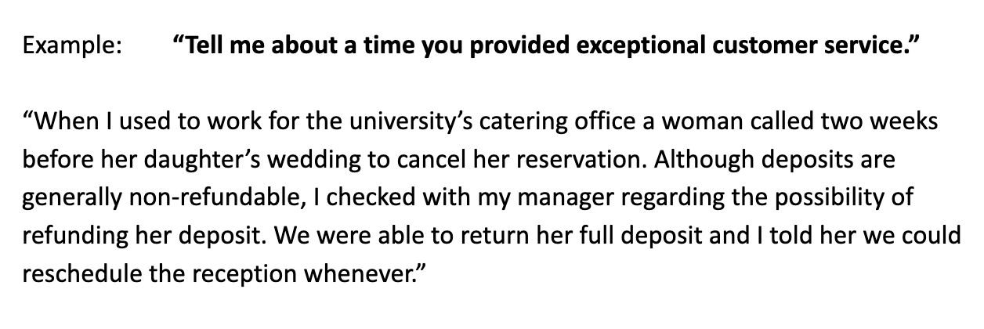
Is this good use of the STAR Method?
Remember… Situation, Task, Action, and Results
Notes:
Bad example not using STAR method

Slide 13
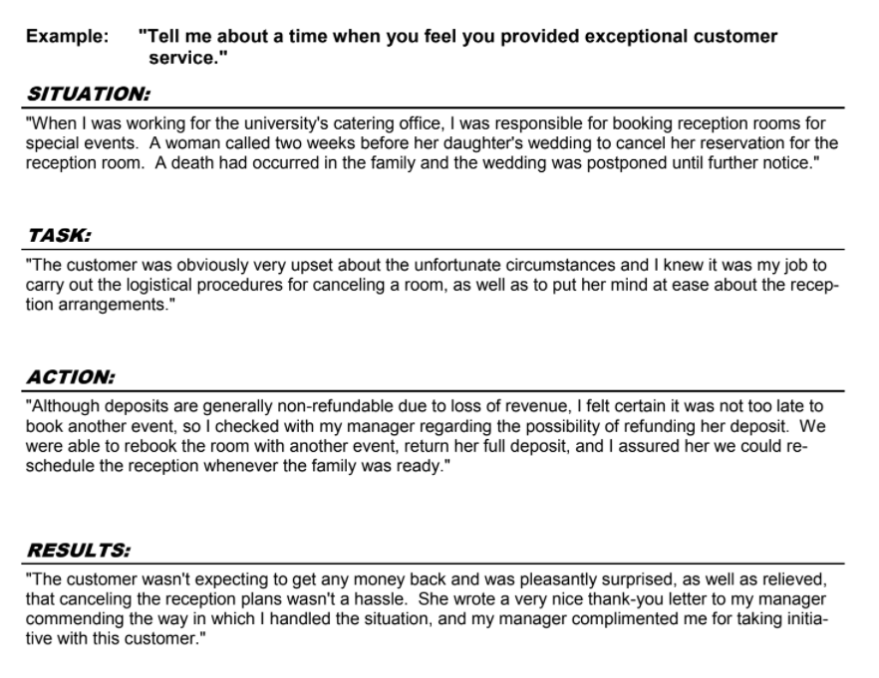
Notes:
Good example using STAR method
Make comparisons between the two examples, point out why this answer is better than last one

Slide 14
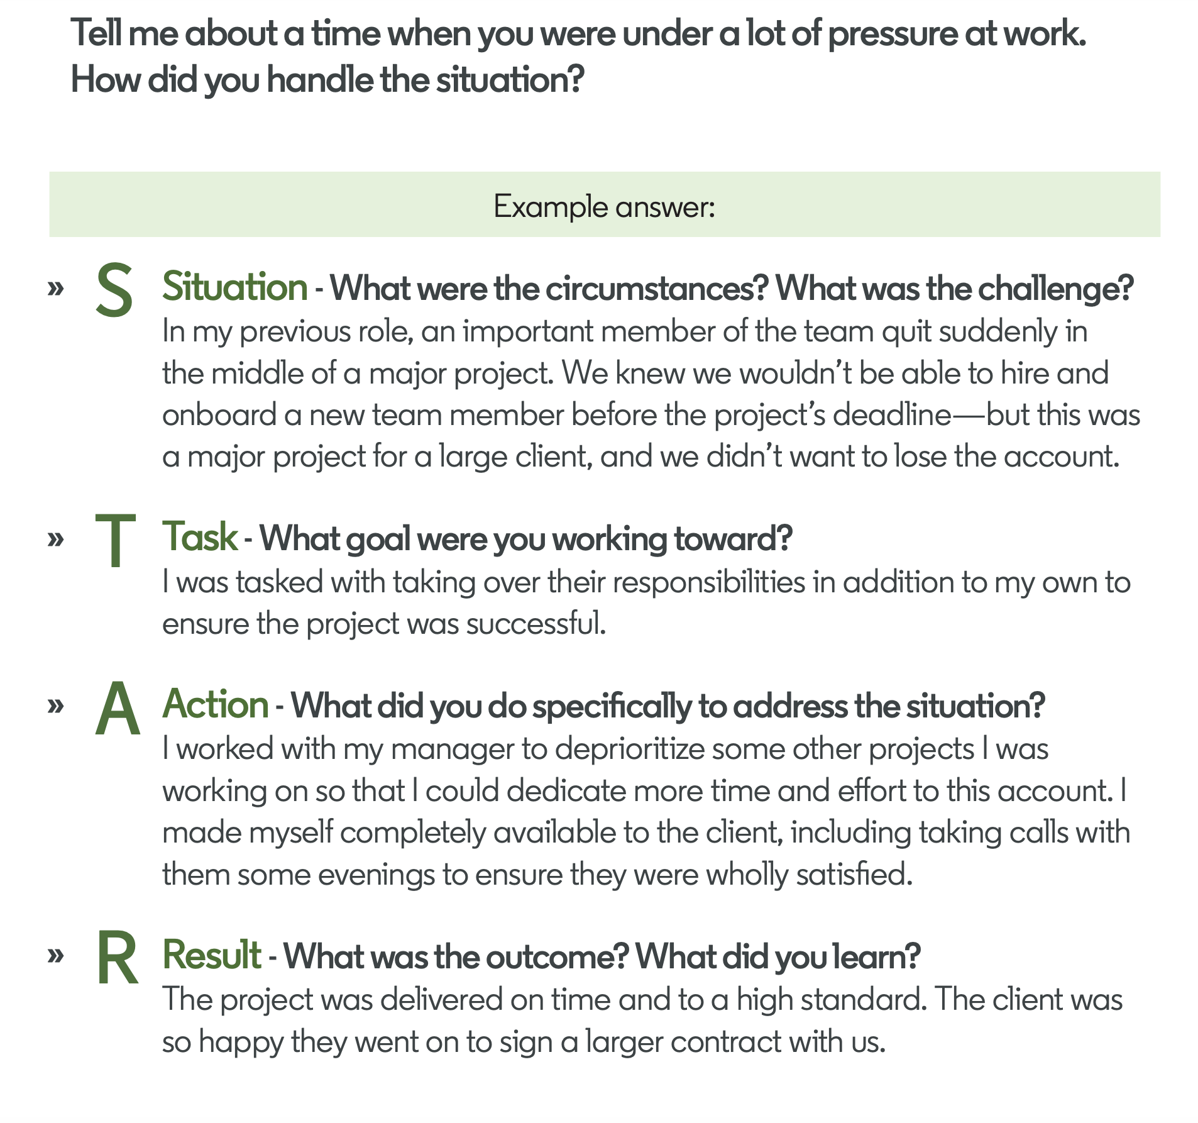
Why STAR Matters
• Provides structure to help you think on your feet
• Keeps answers clear and organized
• Prevents rambling
• Highlights your specific contributions
• Shows measurable results
• Demonstrates confidence and preparation
• Makes you more memorable

Slide 15
Practice the STAR method with a partner.
Situation
Task
Action
Result
Prompts: Choose One
Describe a situation in which you were able to use persuasion to successfully convince someone to see things your way.
Give me an example of an important goal that you have set and tell me how you reached it.
Describe for me a time when you failed at something and how you responded.
Tell me about a time when you worked on a team and a member was not doing their share of the work.
Tell me about a time when you had to handle a tough problem that challenged fairness or ethical issues.
Notes:
Practice with neighbor

Slide 16
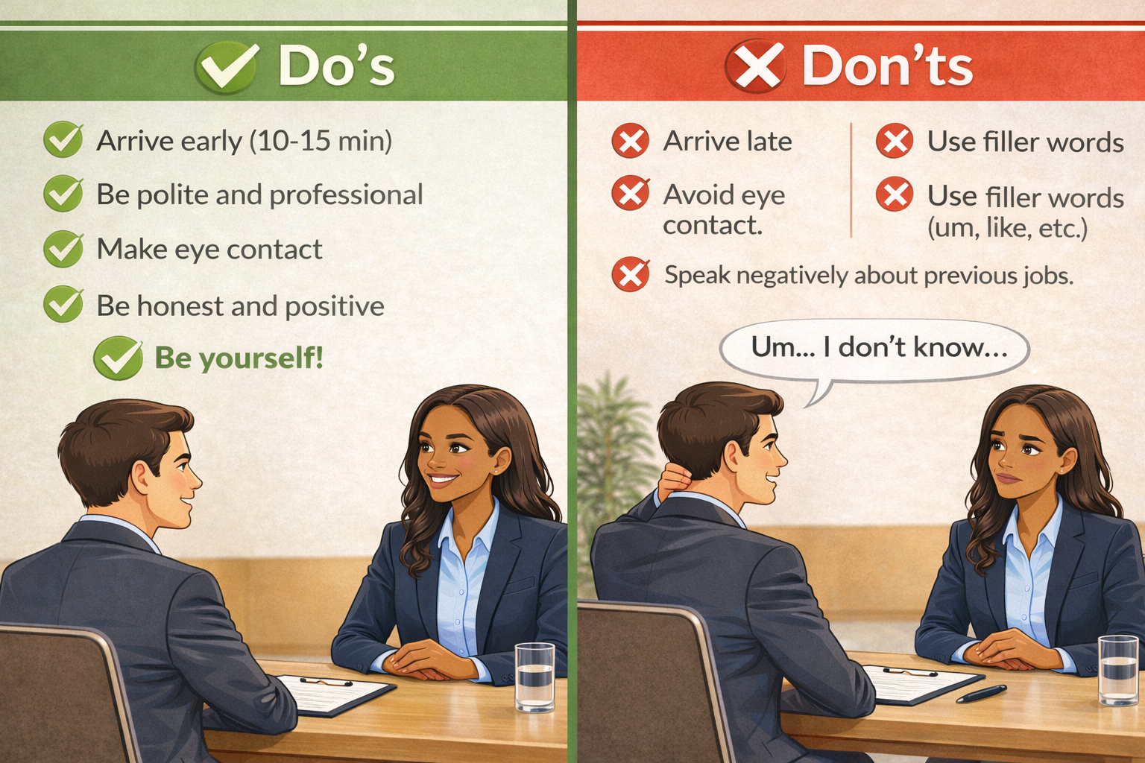
During the Interview
Arrive early (10-15 min).
Be polite at all times.
Avoid fillers like (um, like, etc.).
Make eye contact.
Be honest and don’t cover up past mistakes.
Do not speak bad about former employers, supervisors, colleagues.
Elaborate with your answers but allow the interviewer to lead.
BE YOURSELF!
Notes:
Showing up on time and being polite are both super important for making a first impression. You want to start the interview on a good note, and these are both things you can easily control
A good way to show you are professional is by avoiding filler words (ik i struggle with it too but you can fix it with practice) and making eye contact (specifically during in person interviews, you want to be personable)
You want a balance between being honest and speaking about your experience. Its good to admit your mistakes and show how youve grown from them, but you want to stay positive and make sure you are talking bad about anyone you have worked with
Be
Make sure you arent going too off topic

Slide 17
What to Ask the Interviewer
CULTURE: values, characteristics, working atmosphere, why this organization?
POSITION: definition of success, challenges, skills required (that you might not have), opportunities for learning and growth
PROJECTS/STRUCTURE: what does a typical day/project/etc look like?
FUTURE: company growth in 6 years? Competitive advantages? Exciting changes or areas of growth coming in next years?
Notes:
Questions are an easy way to show your interest. You should come prepared with 5-10 questions, in case they are answered in the interview. Some examples would be…the company’s values, characteristics, what its like working there, why you should want to choose this organization
If you want to be specific about the position you can ask about big challenges, any skills you may not, how to succeed, and what opportunities it provides
You can also ask about what you would be doing in a typical day or how you would go about a project
Lastly you can ask about how the company has performed in the past and how it is growing. This will prove that you are interested in contributing to the company and excited about being there

Slide 18
After the Interview
Send a follow-up with a thank you and any credentials, references, transcripts etc. that were requested by the interviewer
Thank interviewer for their time
Connect on LinkedIn
Notes:
What you do after is crucial because chances are you are not the only person interviewing and there are a few ways you can stand out more. Thanking the interviewer for their time is always a nice touch and then once you leave, you can connect with them on LinkedIn (this is a time when you want to use one of your messages when following someone), you should also send a follow up thanking them again and providing all the information they might need to review you in the future
Narrows down candidates who care about the company

Slide 19
Practice with your Neighbor!
Timer
Tell me about yourself.
Why are you interested in (position/role/career path)?
What is your biggest weakness?
What is your greatest strength?
What is your leadership style? (with examples)
Walk me through your resume
Tell me about a time you had a conflict with a peer. How did you resolve it?
Tell me about a time you exceeded expectations.
Tell me about a time you failed.
Where do you see yourself in 5 years?
Do you work better in a team or alone?
Do you have any questions for me?
If you finish these questions, look up the most commonly asked interview questions and practice those!

Slide 20
Resources
Notes:
Sam
Announcement at 8:25

Slide 21
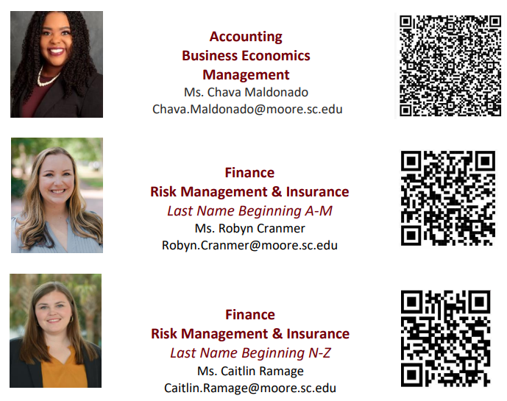
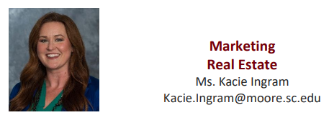
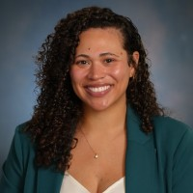
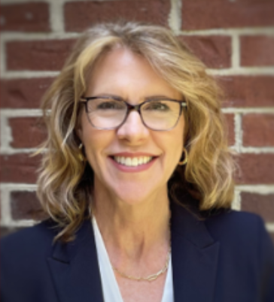
Office of Career Management Staff (sophomores-seniors)
Operations & Supply Chain
Real Estate
Management
Alexis Townsend
Alexis.Rudnick@moore.sc.edu
Accounting
Economics
Viola Konopka
viola.konopka@moore.sc.edu

Slide 22
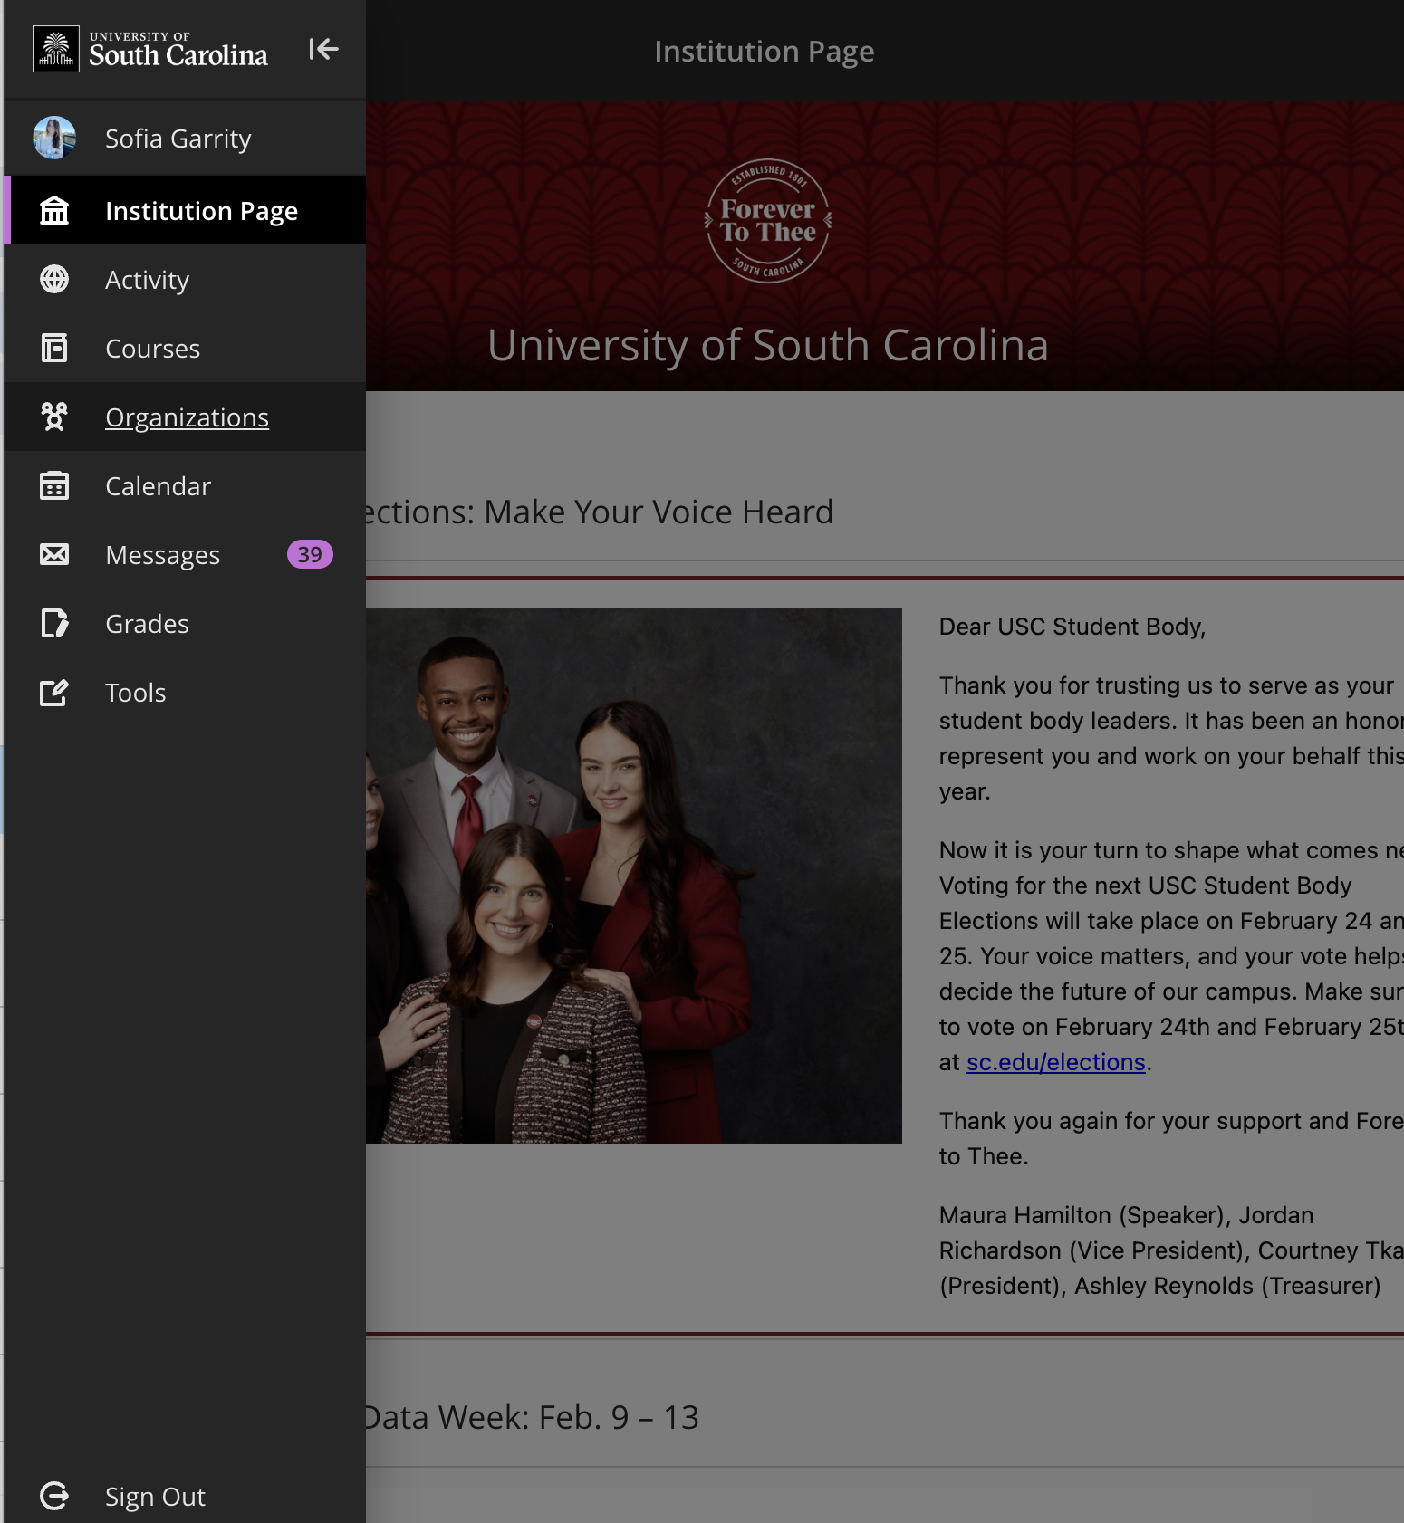
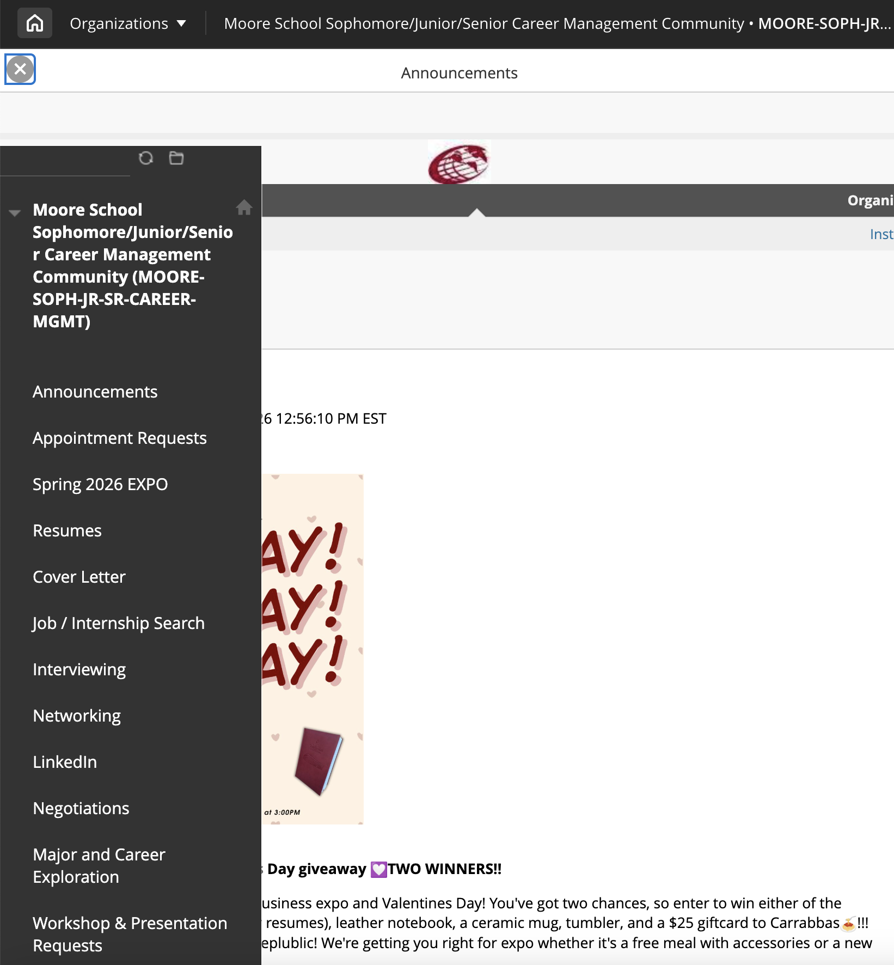
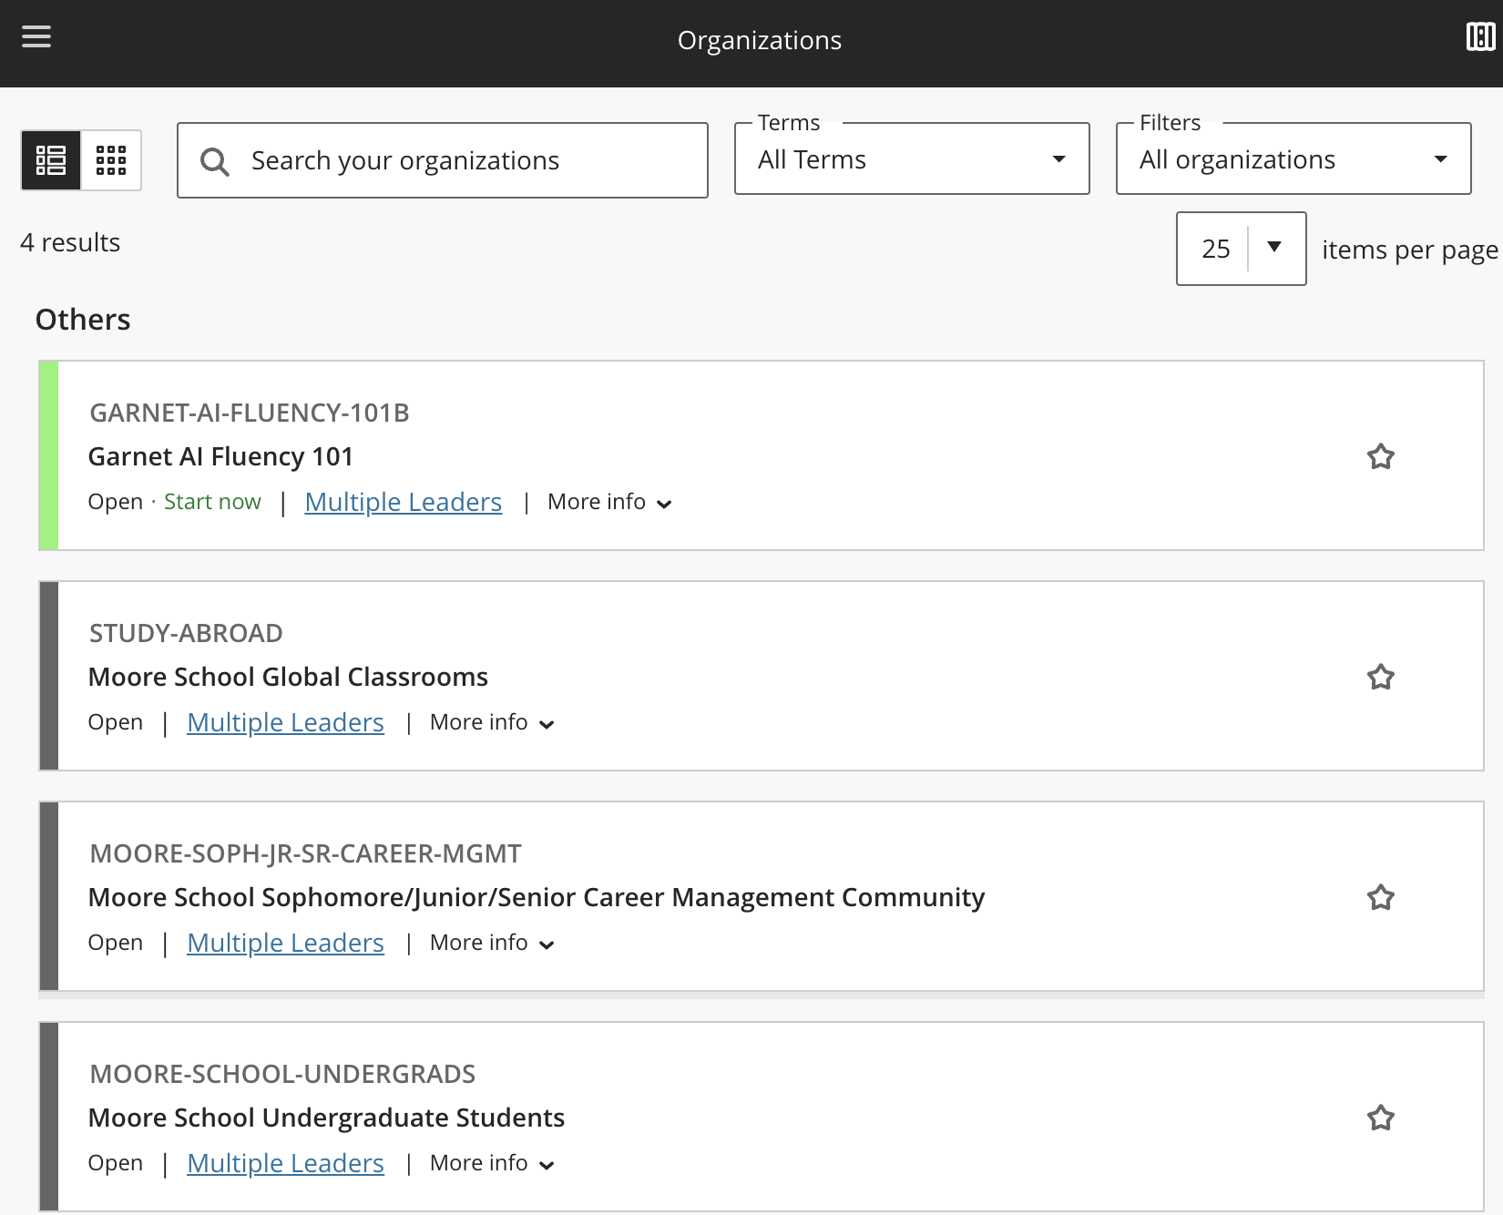
Office of Career Management (sophomores-seniors)
Step 1: Go to “organizations” on blackboard menu
Step 2: Click on Moore School Sophomore/Junior/Senior Career Management Community
Step 3: Open the menu and browse the different categories
Notes:
Check this is still correct

Slide 23
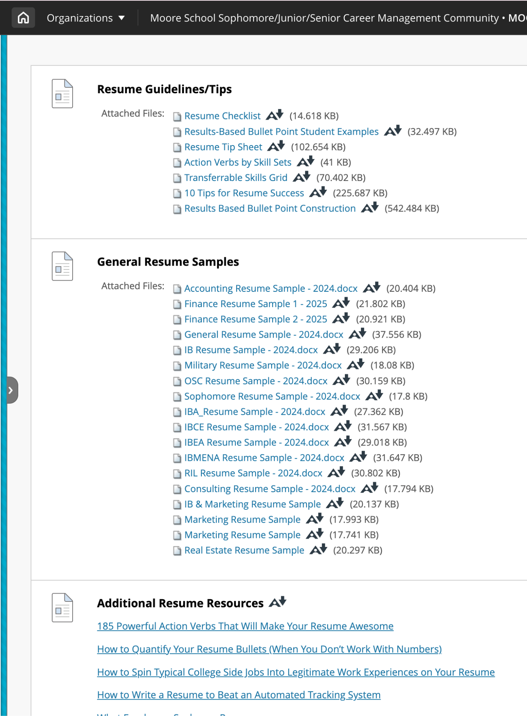
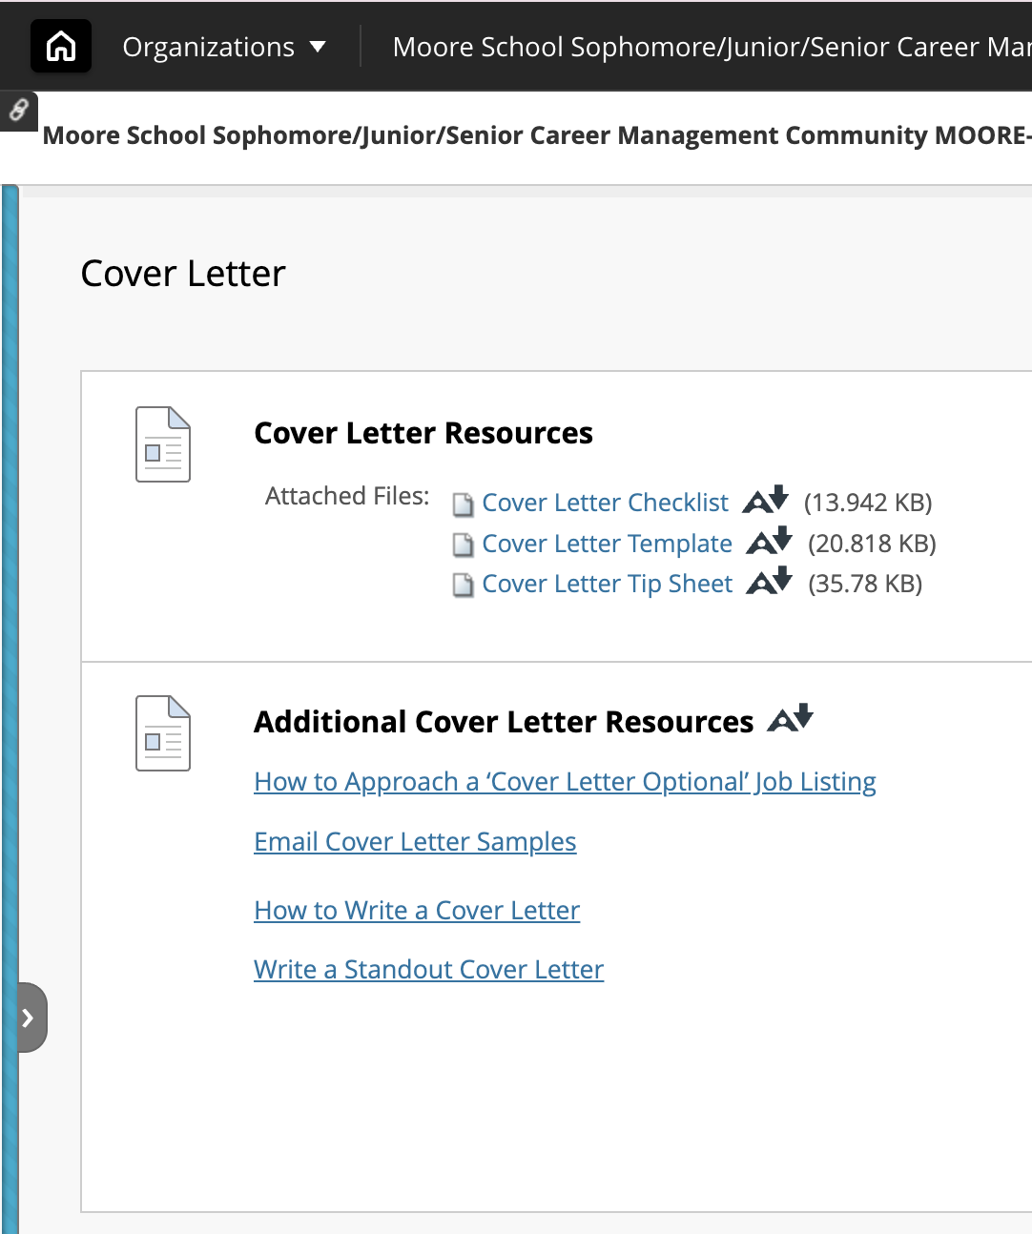
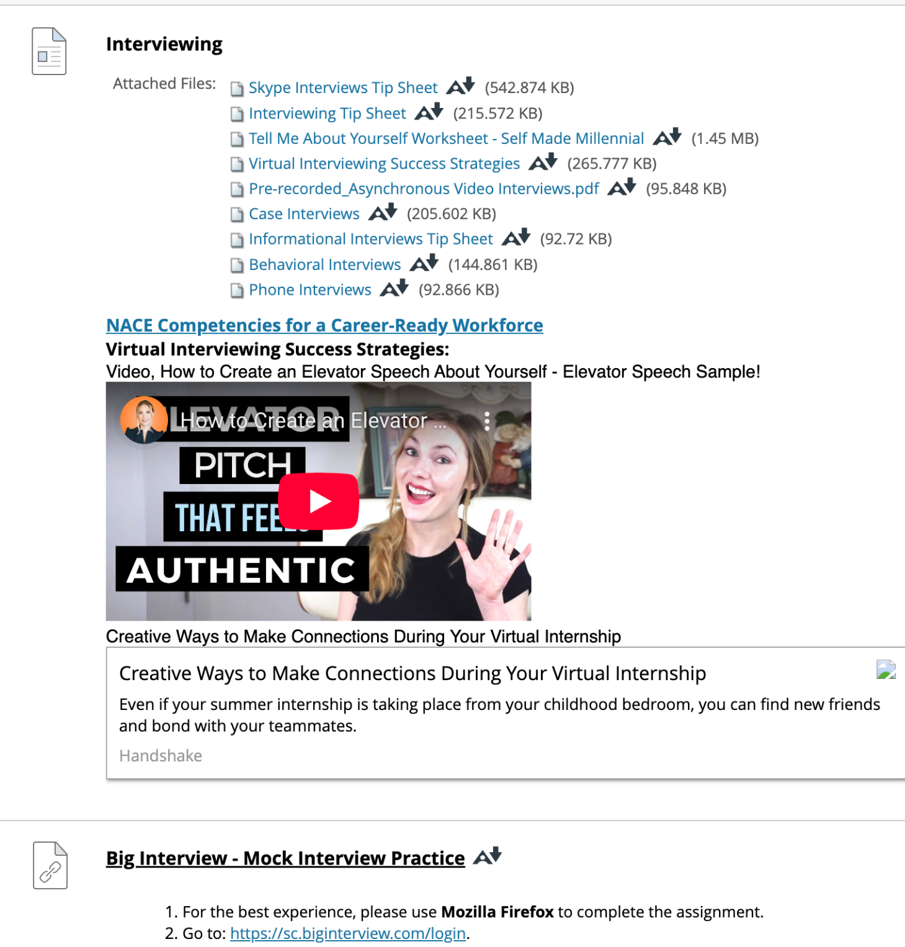
Office of Career Management
Resources
Notes:
You may have to make an appointment though handshake
Follow steps on the website

Slide 24
USC Career Center
Handshake
Make an Appointment
Help with:
Resumes
Interviews
Job Search
Grad School Search
Freshmen do NOT have access to the DMSB OCM… but you can use the USC Career Center!
Notes:
You may have to make an appointment though handshake
Follow steps on the website

Slide 25
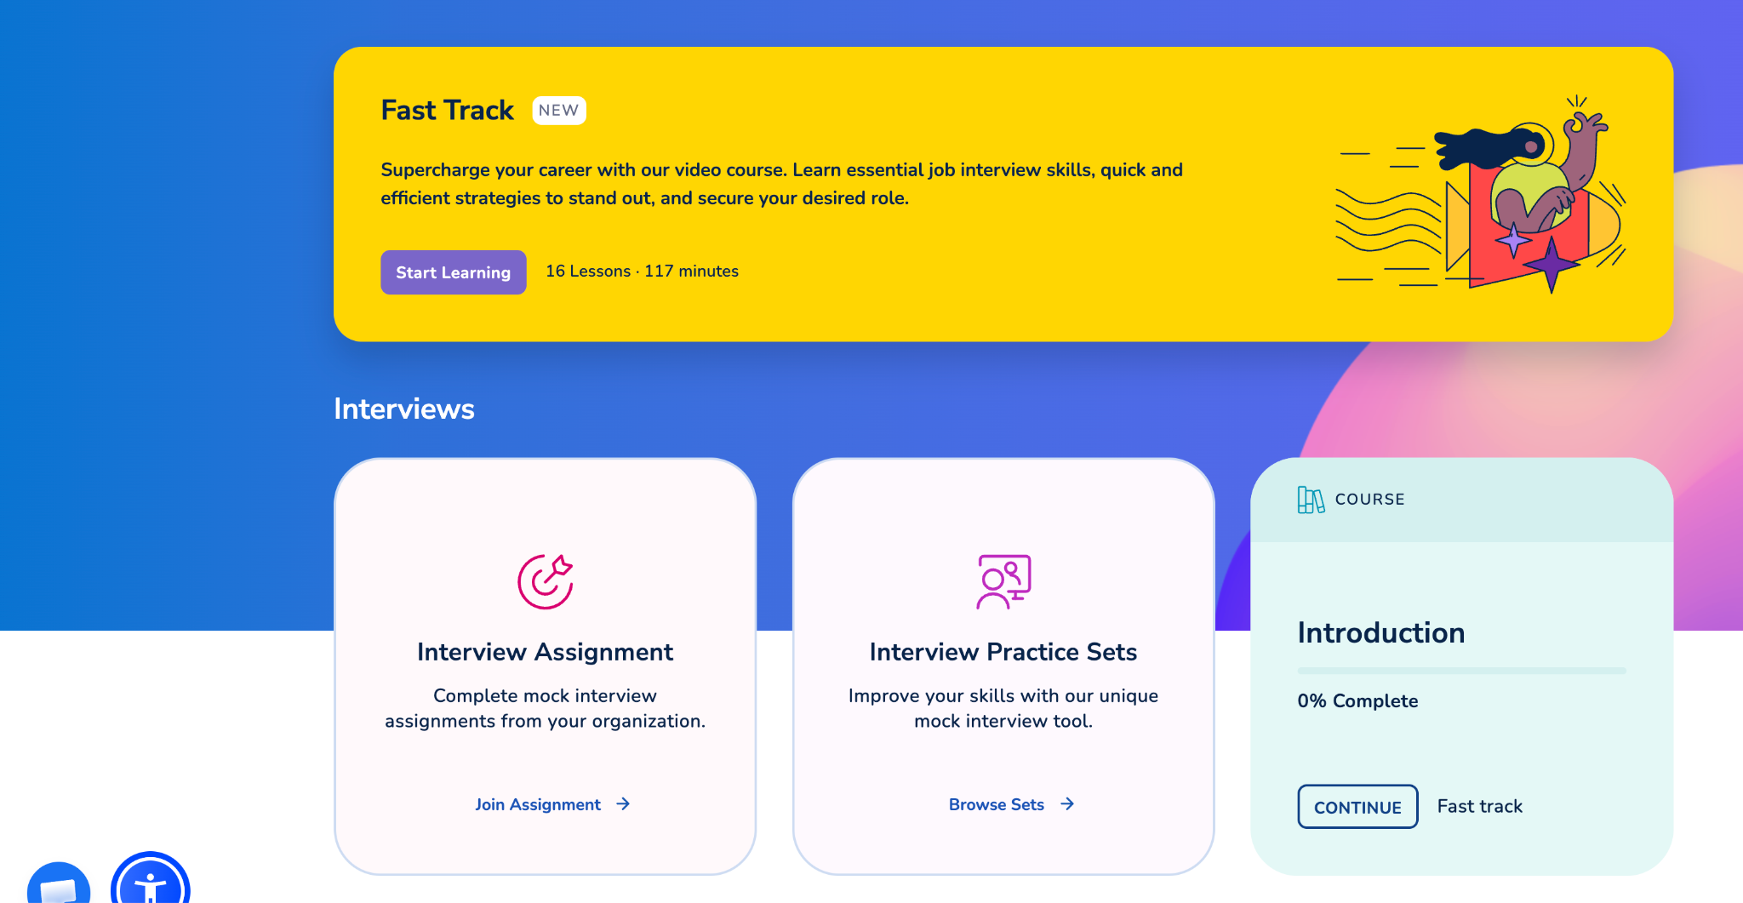
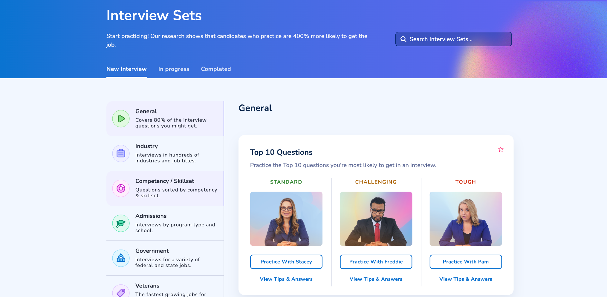
Big Interview
Go to: https://sc.biginterview.com/login.
Click on ‘REGISTER and follow the instructions to create a profile. ONLY use your USC email address.
Once signed in, on the homepage you should see “interview practice sets”
Browse and try all the different types and levels of interview practice sets

Slide 26
RESUMES

Slide 27
Resume Templates
Sophomores, Juniors, Seniors:
DMSB Career Management Blackboard
Check Your Email:
Darla Template
Harvard Template
Notes:
Change contact info
Freshmen cannot access blackboard content yet

Slide 28
What is a Resume?
Spotlights YOU
Education, Experience, Skills
One Page Document
Employment Tool

Slide 29
Key Components of a Resume
Header
Name, contact information, LinkedIn URL
Education
Schools, degrees, graduation dates
Certifications/ awards
Work Experience
List of jobs with bullet points highlighting accomplishments
Action verbs, quantifiable results
Achievements
Leadership experience, Volunteer experience
Skills
Technical (Excel, PowerBi, coding), Languages (include level of fluency)
Hobbies
Campus involvement
Notes:
General Resume:
Add involvement: philanthropy/volunteer work, leadership, campus involvement, job experience
WIBC placed under Campus Involvement/Activities
Highschool activities are fine-
Replace with college involvement as you join orgs
Elaborate on activities/education/experience
2-3 Sentences
ALWAYS start with action verb
Quantify!
So What?

Slide 30
Resume Overview and Tips
Being a WIBC Member is Campus Involvement!
Highschool Jobs + Activities are OK!
Replace highschool activities as you gain college experiences
No job is insignificant
Notes:
Elaborate on activities/education/experience
2-3 Sentences
ALWAYS start with action verb
Quantify!
So What?

Slide 31

Heading
Name should be bolded and a larger font ~ 14pt
Use your school email or an email you check regularly
Name
Address
Phone #
LinkedIn URL
Email
Notes:
Update this

Slide 32
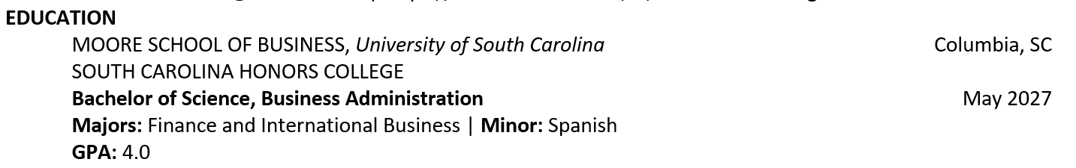
Education
Specific School
University
City
GPA
Minor
Major(s)
Graduation Date
Transfer or Study Abroad

Slide 33
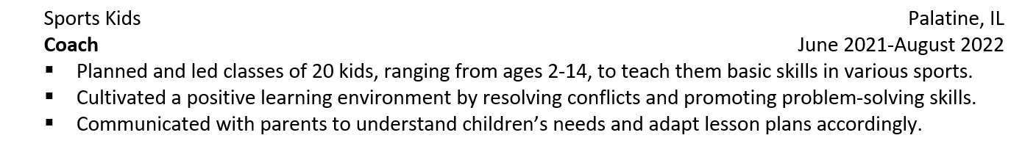
Work Experience
Location
Company Name
Time Period
Job Title
Don’t discount your food service, retail, or other jobs (lifeguarding, babysitting)
Action Verbs

Slide 34
Transferable Skills
Skills that you gain from one experience can be applied to another job, organization, or role.
Communication
Time Management
Teamwork
Leadership
Critical Thinking
Adaptability
Organization
Pick what skills you want to highlight based on the job posting. Make sure to prove it with facts and real-life examples.

Slide 35
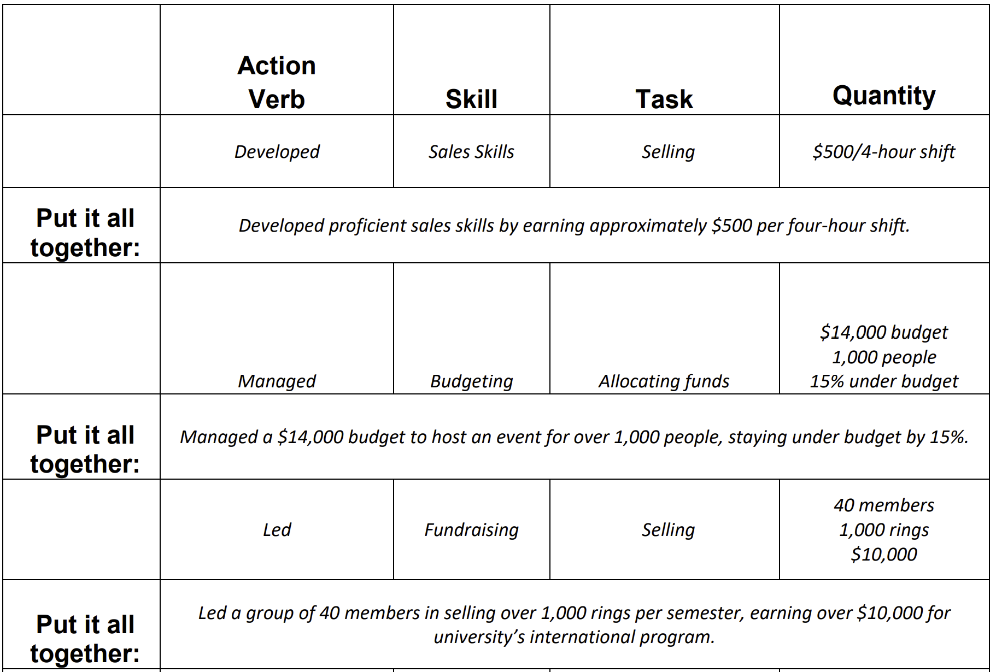
Bullet Points

Slide 36
Bullet Points
Waiter/Server/Busser Examples
  Communicate daily with fifty to a hundred diverse guests to provide excellent service and create repeat customers.
  Received praise in over thirty online reviews which promoted a better online rating for acquiring new potential customers.
  Performed all operating and closing duties to consistently contribute to optimal teamwork.
  Communicated with all restaurant staff to ensure streamlined and efficient service.
  Distributed efforts evenly between two to four tables at a time to promote a positive atmosphere.
  Collaborated with eight serving staff to ensure order accuracy and efficient food delivery, increasing customer satisfaction.
  Provided dietary recommendations and suggestions while upselling specials, including drinks, appetizers, and desserts, increasing overall daily sales.
  Trained and educated six new employees through shadowing to streamline communication and company procedures.

Slide 37
Bullet Points
Student Mentor Example
  Supported two first-year students by answering questions about campus resources, academics, and student life.
  Organized three monthly check-ins and small-group meetings to help mentees feel prepared for college.
  Communicated consistently with mentees through text and in-person meetings.
  Helped students identify challenges and connect with appropriate university resources.
  Developed leadership, communication, and problem-solving skills while fostering an inclusive environment

Slide 38
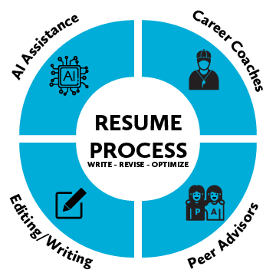
Using AI In Your Resume
Using AI Ethically
AI is meant to be used as a TOOL or ASSISTANT
Grammar checks, keywords, and feedback
Do not simply ask AI to create your descriptions
A Resume is meant to be personalized and authentic, using your own words and voice
Notes:
AI can be used as a helpful tool to improve your resume, you shouldn’t use it to write your entire resume.
You want your resume to reflect your real experiences and accomplishments
Make sure its personalized and in your own voice
Don’t use AI to make up responsibilities and numbers, employer’s may ask you about these experiences and you want to be able to back it up

Slide 39
Using AI In Your Resume
AI prompts to help improve the bullet points in your resume:
“Here is one of my resume bullet points, ask me questions about this experience that could help me identify results that I could quantify. Do not make up numbers for me.”
“Improve this resume bullet point using a strong action verb and concise professional language.”
Example:
Before: “Managed social media accounts, including Instagram, Facebook, and LinkedIn.”
AI Prompt: Improve this resume bullet point using a strong action verb and concise professional language.
ADD RESULTS
After: “Managed and scheduled 5+ weekly posts across Instagram, Facebook, and LinkedIn to support brand awareness and marketing initiatives, resulting in a 10% increase in audience engagement.”
Notes:
A great way to use AI is to improve the bullet points you already wrote
You can use say (AI prompts)
In this example, the original bullet point only says the person managed social media accounts. The improved version gives more detail about what they did, how often they posted, and the result of their work.

Slide 40
Using AI In Your Resume
AI prompts to review your resume:
“Review my resume as if you were a career advisor. Identify areas that could be improved for clarity, professionalism, formatting, grammar, action verbs, specificity, and measurable accomplishments”
“Below are my resume and a job description I am interested in. Compare them and identify skills, qualifications, and keywords from the job description that are relevant to experiences already shown on my resume.”
“Proofread my resume for spelling, grammar, punctuation, verb tense, capitalization, and consistency.”
Example:
Before:
“Manages the companys Social Media accounts and post daily content
Create email campaings that increased open rates by 25.00%.”
AI Prompt: Proofread my resume for spelling, grammar, punctuation, verb tense, capitalization, and consistency.
After:
“Manage the company’s social media accounts and post daily content.
Create email campaigns that increase open rates by 25%.”
Notes:
You can also use AI as a second set of eyes to proofread your resume.
Review for clarity, formatting, grammar, and professionalism
Also use it compare your resume and job description, helping to tailor your resume
In this example, AI catches spelling errors, missing punctuation, and inconsistent verb tense.
Even with AI, you should always read your resume yourself before sending it.

Slide 41
Tailoring Your Resume
Use the job description as your guide:
Read the job description thoroughly.
Highlight skills, duties, and qualifications that you see repeat in the job description and resume.
Find examples and experiences from your jobs, classes, volunteer work, and organizations to match the qualifications.
Move the most relevant bullet points and skills higher on your resume, you want the recruiters to see that first.
Notes:
Every resume should be tailored towards the job description that you are applying for
Highlight matching skills, responsibilities, and qualifications
Find examples from your jobs, classes, volunteer work, or organizations
Move the most relevant information higher on your resume, most recruiters are just doing a quick scan so you want them to quickly see why you are a good fit

Slide 42
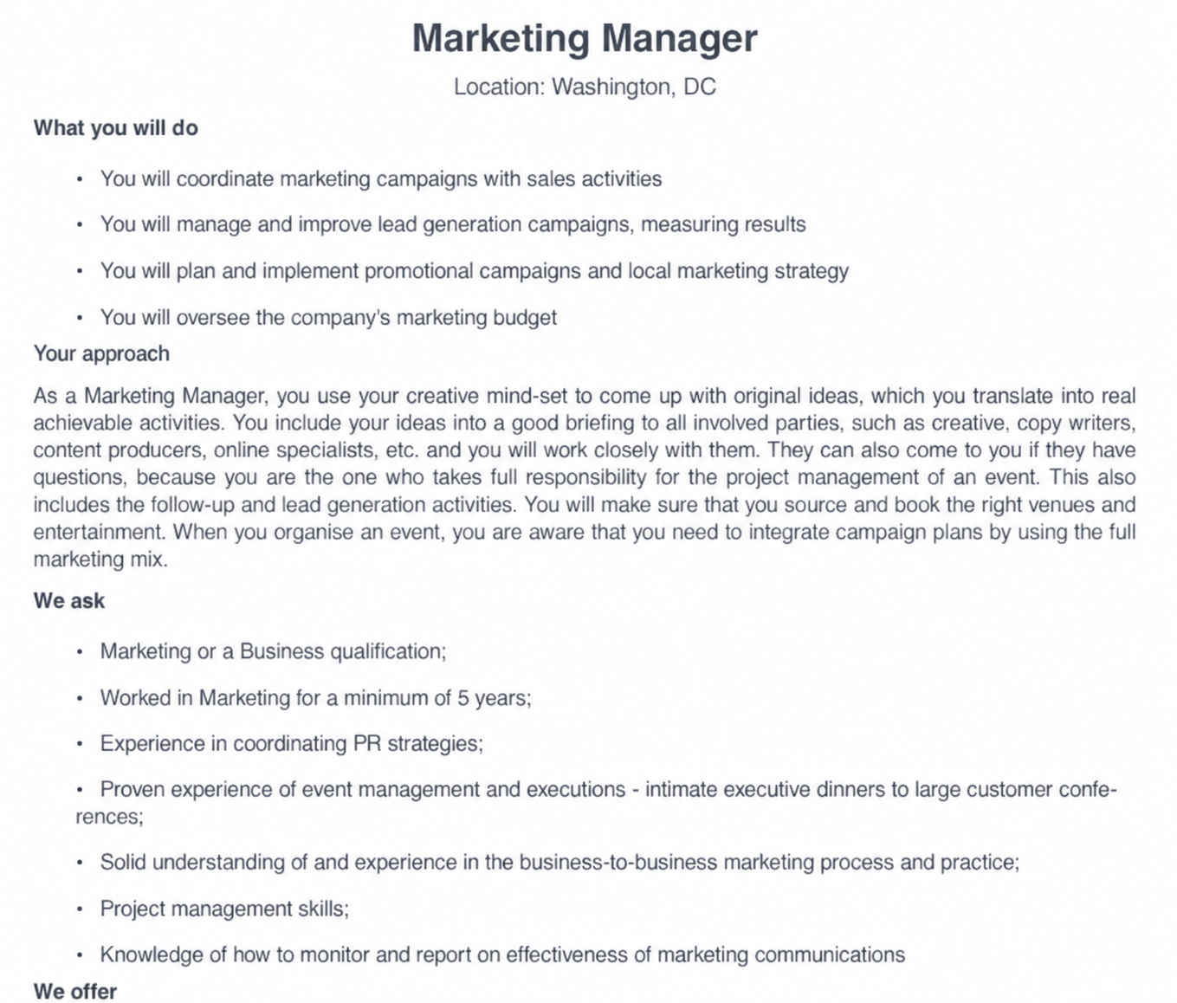
Tailoring Your Resume
Responsibilities of The Role
Preferred Skills
Required Qualifications
Notes:
This slide has animations. Show responsibilities of the role first, preferred skills, then required qualifications.

Slide 43
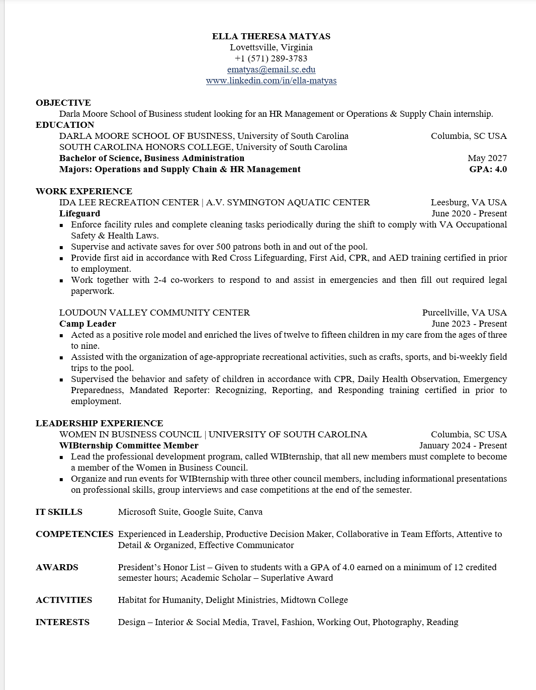
Freshman Resume Example
Work Experience
Lifeguarding
Camp Counseling
Notes:
Incoming freshmen don’t have a lot of professional experience yet
Highschool experiences and jobs still demonstrate valuable transferable skills
Start removing highschool experiences and making work section smaller as you gain more professional experience

Slide 44
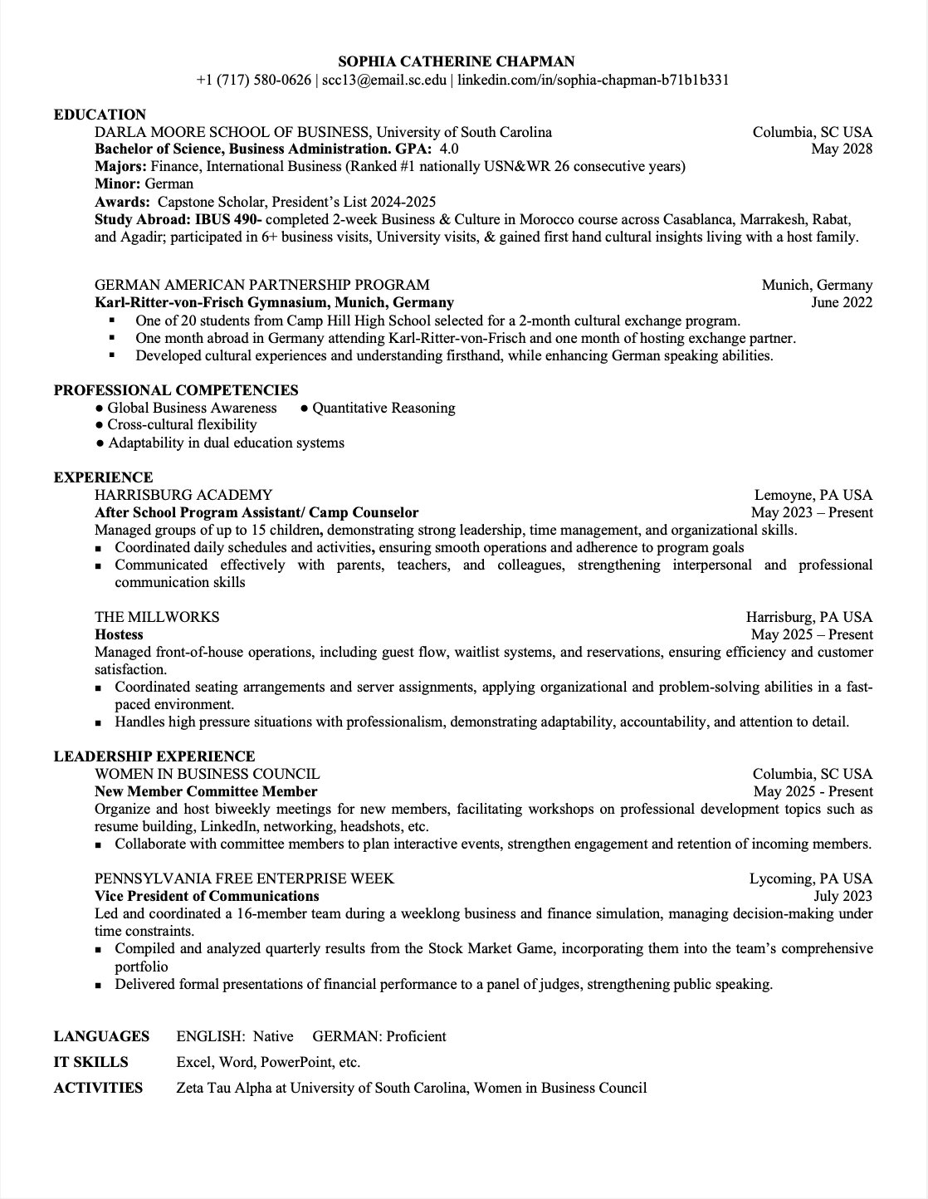
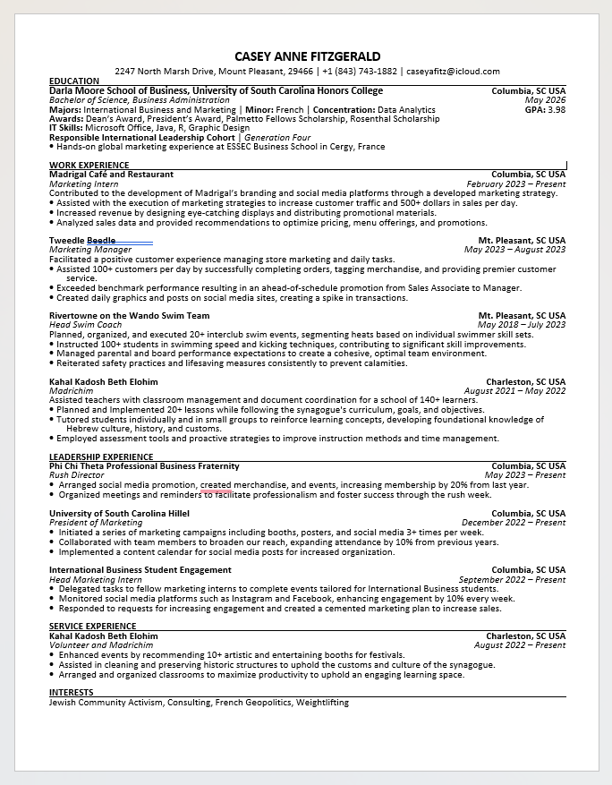
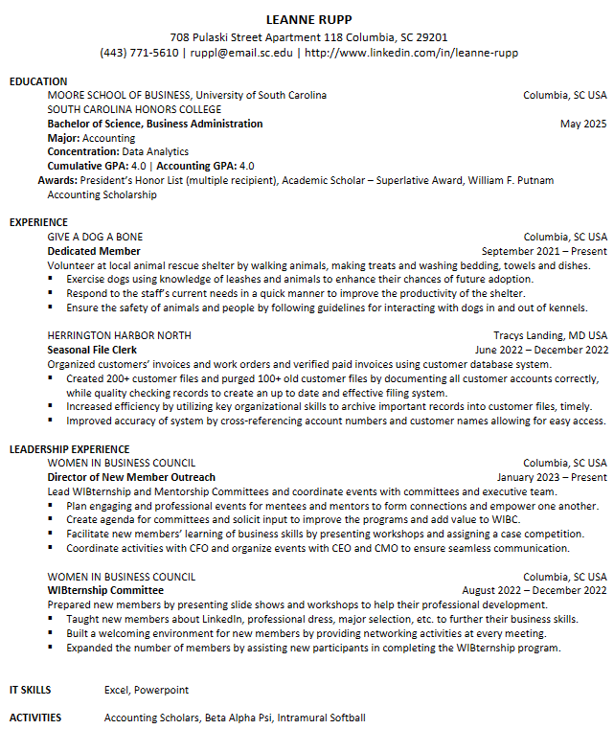
Sophomore Resume Example
Shows different experiences (work, leadership, volunteer, etc):
Notes:
By sophomore year you will probably have more experience to include through classes, campus involvement, and volunteer opportunities
Its okay to not have formal internship experience yet

Slide 45
Resume Checklist
Formatting
☐ Consistent font, size, and spacing
☐ Clean, easy-to-read layout
☐ 1 page (unless experience requires 2)
☐ No graphics, colors, or unnecessary design elements (unless industry-appropriate)
Contact Information
☐ Full name clearly displayed at top
☐ Professional email address
☐ Updated phone number
☐ LinkedIn profile (if applicable)
Content
☐ Tailored to the specific job description
☐ Includes keywords from posting
☐ Strong action verbs used
☐ Quantifies accomplishments when possible (numbers, percentages, results)
☐ Most relevant experience listed first
Sections
☐ Clear section headings (Education, Experience, Skills, etc.)
☐ Education information complete and accurate
☐ Skills section relevant and specific
☐ Dates included and formatted consistently
Final Review
☐ No spelling or grammar errors
☐ Consistent verb tense (past vs. present)
☐ Saved as a PDF (unless otherwise requested)

Slide 46
Cover Letters
Notes:
I will ask if anyone knows what a cover letter is

Slide 47
What Should Be in Your Cover Letter
Header: Full name, location (city, state), email address, and LinkedIn profile.
Current Date: Shows your CL is up to date.
Recipient’s Contact Information: Name, job title, company name, and the company’s address.
Professional Greeting: Dear [recipients name], if you don't know the name write “Hiring Manager” or address it to the company team or department.
Compelling Introduction: What are you applying for and why are you a good fit.
Body Paragraphs: One or two body paragraphs highlighting resume skills and accomplishments.
Conclusion: Express gratitude to the reader, reiterate your interest in the role, and include a call to action.
Professional Sign-Off: Sincerely, with regards, thank you… [Name and education]
What’s the Purpose of Cover Letters?
A chance to introduce yourself to potential employers in a personalized and concise way.
Highlight relevant skills and experiences and explain why they are a perfect fit for the job.
Demonstrates knowledge of company and their culture and how you can contribute to their success.
Helps you standout in a competitive job market.
Notes:
Cover letters are a personalized and concise way to introduce yourself
Many students when going to career fairs and business expos don’t have cover letters ready, so having one shows another level of preparedness and interest in the company

Slide 48
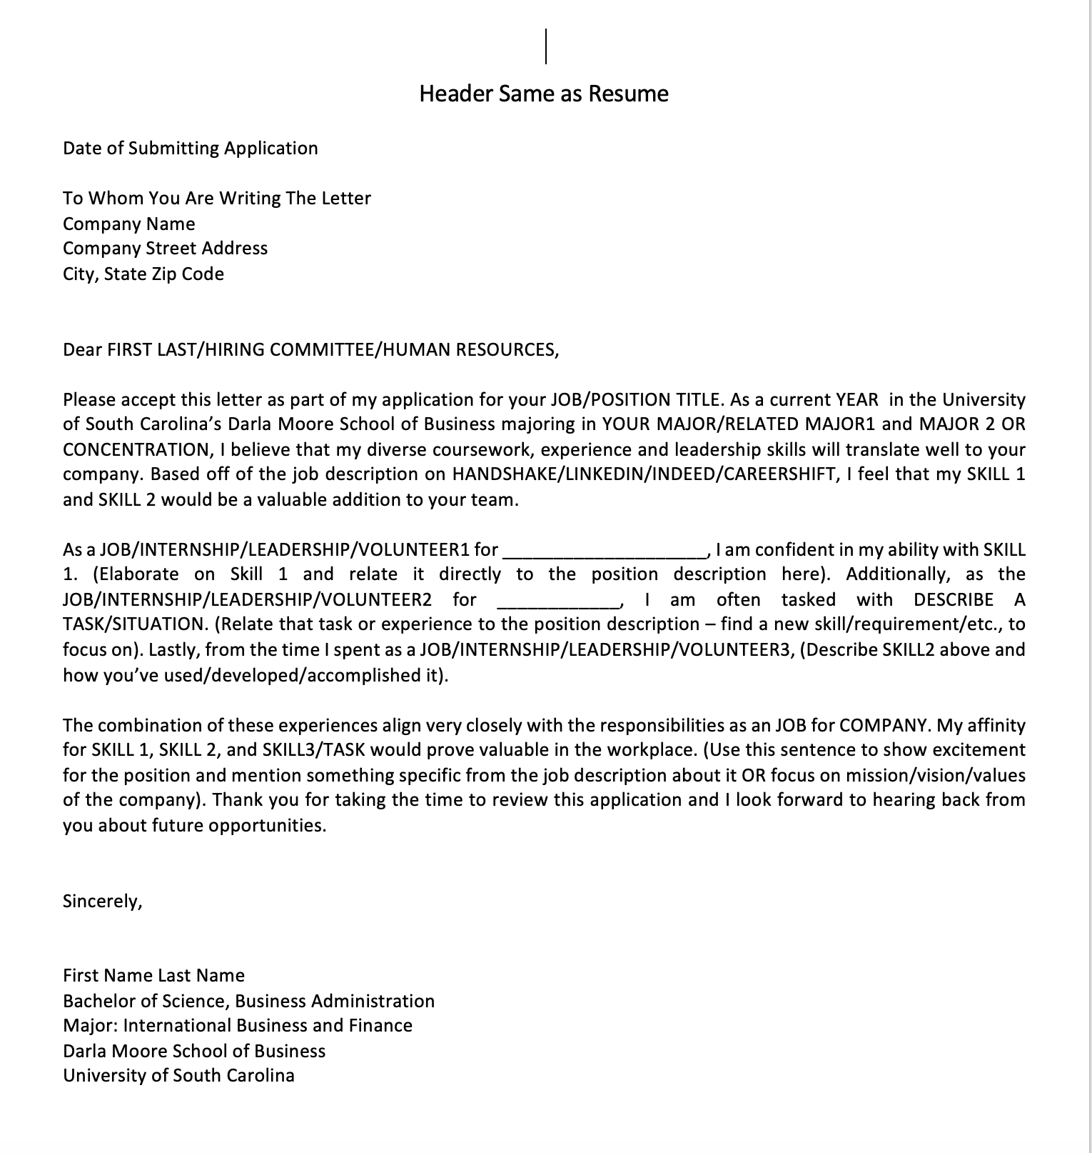
Cover Letter Template
Notes:
Morgan
120:
60: Anna

Slide 49
Cover Letter Checklist
Formatting
Matches resume formatting (font, header, spacing)
Includes date and complete employer contact information
Uses a professional greeting to a named individual
Content
Clearly states position, purpose, and how you learned about the role
Demonstrates genuine interest in the company
Tailored to the job description with specific examples
Highlights the value you bring to the employer
Reaffirms strengths and thanks the employer professionally
General
Professional tone and formal language
Error-free (grammar, spelling, punctuation)
Fully customized for the specific position
How to Approach a ‘Cover Letter Optional’ Job Listing?
Read optional as essential
A cover letter is an extra opportunity to showcase your skills in addition to your resume.
It allows you to be more personal and directly connect your skills with the skills required for the position you are applying for
Notes:
Morgan
120:
60: Anna

Slide 50
Work Time
If you have your laptop you can start working on your resume, if not you can use your phone to start making a list of your experiences. Feel free to ask questions, if you want more help make sure to attend the resume workshop or make an appointment with the OCM! If you attended the 1st WIBternship meeting and your attendance was recorded correctly you should’ve seen an email today with all the resume templates.
Notes:
120:
60: Anna

Slide 51
Announcements

Slide 52
Mentorship
If you signed up to be a mentee and you haven’t heard from your metnor yet email the Director of Mentorship, Ava!
Email: lenahanl@email.sc.edu

Slide 53
Point Requirement
All members of WIBC are expected to get 16 points to be a member in good standing and receive merch at the end of the semester
WIBternship members must get 2 of those 16 points from WIBternship approved events
WIBC Body meetings are usually 3 points
WIBternship events are all 1 point
Other events mentioned at the body meetings are 1-3 points depending on the event
WIBternship meetings are NOT worth points
WIBternship case competitions are NOT worth points
Top 3 point earners receive a gift card!

Slide 54
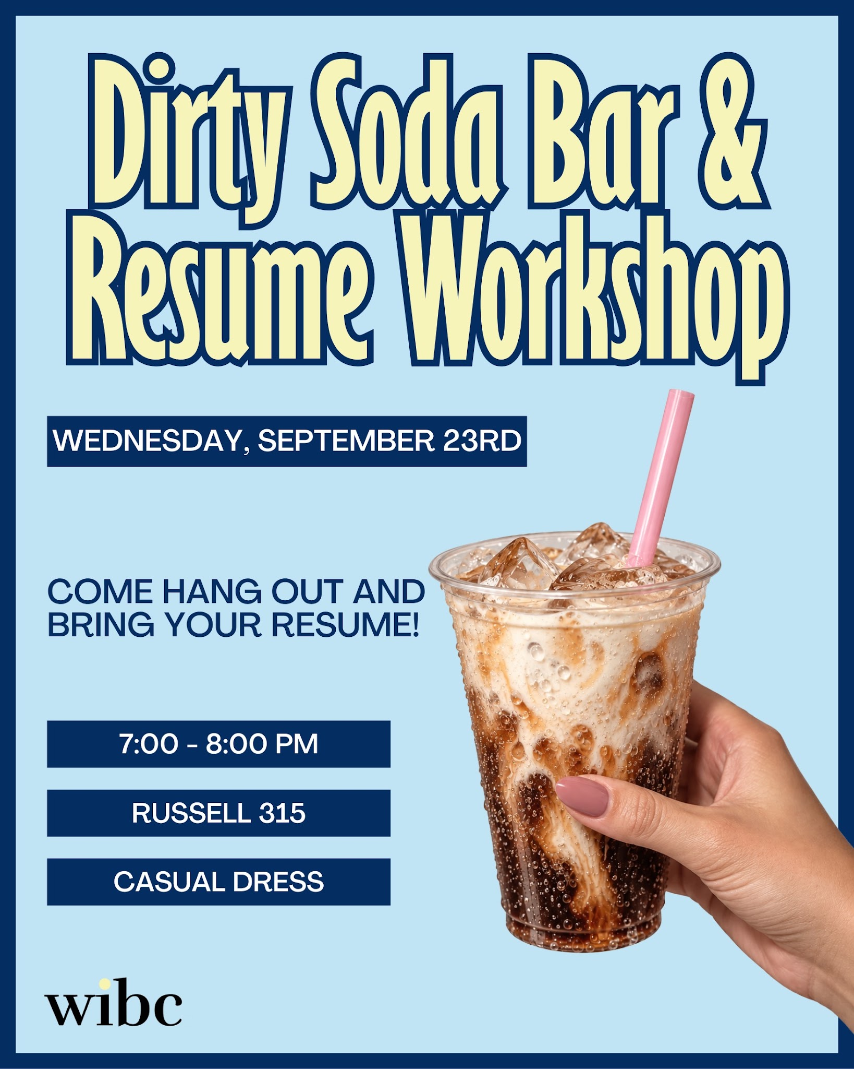
Social Event Tomorrow

Slide 55
Looking Ahead
Events
Friday, September 11th - Letter Writing / Mentor & Mentee Meet
12-2 in Russell 302
Wednesday, September 23rd - Resume Workshop / Dirty Soda
7-8 in Russell 315
Wednesday, October 7th - Paint & Sip with Mentorship
7-9 in Russell 302
Limited sign ups at next body meeting
Events
Wednesday, October 21st - Claw Clip Decorating
7-8 in Russell 305
Wednesday, November 4th - Mentorship Event
TBD
Friday, November 6th - Digital Vision Board Making
1-2 in Russell 203

Slide 56
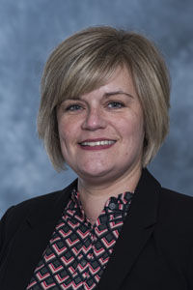
Office of Career Management
Come to our digital vision board social event
Friday, November 6th
1-2 in Russell 203
Dress: Casual
Dollie Newhouse from the Office of Career Management
will be there to answer questions and review resumes

Slide 57
HARVARD CONFERENCE!
Each year, we send a group of members to attend the Harvard Women in Business Conference in Boston, MA. WIB pays for the flights, hotels, and tickets for each remember selected.
When: 11/6-11/8
***MUST miss Friday 11/6
This application is due on September 22nd at 11:59PM. TONIGHT!!!

Slide 58
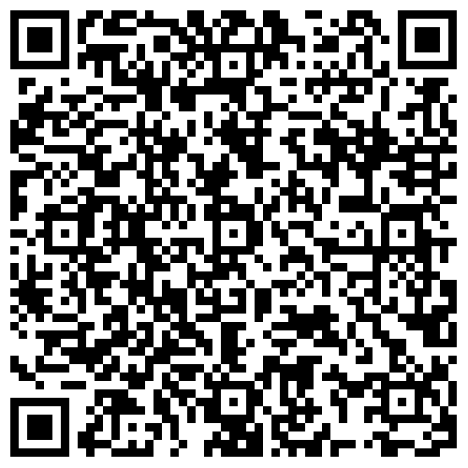
WIBC Emails
If you have paid your dues and are NOT receiving body meeting reminder/recap emails from “WIBC Exec Team”, please fill out this form!
Note: Check your junk/spam folder first!

Slide 59
Next Meetings
Body Meeting
WIBternship Meeting
When
September 29 @ 7:30 pm
When
October 6 @ 7:30 pm
Format and Location
Jones 210
Format & Location
Jones 210
Topic
From Campus to Career: Building Your Brand with PGIM
Topic
Committee Panel and LinkedIn & Headshots
Bring your laptops!
Notes:
Sam
Topic of Next Body Meeting??

