Slide 1

Women in
Business Council
Spring 2026 Interest Meeting

Slide 2
Agenda
Who We Are
Meet the Executive Board and Committees
What We Do
Structure
Schedule
How to Become a Member

Slide 3
Who We Are
We are the Women in Business Council at the University of South Carolina and we strive to connect, empower, and educate women so that they may become respected leaders in the business community.

Slide 4
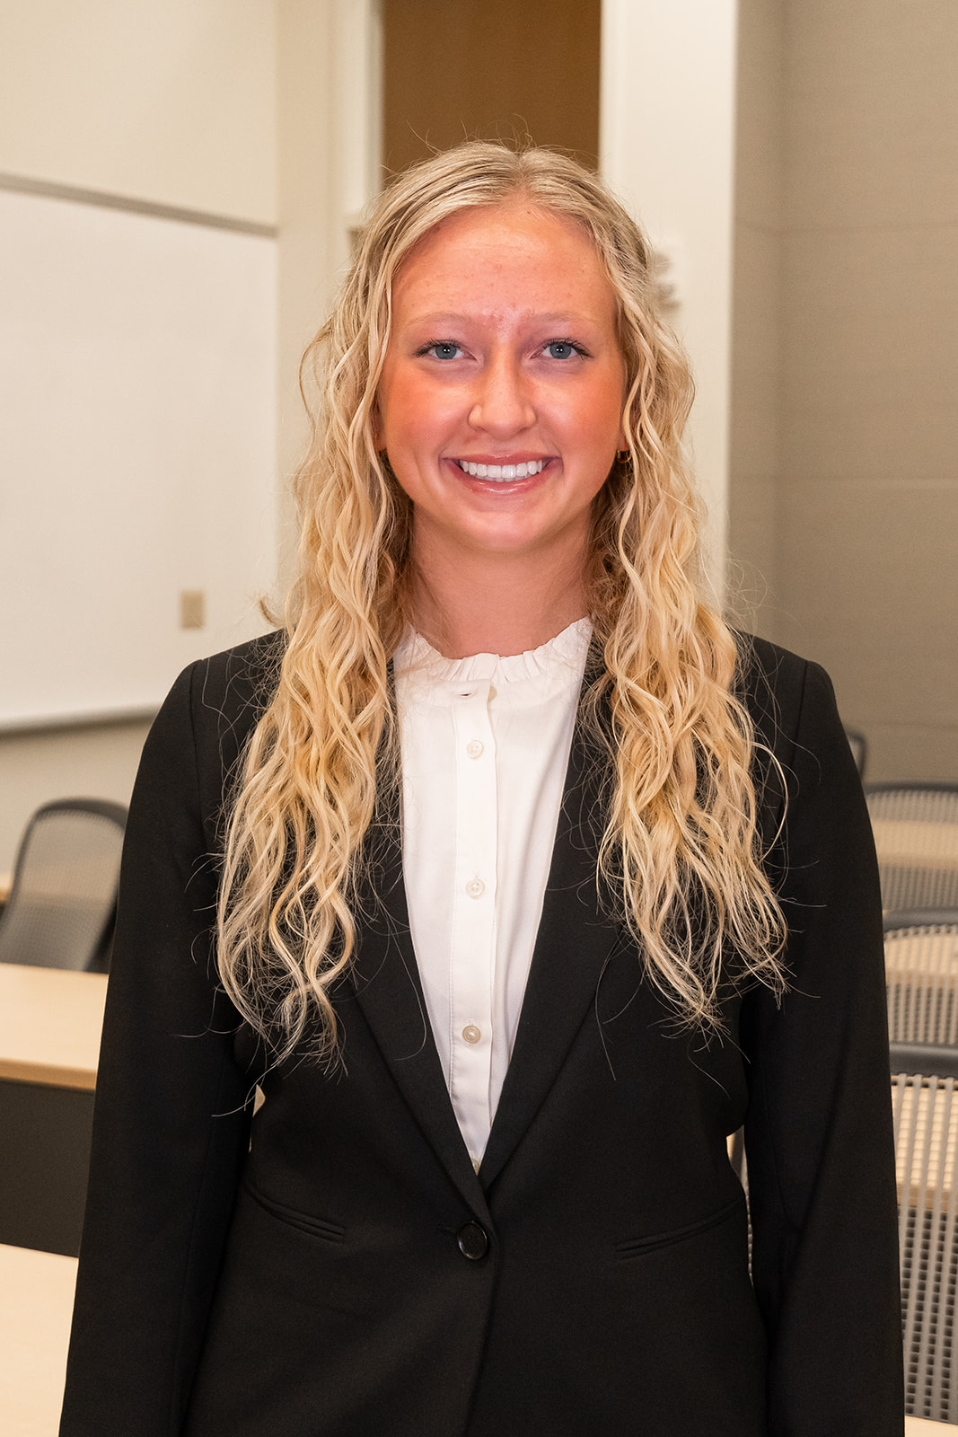
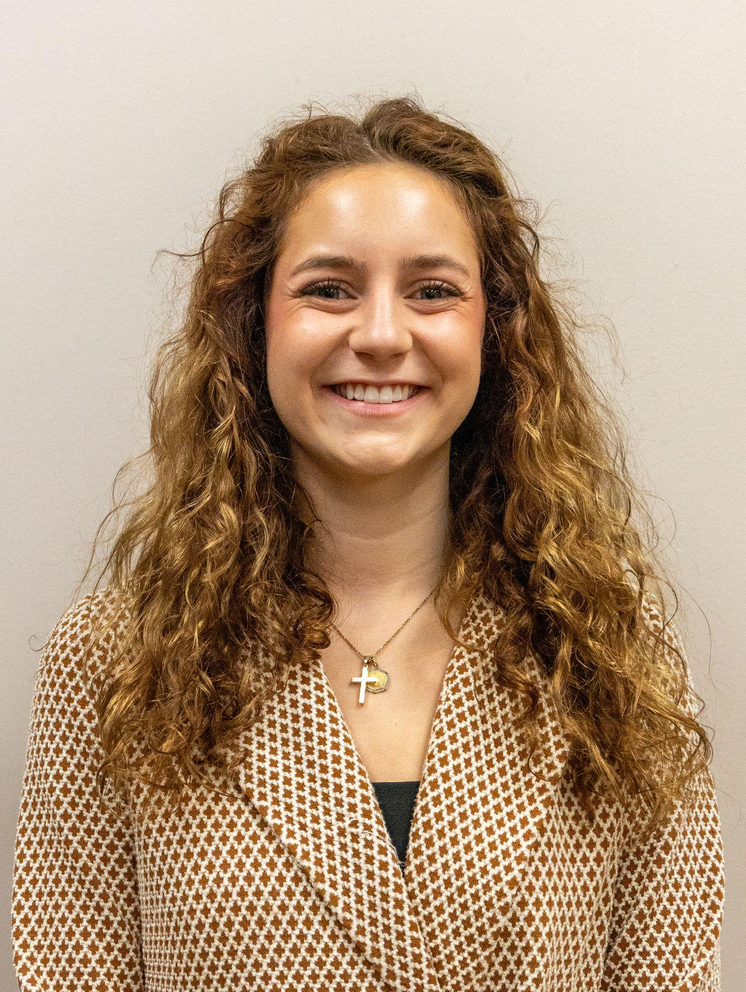
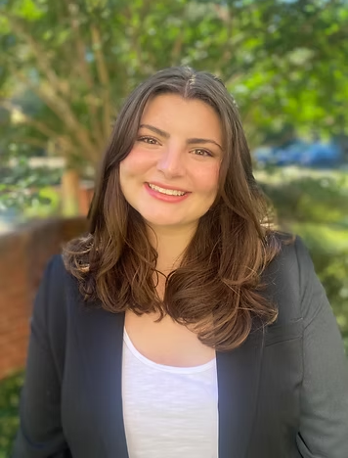
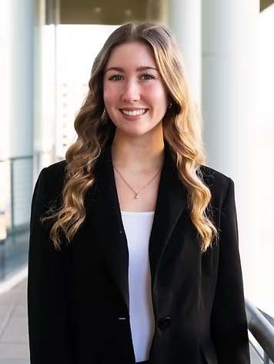
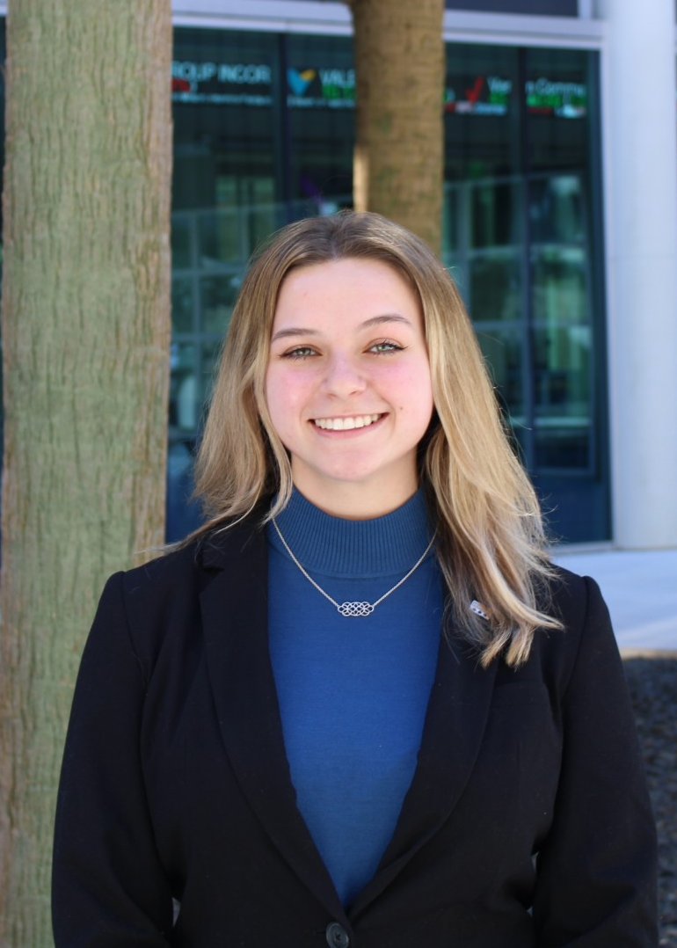
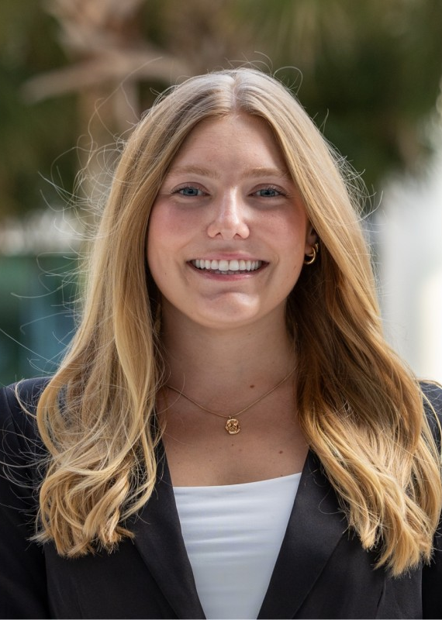
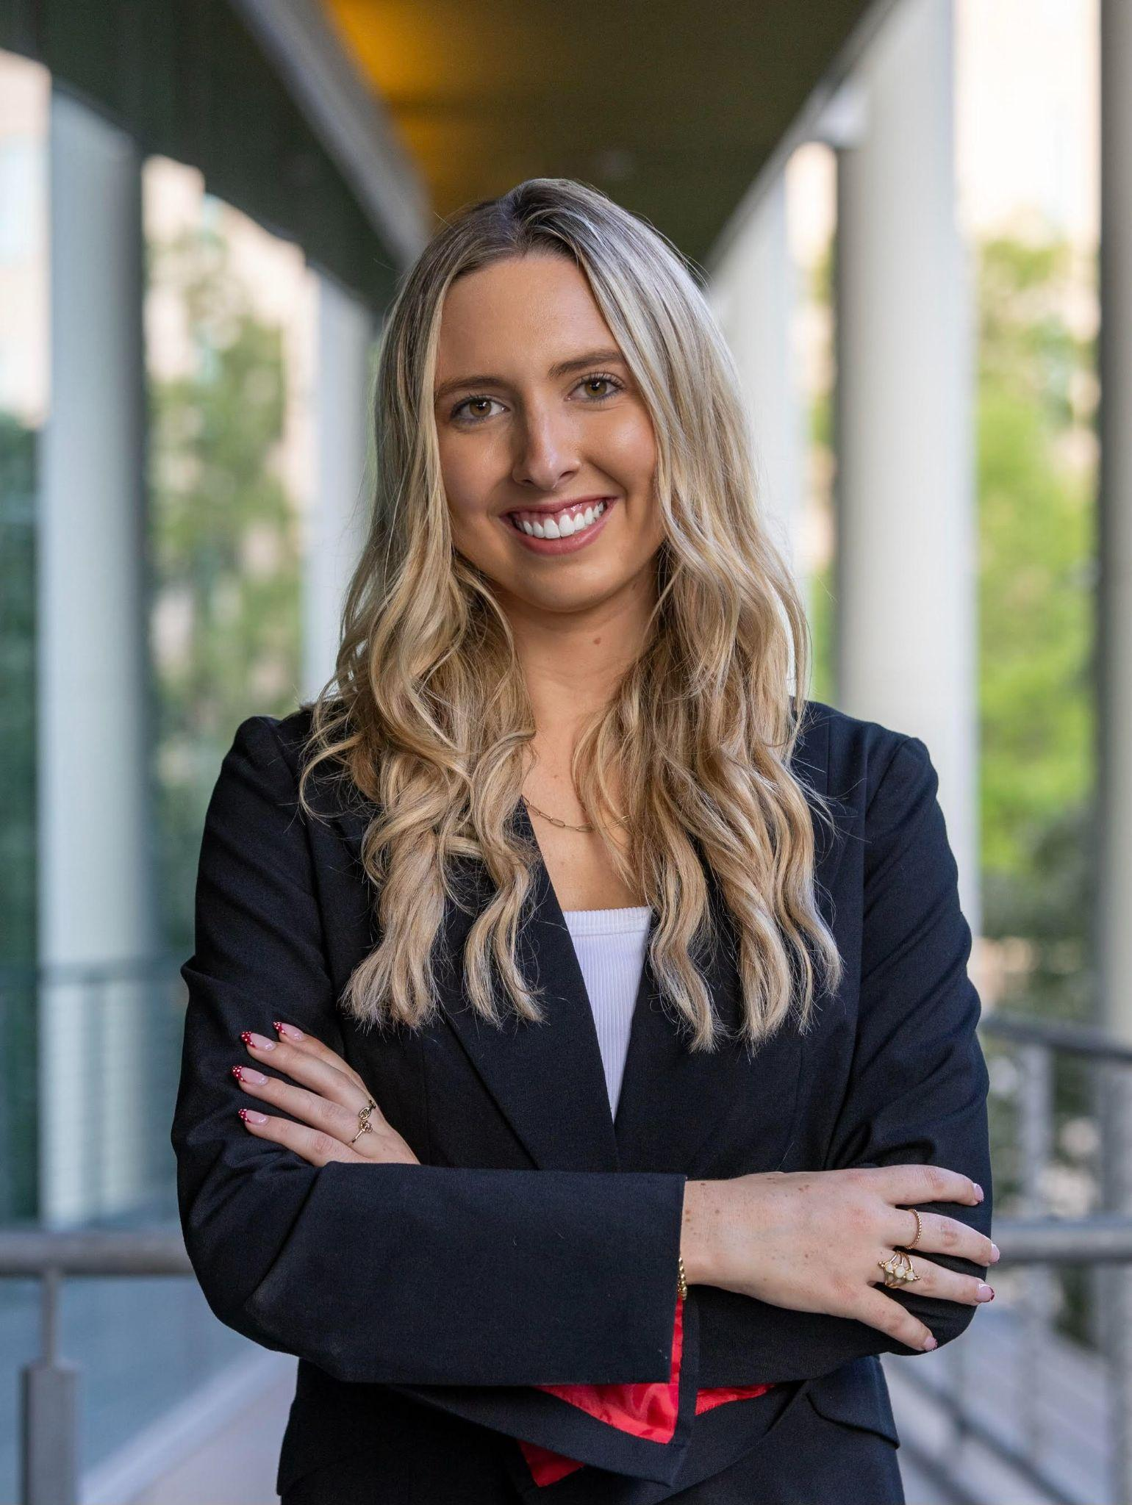
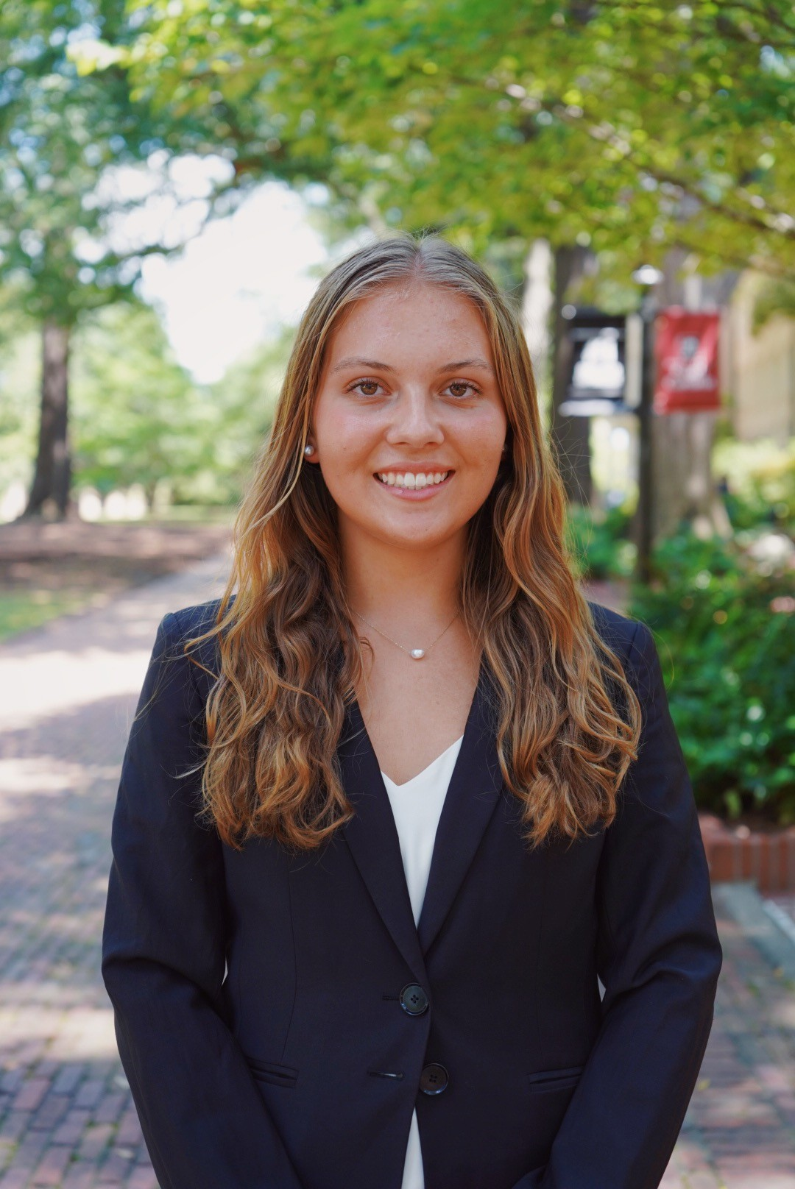
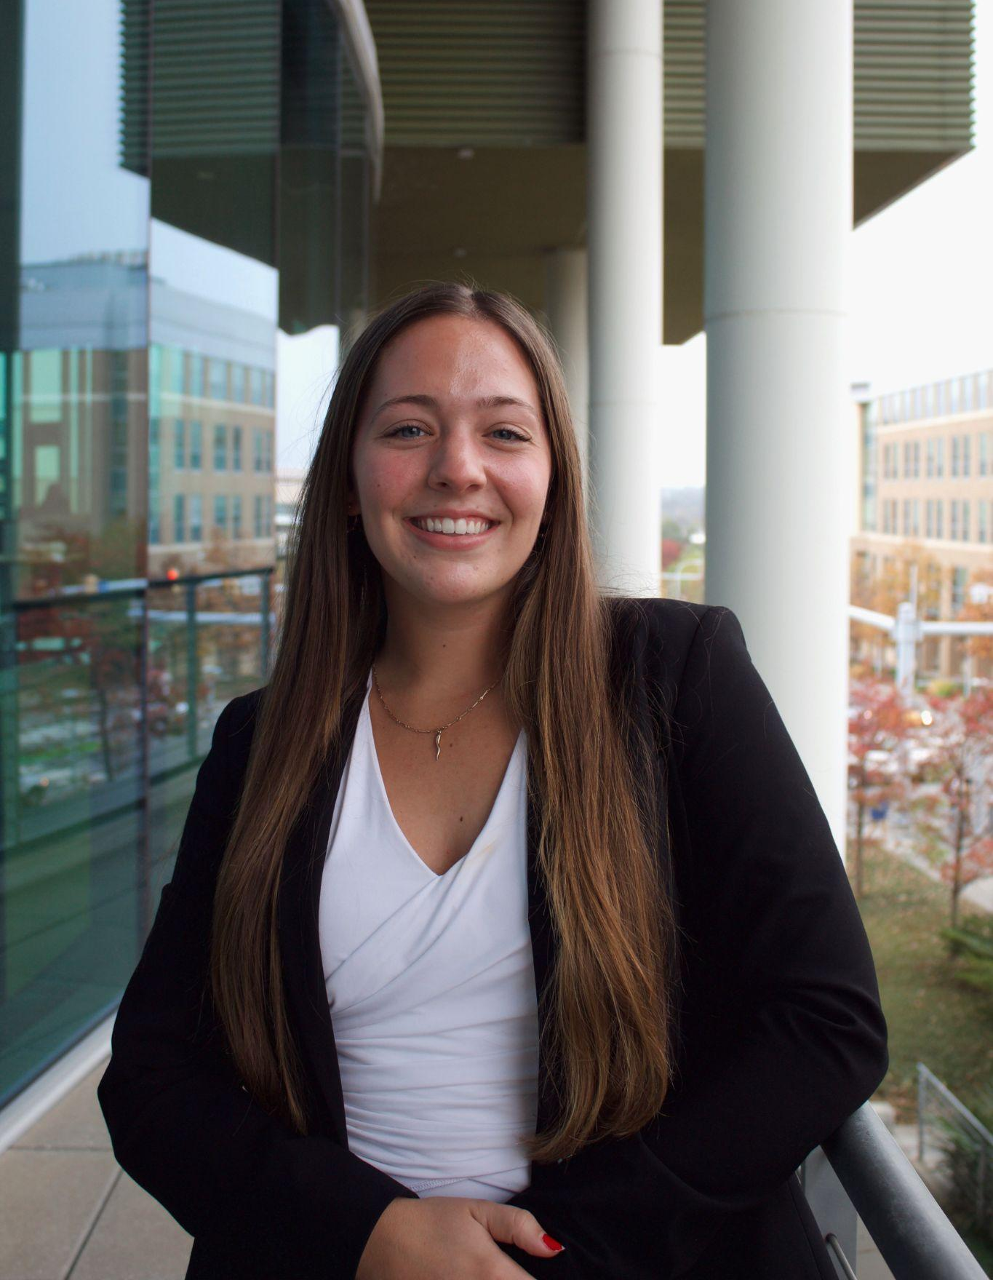
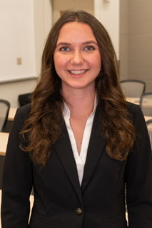
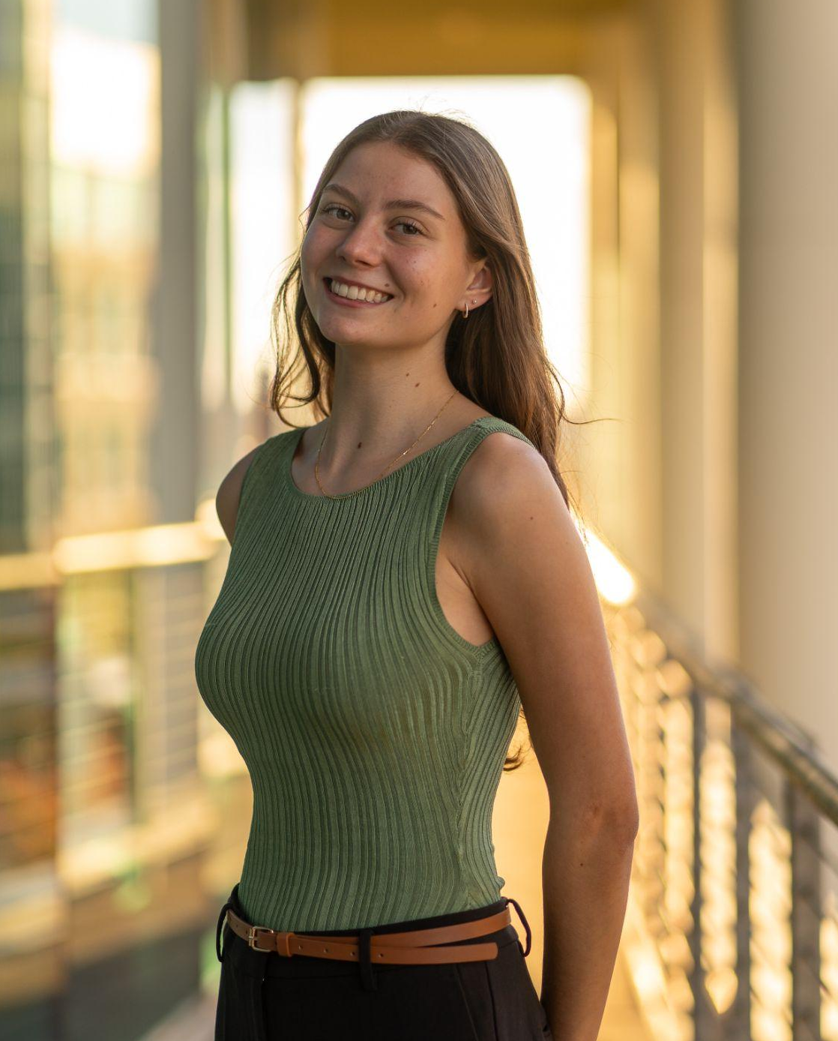
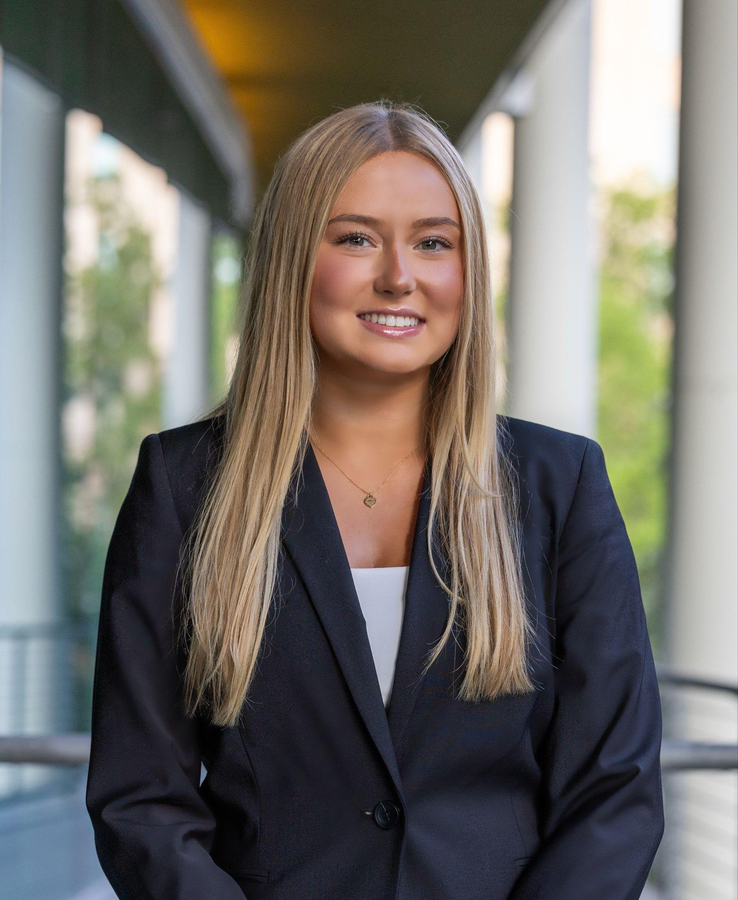
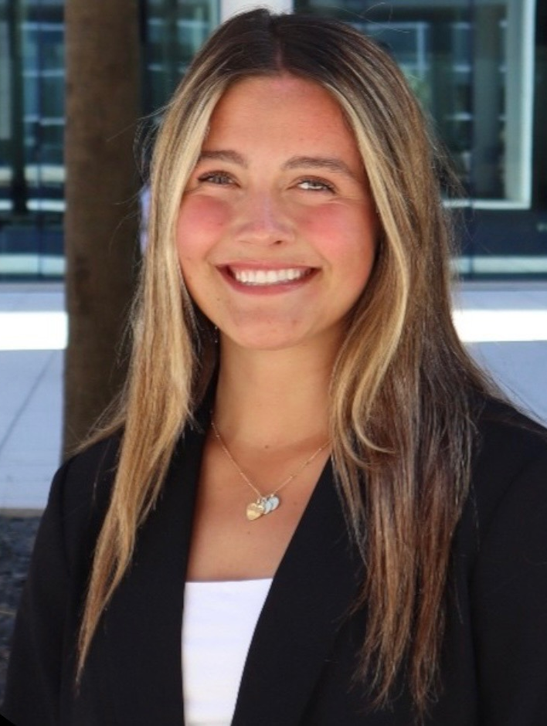
Executive Board
Lilly Ritch (Director Recruitment & Retention)
Ali Michaut
(President)
Ella Underwood
(Vice President)
Casey Fitzgerald
(CMO)
Shea Yeager (COO)
Taylor Wolf (CFO)
Alexis Knapp
(Director of Media)
Katie Roberts (Director of WIBternship)
Frances Overton
(Director of Membership)
Taylor Fontaine
(Director of Conference)
Noelle Klasnick
(Director of Alumni Relations)
Ava Lenahan
(Director of Mentorship)
Jenny Pantoni
(Director of Outreach)

Slide 5
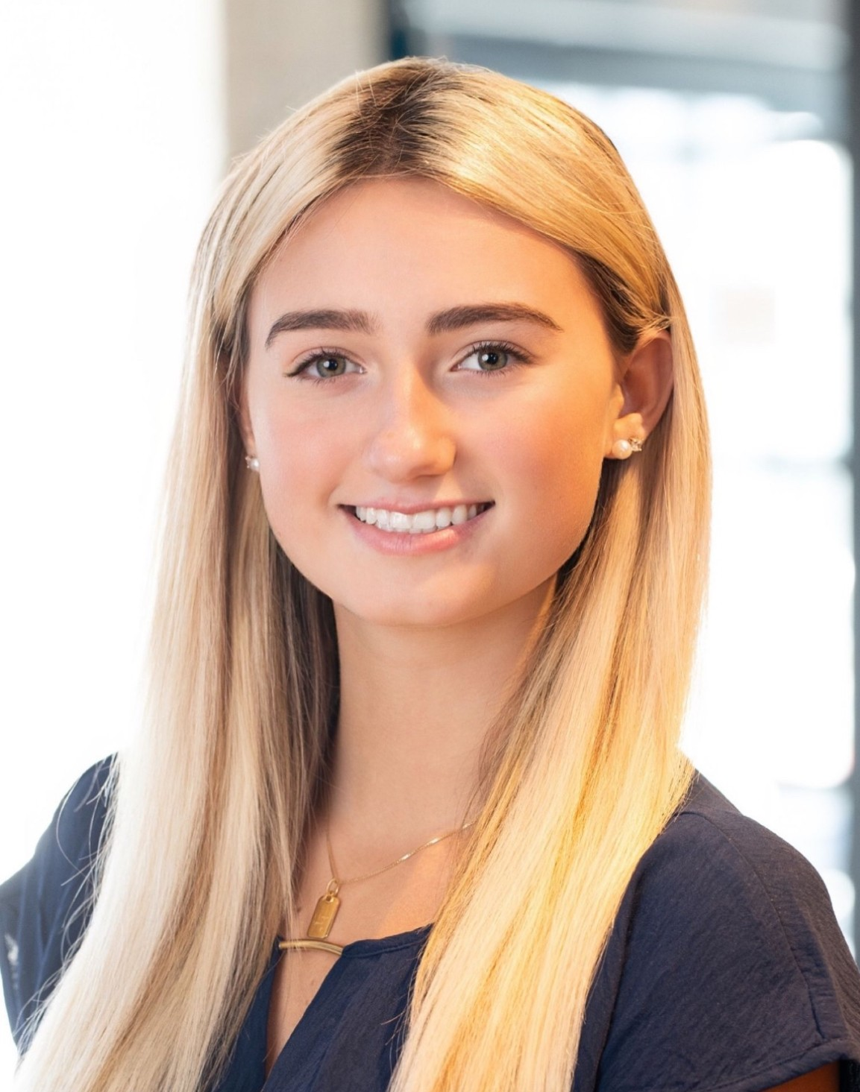
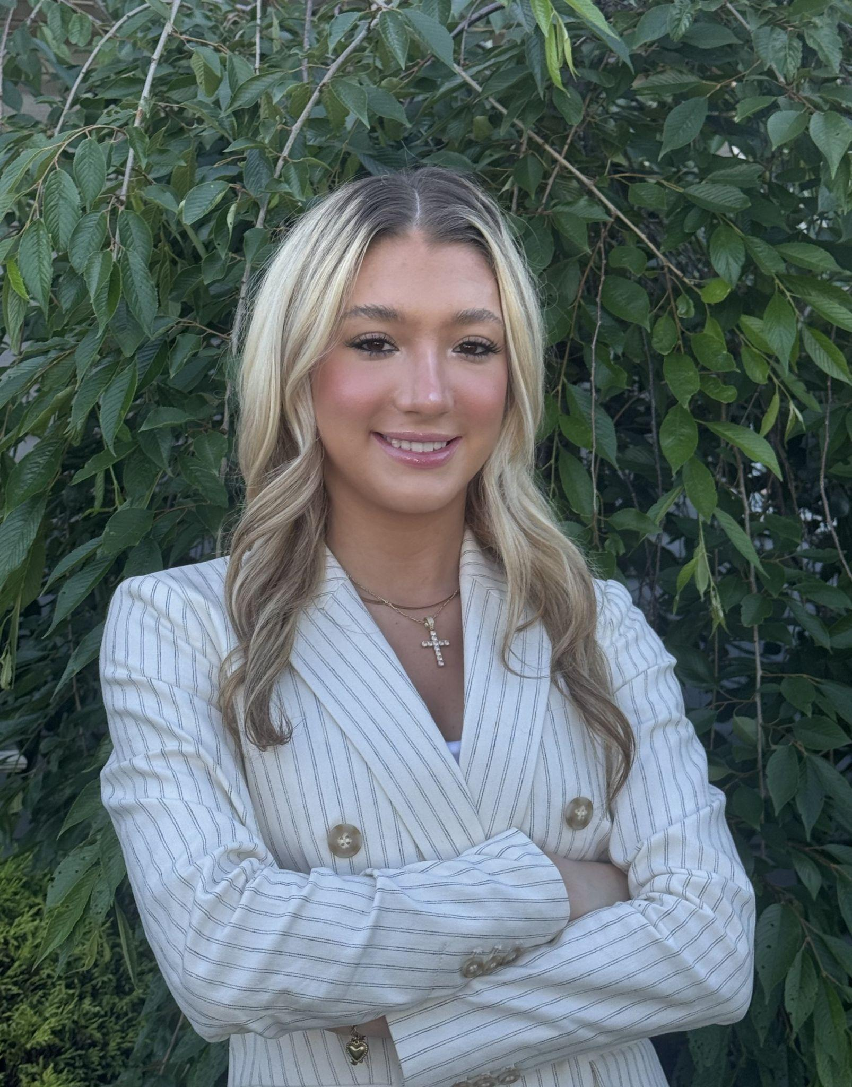
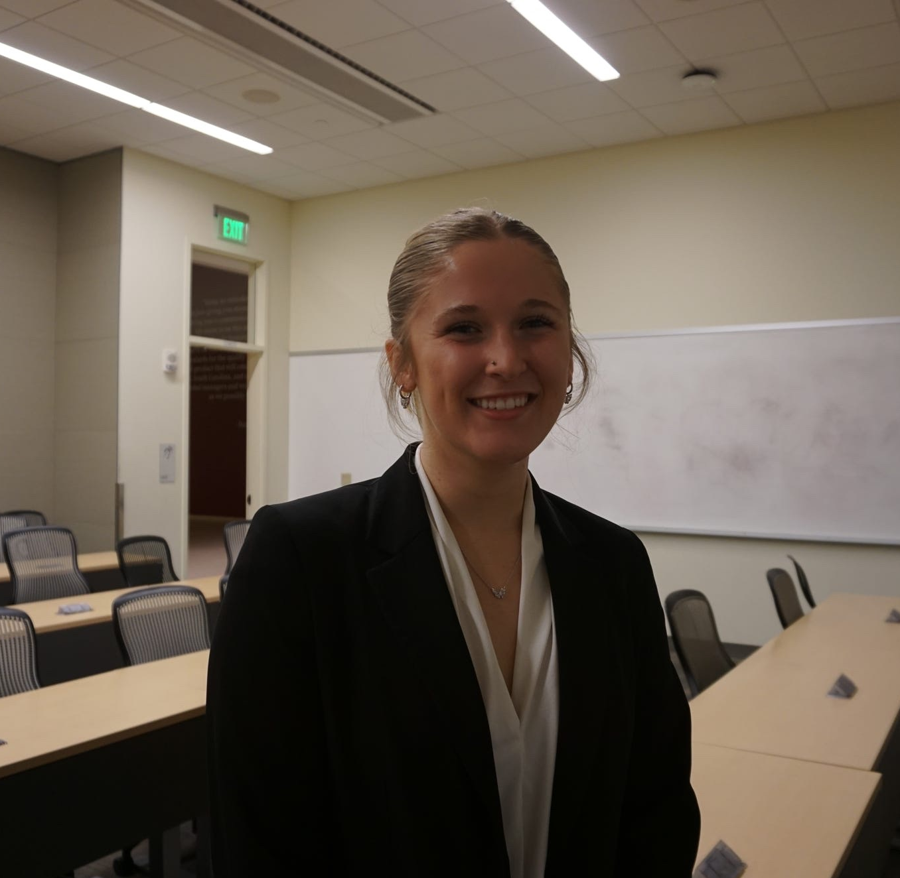
Committees - Mentorship
Chloe Anderson
Ava Lenehan
Kaitlyn Klein
Reese Holland
Notes:
Need other 2 from sabrina

Slide 6
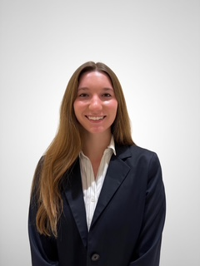
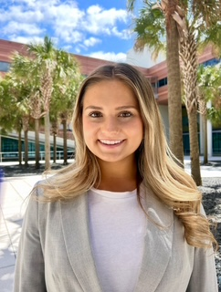
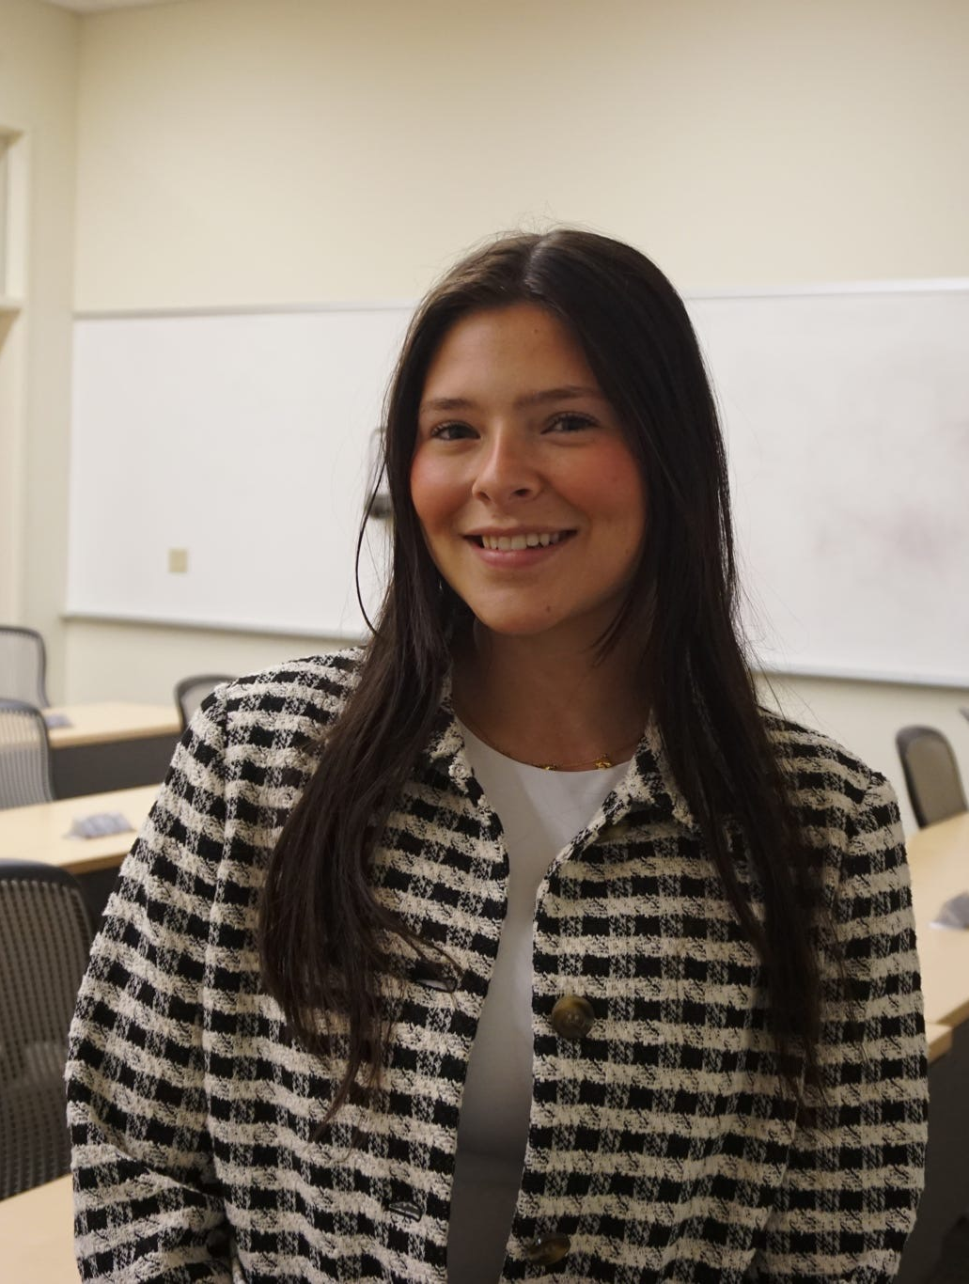
Committees - WIBternship
Casey Fitzgerald
Katie Roberts
Lucy Goddard
Sabryna Johnson
Sophia Chapman
Notes:
Need other 2 from sabrina

Slide 7
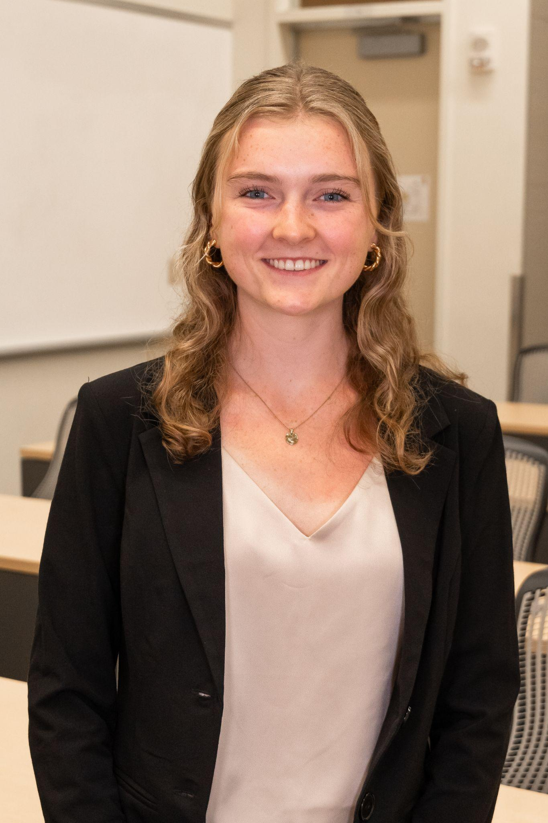
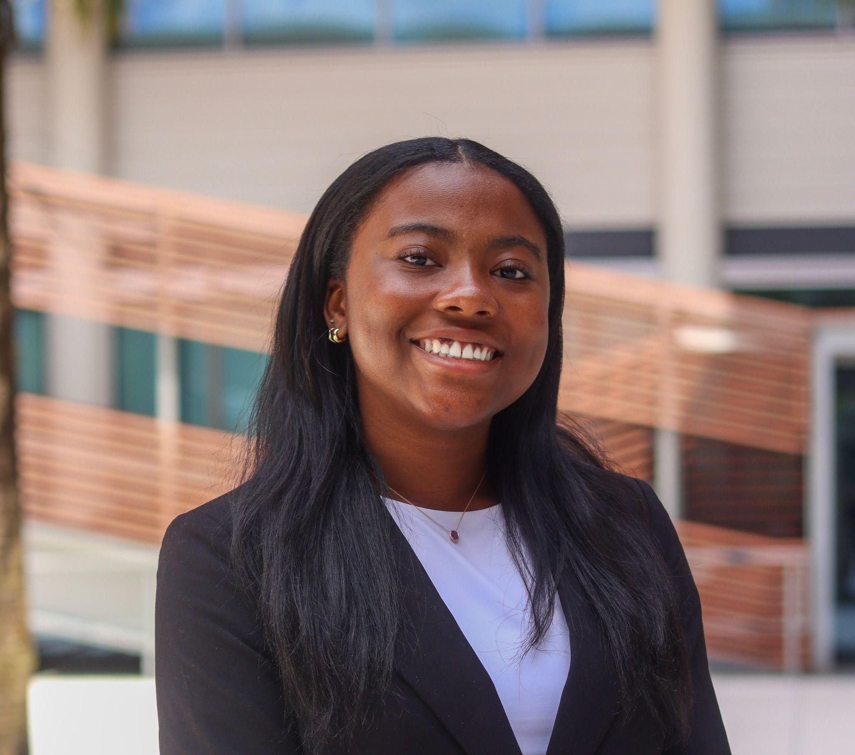
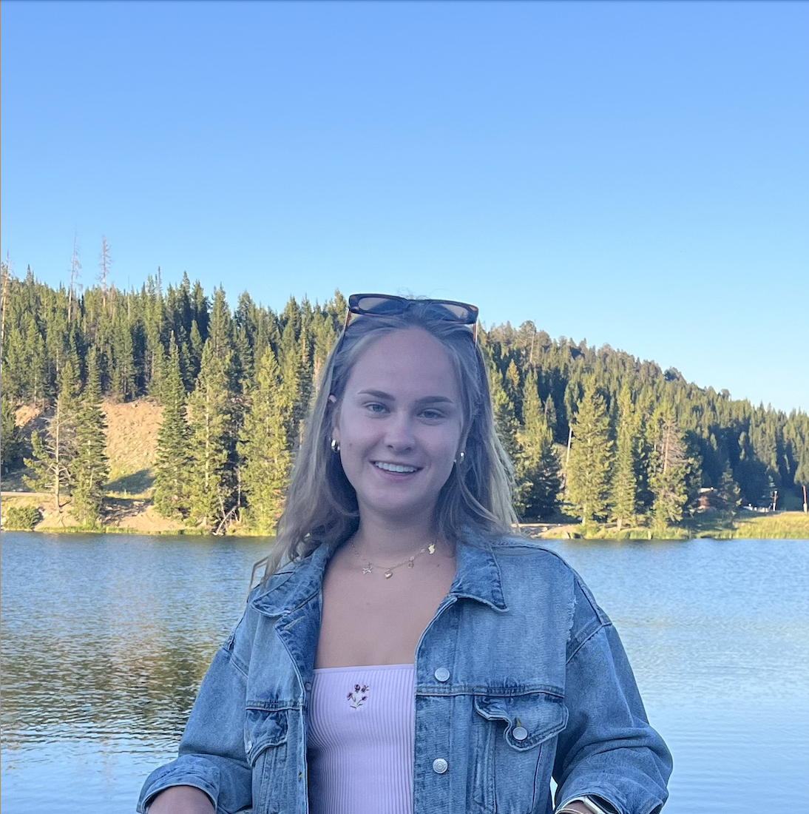
Committees - Outreach
Claire Pruitt
Morgan Thomas
Olivia Schuknecht
Taylor Wolf
Notes:
Need other 2 from sabrina

Slide 8
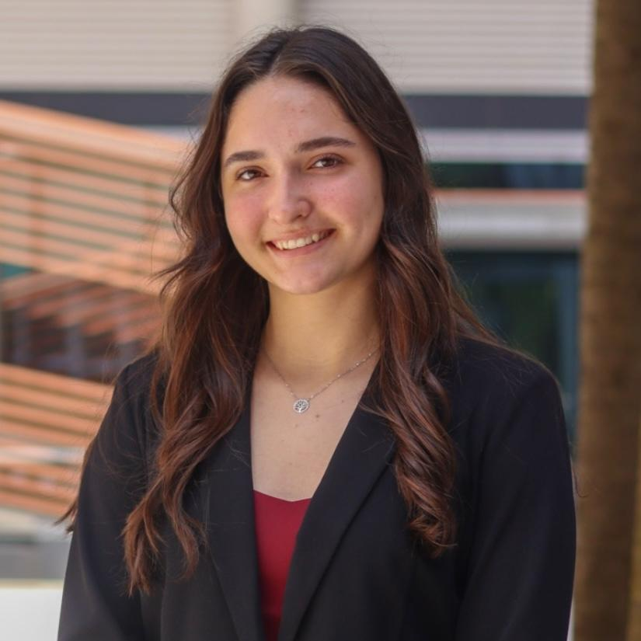
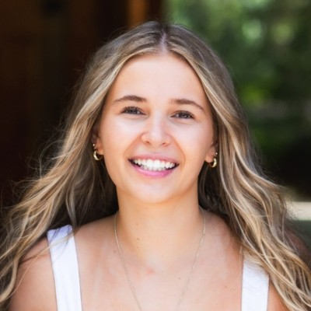
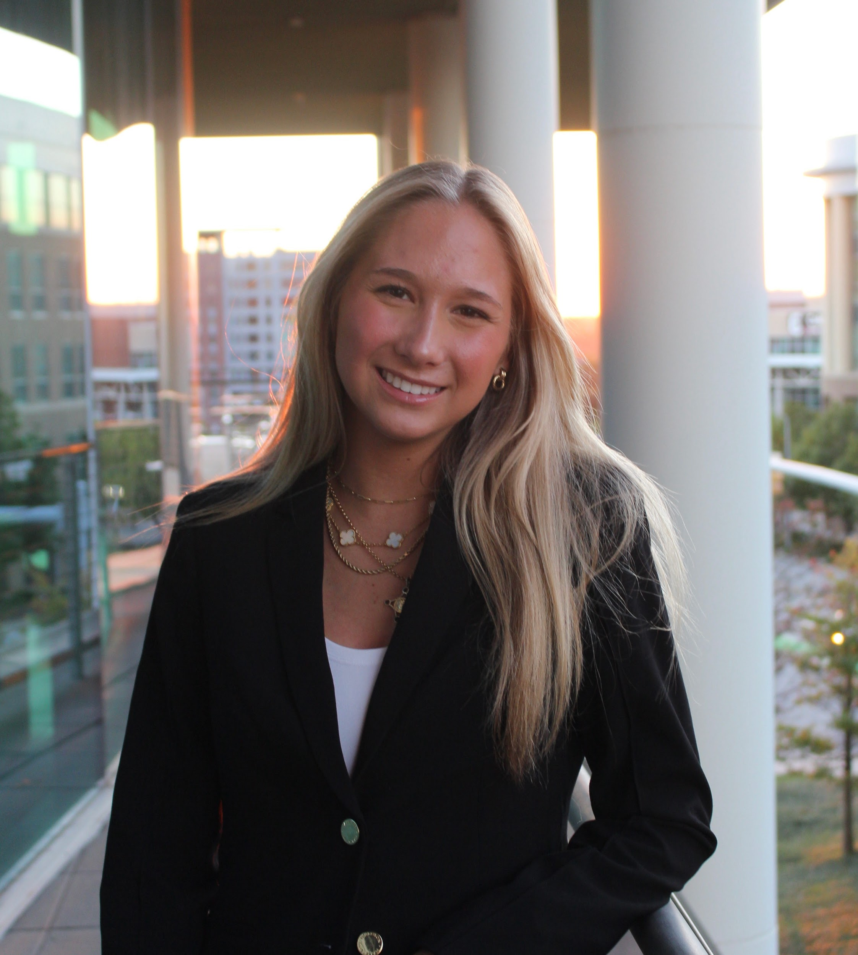
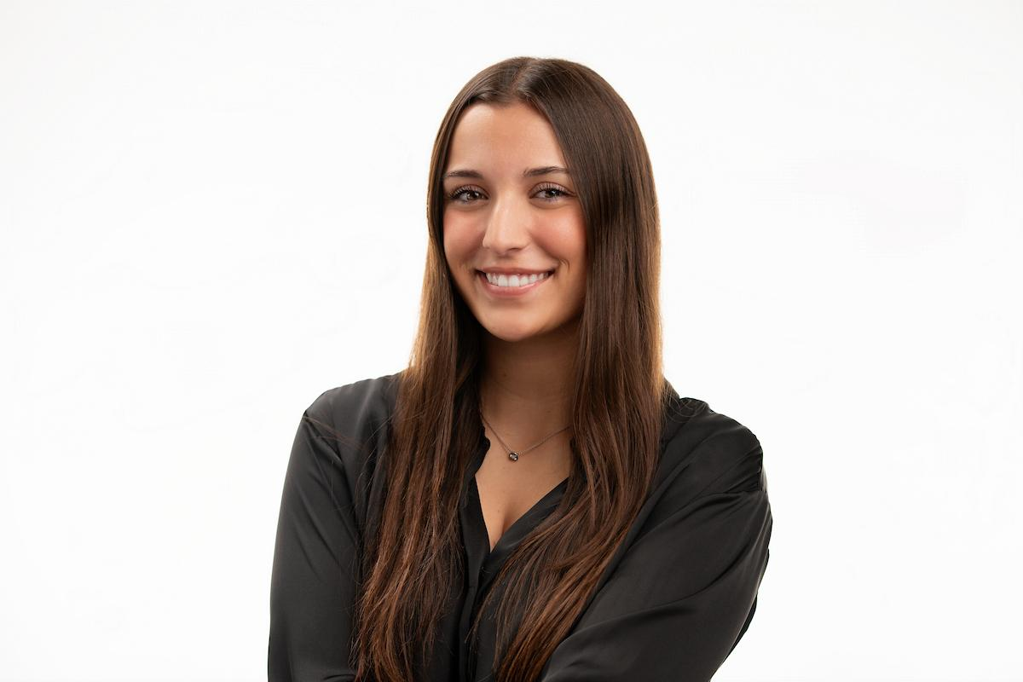
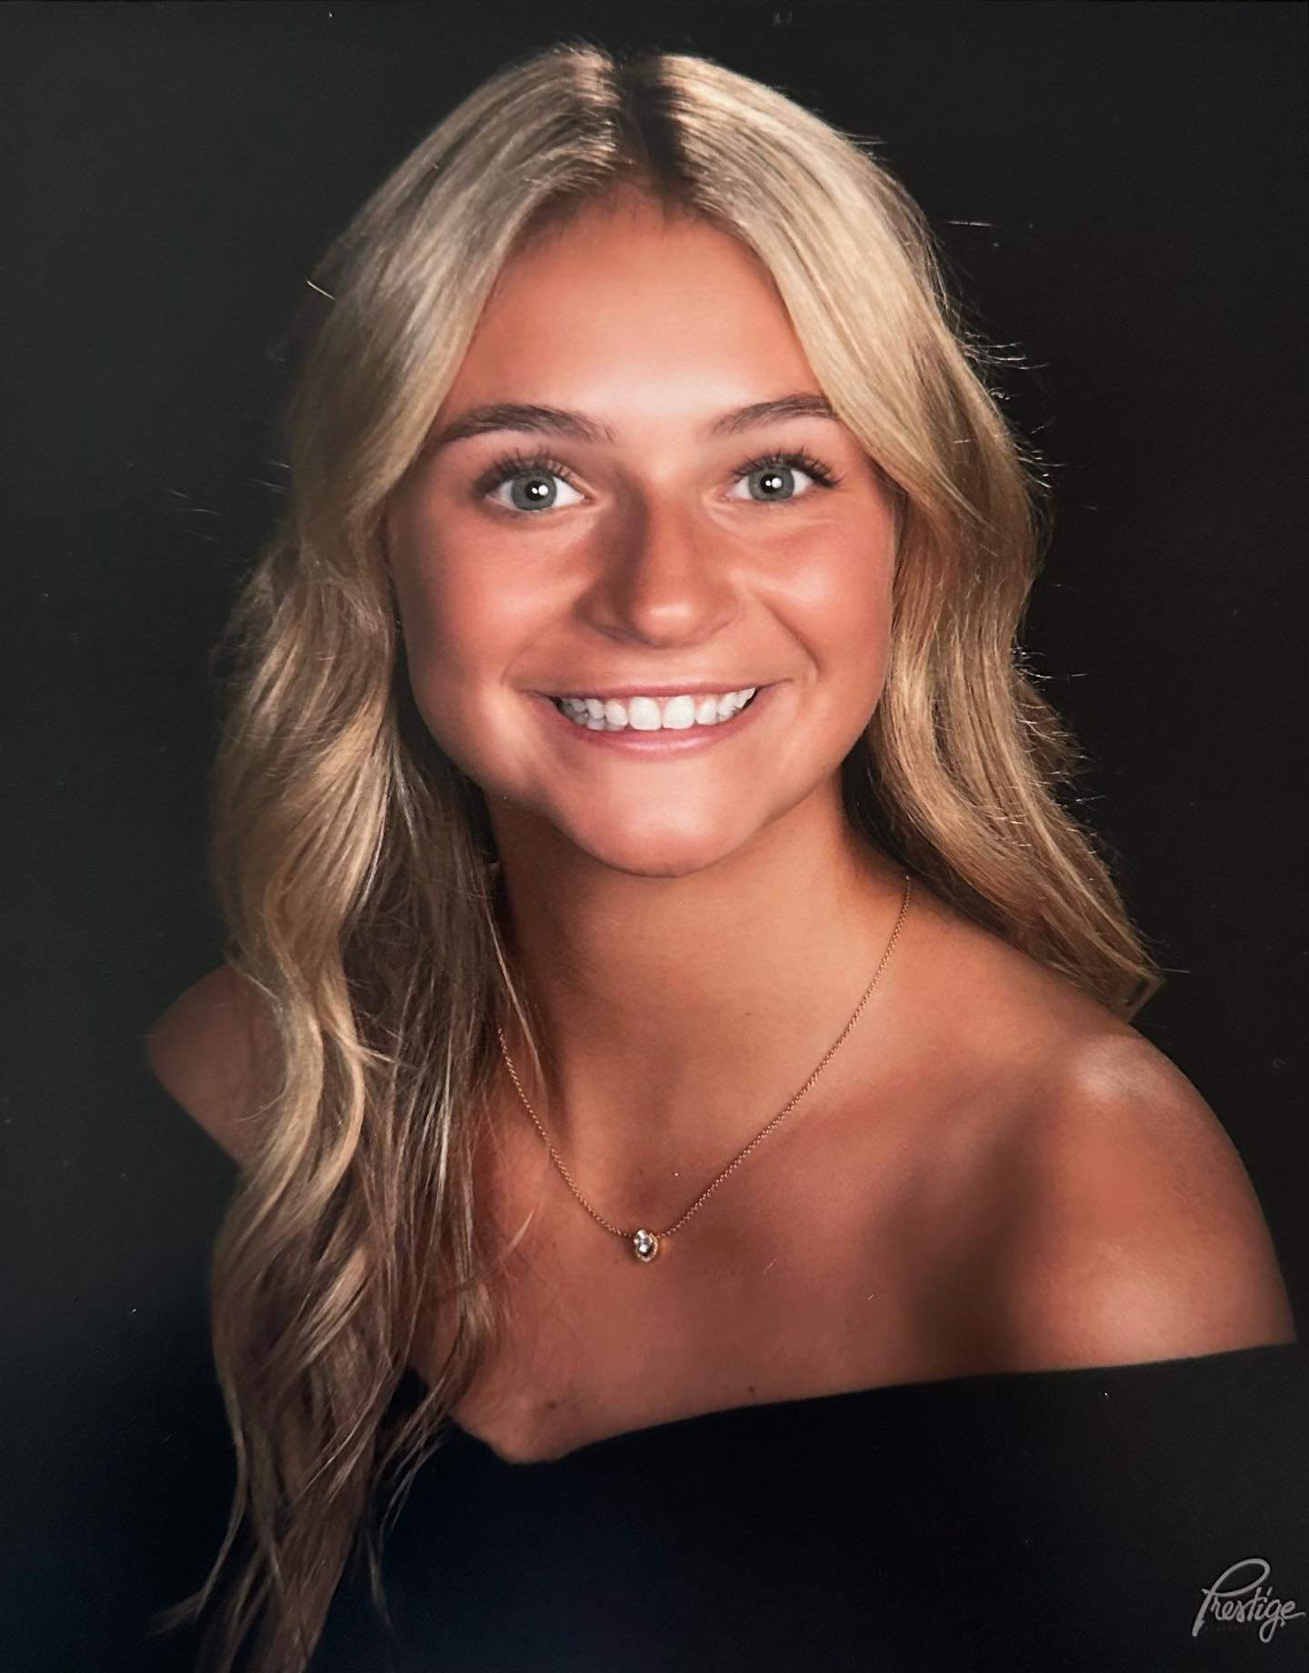
Committees - Conference
Brielle Kevitch Programming Manager
Anna Barber
Outreach Manager
Brooke Childs
Marketing Manager
Clara Valentine
Networking Manager
Gianna DiBattista
Partnership Manager
Notes:
Need other 2 from sabrina

Slide 9
Bi-Weekly Body Meetings
Body meetings are every other week on Tuesdays at 7:30pm. They are a combination of virtual and in person meetings. Our body meetings consist of various speakers from different companies, as well as internship panels, professional development, and more.
Requirements for virtual meetings:
Camera must be turned on
If your camera is off or you look pre-occupied (folding laundry, doing dishes, etc.), you will be removed from the meeting and will not be counted for attendance.

Slide 10
WIBternship
What is WIBternship and why is it required*?
WIBternship is our new member program for freshmen and sophomores (although any WIB member is welcome to attend any workshops).
At meetings we go over the basics of employability in a low stakes environment, focused on learning and development.
Our speakers and contacts want to hire our members, so this program is important to provide our new members with the necessary skills.
What is the time commitment of WIBternship?
Every other Tuesday at 7:30PM* (opposite weeks as the body meetings)
Is WIBternship a competitive/rush process?
No! All we ask is that you show up, are engaged, and do your best!

Slide 11
WIBternship- Schedule
Tuesdays at 7:30PM, location TBD
  2/3– Professional Dress and Networking
  2/17– Resume & Interview Workshop
  3/3– LinkedIn and Headshots
  3/17– How to do a Case Competition
  4/7– Major Exploration & Internship Panel
  Week of 4/13– Case Competition (group sign-up)
To complete the WIBternship program members may miss one of the workshop meetings but everyone must complete the case competition!
Dress code is business casual (first meeting is casual!)
Once you complete the program - you’re an official WIBC member!

Slide 12
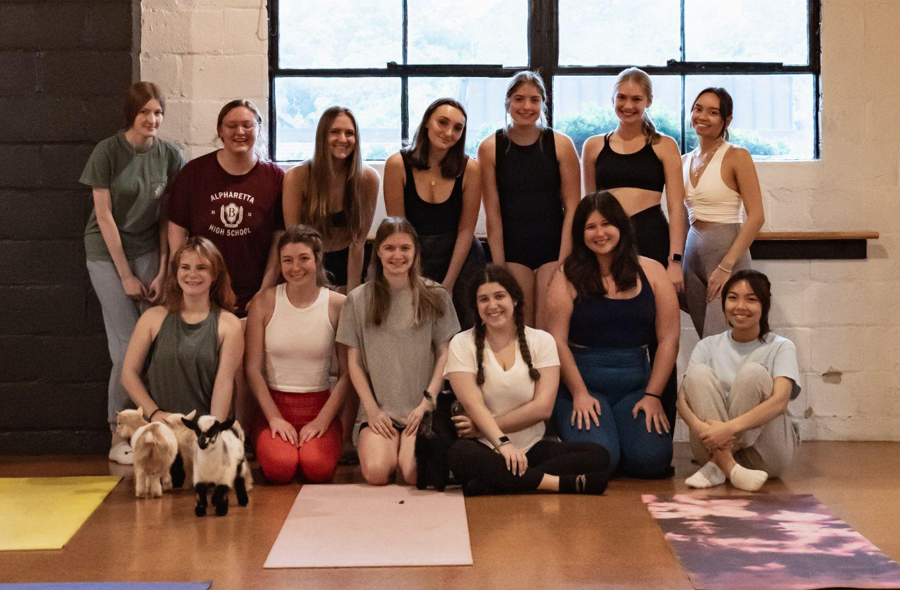
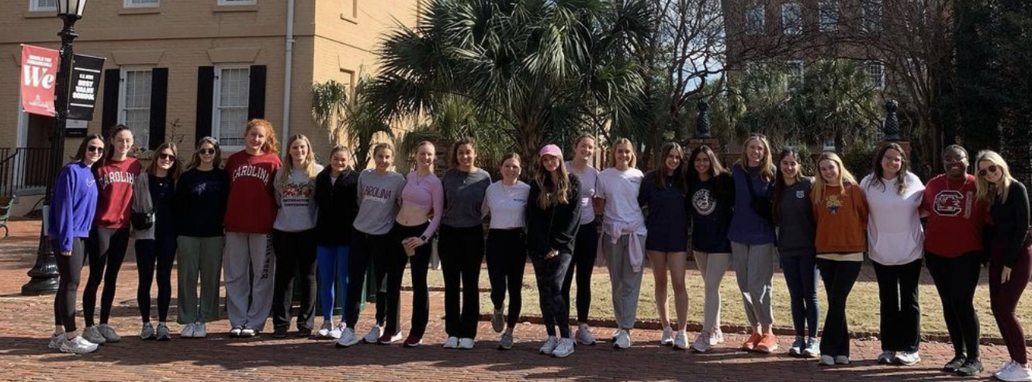
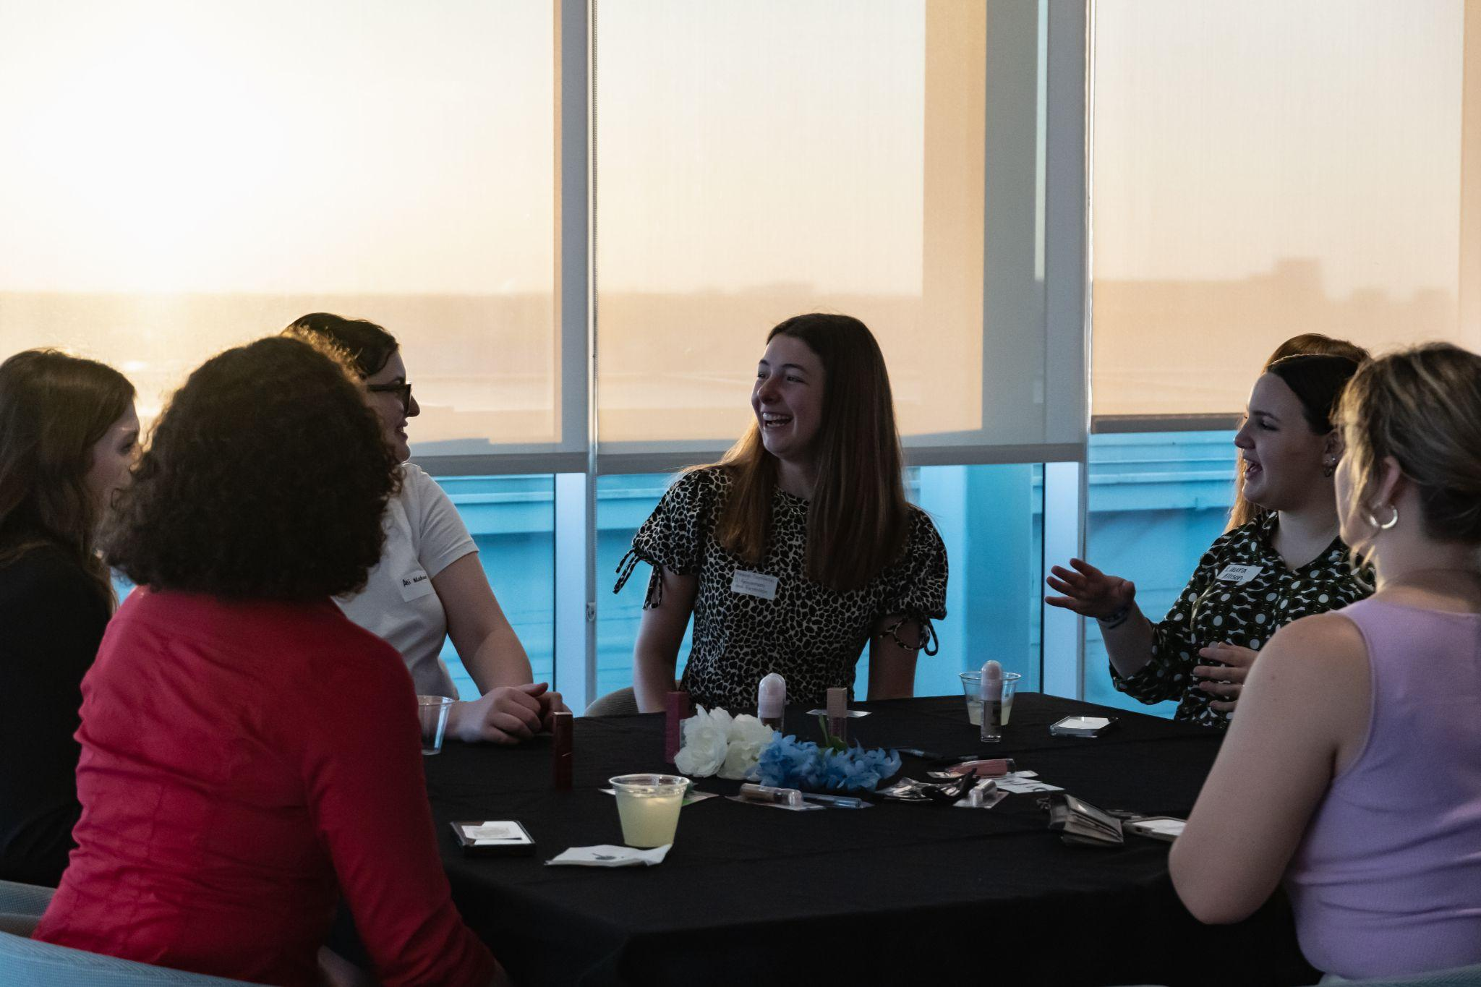
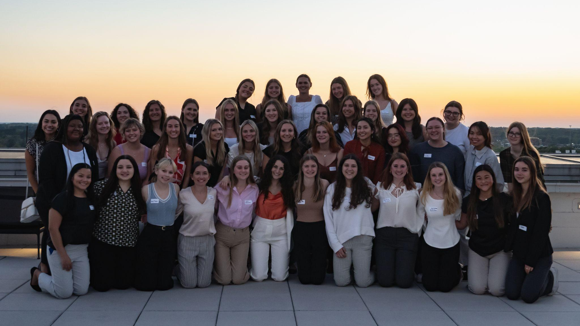
Past Social Events

Slide 13
Events to Look Forward To…
Mocktail Hour Networking Event
Valentines Craft Events
Community Service Opportunities
Collaboration Events with other student orgs
Coffee Tabs
Company Panels
WIBC Spring Conference
And More!

Slide 14
Mentorship
In business it is always stressed how important it is to mentor and have a mentor, so we are bringing that idea to WIBC!
After filling out a form, you’ll get matched up with an upper or lower classmen based on major, interests, career, goals/etc.
We have fun events throughout the semester that all the mentee/mentor groups will come together for, but you’re also encouraged to meet outside of those!
You can earn up to 6 points by going to every event!
Some of our Mentorship events in past semesters include…
Charcuterie Box Night
Claw Clip Making
Movie Nights
Holiday Cookie Decorating and Movie Night

Slide 15
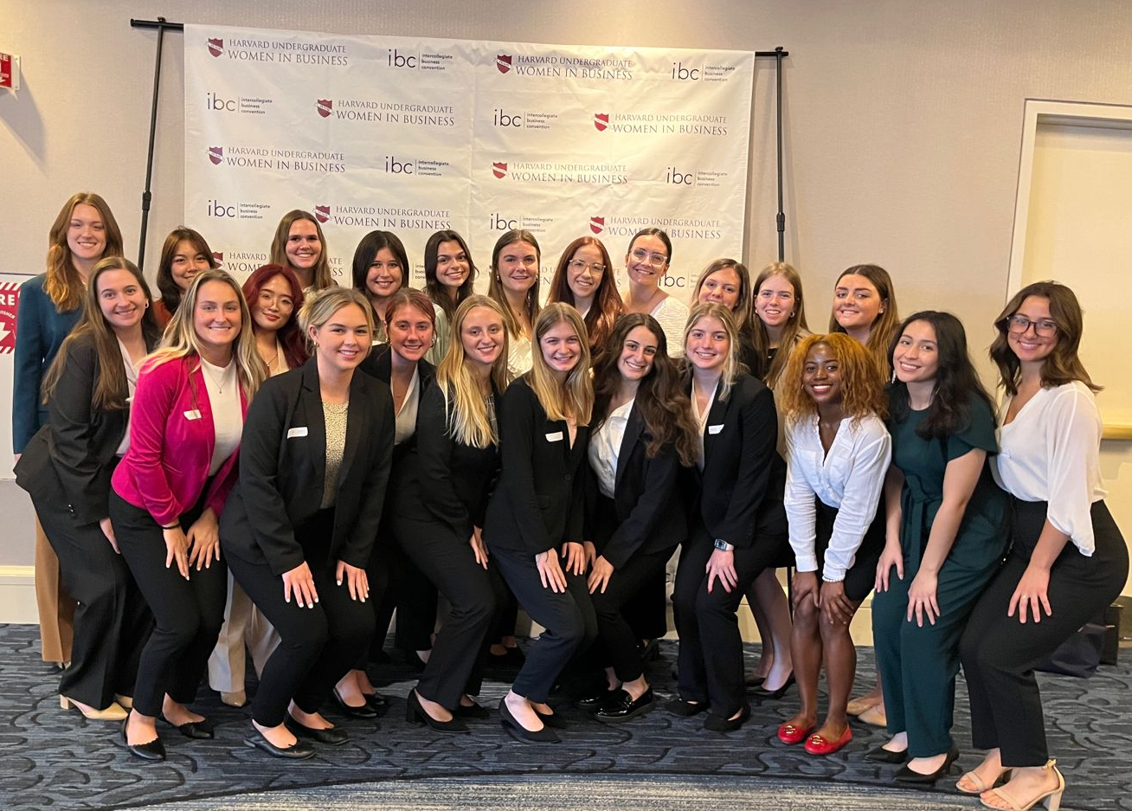
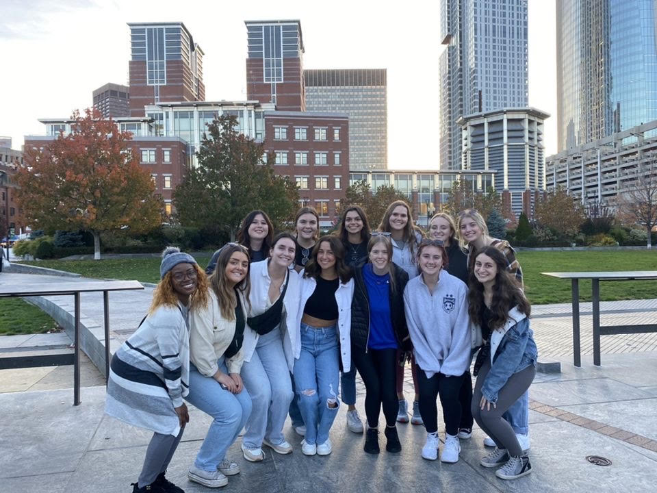
Harvard Intercollegiate Business Conference
The Harvard Women in Business Council puts on the annual IBC in Boston, MA. We have attended for many years, and are excited to be taking more members this year! Keep a look out for an application SOON!

Slide 16
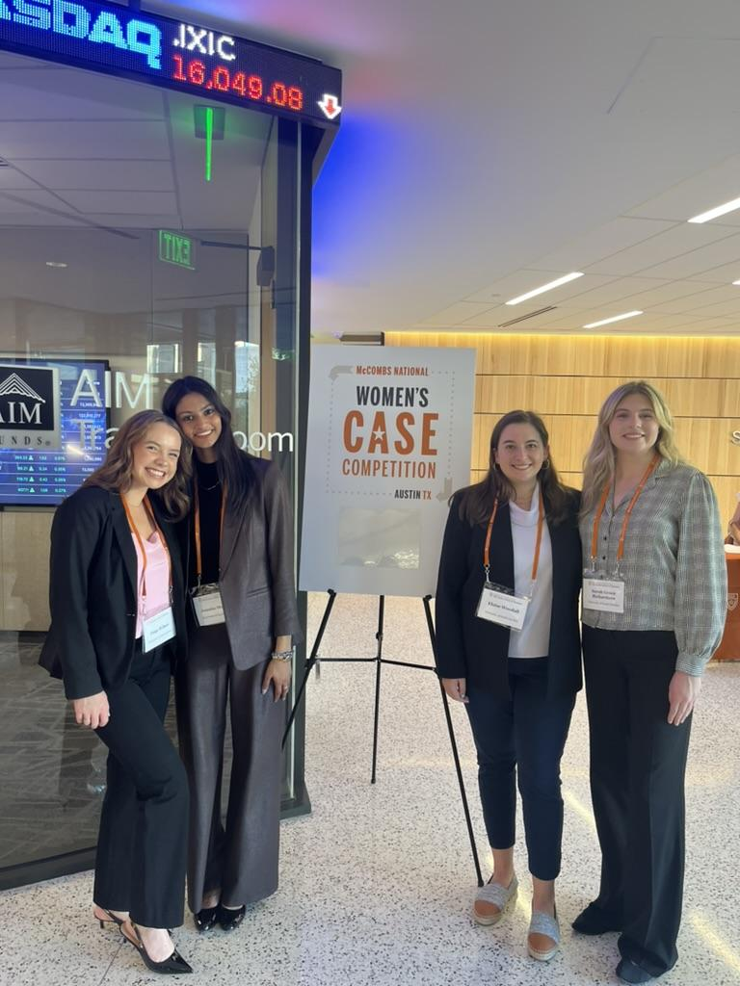
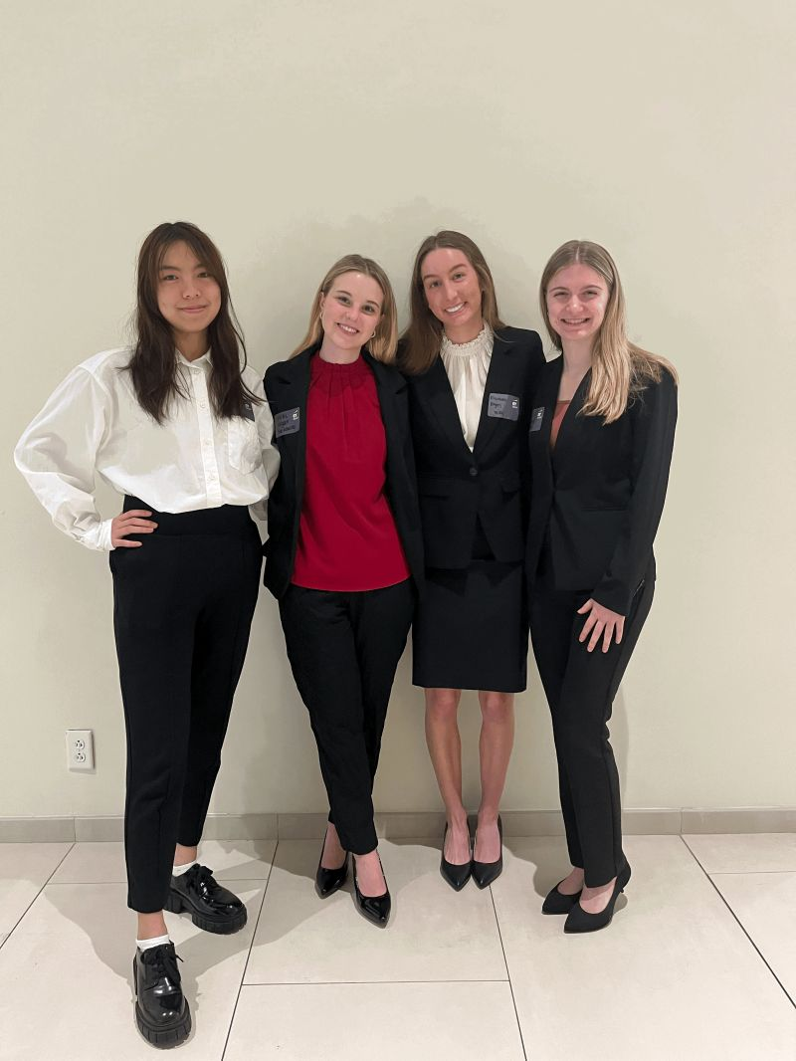
Case Competitions
In the past we had teams compete in case competitions including…
EY Case Competition at USC
Annual Women’s Case Competition in Austin, Texas

Slide 17














Where WIBC Works

Slide 18
Structure- Points System
New Members
  Must obtain 16 points AND attend 4 out of 5 of the WIBternship meetings ( Case Comp cannot be missed)
  4 of those general points must be from WIBternship exclusive social events
Returning Members
  Must obtain 16 points
All Members
  Free t-shirt at 16 points
  Top 3 point earners will receive a gift card at the end of the semester

Slide 19
TLDR:
New members can expect a meeting every Tuesday*
Returning members can expect a meeting every other Tuesday*
*Additional events not included
Points
Body Meetings–3 points each (5 body meetings + one social event meets your point requirement!)
Other events will count for 1-3 points depending on the event (Mentorship, social events, coffee and conversations, additional company speakers)
WIBternship does not count for points
The point requirement is not intended to be difficult to make!

Slide 20
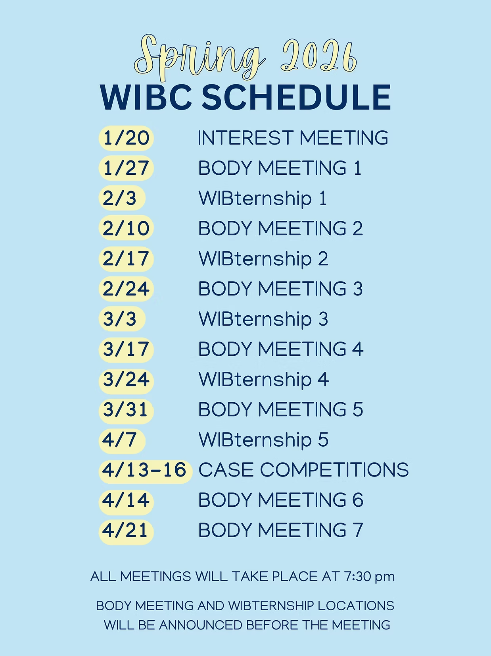
Spring 2026 WIBC Schedule

Slide 21
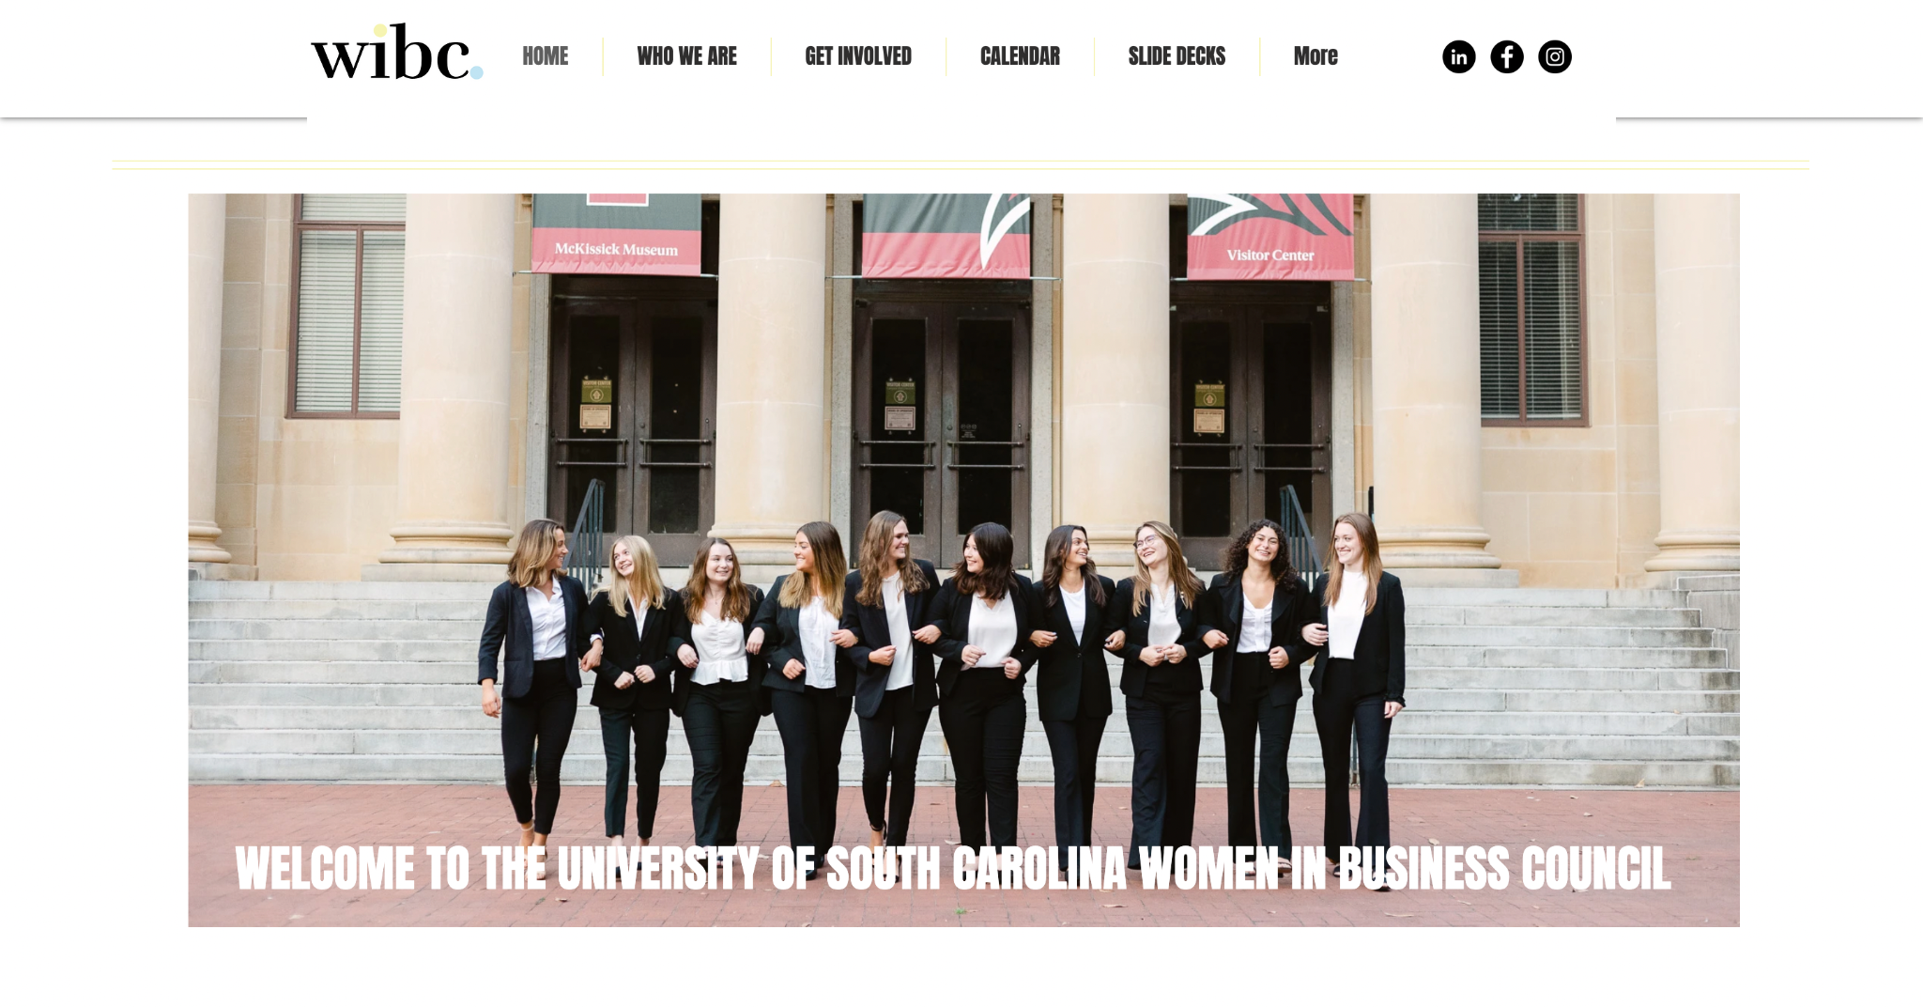
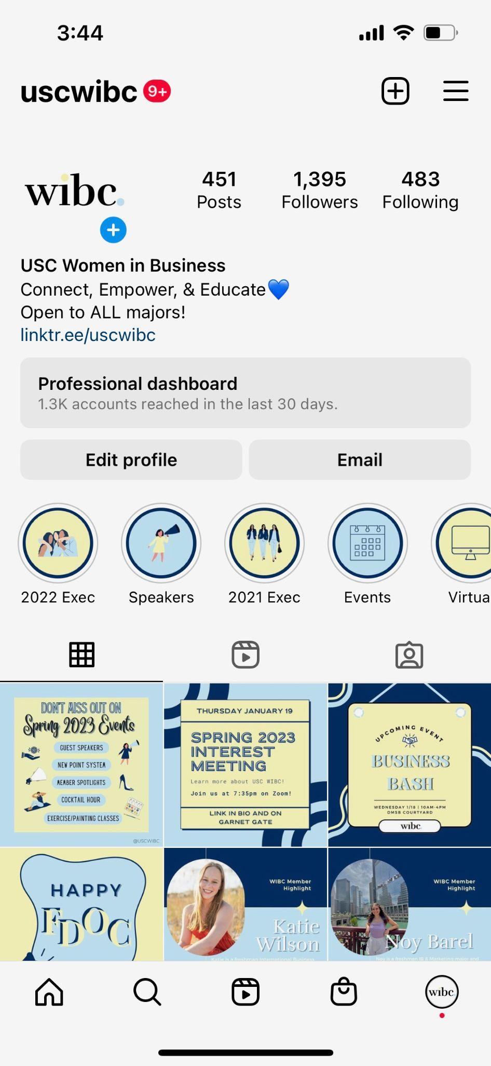
Where to Find Information
uscwibc.com
@uscwibc

Slide 22
How to Join
Ready To Join?
ZELLE $25 dues to uscwibc@gmail.com
  Due February 3rd by 11:59pm
  Include your Name, USC email (WITHOUT the @email.sc.edu), and grade in the description
Request Membership on Garnet Gate
  We will only accept your request after you send dues

Slide 23
Body Meeting 1
"You don't find yourself, you build yourself" with Felicia Trujillo
Our first body meeting will be Tuesday, January 27th, at 7:30pm IN-PERSON, location TBD (will be communicated via the instagram and email).

Slide 24
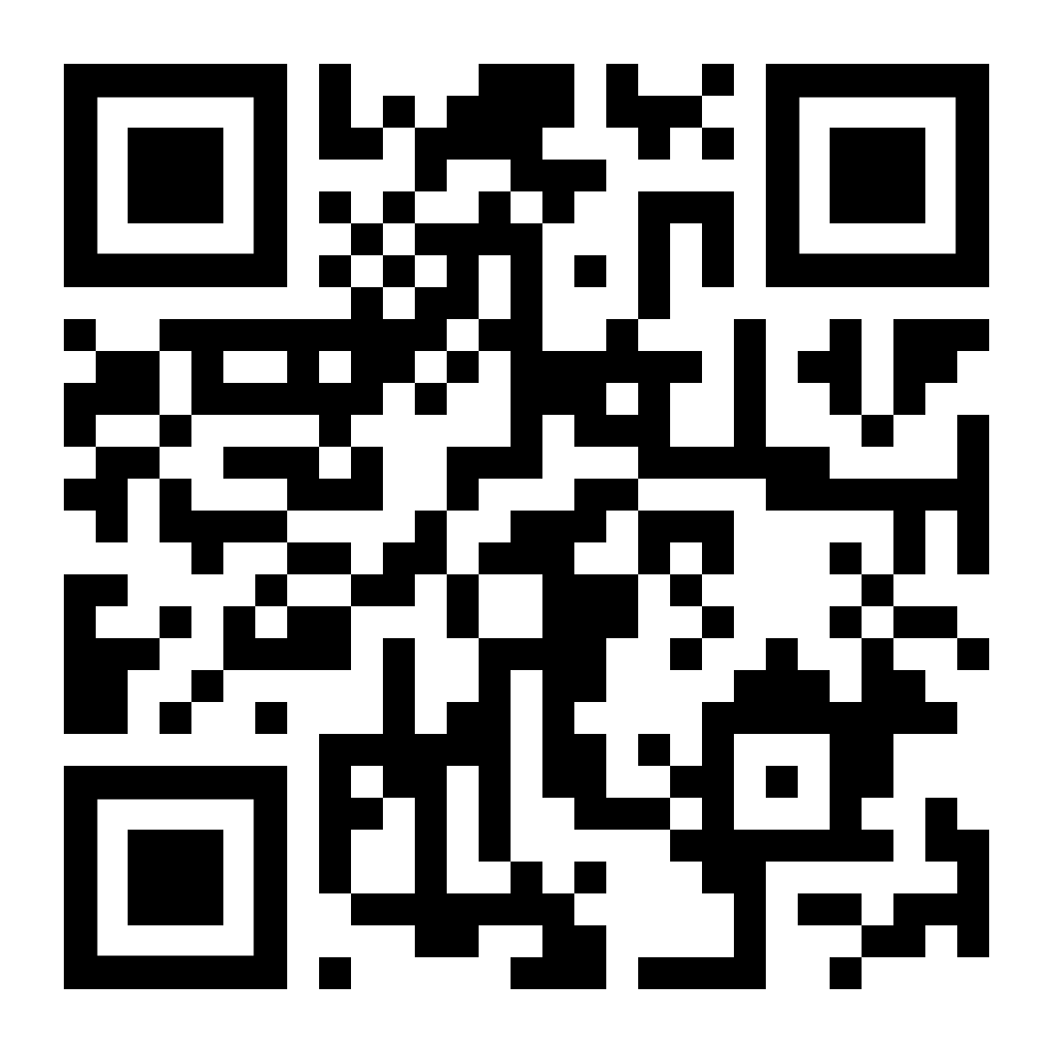
Interest Form

Slide 25
Thank you!

