Slide 1

Women in
Business Council
WIBC Body Meeting #1
1/27

Slide 2
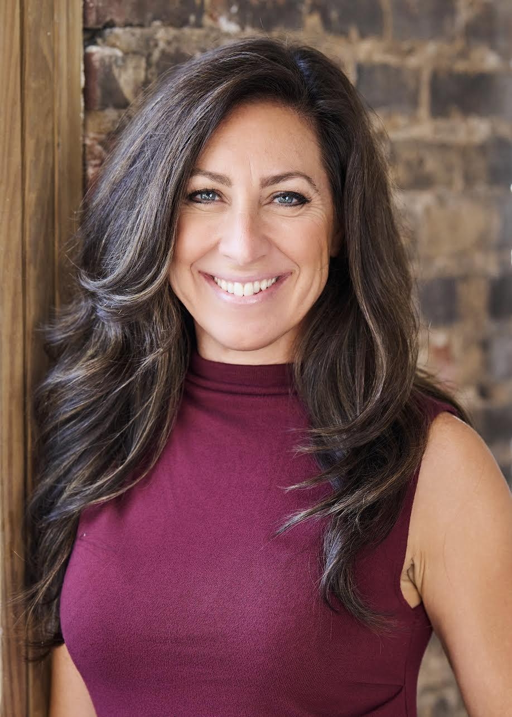
Felicia Perry Trujillo
Felicia Perry Trujillo is a Raleigh, North Carolina based creative entrepreneur, marketing strategist, and commercial real estate professional. She is best known as the founder and CEO of Food Seen, a boutique marketing studio specializing in food, beverage, and hospitality brands. With a background in photography and visual storytelling, Felicia has built a career helping businesses from local restaurants to international consumer packaged goods companies strengthen their brand presence through compelling content, strategic marketing, and thoughtful positioning.
Originally from Los Angeles, Felicia moved to Raleigh and quickly identified an opportunity to support the region’s growing food and hospitality scene. She began by offering photography and social media services to local restaurants, eventually expanding Food Seen into a full service marketing studio. Today, Food Seen offers photography, digital marketing, and consulting services, operating with a small, relationship driven team focused on quality, strategy, and long term partnerships.
In parallel with her marketing work, Felicia is active in commercial real estate, with a focus on retail and hospitality properties. Drawing on more than a decade of experience working closely with restaurateurs, founders, and operators, she brings a unique perspective to site selection, brand positioning, and tenant landlord relationships. Her work sits at the intersection of marketing, real estate, and community development, helping businesses not only tell their story but choose the right physical spaces to grow.
Beyond her professional work, Felicia is deeply engaged in mentorship and civic involvement. She serves as a student mentor at the NC State Entrepreneurship Clinic and is a board member of the Downtown Raleigh Alliance. She is also a frequent speaker and workshop leader, with recent engagements including the 2025 NC Wine Digital Media Summit and the NC Craft Brewers Expo, where she led sessions on marketing strategy and social media for winemakers, brewers, and entrepreneurs.

Slide 3
Structure- Points System
New Members
  Must obtain 16 points AND attend 4 out of 5 of the WIBternship meetings ( Case Comp cannot be missed)
  4 of those general points must be from WIBternship exclusive social events
Returning Members
  Must obtain 16 points
All Members
  Free t-shirt at 16 points
  Top 3 point earners will receive a gift card at the end of the semester

Slide 4
WIBternship
What is it and why is it required*?
WIBternship is our new member program for freshmen and sophomores (although any WIB member is welcome to attend any workshops).
We lay down the basics of employability in a low stakes environment, focused on learning and development.
Our speakers and contacts want hire our members, so it is important to employ our members with the necessary skills.
What is the time commitment of WIBternship?
Every other Tuesday at 7:30PM* (opposite weeks as the body meetings)
Is WIBternship a competitive/rush process?
No! All we ask is that you show up, are engaged, and do your best!

Slide 5

WIBternship Requirement
Tuesdays at 7:30PM
Location: Currell 107
We ask you make you best effort to attend all meetings as they will each teach an important skill! However we understand life happens so one (1) workshop absence is allowed. The case competition is required.
Dress code is business casual.
Once you complete the program - you’re an official WIBC member!

Slide 6
Next WIBternship
Next Tuesday February 2, 2026
Time & Location: 7:30 at Currell 107
Meeting Content: Professional Dress & Networking
Dress code: Casual
Also join us at our beginning of year party! Worth 2 social points!
Next Friday February 6, 2026
Time & Location: 11-1 at Russell
Event: Write a letter to your future self and meet other members

Slide 7
Social Event Policy
Policy to Social Events:
Members who register & don’t attend events (or cancel without warning) will receive a penalty.
Penalties:
1st Offense: Reminder & Warning
2nd Offense: 1 Point removed
3rd Offense: Restriction of events sign-up/registration

Slide 8

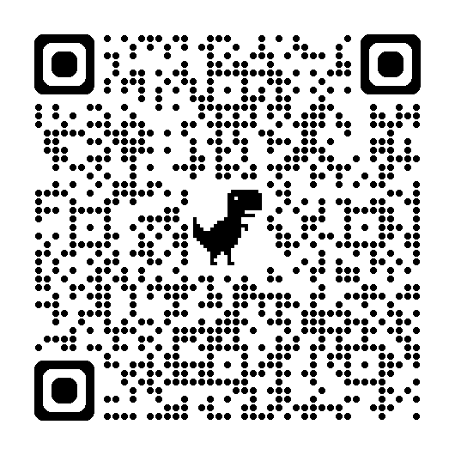
Outreach/R&R

Slide 9

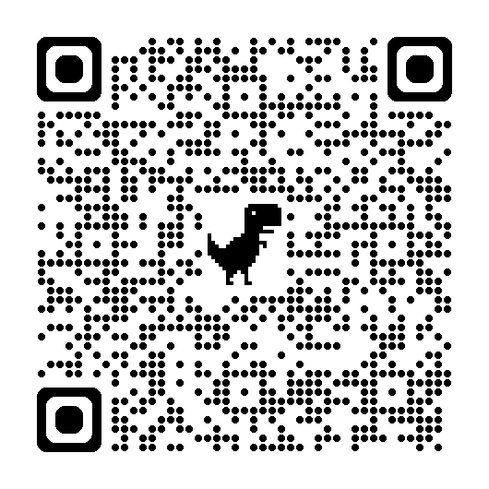
Outreach/R&R

Slide 10
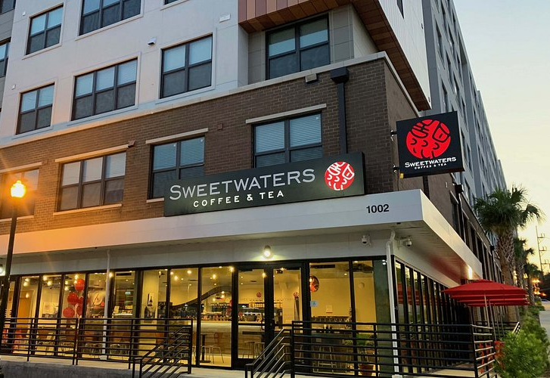
Outreach/R&R
Coffee tab!!
Sweetwaters on February 5 from 9:00am-11:00am

Slide 11

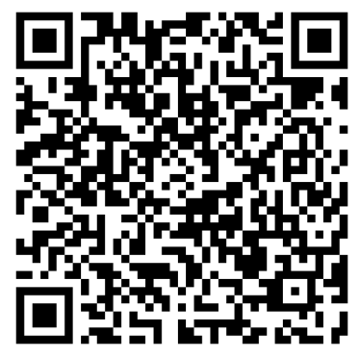
Mentorship
Sign Up Sheet

Slide 12
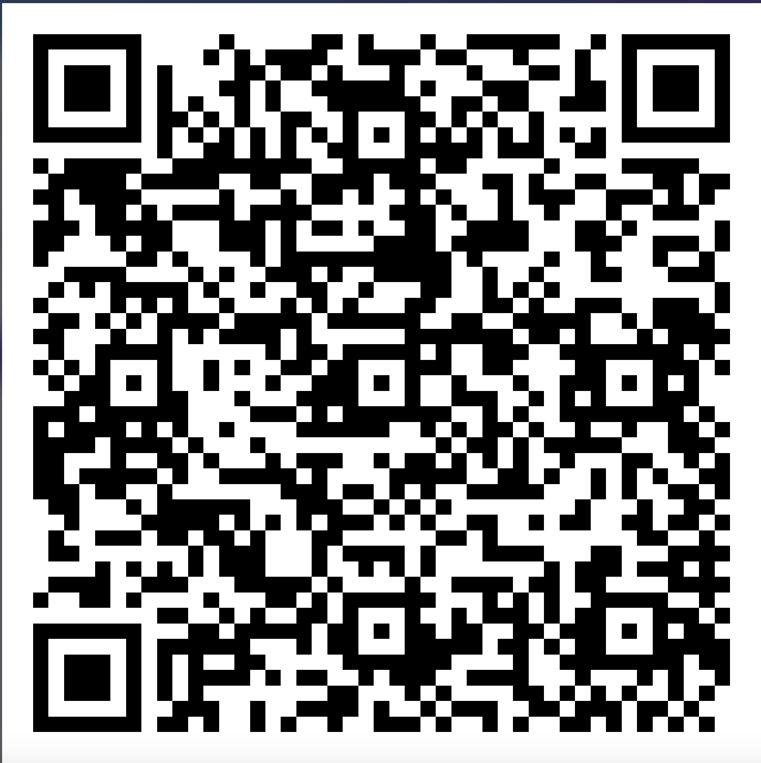
Mentorship
Mentorship Matching Form

Slide 13
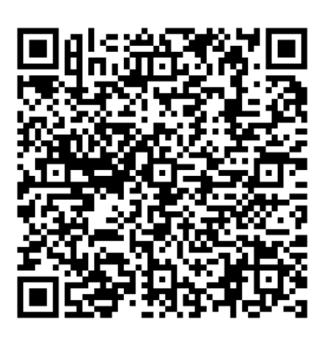

Conference
Register Here!
1 Month Away from Our 2026 Conference!
Date: Saturday, February 28th
Time: 10 AM - 4 PM (Check-in starts at 9AM)
Location: Darla Moore School of Business
✨ Keynote speakers & expert panels
✨ Networking session with recruiters from top companies
✨ Interactive professional development workshop
✨ FREE professional headshots and marketplace vendors
✨ FREE goodie bags, merch, and more!
Earn 3 WIBC points for attending!
FREE for all USC Students!!
Follow our IG @uscwibcconference for more updates!

Slide 14
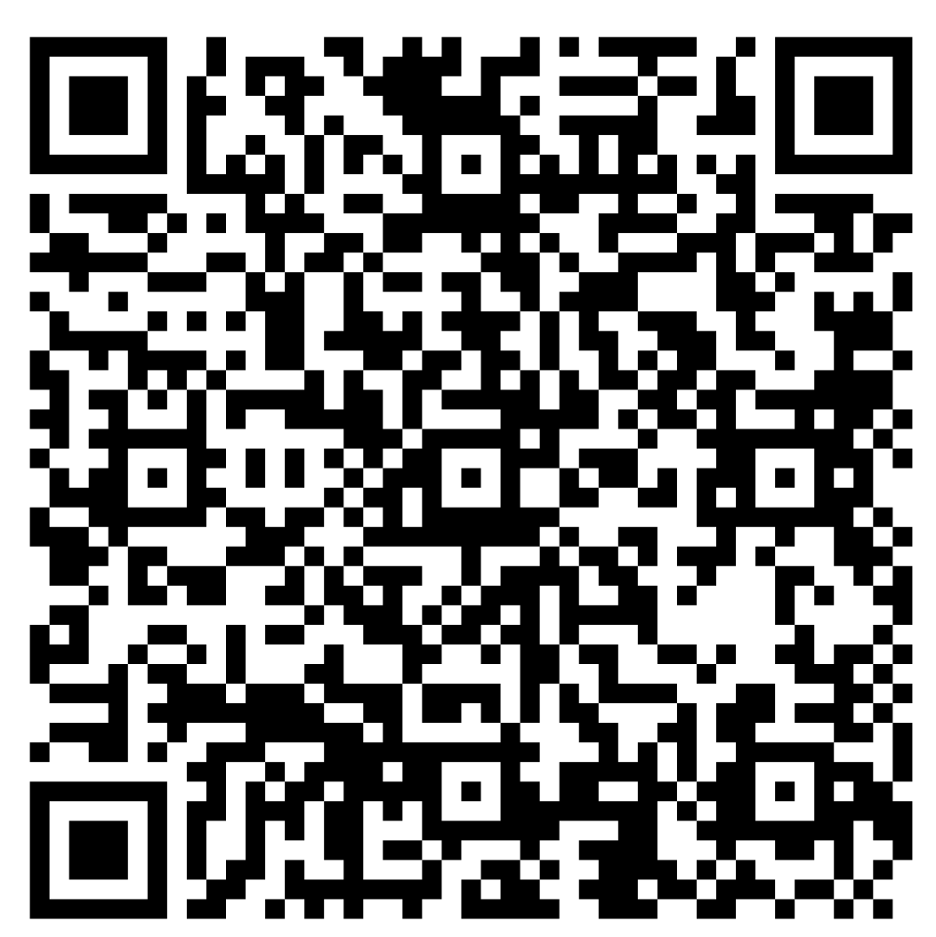
Conference
Want to Help Out at the Conference? Become an Event Ambassador!
Only 4.5-hour shifts
Super fun, low-pressure environment
Assist with check-in, guiding attendees, workshops, lunch, and more
Perks: 1 WIBC Point, FREE merch, breakfast/lunch/snacks, hands-on experience, networking, and a certificate!
Apply Here!
Due Feb 10 at 11:59 PM

Slide 15
Next Body Meeting
Meeting Etiquette:
During body meetings (virtual & in-person), please be as respectful as possible to our speakers and your peers.
This includes: showing up on time & staying engaged throughout the meeting
February 10 IN-PERSON
Time & Location: 7:30 at Currell 107
Speaker: Lauren Truslow, Barre3 Columbia Owner
Dress code: Business Casual

Slide 16
How to Join
Ready To Join?
ZELLE $25 dues to uscwibc@gmail.com
  Due February 3rd by 11:59pm
  Include your Name, USC email (WITHOUT the @email.sc.edu), and grade in the description
Request Membership on Garnet Gate
  We will only accept your request after you send dues

Slide 17
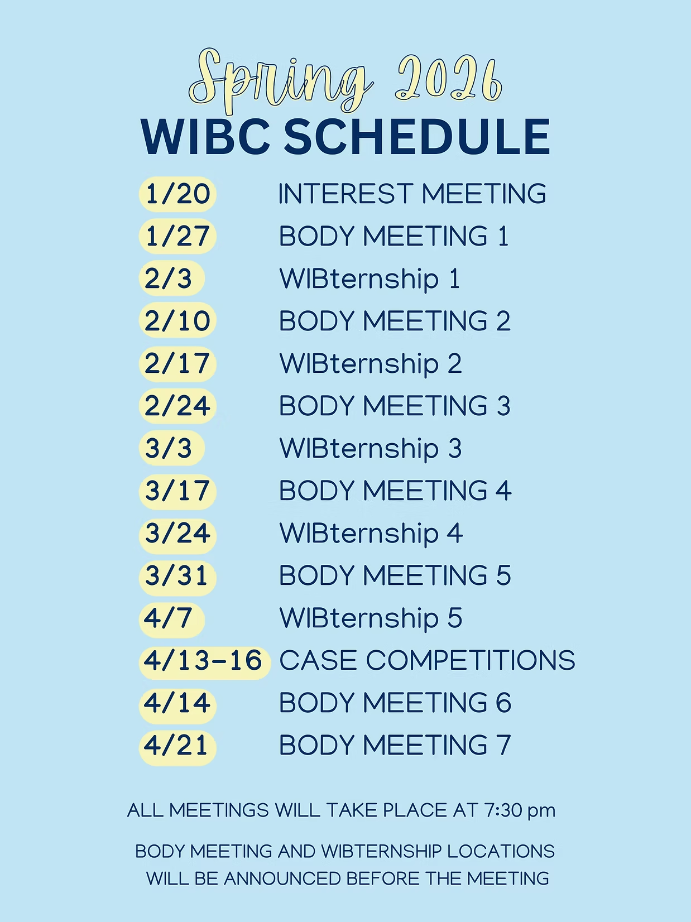
Spring 2026 WIBC Schedule

Slide 18
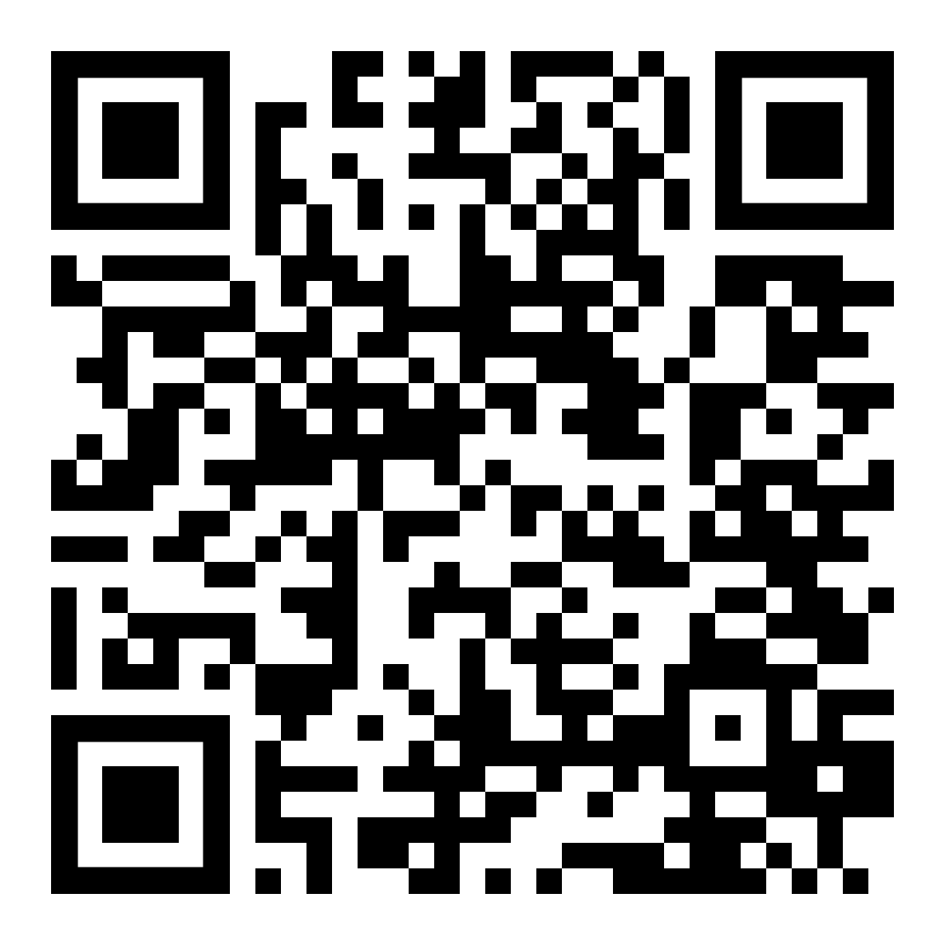
GroupMe - WIBC

Slide 19
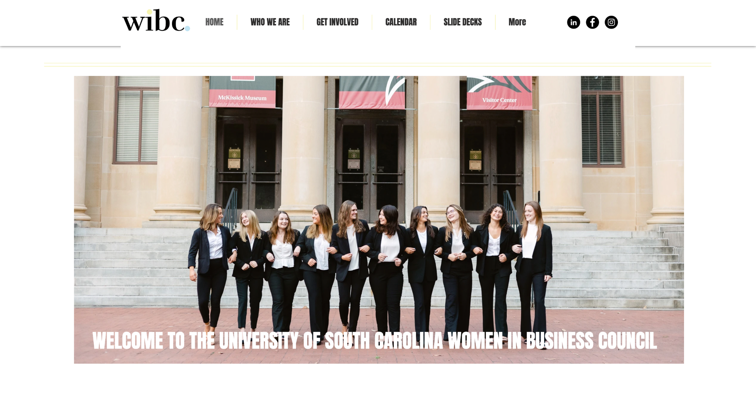
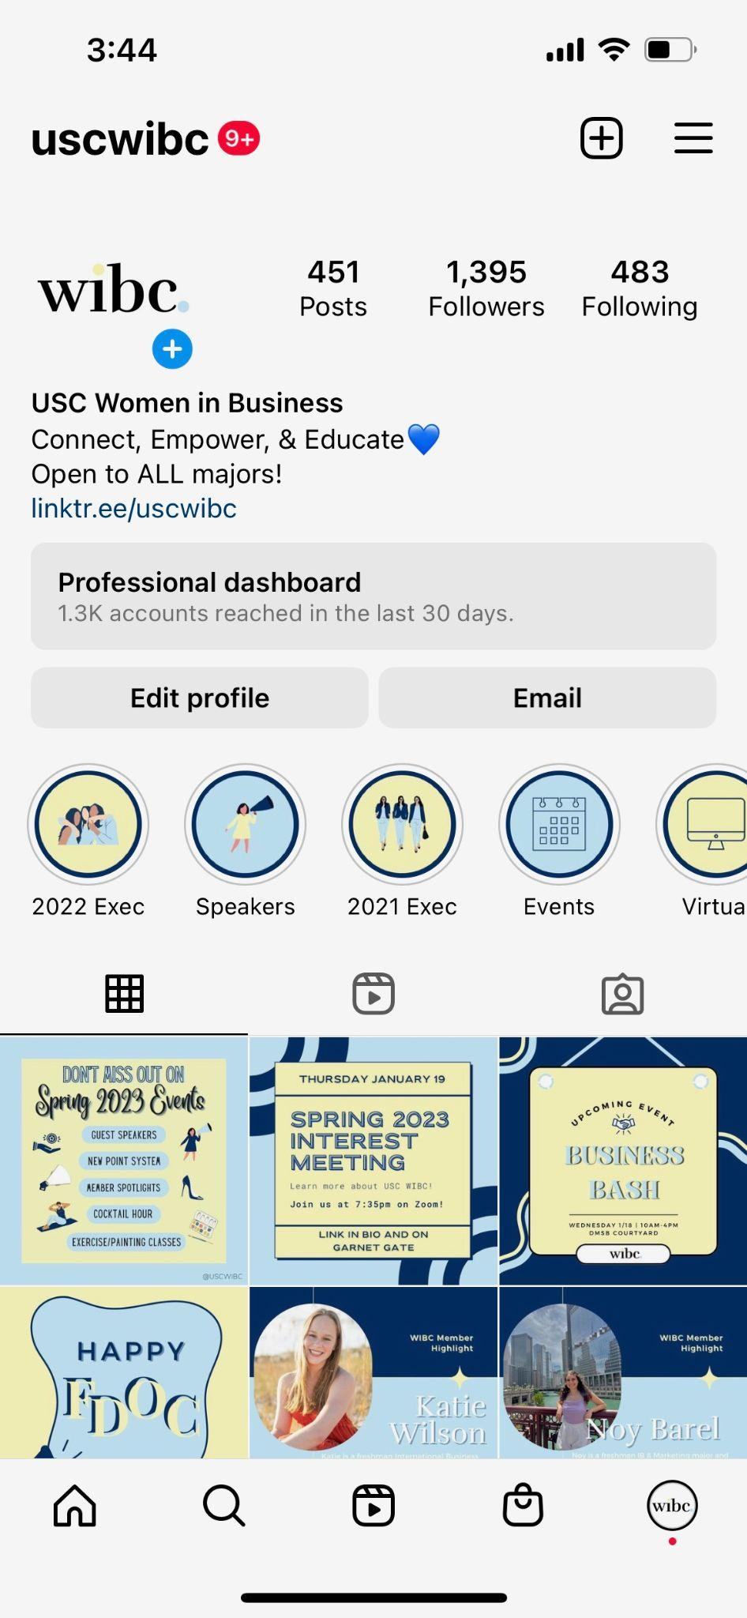
Where to Find Information
uscwibc.com
@uscwibc

Slide 20
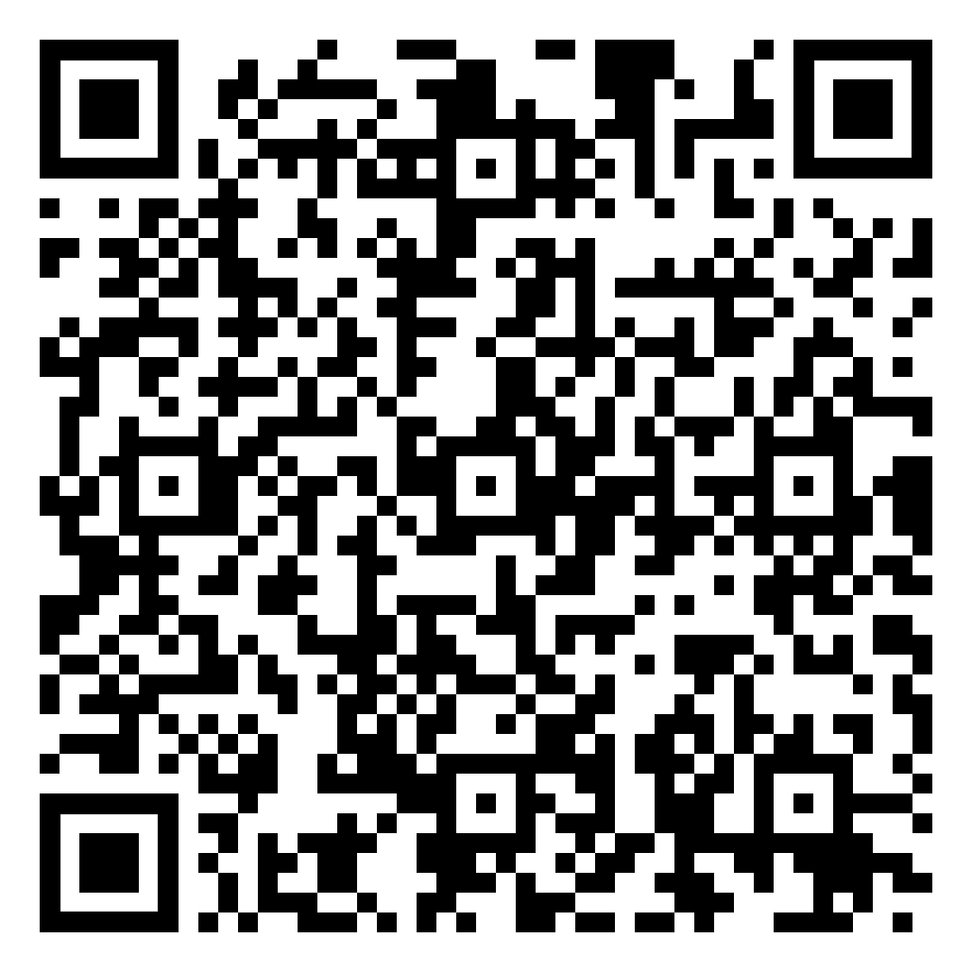
Attendance!

Slide 21
Thank you!

