Slide 1

WIBternship 1 | Sep 8, 2026

Slide 2
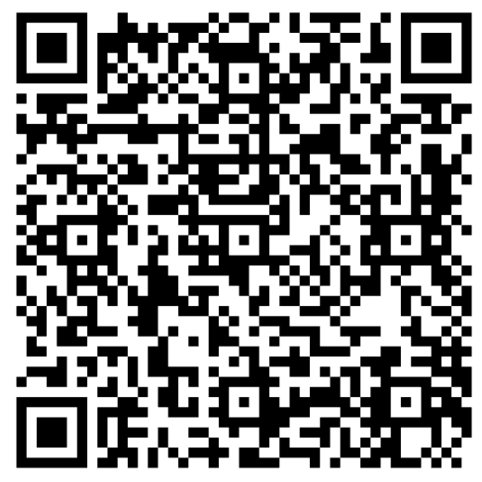
Mentorship
Great way to connect with other people in WIBC
Fun social events
Get paired with an upperclassman to answer any questions you may have
Form is open until 9/8 after Wibternship- pairings will be sent out on 9/11 in the AM so you can attend the first event mid-day on 9/11

Slide 3
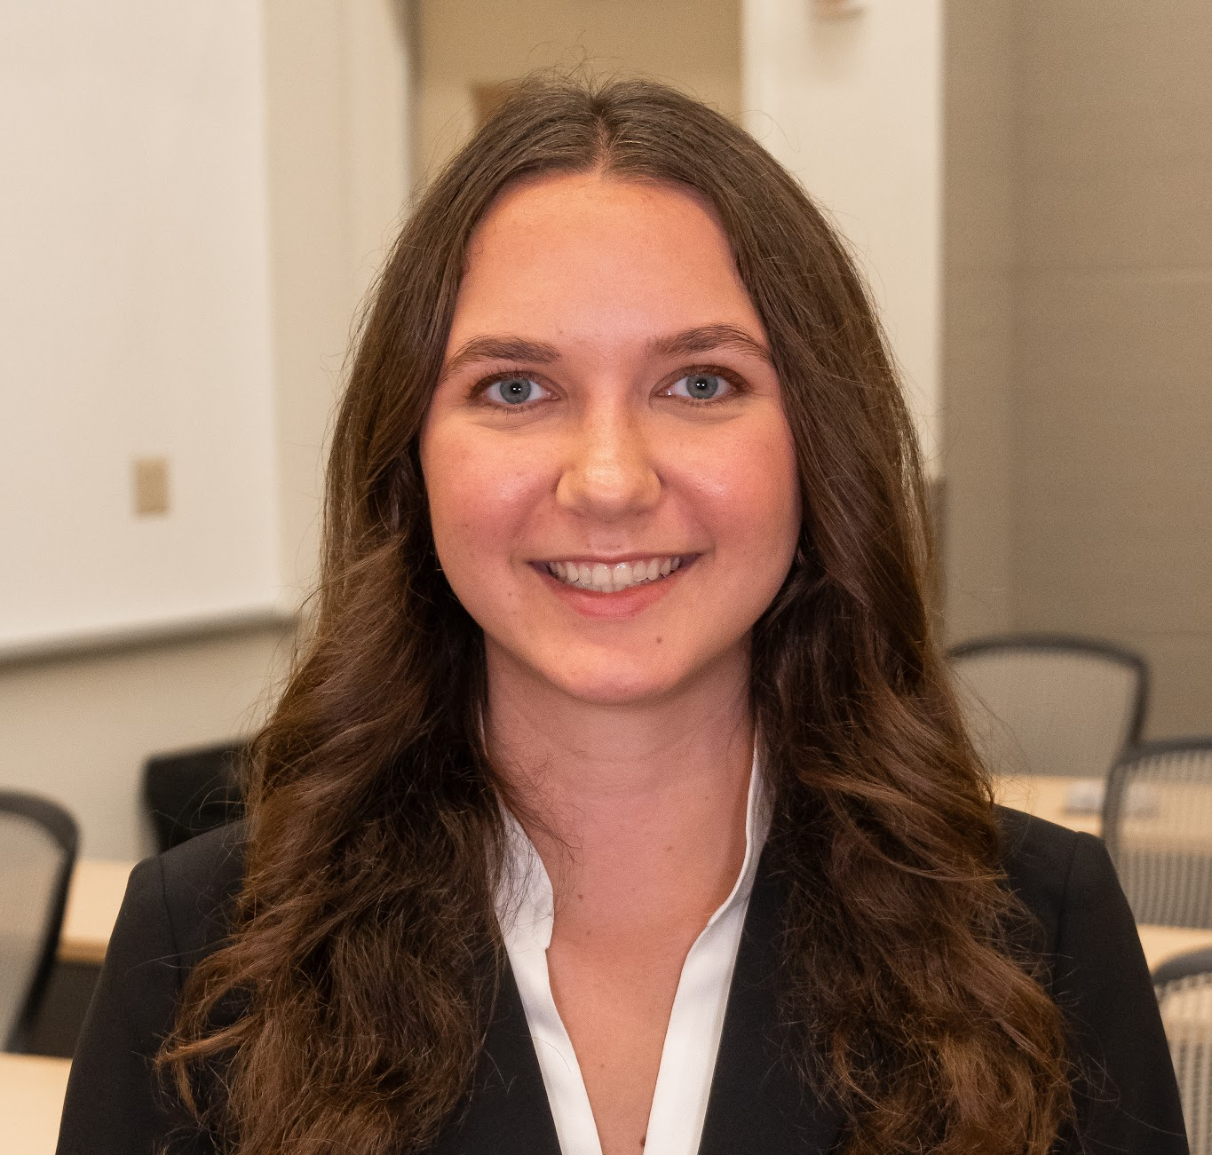
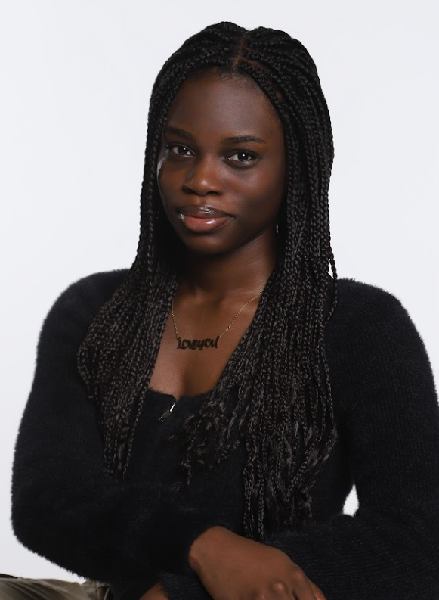
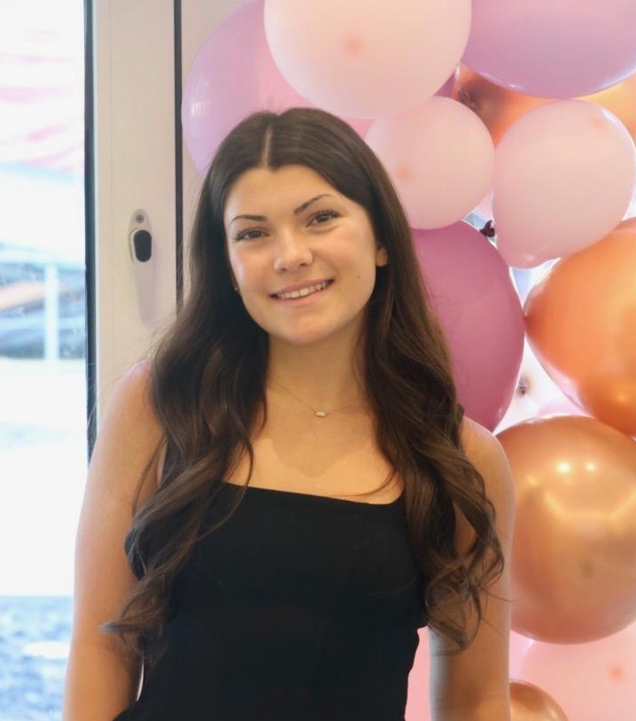
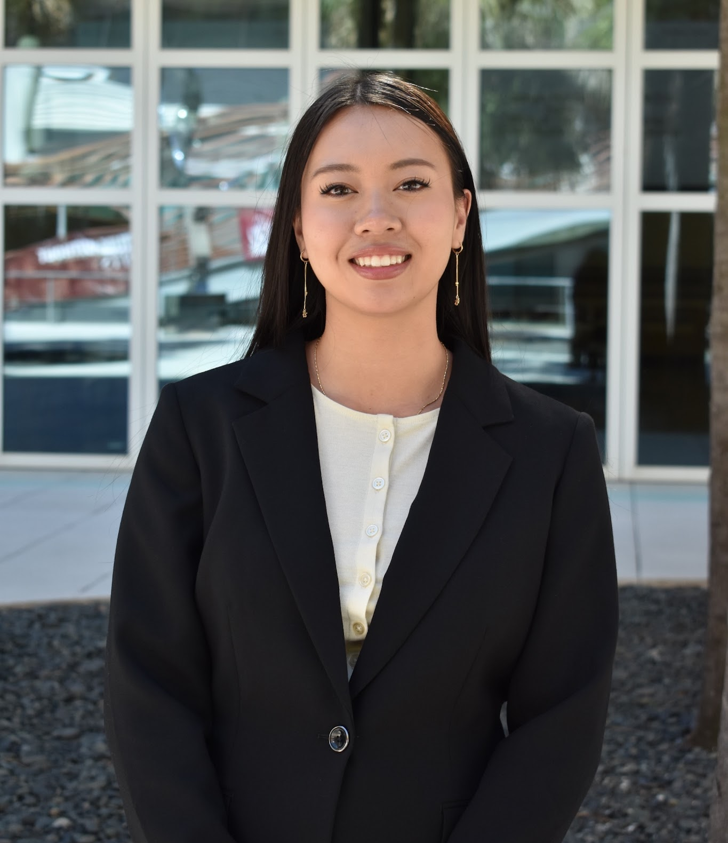
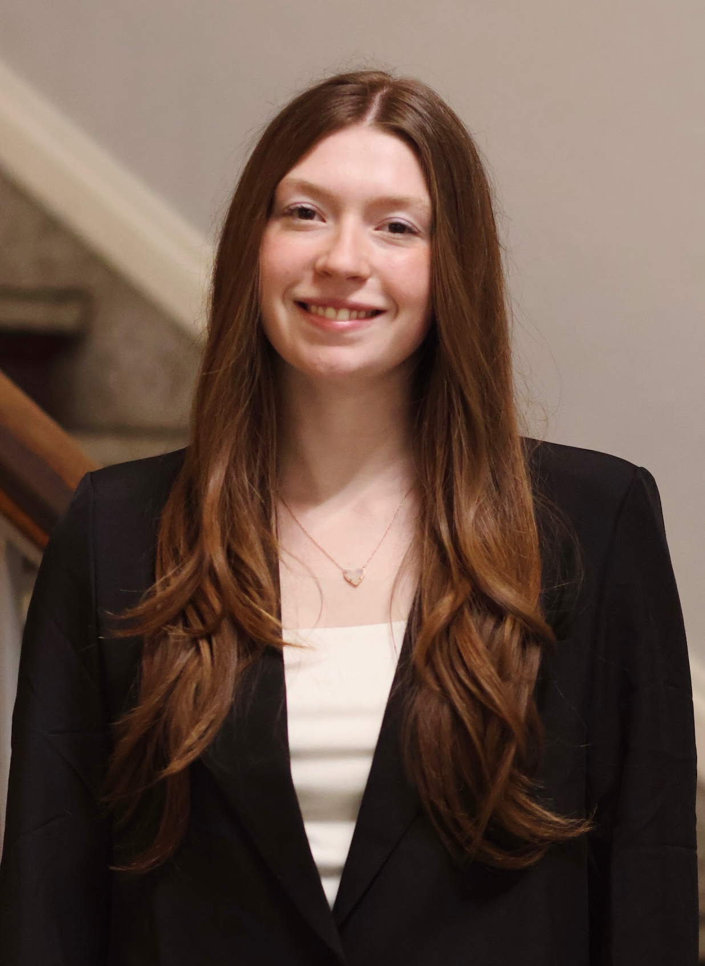
WIBternship Team
Katie
Anna
Cassie
Cynthia
Madison

Slide 4
Schedule
Week of 11/16/2026
9/8/2026
9/22/2026
10/6/2026
10/20/2026
11/17/2026
Professional Dress
Networking
Resume
Interview
Committee Panel
LinkedIn
Headshots
Case Competition Tips
Major Exploration
Internship Search
Case Competition

Slide 5
Today’s Agenda
Meeting Expectations
Professional Dress
Networking
Announcements

Slide 6
Expectations

Slide 7
WIBC
WIBC body meetings every Tuesday for ALL members
  WIBternship meetings are the alternate Tuesday for new members
WIBternship is a required program within WIBC for first-semester freshmen and sophomores to complete
Attendance is required at 4/5 of the WIBternship meetings
  The case competition is required
  2 approved social events required for merch
NOTE: Once you complete WIBternship at the end of this semester, your attendance to WIBternship meetings and related social events are no longer mandatory.

Slide 8
Point Requirement
All members of WIBC are expected to get 16 points to be a member in good standing and receive merch at the end of the semester
WIBternship members must get 2 of those 16 points from WIBternship approved events
WIBC Body meetings are usually 3 points
WIBternship events are all 1 point
Other events mentioned at the body meetings are 1-3 points depending on the event
WIBternship meetings are NOT worth points
WIBternship case competitions are NOT worth points
Top 3 point earners receive a gift card!

Slide 9
Excuses
If you are missing a body meeting with a valid excuse you can email uscwibc@gmail.com
If you are missing a WIBternship with a valid excuse you can email uscwibternship@gmail.com
Do not DM the instagram if you aren’t going to make it to a meeting
If you do not have a valid excuse you do not need to email, as long as you meet the point requirements you will be a member in good standing

Slide 10




Online Meetings
Dress appropriately
Choose a good location
Keep your camera on
Test your technology beforehand

Slide 11


In Person Meetings
Respect Our Speakers
NO PHONES OR LAPTOPS OUT (UNLESS INSTRUCTED TO DO SO)
DO NOT WALK IN FRONT THE SPEAKERS
NO SIDE CONVERSATIONS

Slide 12
Professional Dress

Slide 13
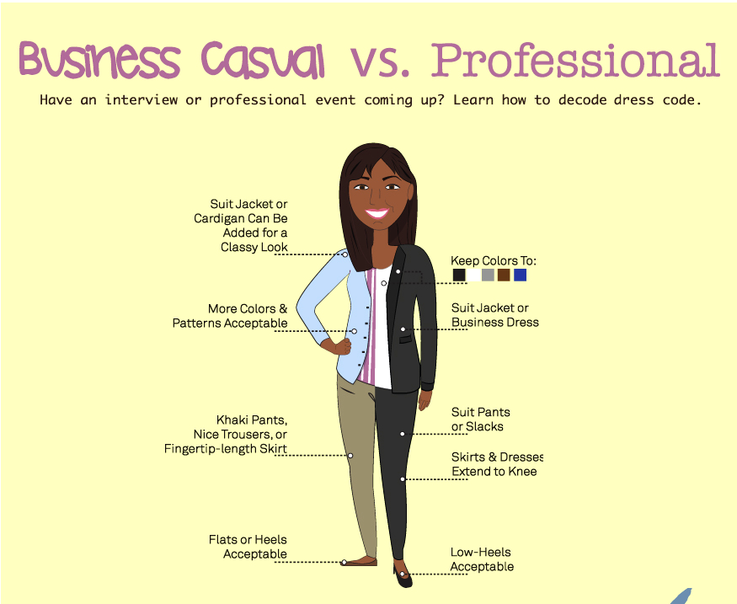

Slide 14
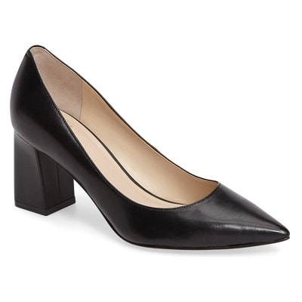
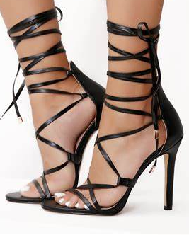
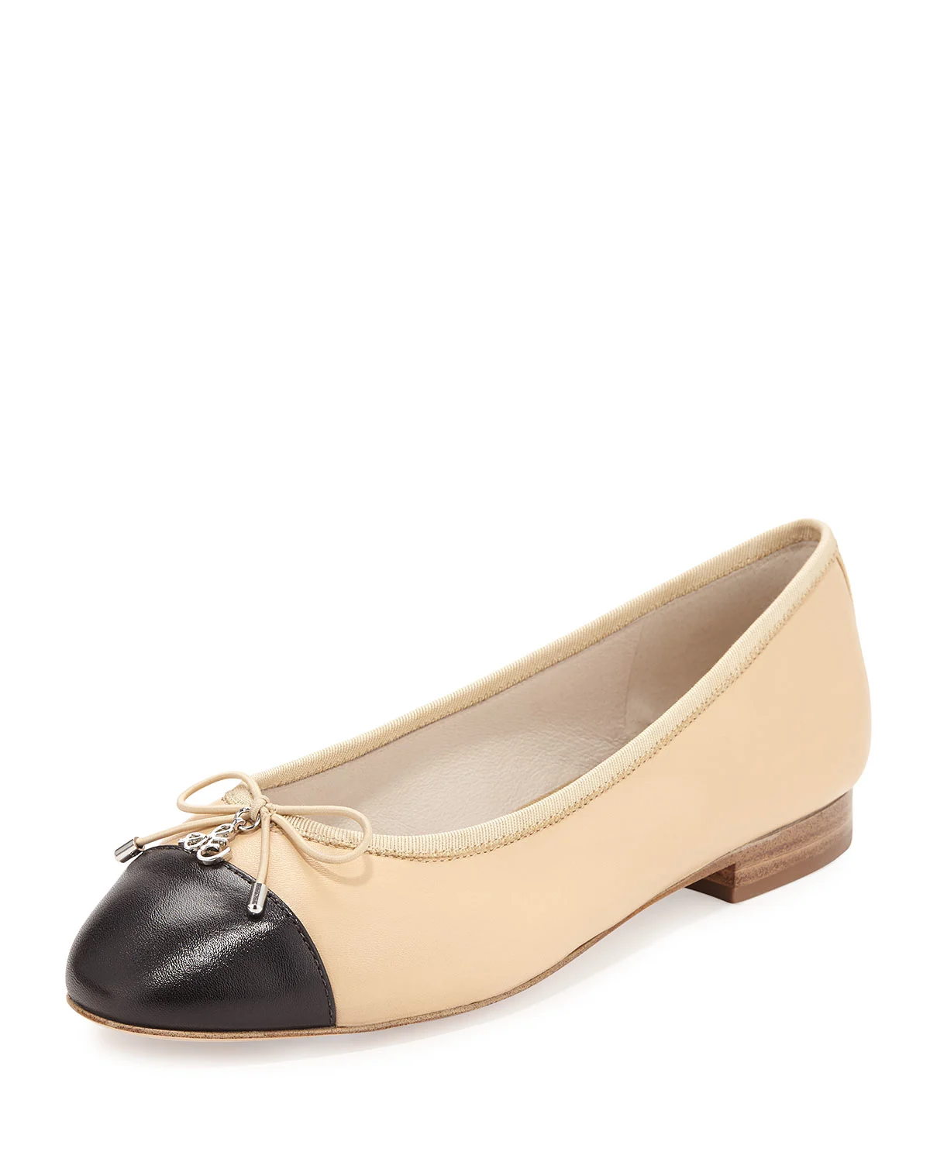
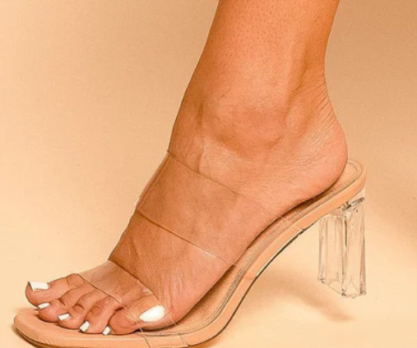
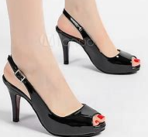
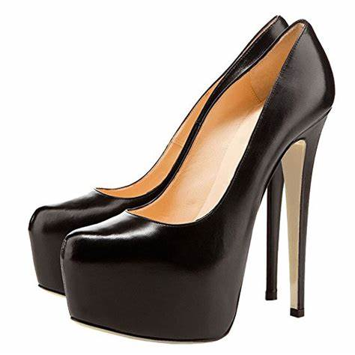
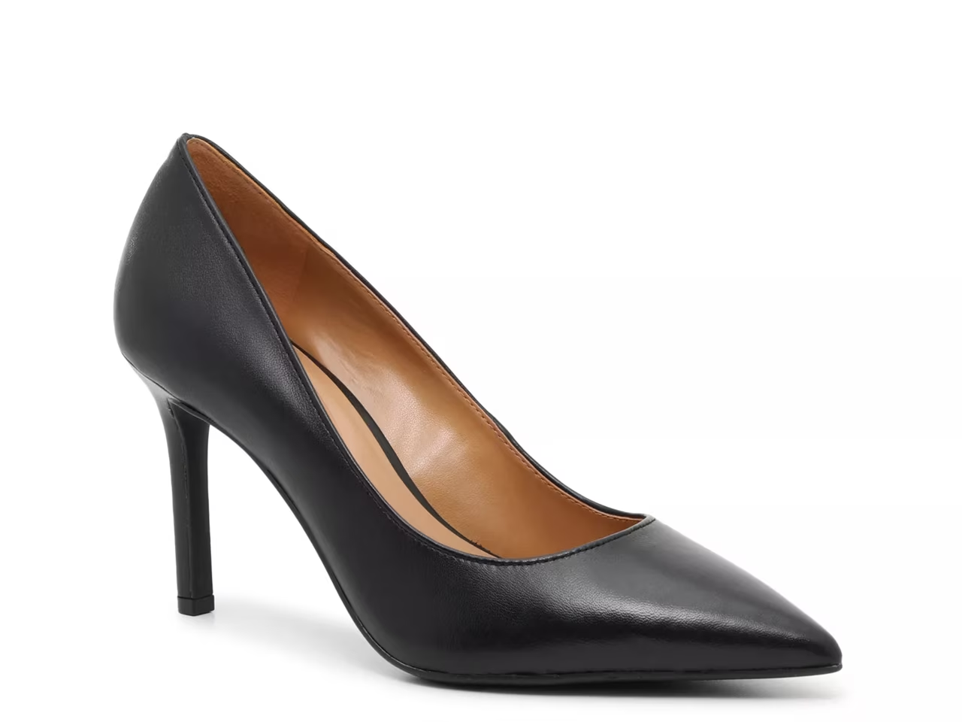
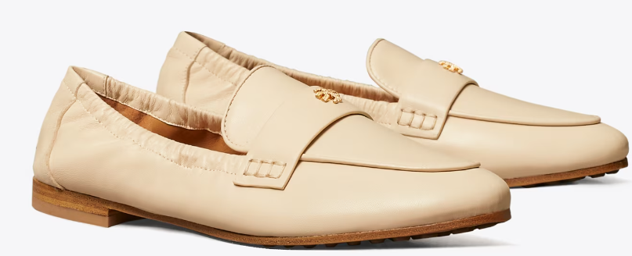
Footwear
Yes
No
***NO SANDALS OR FLIP FLOPS***

Slide 15
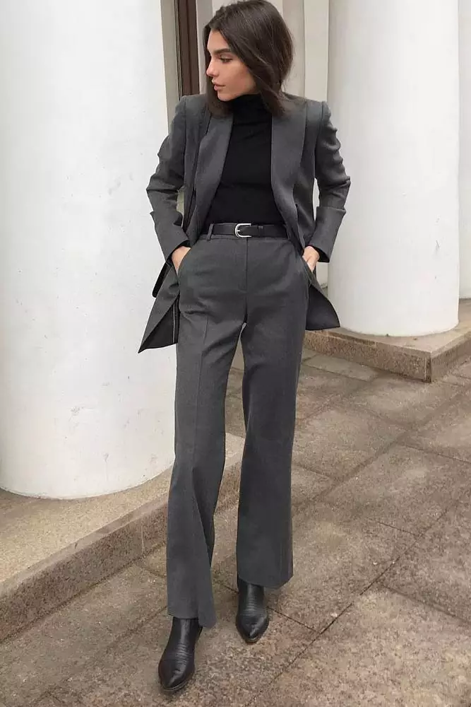
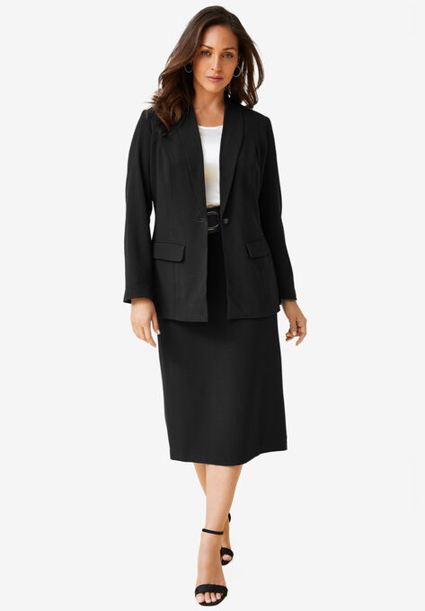
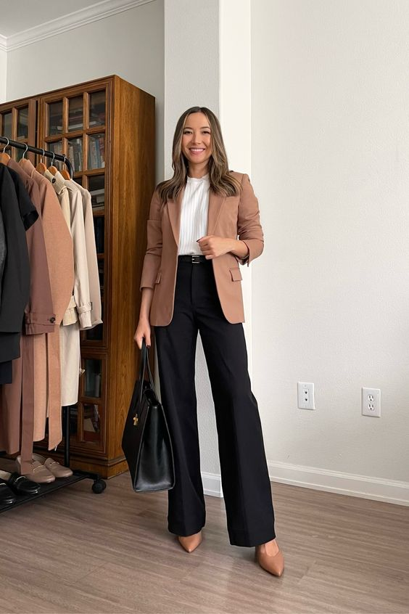
Business Professional

Slide 16
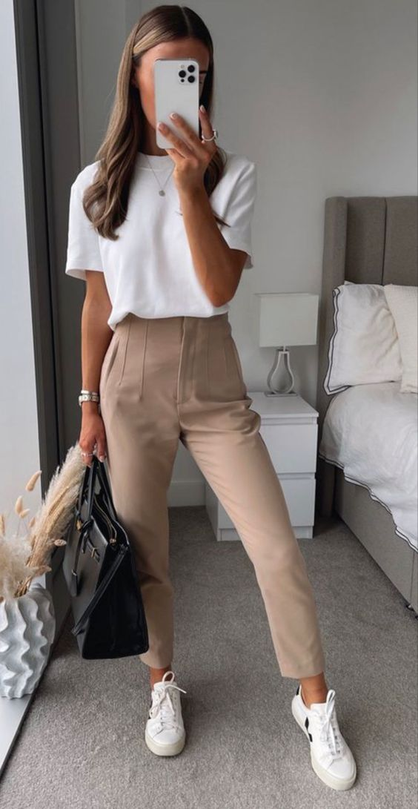
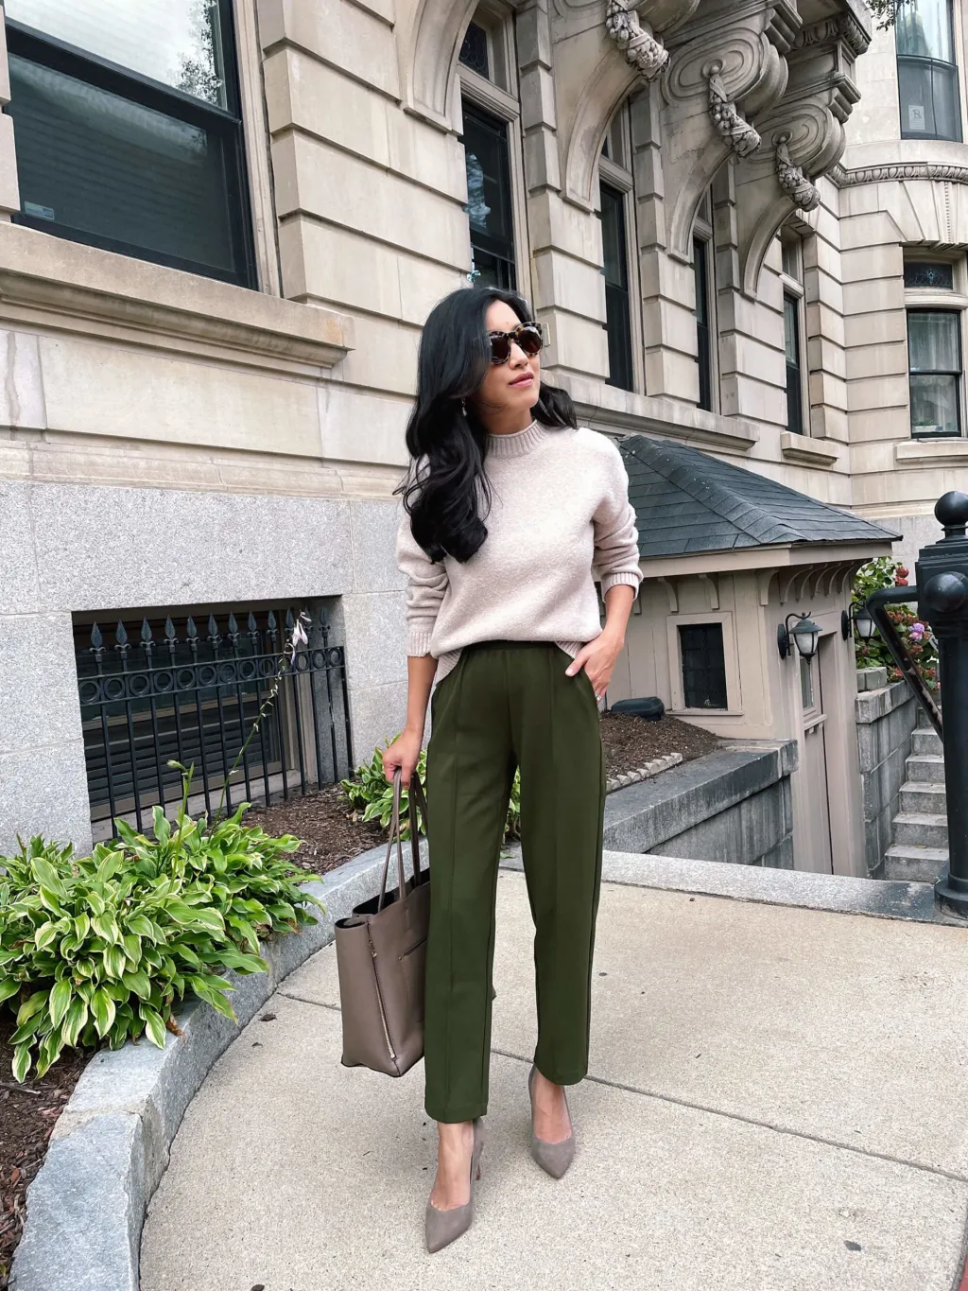
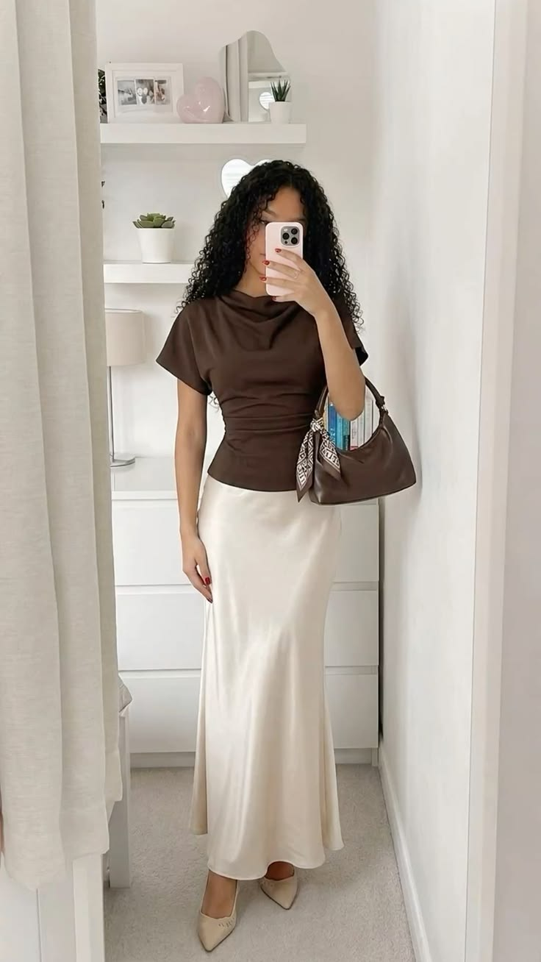
Business Casual

Slide 17
Gamecock CommUnity Shop
Provide the building blocks
Become Successful
Everything is FREE

Slide 18
Gamecock CommUnity Shop
03
Checkout & Receive Points
Collect & Organize Donations
Want to Donate? Amazon Wishlist
01
02
Student Shop
**Bring USC ID**
4000 Suite, Carolina Coliseum

Slide 19








Recommended Stores

Slide 20




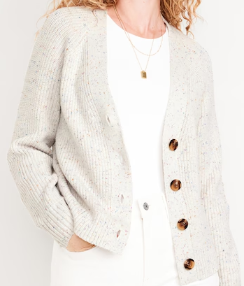
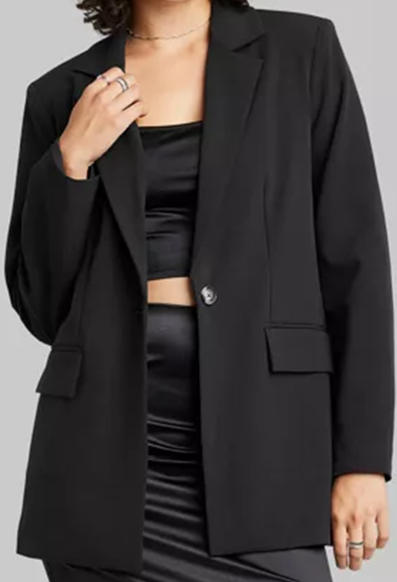
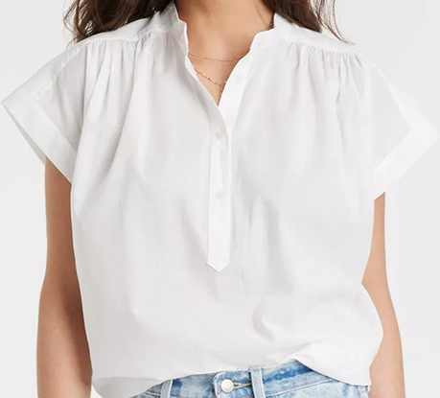
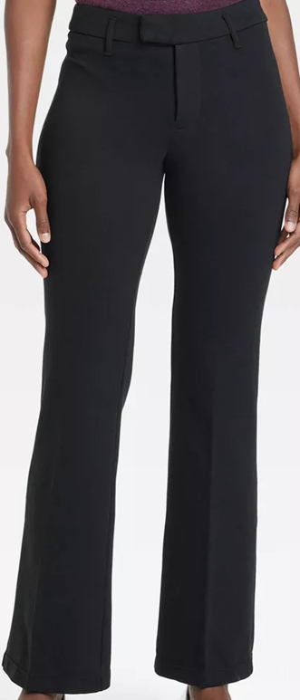
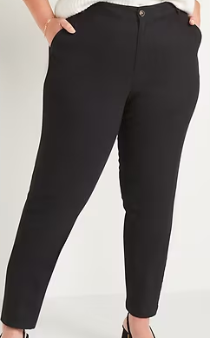
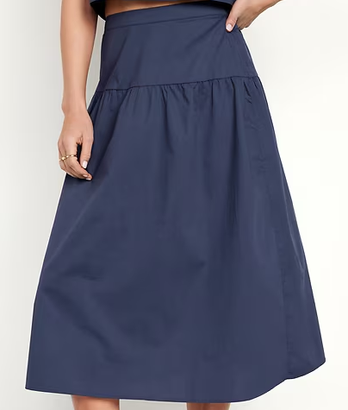
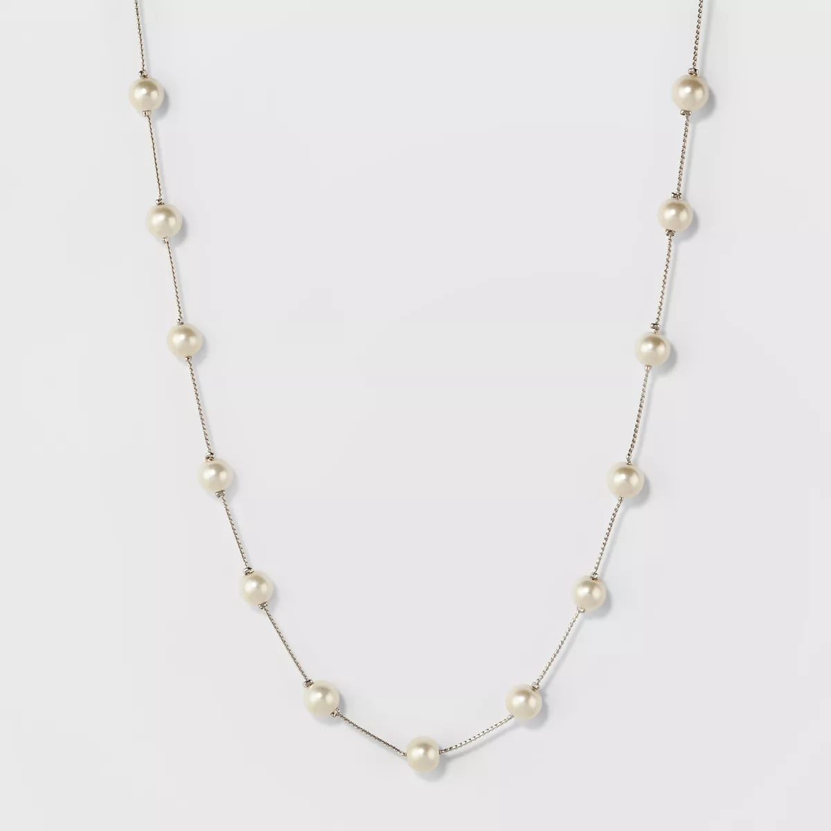
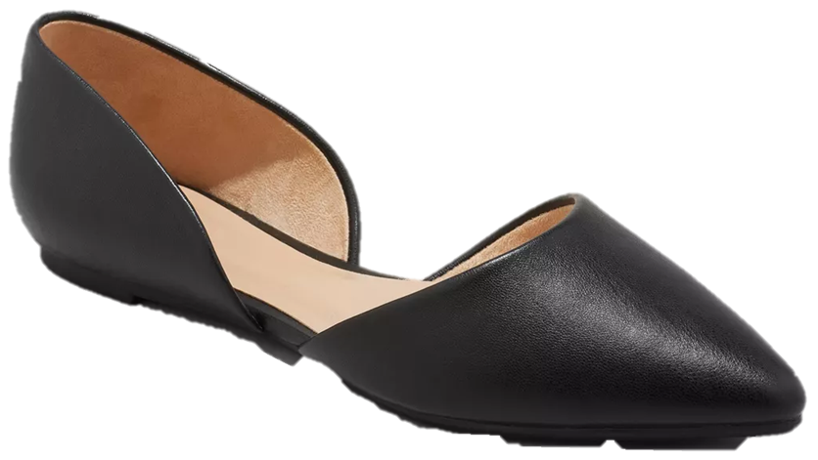
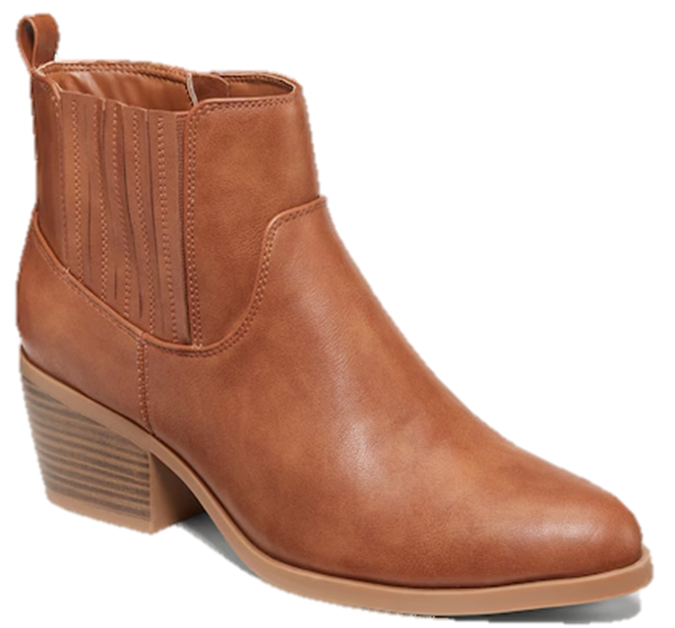
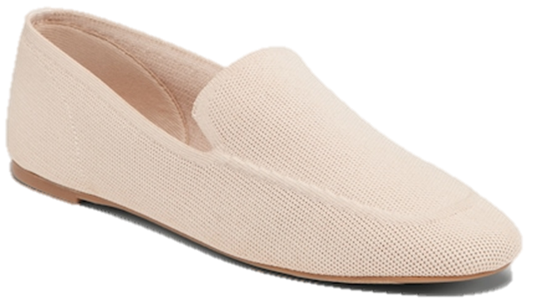
Building Your Closet

Slide 21
Reminders
This takes TIME
Confidence
Sizing varies with brands
Use your resources

Slide 22
Professionalism Tips
Overdressed > Underdressed
Look at the Company Culture
Shake with RIGHT Hand

Slide 23
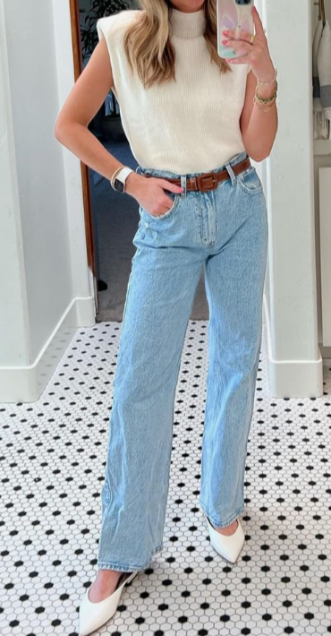
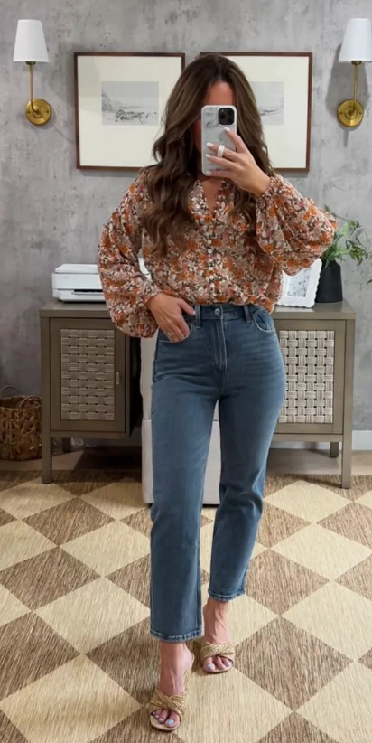
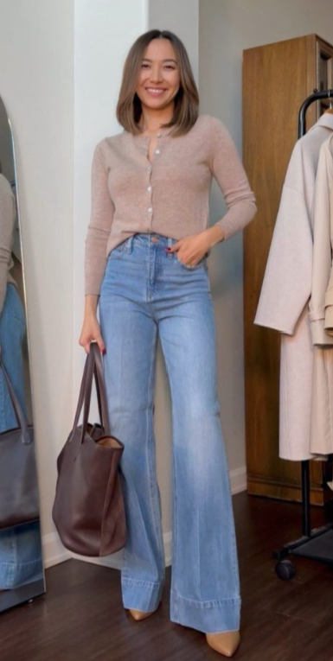
Company Culture
Pay attention to company culture when deciding what is appropriate to wear. Ask around if jeans or more casual clothing is ever appropriate for your job. Never assume!!
This can happen when clients don’t come into the
office often.

Slide 24
QUIZ TIME!!
Pair up in teams of two
There is a prize for the top three teams!
Take Quiz

Slide 25
NETWORKING

Slide 26

How to Give a Handshake
Firm, but not bone-crushing
Last about 3 seconds
Maintain good eye-contact with the other person
After shaking, you release and continue the introduction

Slide 27





Personal Brand
Step 2
Personal brand audit
Step 4
Embody your brand
Step 1
Define your purpose
Step 3
Construct a narrative
Step 5
Find your community

Slide 28
Guess the Personal Brand:
Purpose → Wanted to build a beauty brand for every skin tone
Audit → Google her, and you’d find a “pop superstar, 8 Grammys,” but she believed the beauty industry was failing at diversity
Narrative → From a teen singer from Barbados, to a global pop star and now beauty mogul
Embody → Fenty is her brand and namesake
Community → Women of color who found represented enough to buy from her brands

Slide 29
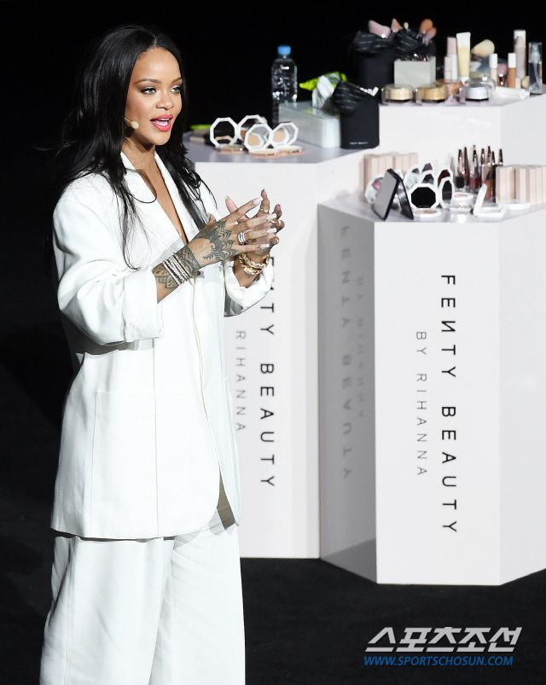
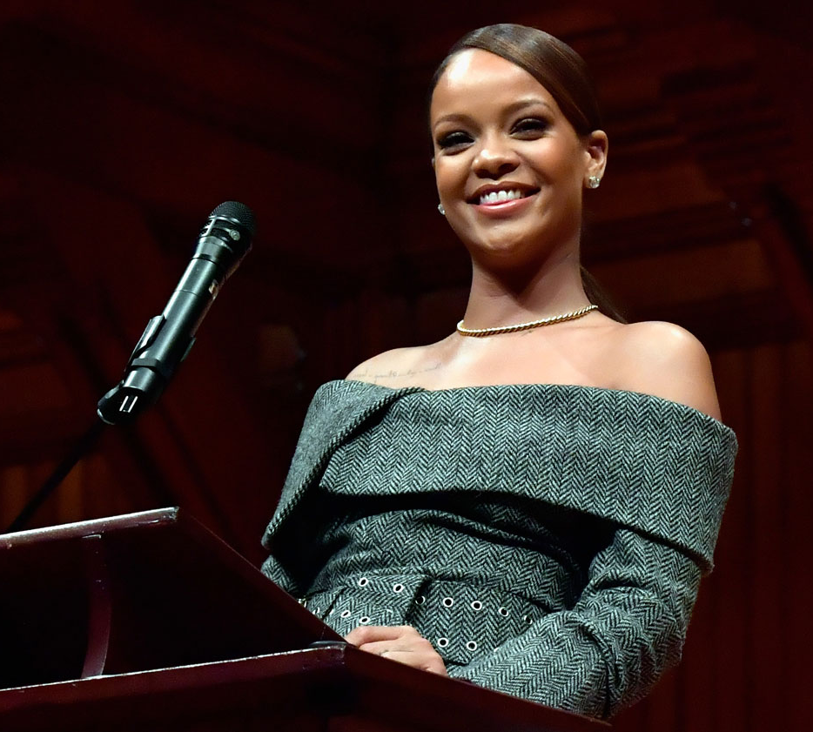
Answer: Robyn Rihanna ‘Fenty’

Slide 30
Confidence Tips
Sleep well, exercise regularly, and maintain a balanced nutrition
Identify and challenge negative self-talk
Surround yourself with positive people
Set achievable goals and celebrate your progress

Slide 31
Networking
The action/process of interacting with others to exchange information and develop professional or social contacts
Connections you make
Potential job and internship opportunities

Slide 32
How to Start
Capitalize on friends and family connections
Utilize LinkedIn or MooreConnect to connect with alumni
Talk to people in classes or clubs
Attend University/Moore school events
Get involved within the Moore School
Get to know your professors

Slide 33
Elevator Pitch
Hello! My name is ____________ (full name), and I am a ____________ (class year, major area of study), with expertise in ____________ (key functions, skills, capabilities). My strengths include ____________, ____________, and ____________ (unique professional competencies), and I am well-versed in the areas of ____________ (specific industry/field/techniques), because of my experiences in ____________ and ____________. I am interested in this company because of ____________, ____________, and ____________.

Slide 34
“Tell Me About Yourself”
Elevator Pitch (PETS)
P - what type of professional are you?
E - what expertise/experience do you have?
T - what types of organizations/fields have you worked for?
S - what are your strengths/skills?
This is another way to think about an elevator pitch. Do what works for you!

Slide 35
Attending a Networking Event
Define Your Goals
Preparation and Mindset
Are you looking to just meet people, looking for a job currently?
Polish Your Online Presence: Ensure your LinkedIn profile is current to make a strong impression.
Have a completed/updated linkedin (will go over in future meeting)
Prepare Your elevator pitch (more in a later slide)
Have copies of your resume (will go over in future meeting)
Research Attendees: Know what companies will be at the event and plan out a few people to talk to, maybe the website will have the recruiters name listed. Know the company's mission.
Know WHY you are attending an event to guide your focus!

Slide 36
Attending a Networking Event
During the Event
Be Strategic: Approach people standing alone, or look for gaps in conversations. Sometimes a firm will be popular and busy and you will have to wait a minute.
Listen Actively: Ask open-ended questions that require more than 'yes' or 'no' answers.
Come Prepared: Have questions ready to ask an employer/recruiter.
Offer Value: Tell them about yourself and why you might be interested in working for them
Resume Ready:Offer them a copy of your resume (if you want to stand out more have personalized resumes for each firm)
What is company culture like?
What are key skills for this role?
What does your day to day look like in your current role?

Slide 37
Upcoming Networking Event
DMSB
Fall 2026 EXPO
September 30, 2026
10am-4pm
HRSM
Spring 2027 Expo
TBD
12-4pm
USC STEM
Career & Internship Fair
(Fall 2026)
September 9-10, 2026 11-4pm
All Majors Career & Internship Fair
(Fall 2026)
October 21,2026
11am-3pm
*****More information and registration can be found on Handshake*****

Slide 38
Attending a Networking Event
Building Long-Term Connections
Informational Interviews: Set up casual conversations to learn from others in your industry. (more on a later slide)
Be Consistent: Networking is a long-term investment, not a one-time activity
After the Event (Follow-Up)
Jot Down Notes: Immediately note details about new contacts to make follow-ups personal.
Connect Promptly: Reach out via LinkedIn or email within 24-48 hours.
Maintain the Relationship: Send check in and congratulations on achievements messages, share relevant articles, or ask for updates to keep the connection alive.

Slide 39
Informational Interviews
How to ask someone
& prep tips
Research
  Company website, LinkedIn, Google
Prepare questions you are actually interested in knowing
Always have an ask at the end!
What is it?
A Meeting
To learn about a Profession or Business

Slide 40
Informational Interview Questions
What does your day to day at work look like?
What do you like about your job?
What do you not like?
What is the natural career progression of the role?
What are things I can do/learn while I’m in school that could prepare me for a role in this industry?
How is success typically measured for someone in this field?

Slide 41
Post Informational Interview
Immediate
Send follow-up email or handwritten letter
Attach Resume
Secondary
Connect on LinkedIn
Follow - Up
Remain in touch
*Keep the relationship strong*

Slide 42
NETWORKING PRACTICE

Slide 43
Networking Questions
Timer
Introduce yourself (Name, Major, Hometown)
Why did you choose USC?
What other organizations would you like to get involved in?
If you could go anywhere with anyone but it has to be a place you have already been with people you already know, where would you go and who would you go with?
What is your dream job?
If you could choose a major other than business what would you pick? (or if you are not studying business which business major would you pick?)
If you have LinkedIn, feel free to exchange contact information.

Slide 44
Networking
Game time

Slide 45
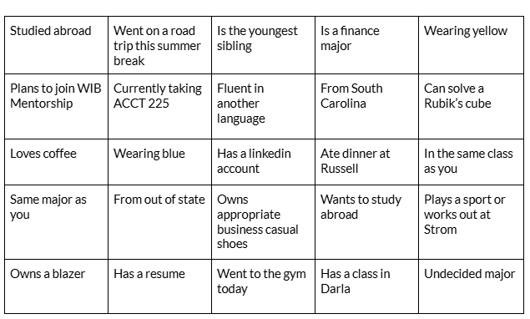
Networking Bingo
Instructions:
Walk around the room and meet people that have done these things. Have them sign their name in a box that applies to them. Only one box per person!
Timer

Slide 46
Announcements

Slide 47
How to Join
Ready To Join?
Zelle $25 dues to uscwibc@gmail.com
  Due TONIGHT at 11:59pm!
  Include your Name, USC email (without @email.sc.edu) , PHONE NUMBER, and grade in the description
Request Membership on Garnet Gate
***We will only accept your request after you send dues***

Slide 48
WIBC Dues
These are due tonight!!!
CFO Taylor Wolf
After filling out attendance you will have the chance to pay cash dues
Zelle $25 dues to uscwibc@gmail.com
Include your Name, USC email (without @email.sc.edu) , PHONE NUMBER, and grade in the description

Slide 49
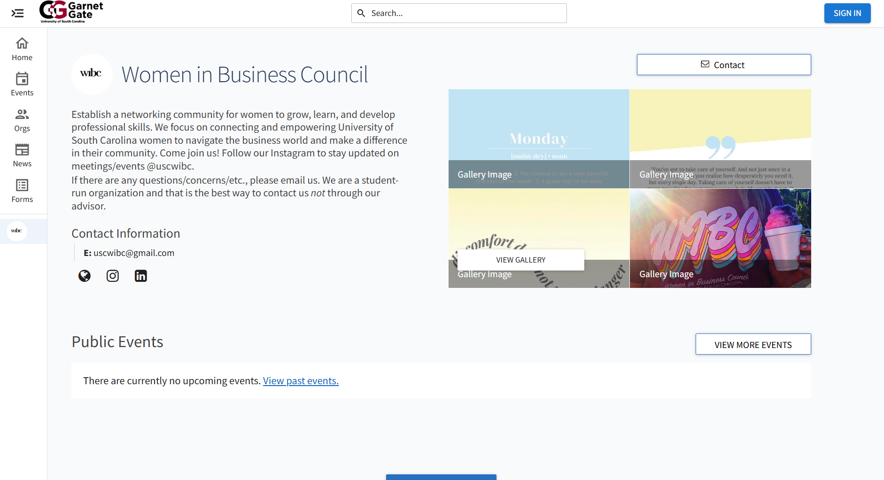

Garnet Gate
To join WIBC,
Go to Garnet Gate and login with your USC credentials
Type “Women in Business Council” in the search bar
Click ‘Join’

Slide 50

Structure- WIBternship
Attendance Requirement
  Must attend 4 out of 5 of the WIBternship meetings
  Attend 2 WIBternship/Mentorship events
  Case Competition

Slide 51

1st WIBternship Social Event!
Friday, September 11th
12-2pm
In Russell 302
Letter To
Future Self
Come stop by, grab snacks, meet the WIBternship committee and other members including your mentor
Write a letter to your future self for the end of the program!
1 point!

Slide 52
Looking Ahead
Upcoming Events
Friday, September 11th - Letter Writing / Mentor & Mentee Meet
12-2 in Russell 302
Wednesday, September 23rd - Resume Workshop / Dirty Soda
7-8 in Russell 315
Wednesday, October 7th - Paint & Sip with Mentorship
7-9 in Russell 302
Upcoming Events
Wednesday, October 21st - Claw Clip Decorating
7-8 in Russell 305
Wednesday, November 4th - Mentorship Event
TBD
Friday, November 6th - Digital Vision Board Making
1-2 in Russell 203

Slide 53

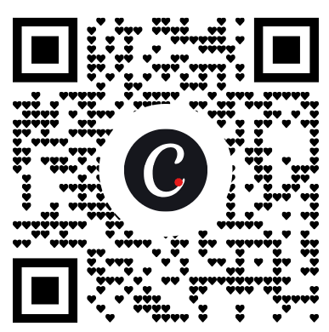

Slide 54
Mentorship
Great way to connect with other people in WIBC
Fun social events
Get paired with an upperclassman to answer any questions you may have
Form is open until 9/8 after Wibternship- pairings will be sent out on 9/11 in the AM so you can attend the first event mid-day on 9/11

Slide 55
Upcoming Meetings
Body Meeting
WIBternship Meeting
When
September 15th @ 7:30 pm
When
September 22nd @ 7:30 pm
Format & Location
In-Person,
Jones 210
Format & Location
In-Person,
Jones 210
Topic
Ace the Recruiting Process with Gartner
Topic
Resume & Interviews
Bring a laptop!

