Slide 1

Third Meeting | Oct 6, 2026

Slide 2
Schedule
Week of 11/16/2026
9/8/2026
9/22/2026
10/6/2026
10/20/2026
11/17/2026
Professional Dress
Networking
Resume
Interview
Committee Panel
LinkedIn
Headshots
Case Competition Tips
Major Exploration
Internship Search
Case Competition

Slide 3
Agenda
Committee Panel
LinkedIn Overview
Headshots
Announcements

Slide 4
Committee Panel

Slide 5
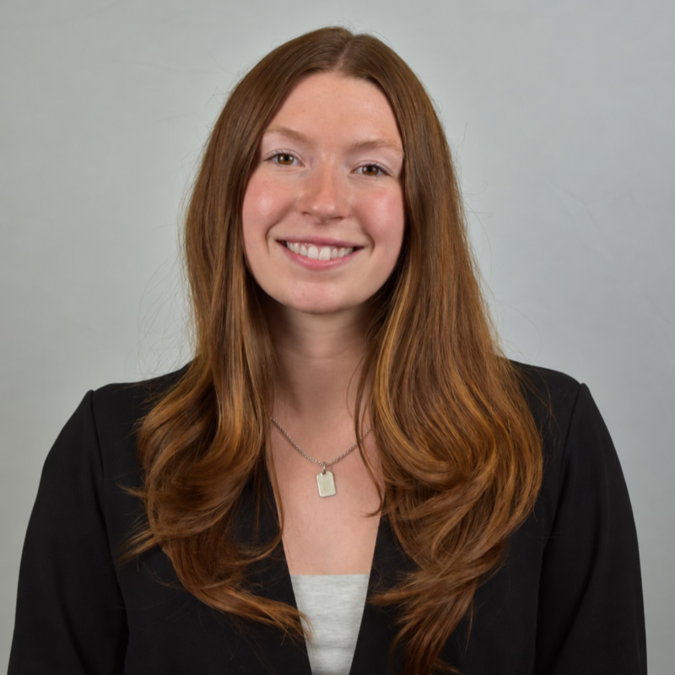
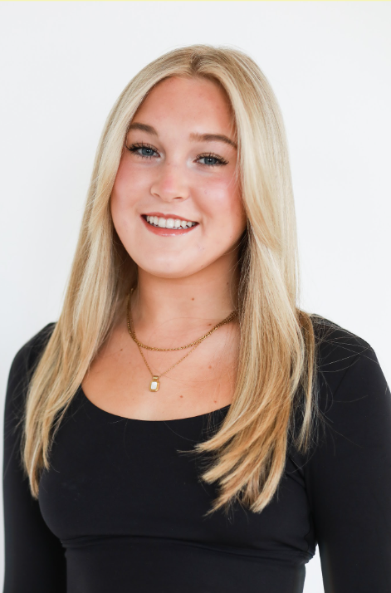
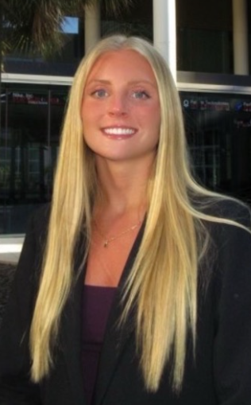
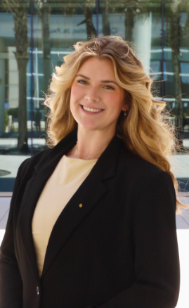
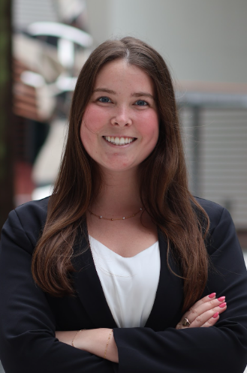
Panelists
Madison Lewis
WIBternship
Melissa Lowrie
Mentorship
Cat Lahr
Outreach
Jessi Bartlett
Conference
Julia Schnell
Outreach
Notes:
Jenny,

Slide 6
LinkedIn
Already created an account? →
Notes:
Maddie

Slide 7
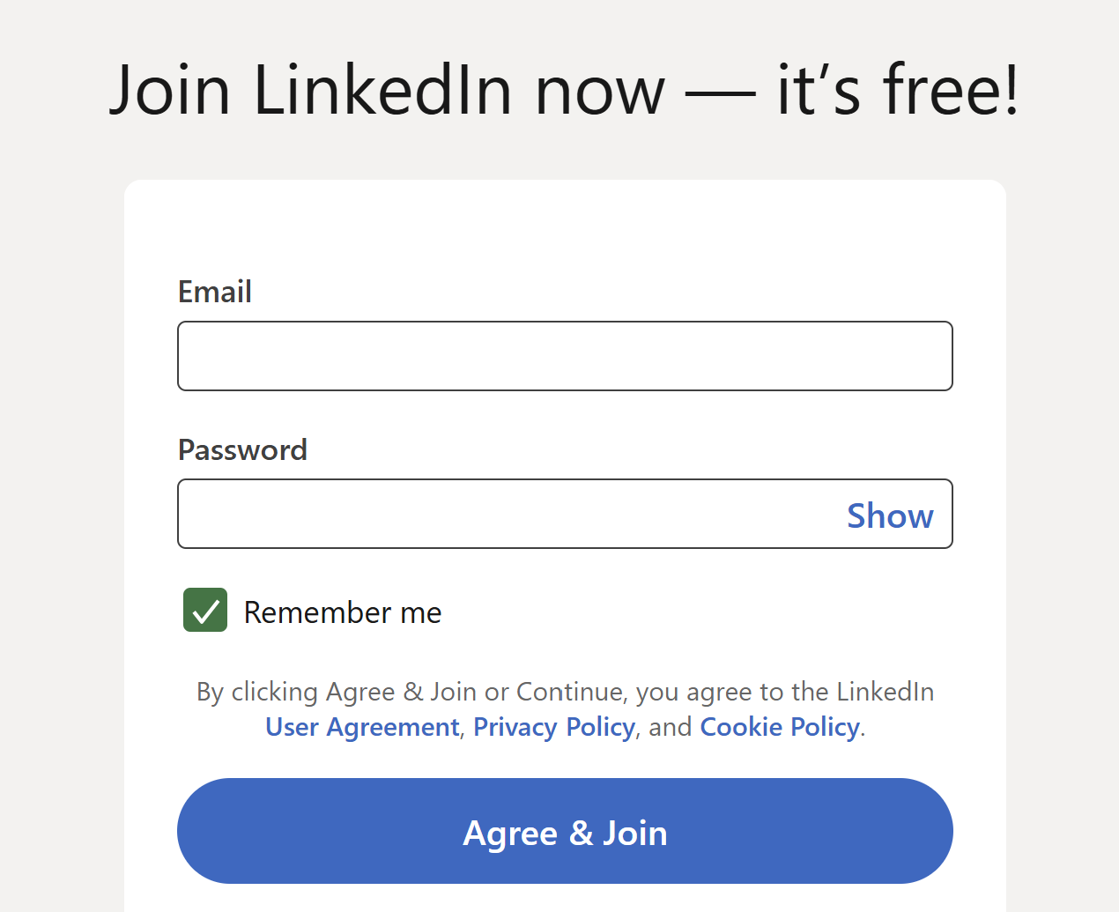
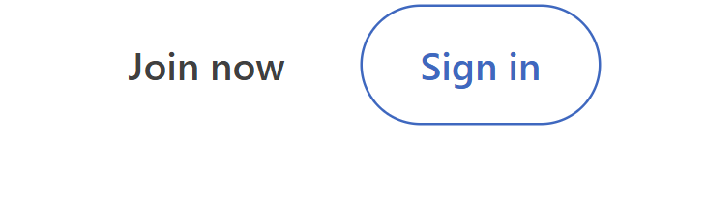
Creating a LinkedIn Account
Notes:
Change contact info
Freshmen cannot access blackboard content yet

Slide 8
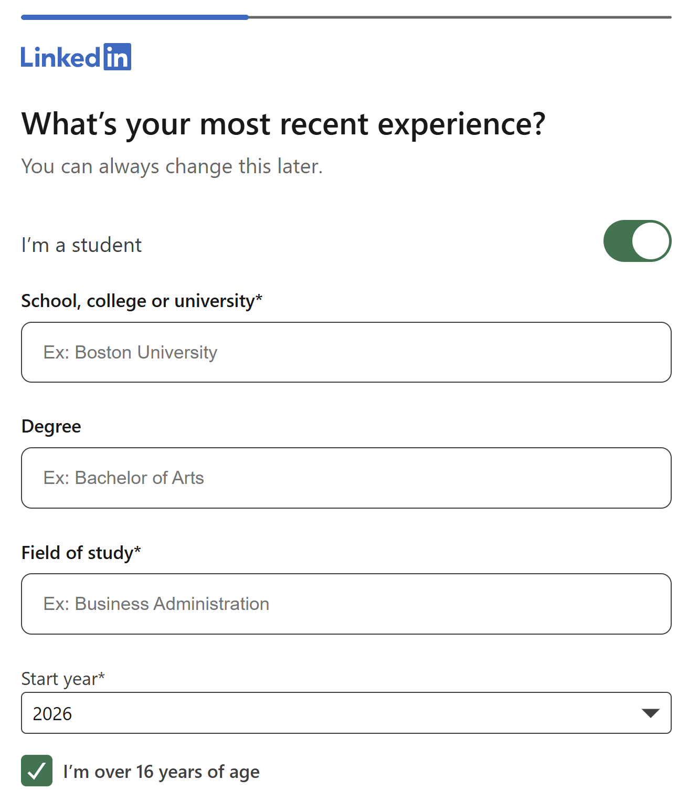
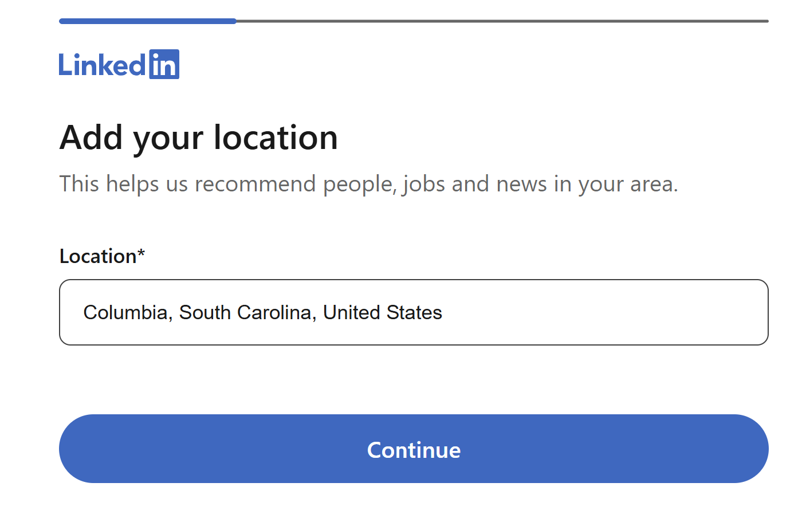
Creating a LinkedIn Account
Notes:
Change contact info
Freshmen cannot access blackboard content yet

Slide 9
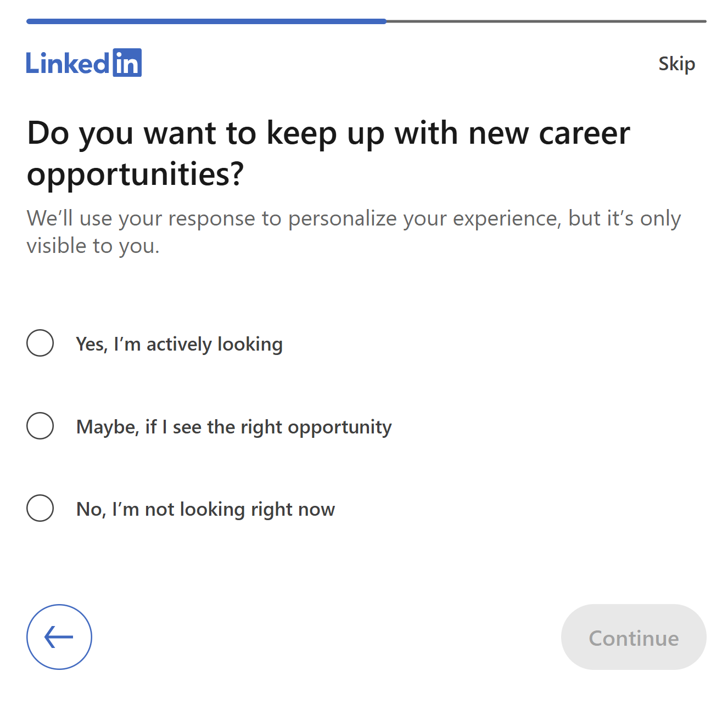
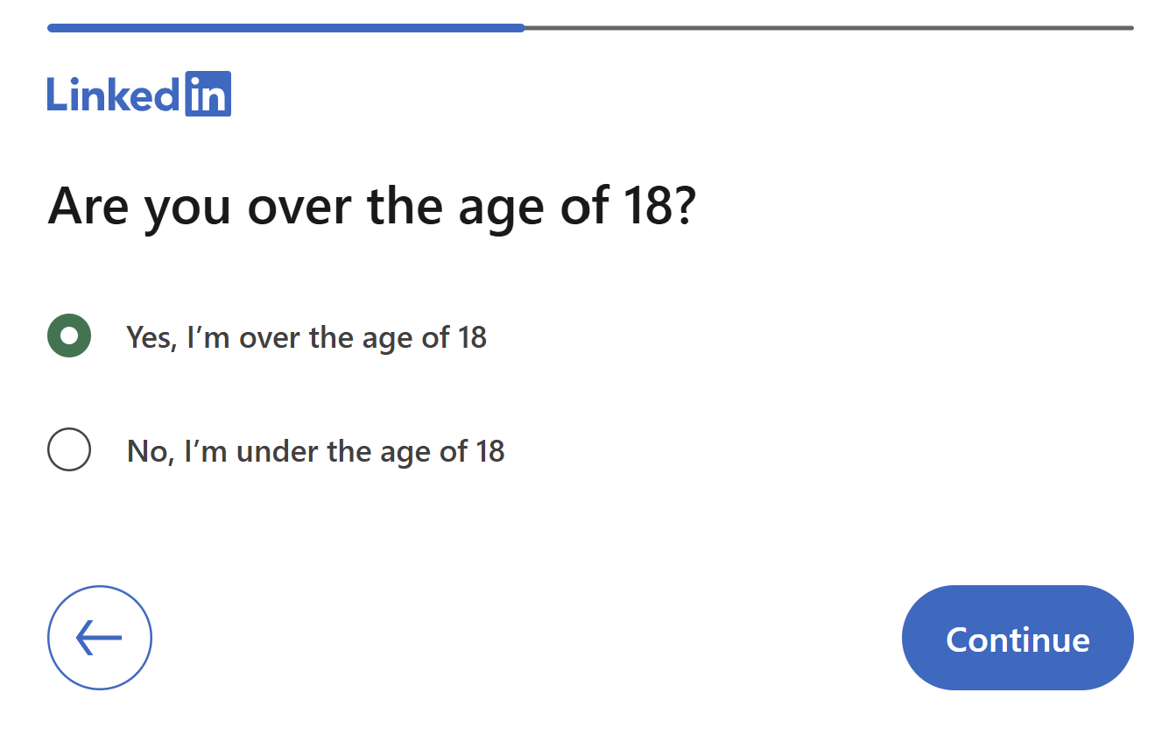
Creating a LinkedIn Account
Notes:
Change contact info
Freshmen cannot access blackboard content yet

Slide 10
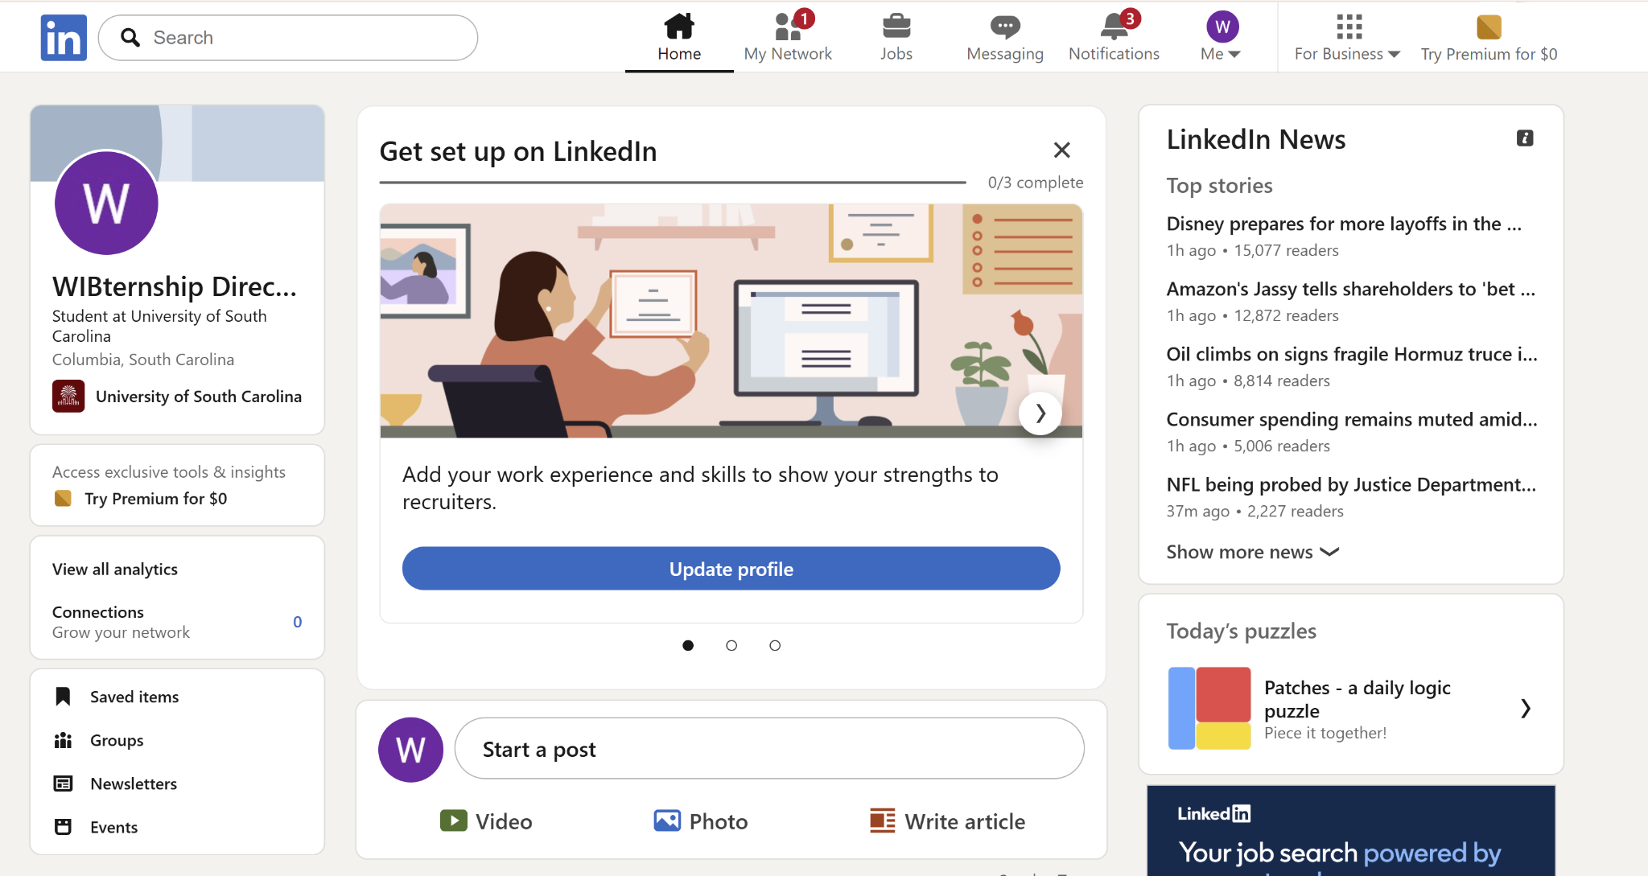
Creating a LinkedIn Account
Notes:
Change contact info
Freshmen cannot access blackboard content yet

Slide 11
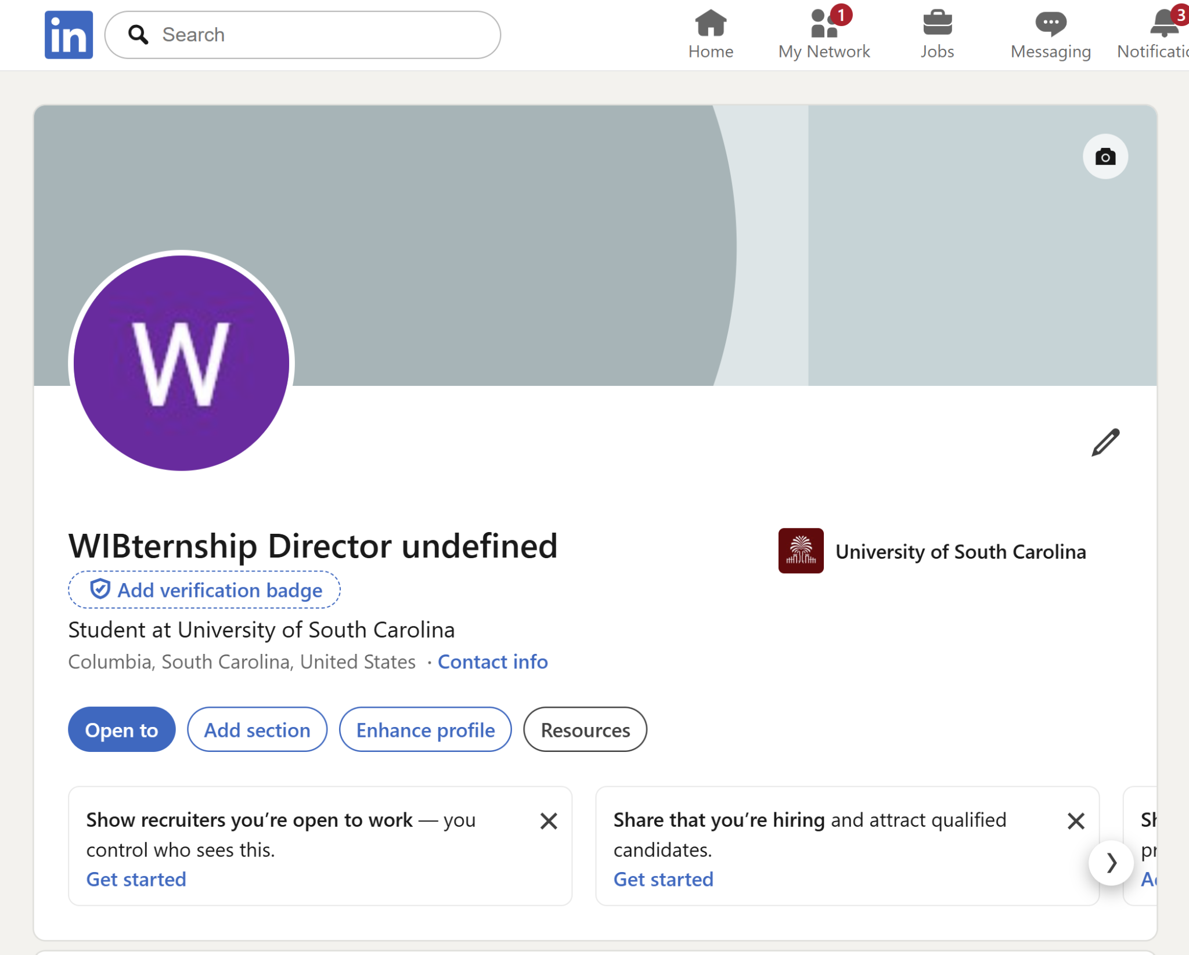
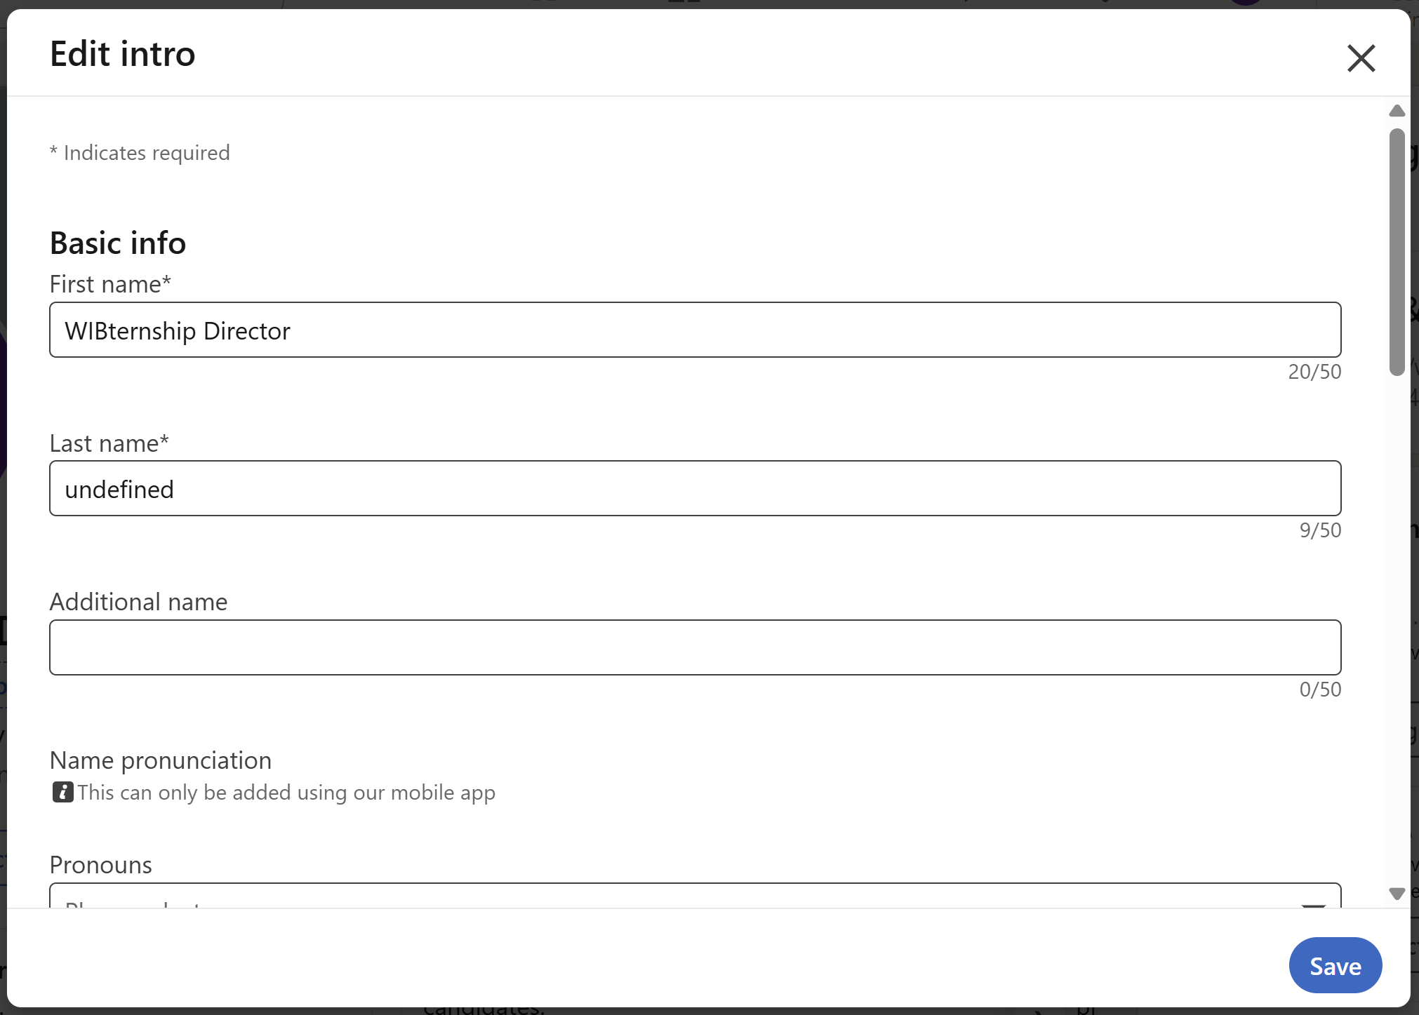
Creating a LinkedIn Account
Notes:
Change contact info
Freshmen cannot access blackboard content yet

Slide 12
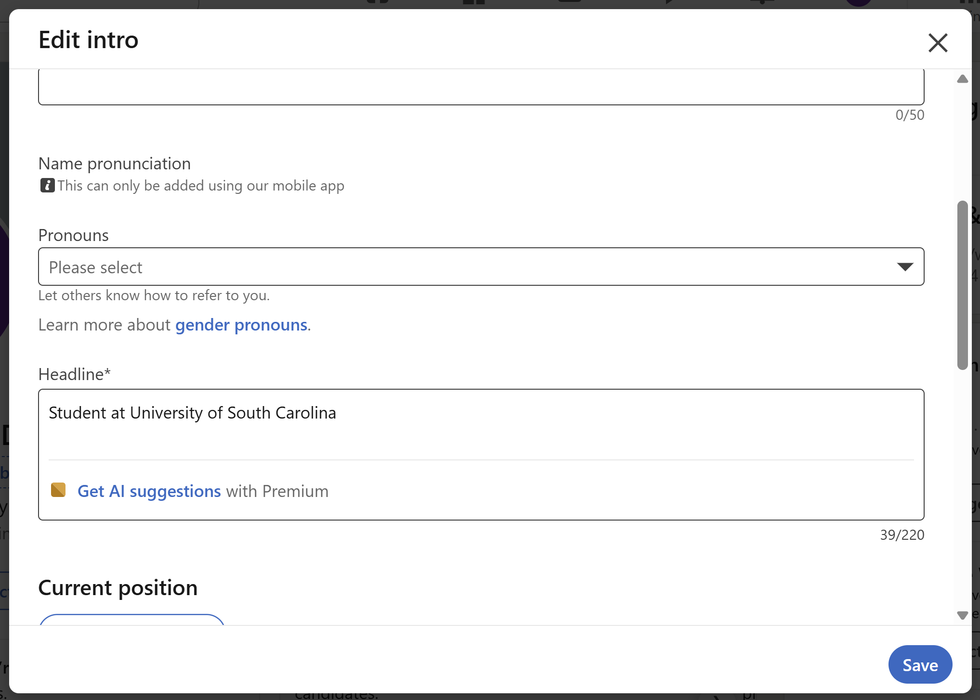
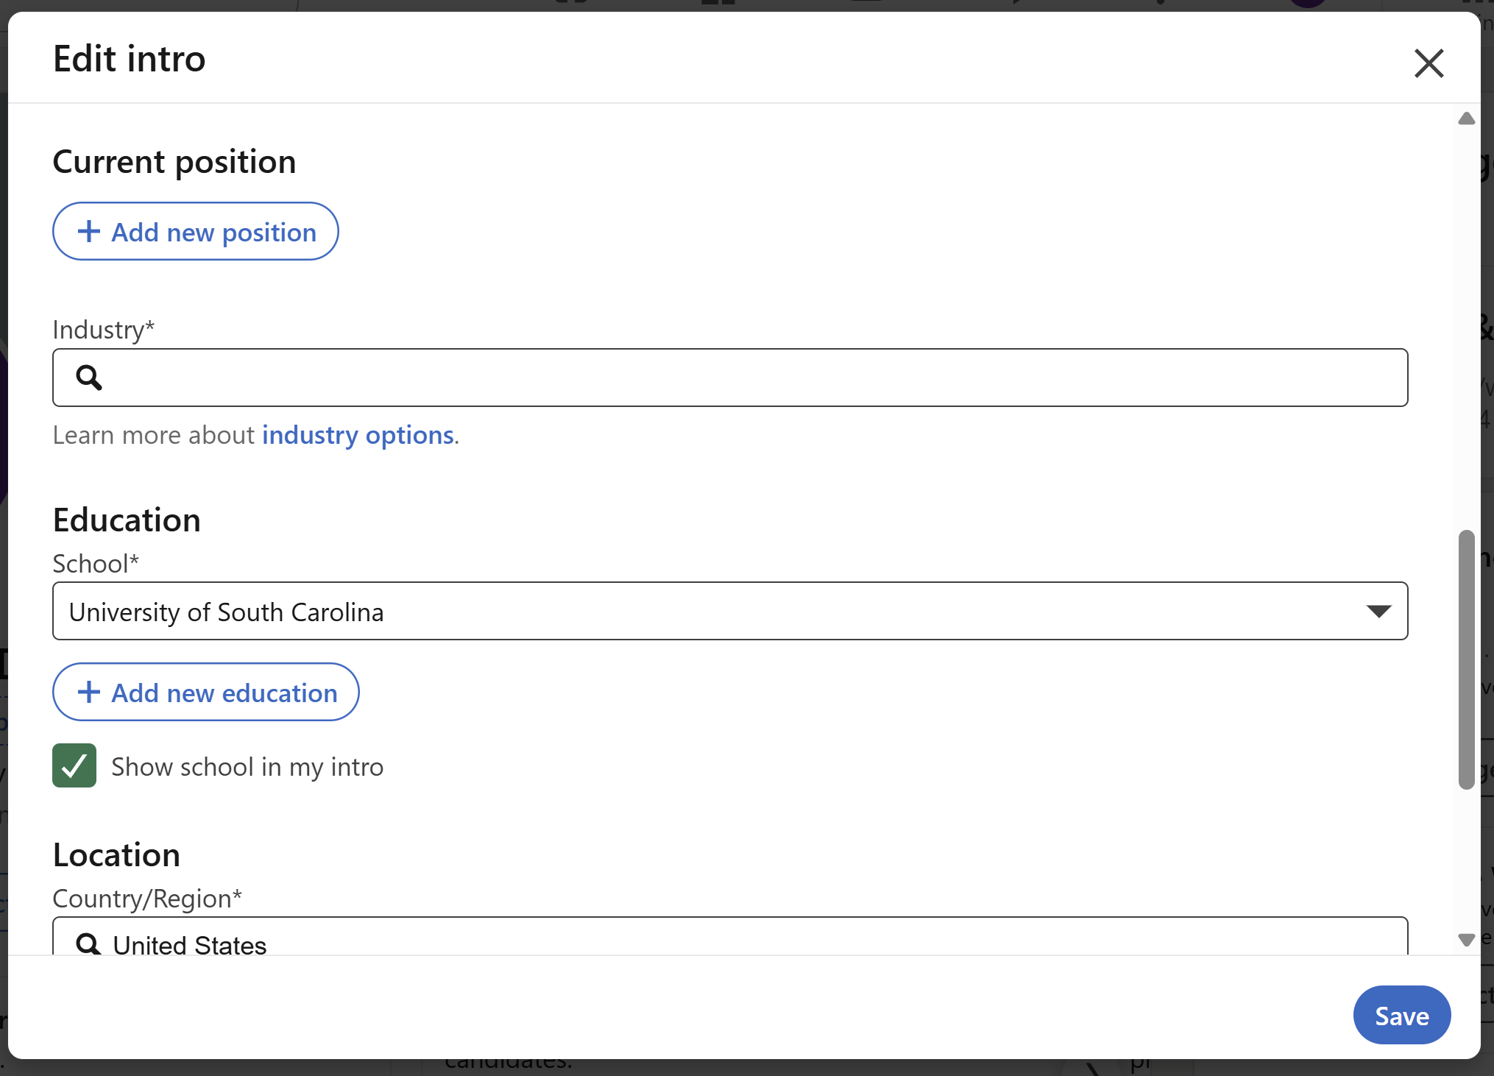
Creating a LinkedIn Account
Notes:
Change contact info
Freshmen cannot access blackboard content yet

Slide 13
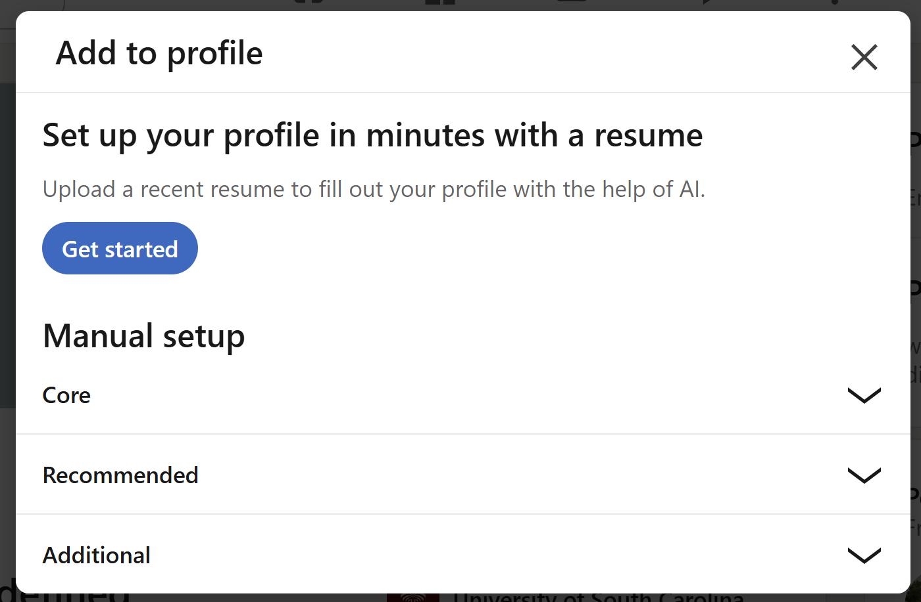
Creating a LinkedIn Account
Notes:
Change contact info
Freshmen cannot access blackboard content yet

Slide 14
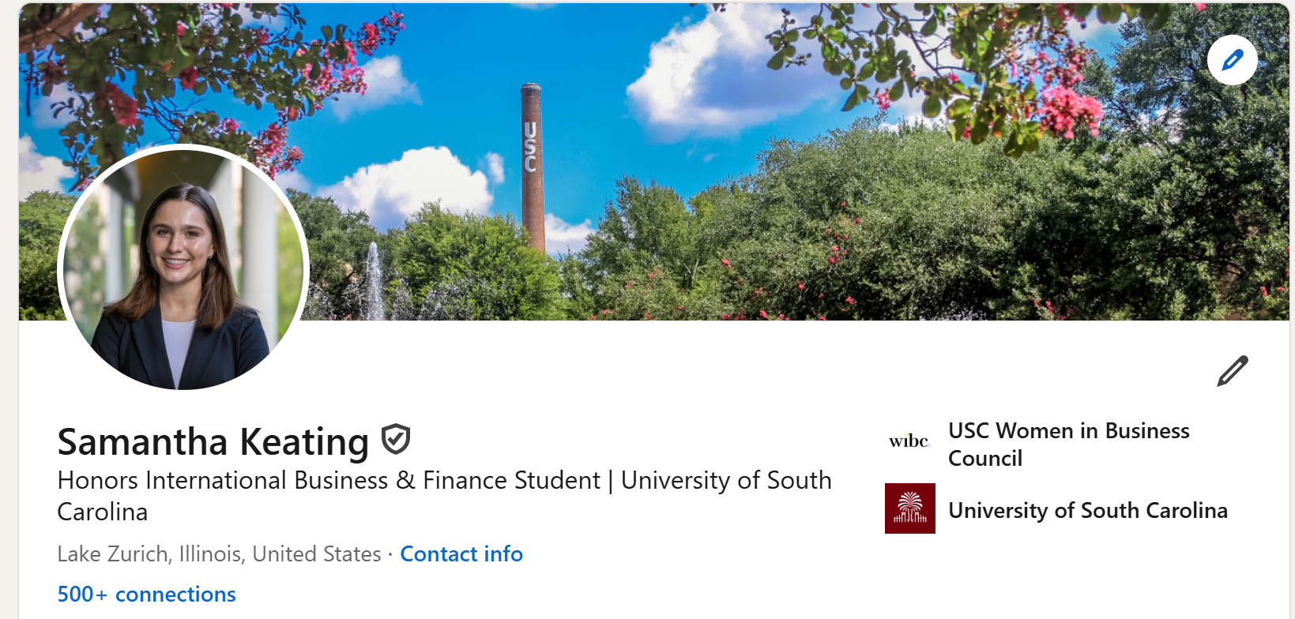
Complete Your Profile
Profile Picture: Professional looking headshot (you will get one tonight!)
Background Photo: most popular is Darla or Horseshoe, but can be whatever you want
Headline: many different approaches to take.. . but most students take the simple one shown
Notes:
Maddie
120: Taylor
60: Anna

Slide 15
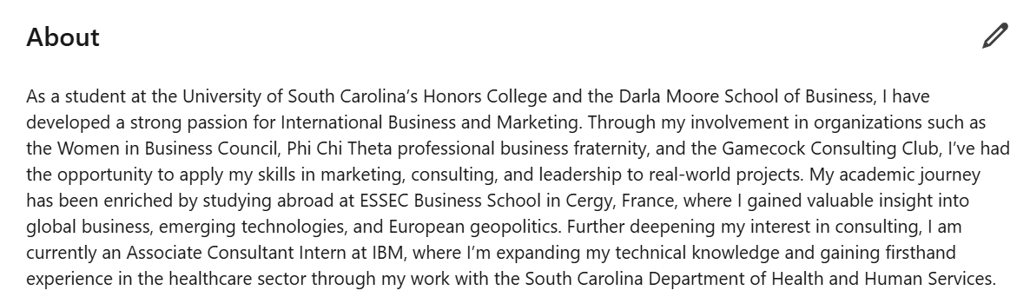
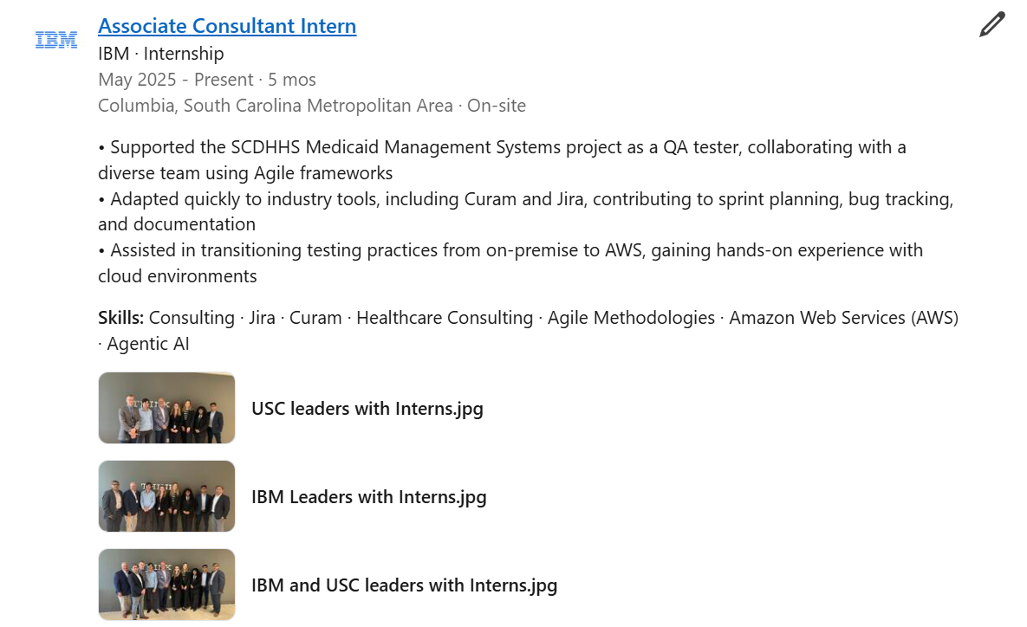
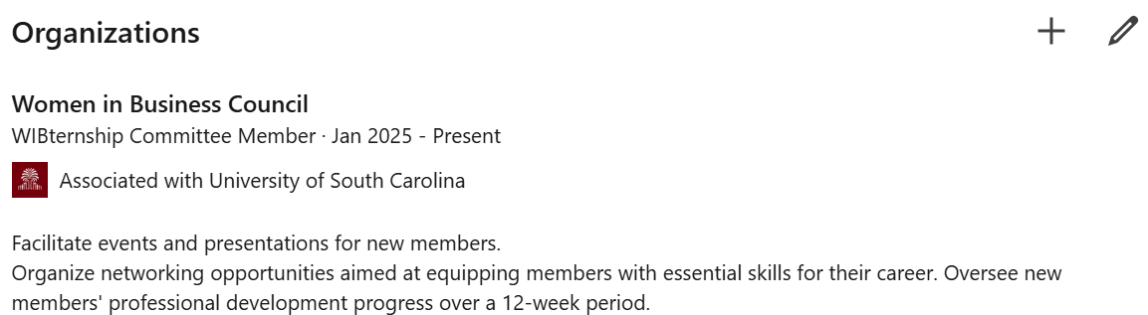
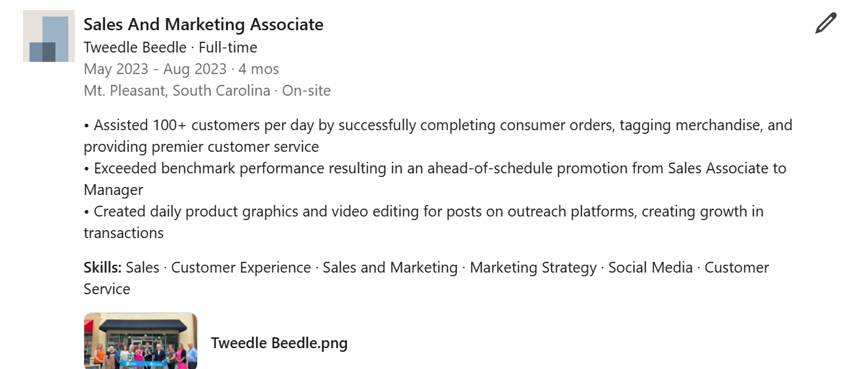
Complete Your Profile
About Section
Work Experiences
Add Organizations
Notes:
Maddie
120: Taylor
60:

Slide 16
Turning your About Section into your Story!
Make sure your About section isn’t blank—this is your space to tell your story.
Go beyond listing skills by explaining why they matter and the impact you create.
Draft a few versions and get feedback from your peers and professors
Premium users can use AI tools to polish and enhance their About section.
Notes:
Maddie

Slide 17
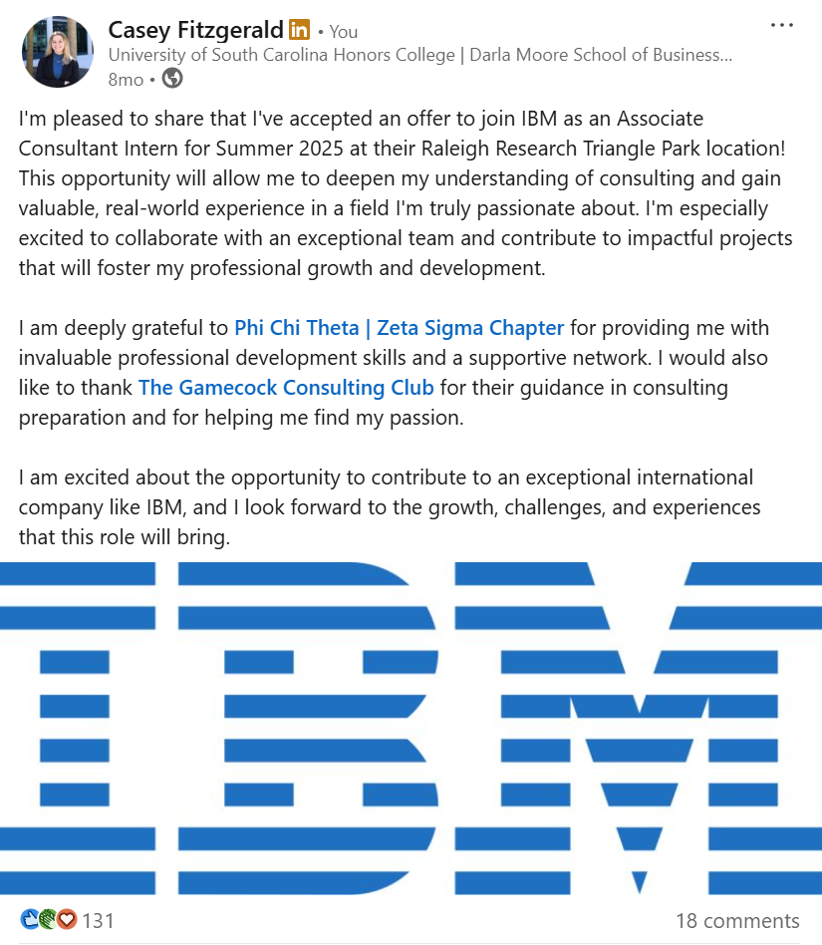
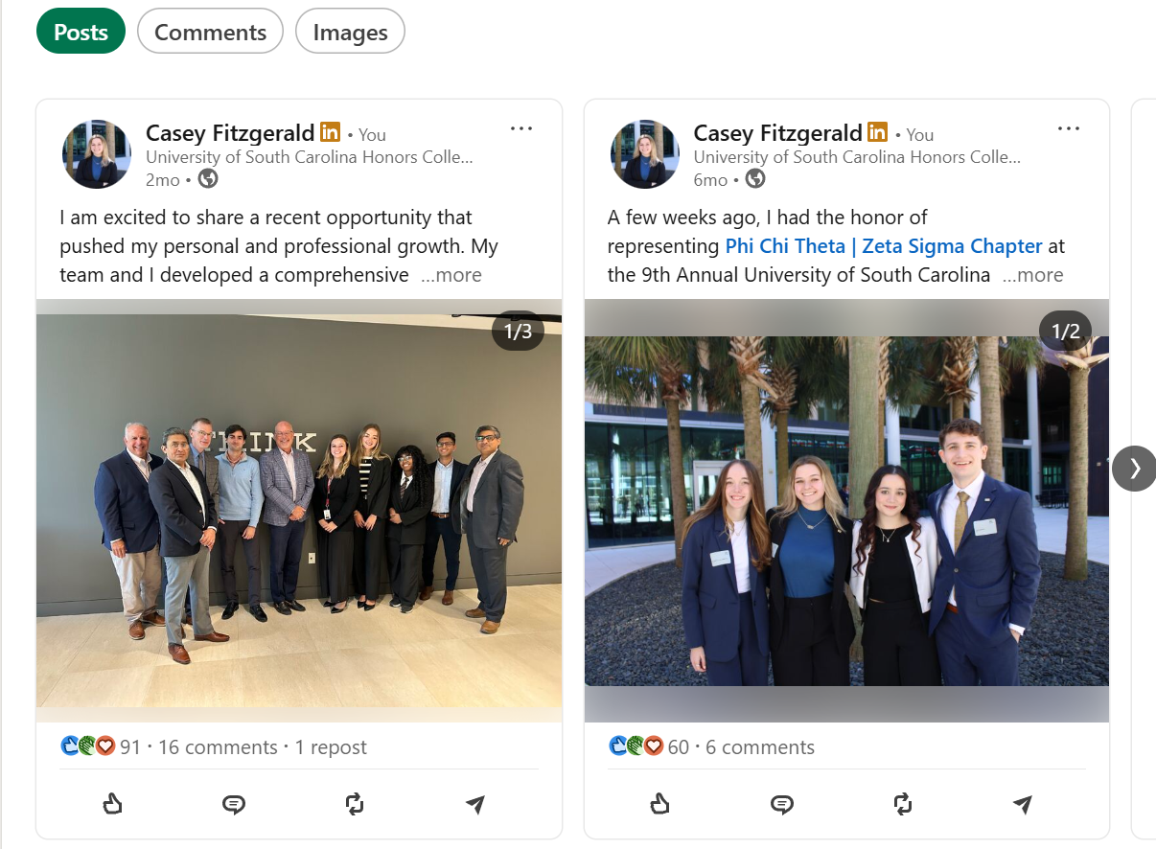
Post when Appropriate!
Notes:
Morgan
120: Taylor
60: Anna

Slide 18
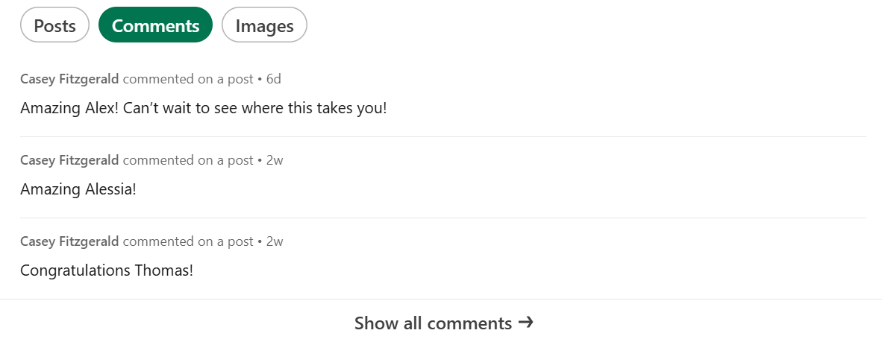
Stay Active!
Notes:
Morgan
120: Taylor
60:

Slide 19
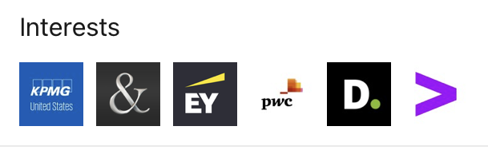
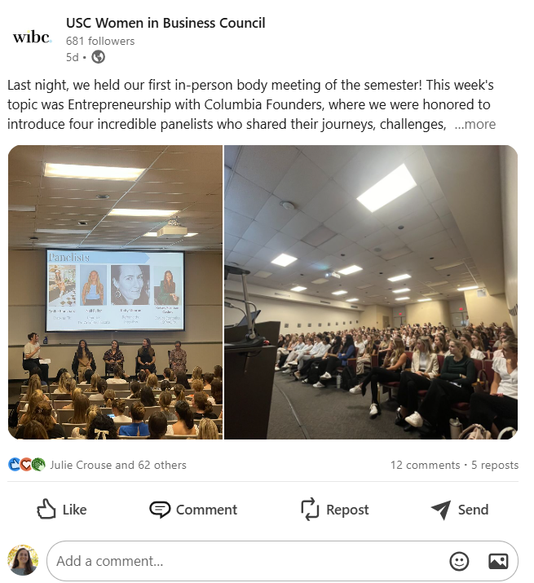
LinkedIn Formatting
Just Like a Resume!
Fill Out Your Profile
Be ACTIVE
Connect with WIBC Members, classmates, and friends
Like, Comment, Post
Follow Companies that Interest You
Professional Headshot
Headshots will be taken after the slides!
Notes:
Morgan

Slide 20
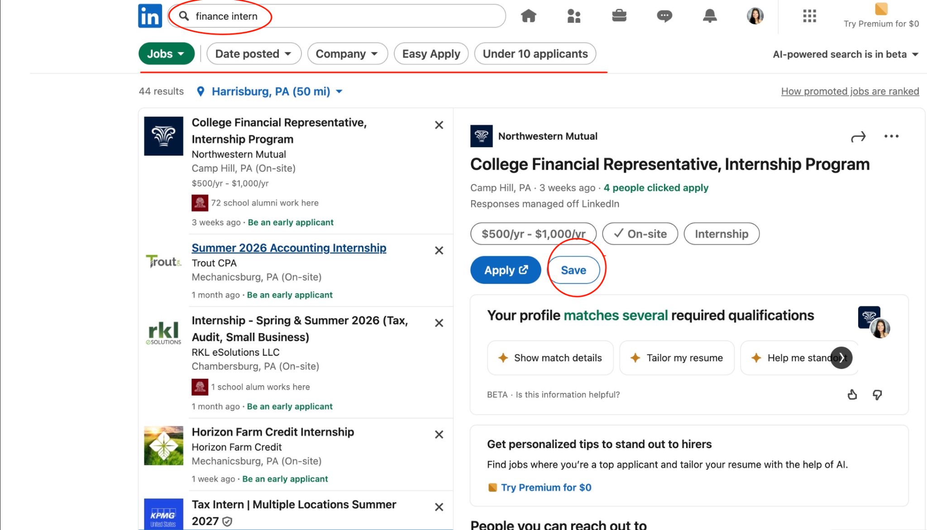
Internships
Look for & save 3 internships!
Search & filter internships
Save jobs/internships you’re interested in
Notes:
Morgan
120: Taylor
60:

Slide 21
SHARE & DISCUSS
With Someone Beside You:
1. Share one internship you found
2. Explain why you chose it
3. Discuss how it aligns with your career goals
Notes:
Morgan
120: Taylor
60:

Slide 22
Growing your Network
Send quick, personalized LinkedIn request after conversation to keep your network active
Check someone’s profile so you an reference shared interests in your message
Prepare a couple of questions to spark connection and find common ground
Notes:
Morgan

Slide 23
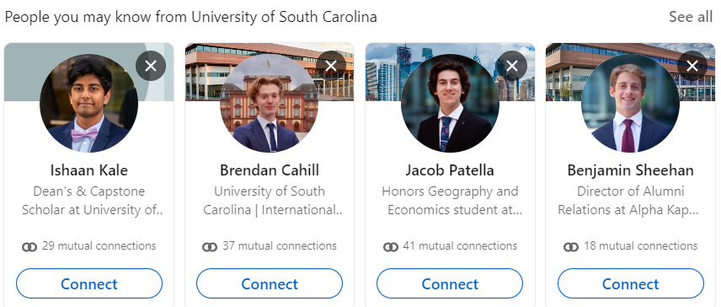
Get Connected
Reach out to USC alumni working where you are interested in- great way to connect and set up an interview
  Click on Interested Company and then on the People tab
  Shows your connects that work there
  Shows Alumni that work there
Handshake-Account set up similar-used for University Recruiting
Notes:
Pressley Ann
120: Taylor
60:

Slide 24

Build Your Network
You can make up to 20 connections per day on LinkedIn.
Who to connect with?
  Classmates & alumni from USC (& your high school)
  Colleagues from jobs/internships
  Professors, mentors, advisors, etc.
  Industry professionals you admire
  Speakers or panelists from events you attend
  Members of professional organizations
Notes:
Pressley Ann
120: Taylor
60:

Slide 25
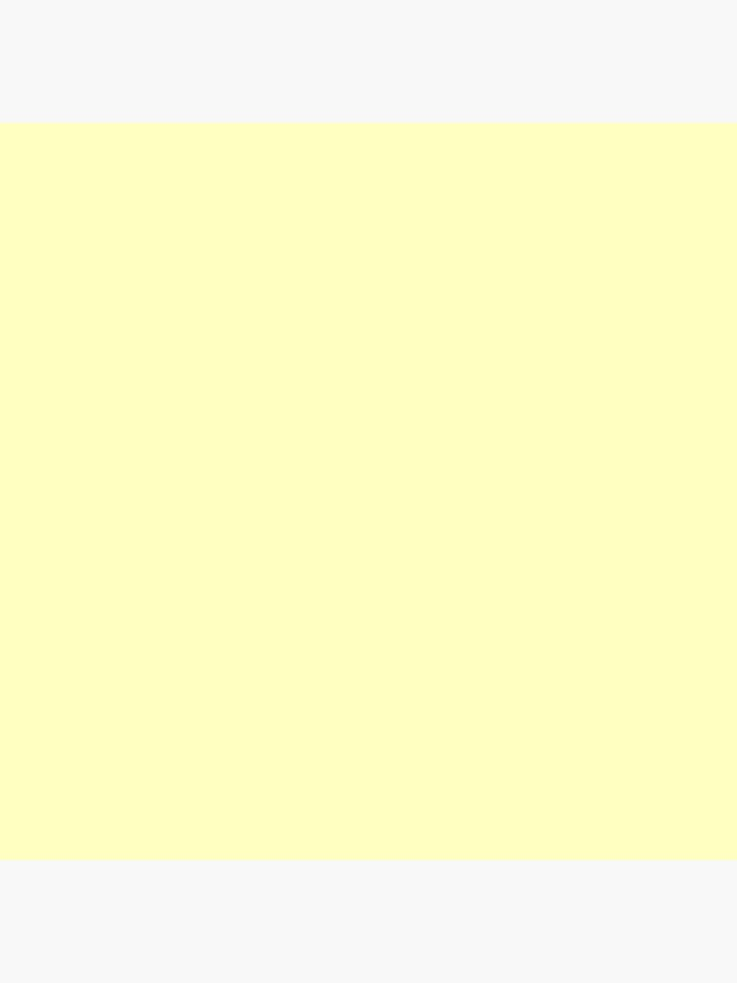

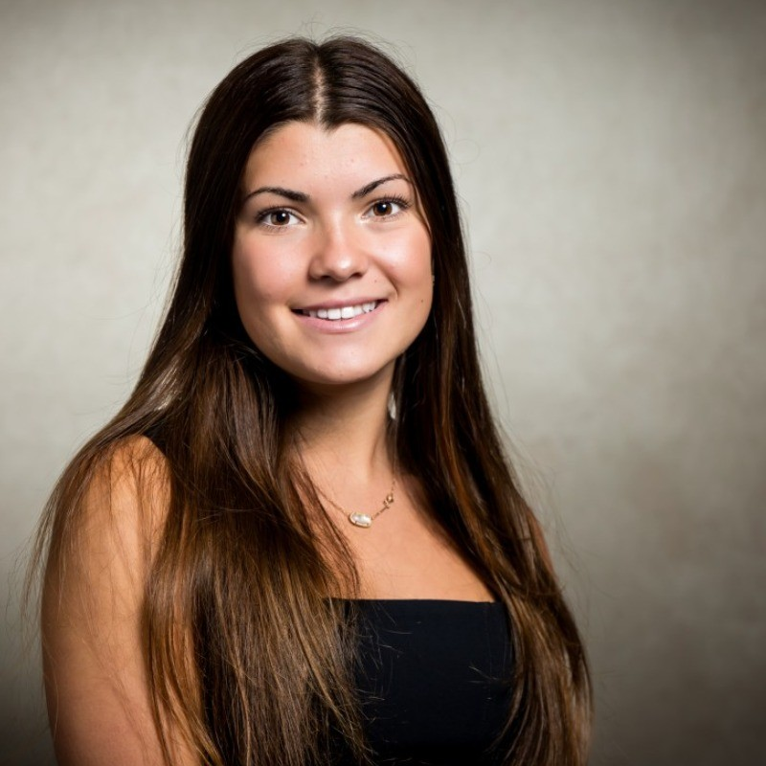
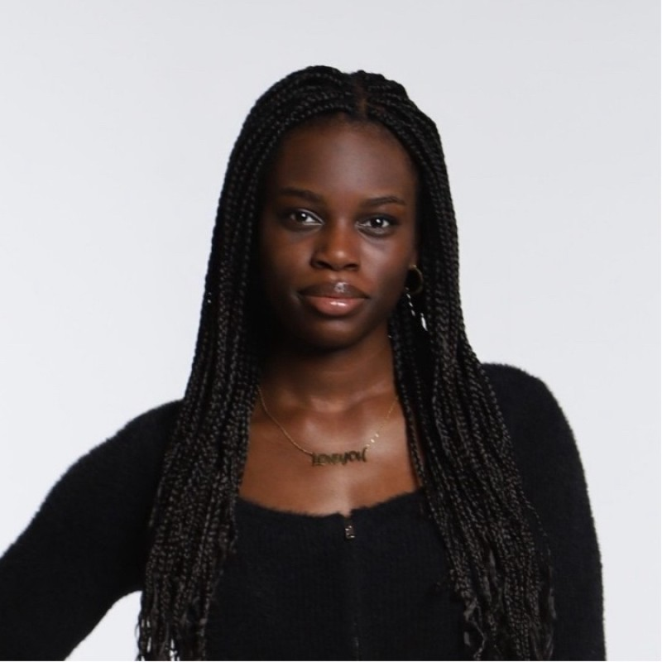
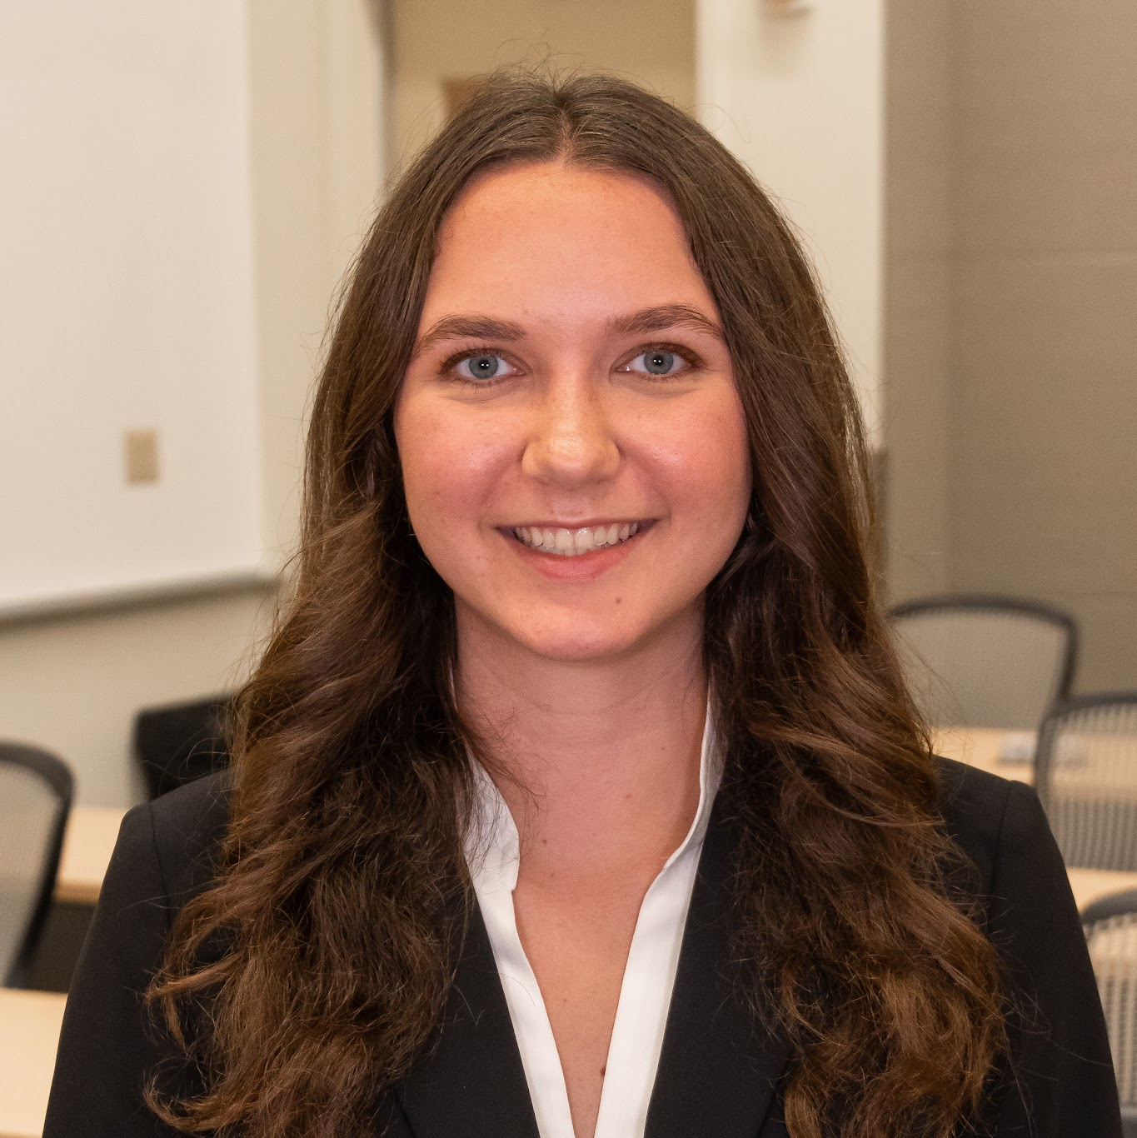
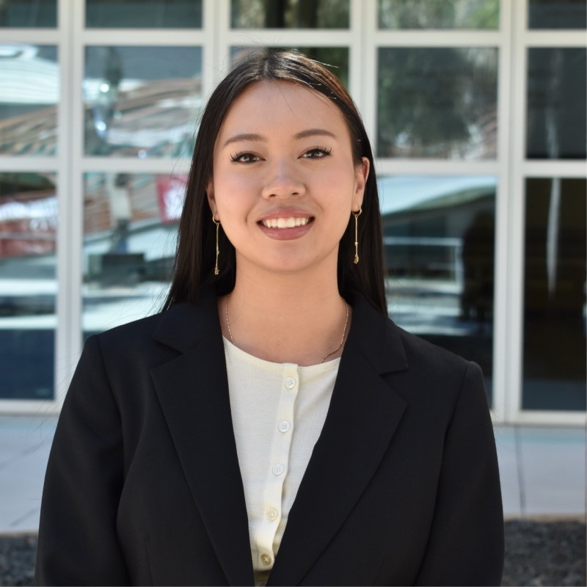
Connect with Us!
WIBTERNSHIP CONNECTIONS
Cassandra Griswold
linkedin.com/in/cassandra-griswold-470289385
Madison Lewis
linkedin.com/in/madison-lewis-24b293391
Anna
Koroma
Katie
Roberts
Cynthia
Tran
linkedin.com/in/anna-koroma
www.linkedin.com/in/katieroberts38
linkedin.com/in/cynthia-tran-793310351
Notes:
Pressley Ann

Slide 26
WIBTERNSHIP CONNECTIONS
Connect with each other!
Notes:
Pressley Ann

Slide 27
Linkedin Profile Optimization
Profile:
Use a professional headshot (21× more views, 7× more recruiter searches)
Be careful with AI photos
Headline & About:
Customize headline: major + school + interests
About section: elevator pitch, conversational, personal
End with a call-to-action: “Let’s connect!”
Experience & Education:
Copy experience from resume (focus on impact/results)
Education: University of South Carolina, DMSB
Credibility & Networking:
Request recommendations
Add 5+ skills
Personalize connection requests
Update profile regularly
Reminder: When you view someone's LinkedIn profile, they may be able to see that you viewed their profile.
Notes:
Pressley Ann Remind them that once they view someones profile it will show

Slide 28
Announcements

Slide 29
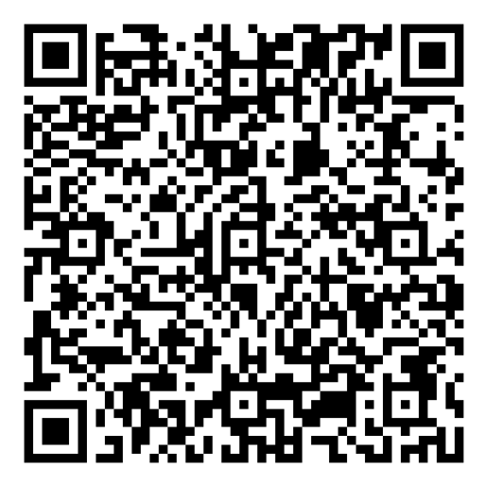

Outreach/ R&R
WIBC x Her Campus Mingling Night
Join us for a mingling night with Her Campus! We’ll have light refreshments, networking, and a short professional development workshop while getting to know members from both organizations.
**Bring your laptop!
Where: DMSB Room 133
When: Thursday, 10/8 @6 PM
Sign up: Scan QR Code. Link is in the GroupMe!

Slide 30

Outreach/ R&R
*1 POINT TO ATTEND!!!!

Slide 31

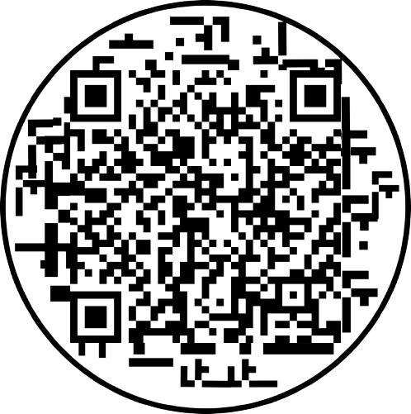
Outreach/ R&R
Outreach/R&R
HOTWORX Workout Class
Come get your sweat on with WIB x HOTWORX! Scan the QR code to claim your FREE class for October 12 or 13 anytime between 11AM - 6:30PM
Enter your info, select “Not Ready to Book,” and let the HOTWORX team know you’re with Women in Business when they reach out to schedule!
Where: 4464 Devine St Suite G
When: 10/12 and 10/13, anytime between 11-6:30PM

Slide 32


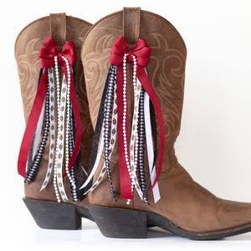
Outreach/ R&R
Boots, Bows, and Canal Coffee
Get ready for game day by sprucing up the side of your boots with some cute ribbon!
You bring the boots, we will provide the coffee and supplies! Feel free to bring any extra ribbon you’d like but we will provide ribbon if not.
Where: Russell 205
When: 10/20, anytime between 9AM -11:30AM
Sign up: No sign-up!

Slide 33

Attendance Reminder
WIBternship is a required program for new freshman and sophomore members. For the five meetings you are allowed ONE unexcused absence.
Case Competition: you can only do the case competition if you have meet these meeting requirements. If you do not complete the case competition you will have to do WIBternship again next semester. You will be sitting with your case comp teams at our next WIBternship meeting!

Slide 34
Case Competition Teams
The teams will be sent out before the next WIBternship meeting. If you do not receive an email it means our attendance records will show you have missed more than one WIBternship meeting. If you believe this is a mistake you will need to reach out to the membership director.
Frances Overton: overtonf@email.sc.edu
We encourage you to sit together at meetings and attend social events together!
Case competitions are great to add to your resume and linkedin!

Slide 35
Point Requirement
All members of WIBC are expected to get 16 points to be a member in good standing and receive merch at the end of the semester
WIBternship is a program within WIBC
WIBternship members (first semester freshman and sophomores) must get
2 of those 16 points from WIBternship or mentorship events
Body meetings are usually 3 points
WIBternship events are all 1 point
Other events mentioned at the body meetings are 1-3 points depending on the event
WIBternship meetings are NOT worth points
WIBternship case competitions are NOT worth points

Slide 36
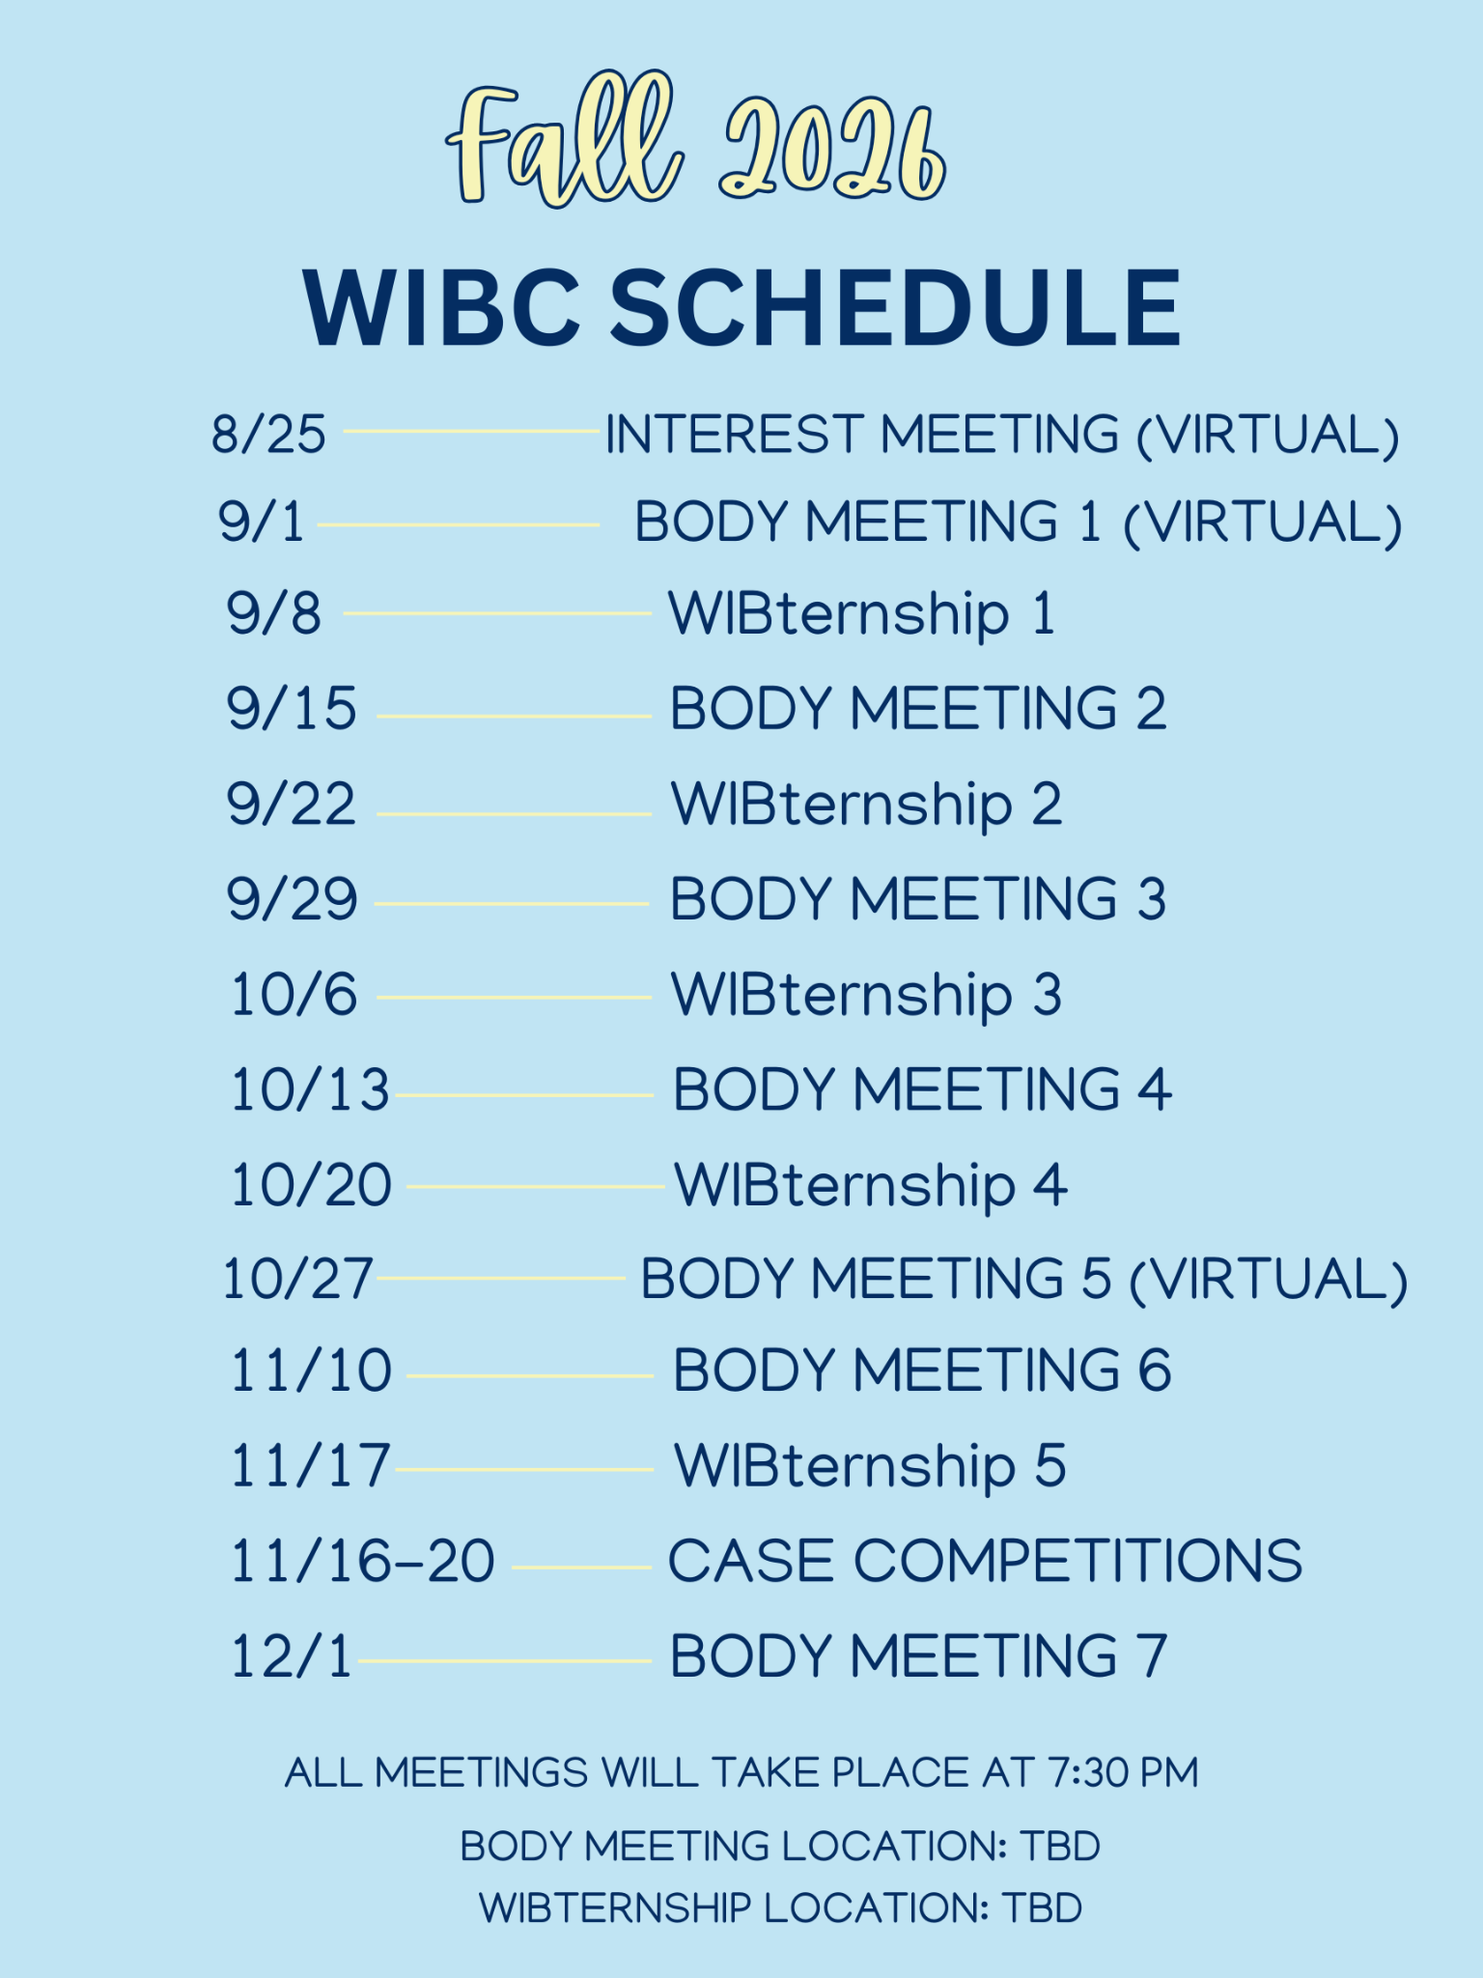
Schedule
Point tracker will be
out next week!

Slide 37
Looking Ahead
Events
Friday, September 11th - Letter Writing / Mentor & Mentee Meet
12-2 in Russell 302
Wednesday, September 23rd - Resume Workshop / Dirty Soda
7-8 in Russell 315
Wednesday, October 7th - Paint & Sip with Mentorship
7-9 in Russell 302
Limited sign ups went out last week
Events
Wednesday, October 21st - Claw Clip Decorating
7-8 in Russell 305
Wednesday, November 4th - Mentorship Event
TBD
Friday, November 6th - Digital Vision Board Making
1-2 in Russell 203

Slide 38
Next Meetings
Body Meeting
WIBternship Meeting
When
Oct 13th @ 7:30 pm
When
Oct 20th @ 7:30 pm
Format & Location
Jones 210
Format & Location
Currell 107
Topic
Turning Ideas into Impact with Kelsey Caskey
Topic
Case Competition Tips
Bring a laptop!

Slide 39
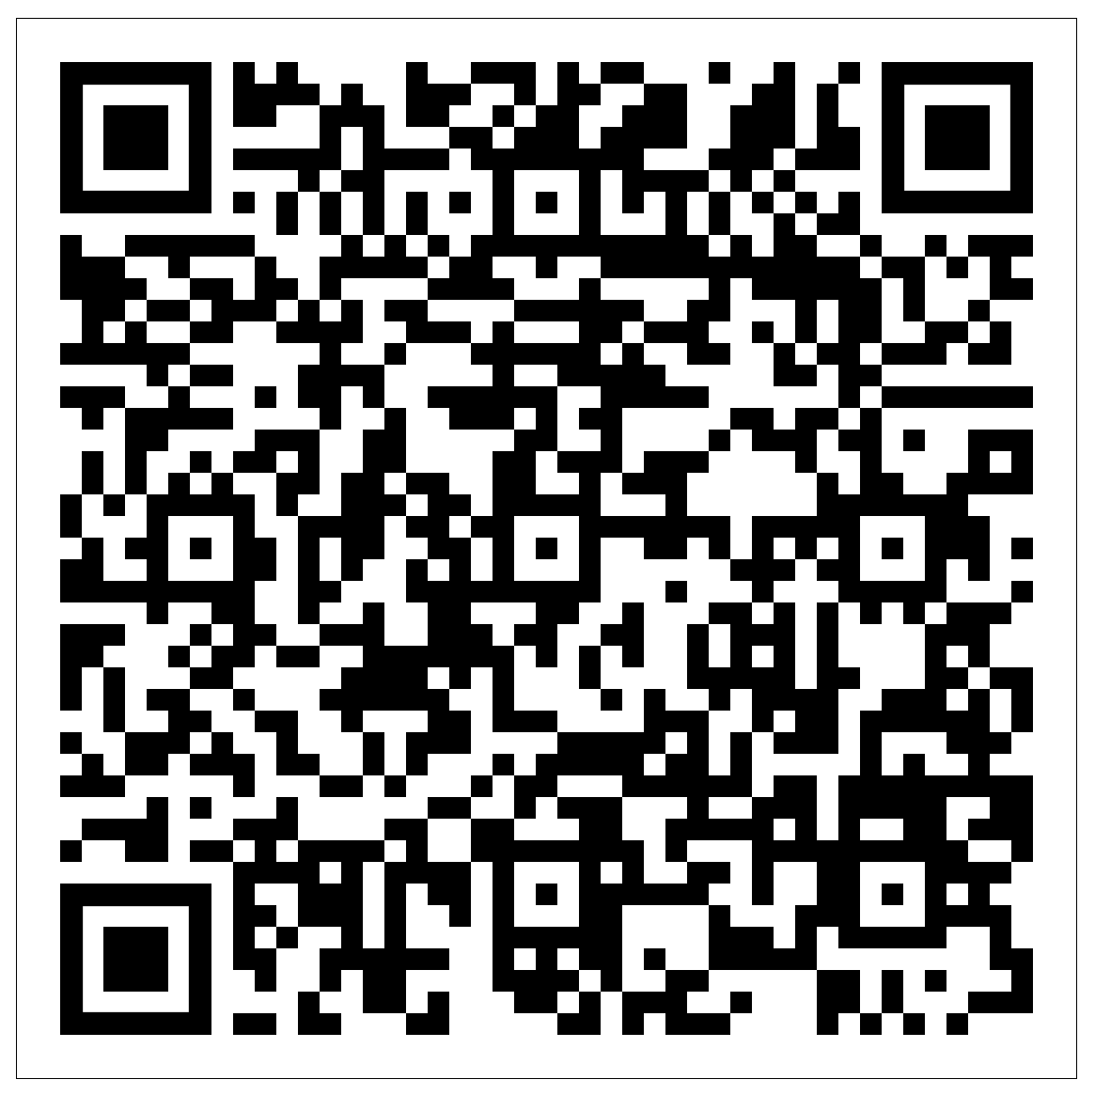
Attendance

