Slide 1

Women in
Business Council
Fall 2026 Interest Meeting

Slide 2
Agenda
Who We Are
Meet the Executive Board and Committees
What We Do
Structure
Schedule
How to Become a Member

Slide 3
Who We Are
We are the Women in Business Council at the University of South Carolina and we strive to connect, empower, and educate women so that they may become respected leaders in the business community.

Slide 4
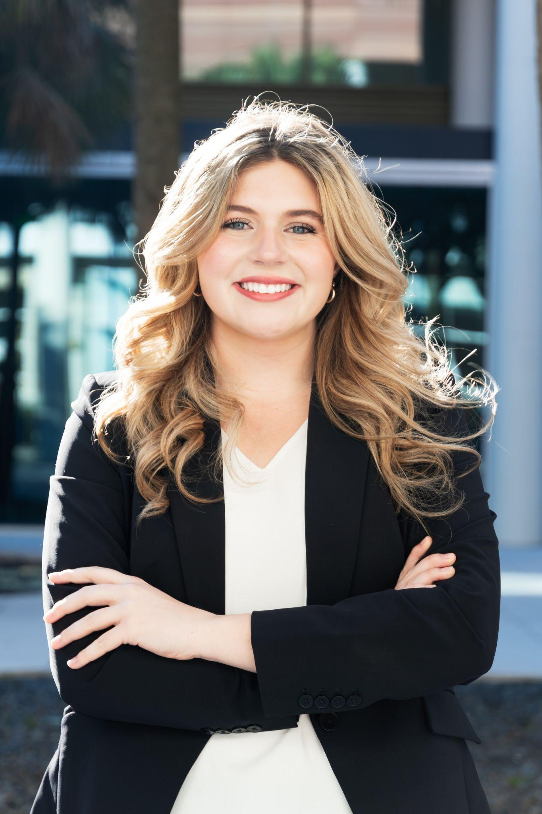
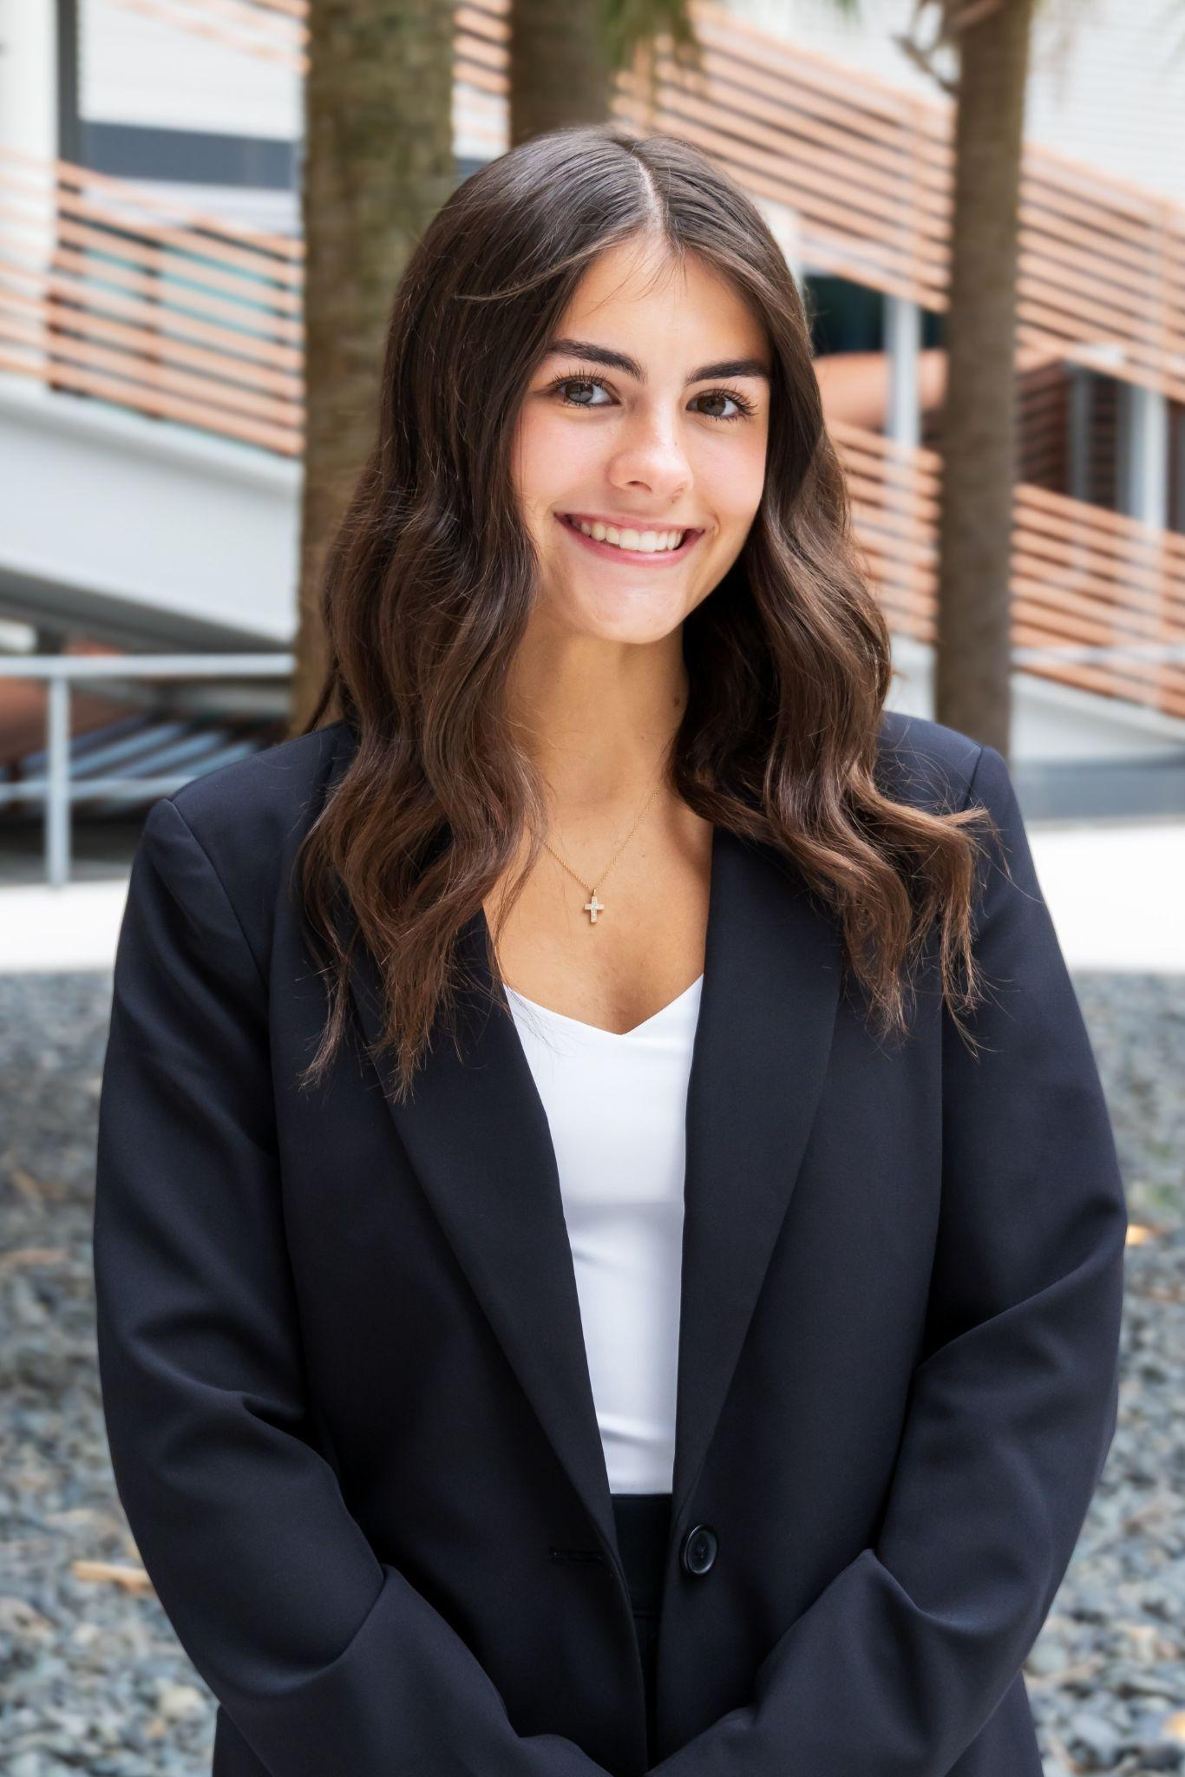
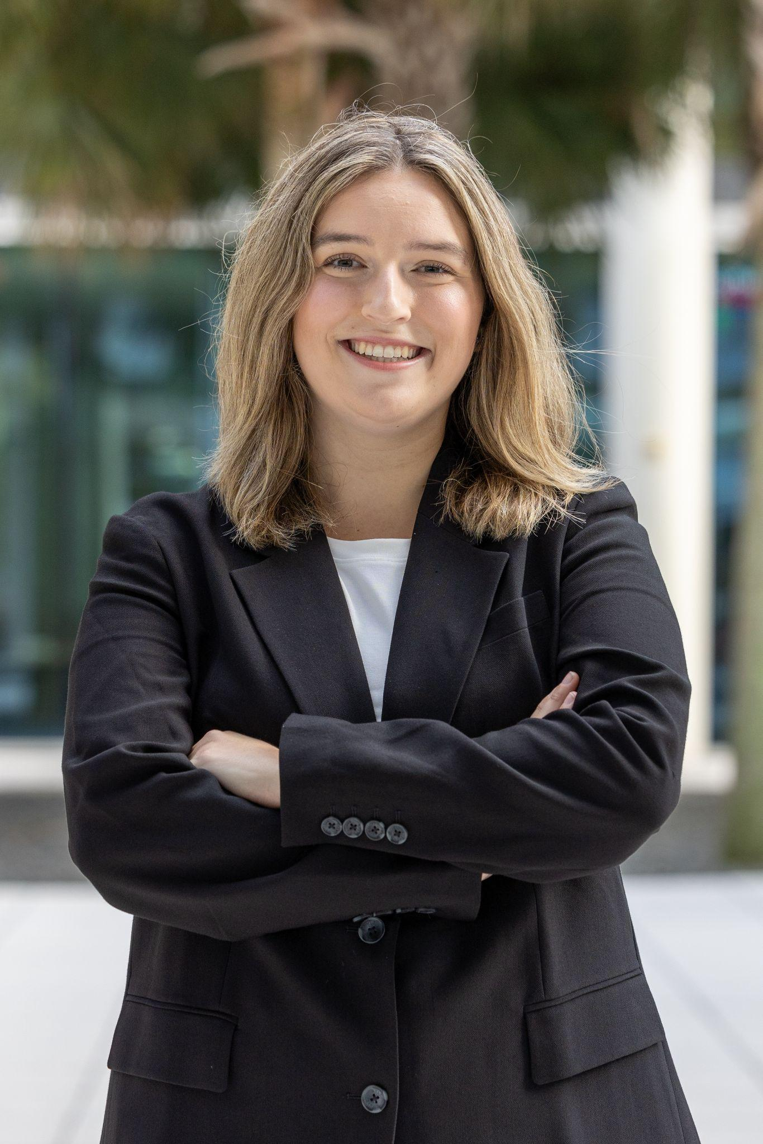
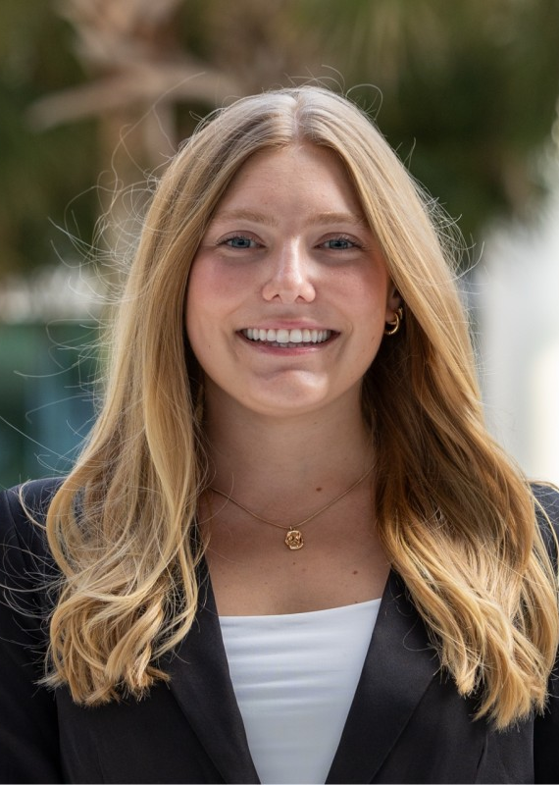
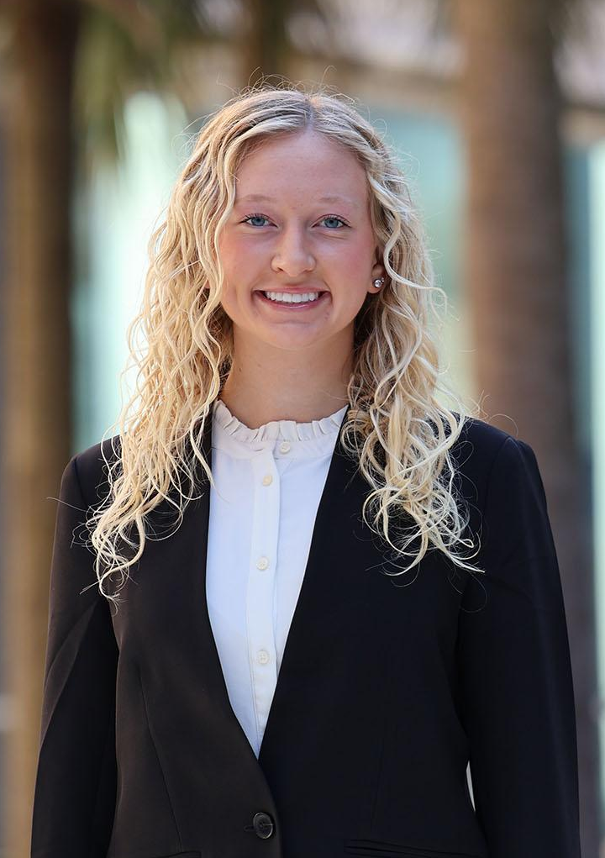
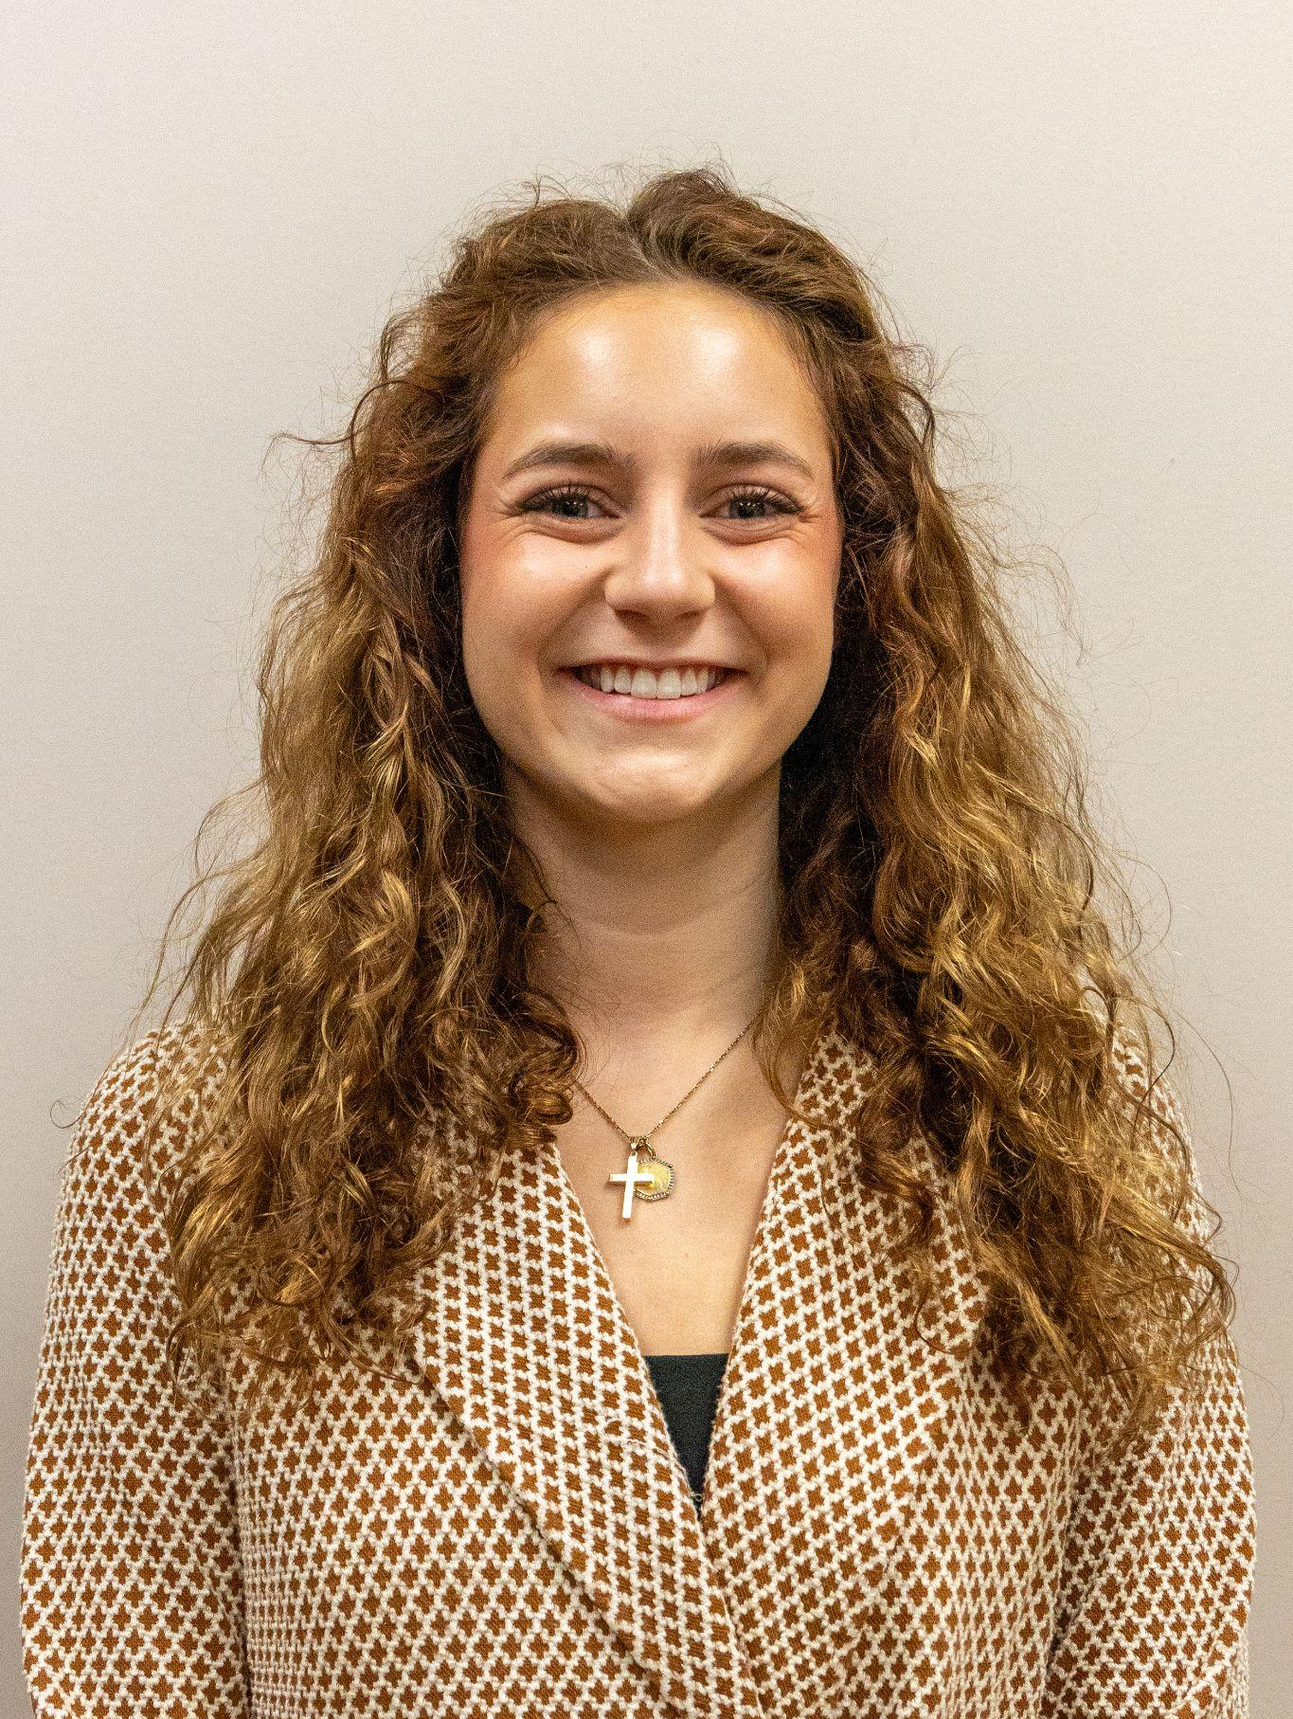
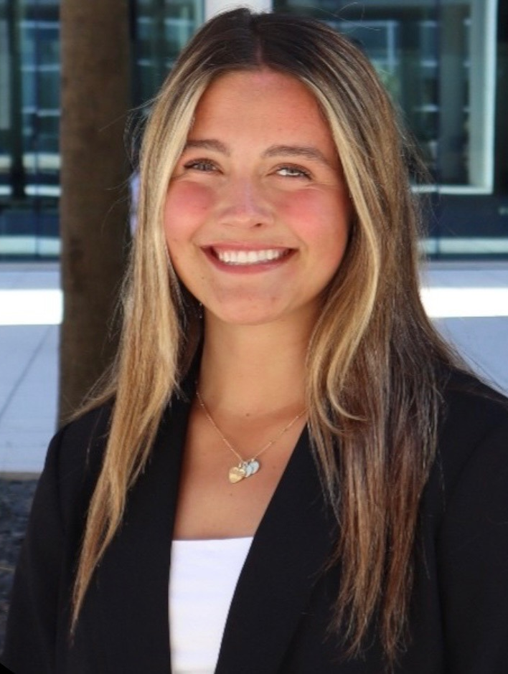
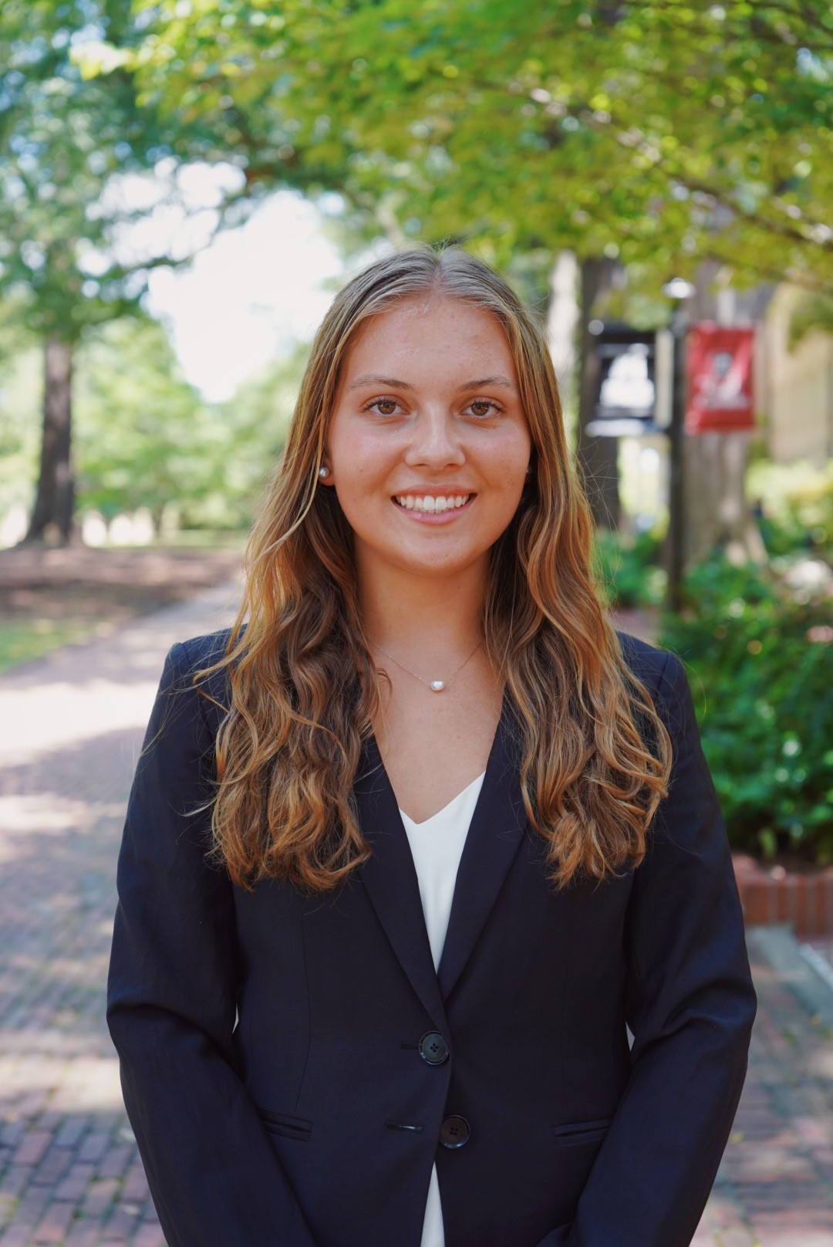
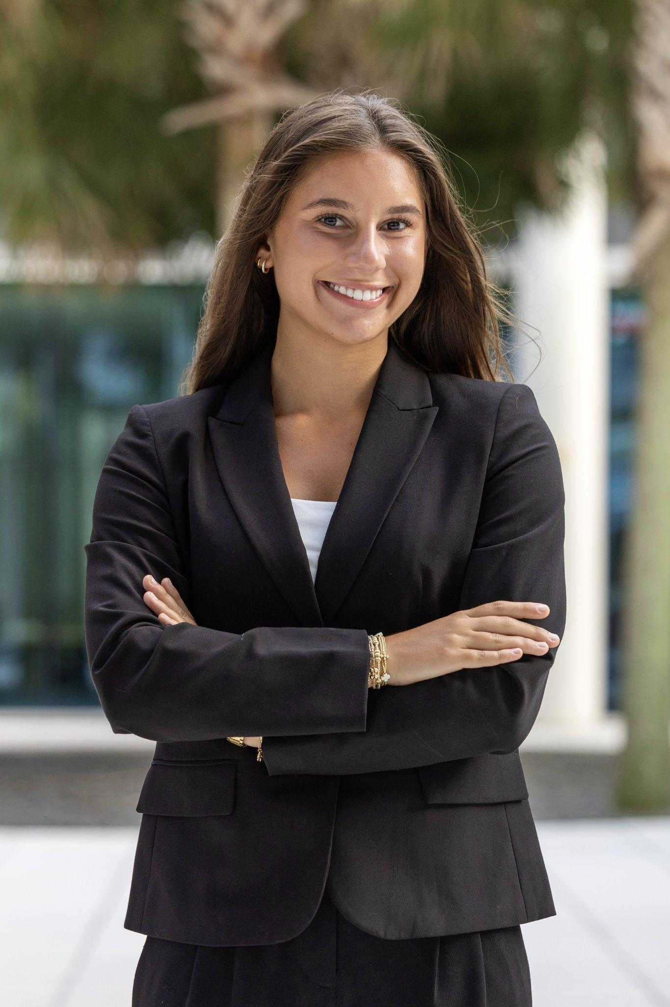
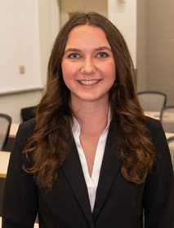
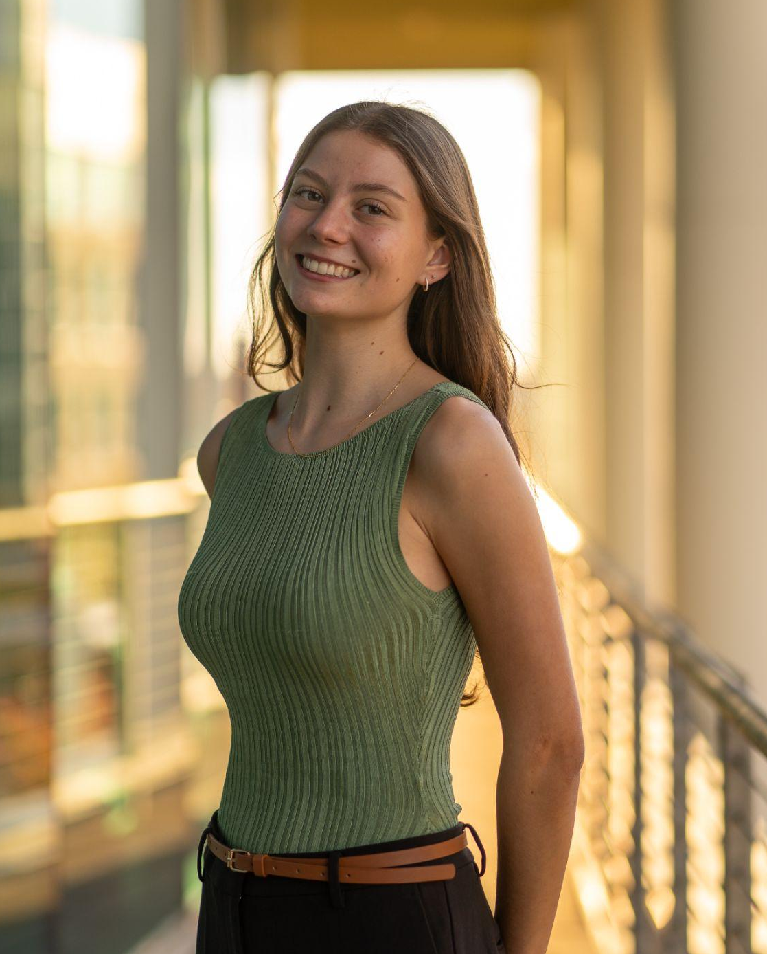
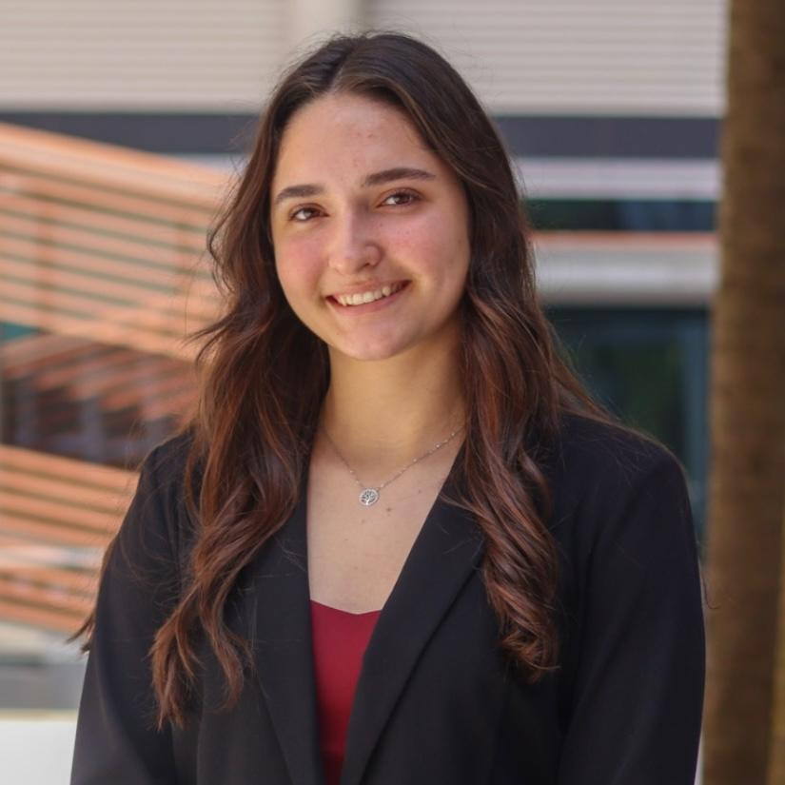
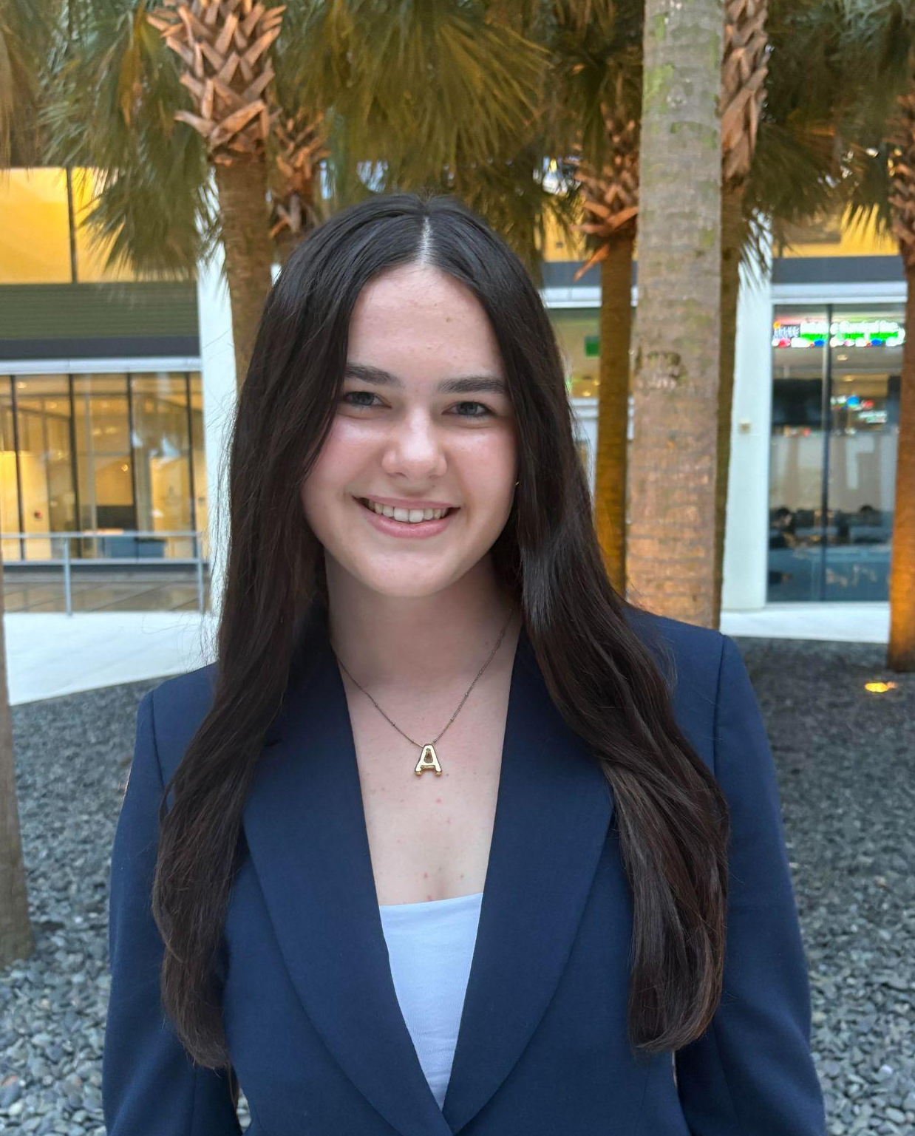
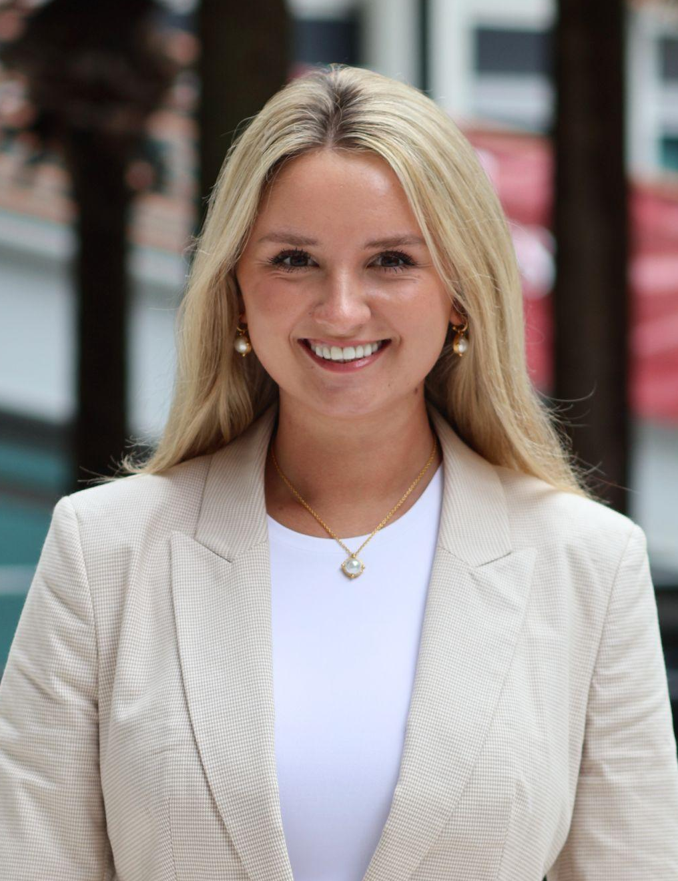
Executive Board
Sarah Grace Richardson
(President)
Francesca Zobrist
(Vice President)
Lilly Ritch (Director Recruitment & Retention)
Noelle Klasnick
(Director of Alumni Relations)
Brynley Wall
(CMO)
Shea Yeager (COO)
Taylor Wolf (CFO)
Kyndal Coleman
(Director of Media)
Katie Roberts (Director of WIBternship)
Frances Overton
(Director of Membership)
Brielle Kevitch
(Director of Conference)
Ava Rocco
(Director of
Finance)
Ava Lenahan
(Director of Mentorship)
Catherine Dewees
(Director of Outreach)

Slide 5
Bi-Weekly Body Meetings
Body meetings are every other week on Tuesdays at 7:30pm. They are a combination of virtual and in person meetings. Our body meetings consist of various speakers from different companies, as well as internship panels, professional development, and more.
Requirements for virtual meetings:
Camera must be turned on
If your camera is off or you look preoccupied (folding laundry, doing dishes, etc.), you will be removed from the meeting and will not be counted for attendance.

Slide 6
WIBternship
What is WIBternship and why is it required?
WIBternship is our new member program for freshmen and sophomores (although any WIB member is welcome to attend any workshops).
At meetings we go over the basics of employability in a low stakes environment, focused on learning and development.
Our speakers and contacts want to hire our members, so this program is important to provide our new members with the necessary skills.
What is the time commitment of WIBternship?
Every other Tuesday at 7:30PM* (opposite weeks as the body meetings)
Is WIBternship a competitive/rush process?
No! All we ask is that you show up, are engaged, and do your best!

Slide 7
WIBternship- Schedule
Tuesdays at 7:30PM, location TBD
  9/8– Professional Dress and Networking
  9/22– Resume & Interview Workshop
  10/6– LinkedIn and Headshots
  10/20– How to do a Case Competition
  11/17– Major Exploration & Internship Panel
  Week of 11/16– Case Competition (group sign-up)
To complete the WIBternship program members may miss one of the workshop meetings but everyone must complete the case competition!
Dress code is business casual (first meeting is casual!)
Once you complete the program - you’re an official WIBC member!

Slide 8
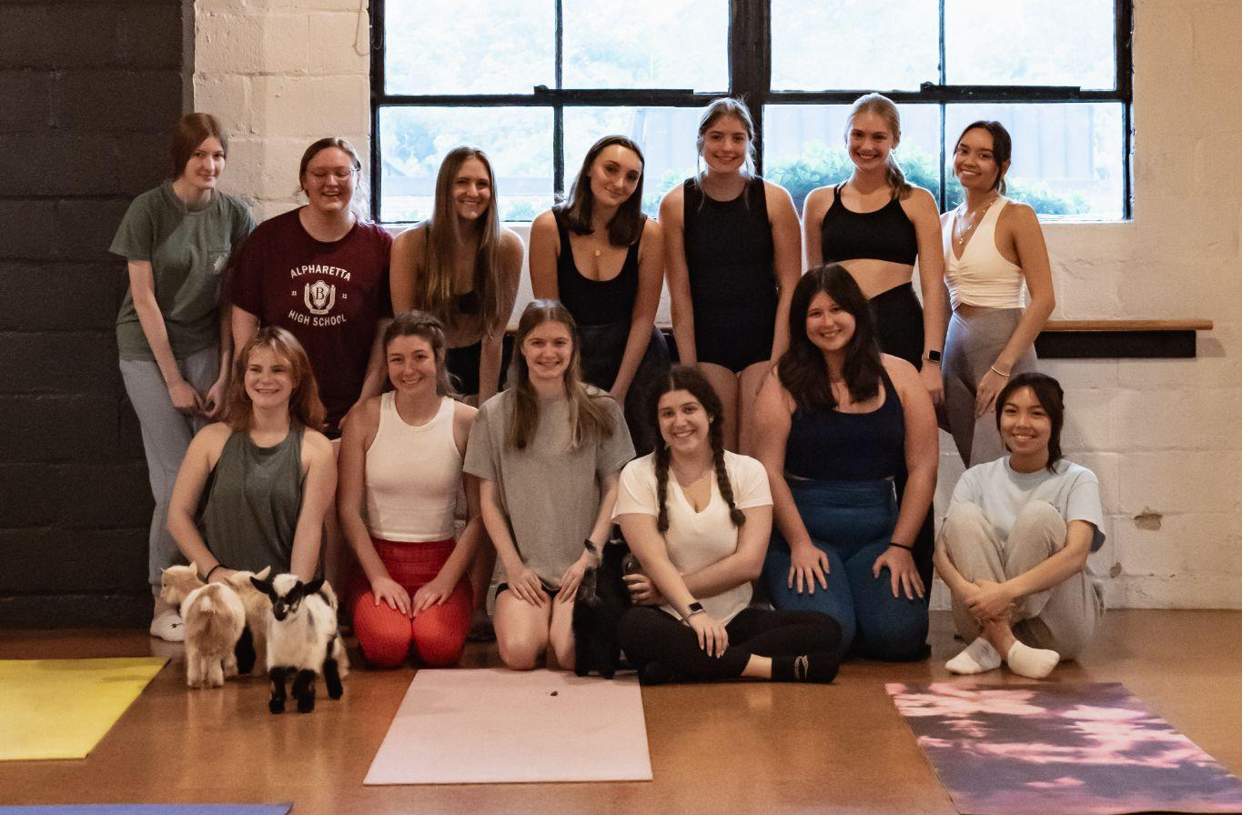
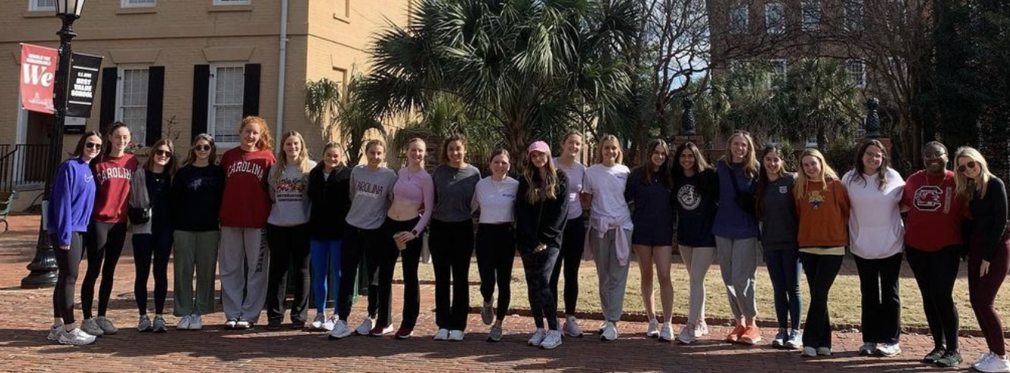
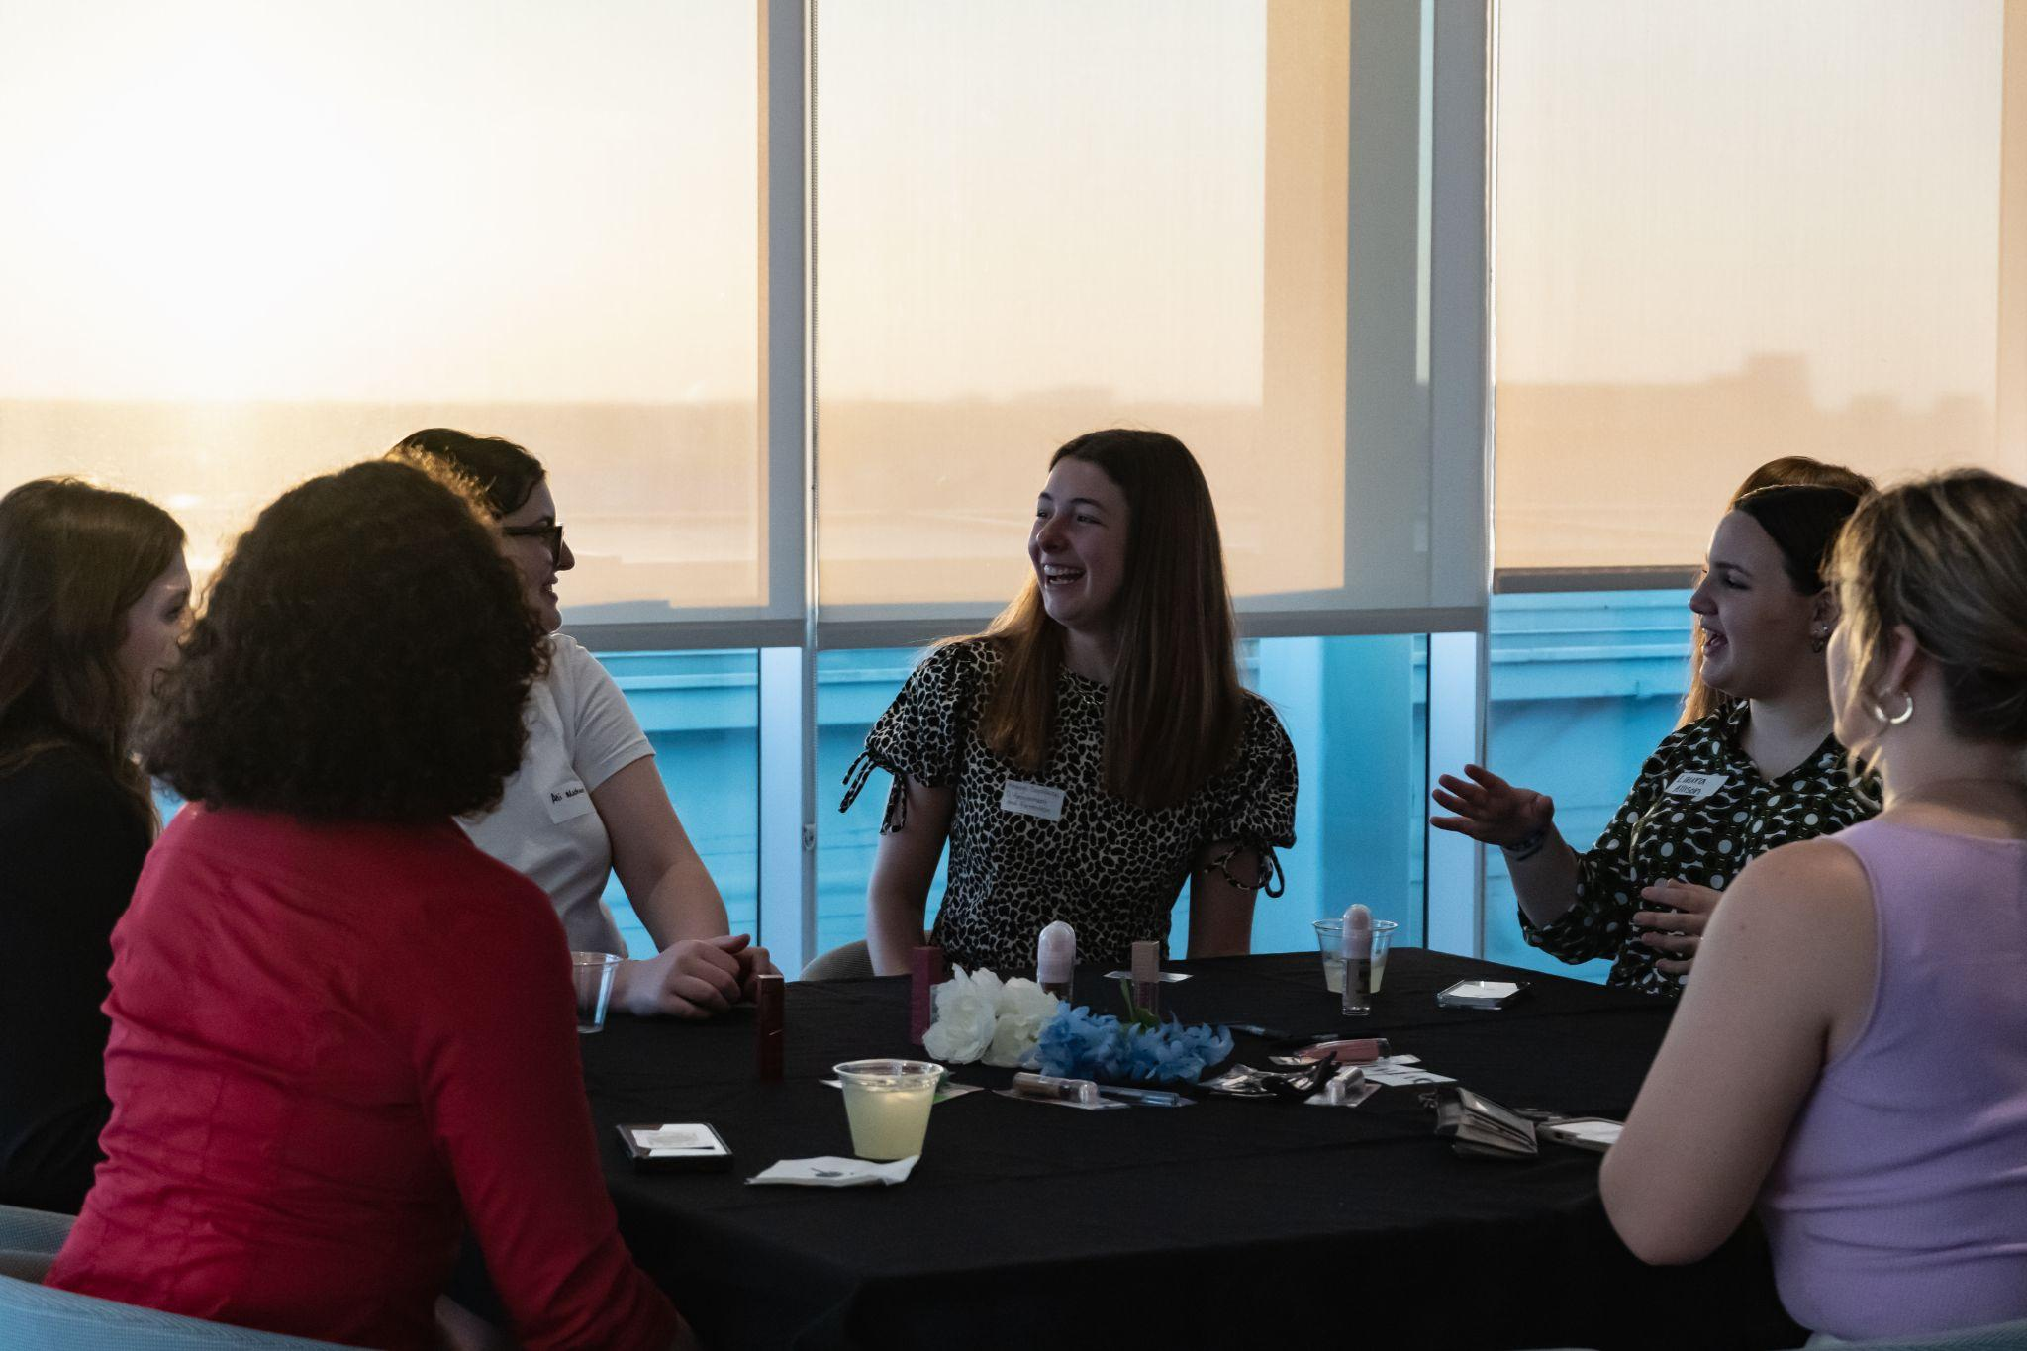
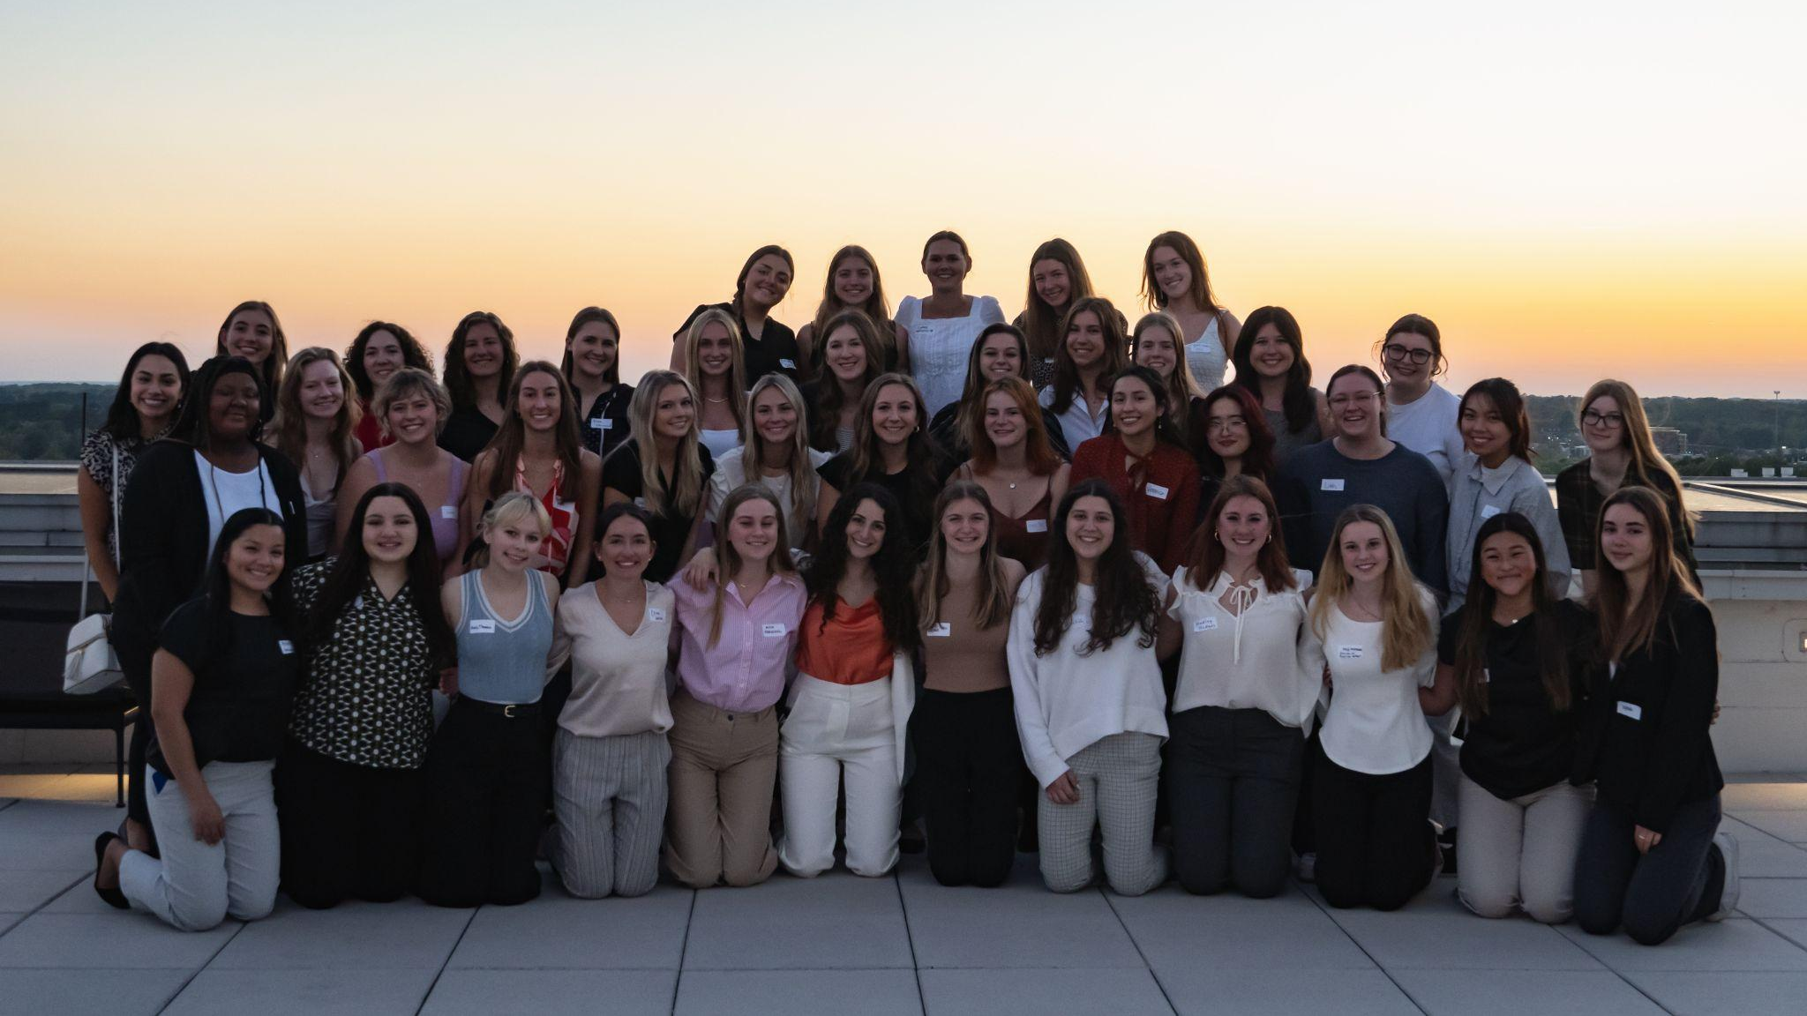
Past Social Events

Slide 9
Events to Look Forward To…
Potlucks
Craft events
Community Service Opportunities
Collaboration Events with other student orgs
Coffee Tabs
Company Panels
WIBC Spring Conference
And More!

Slide 10
Mentorship
In business it is always stressed how important it is to mentor and have a mentor, so we are bringing that idea to WIBC!
After filling out a form, you’ll get matched up with an upper or lower classmen based on major, interests, career, goals/etc.
We have fun events throughout the semester that all the mentee/mentor groups will come together for, but you’re also encouraged to meet outside of those!
You can earn up to 6 points by going to every event!
Some of our Mentorship events in past semesters include…
Claw Clip Making
Movie Nights
Paint & Sip
Ice Cream Sundae Bar
Walk & Talk
Class Registration Assistance

Slide 11
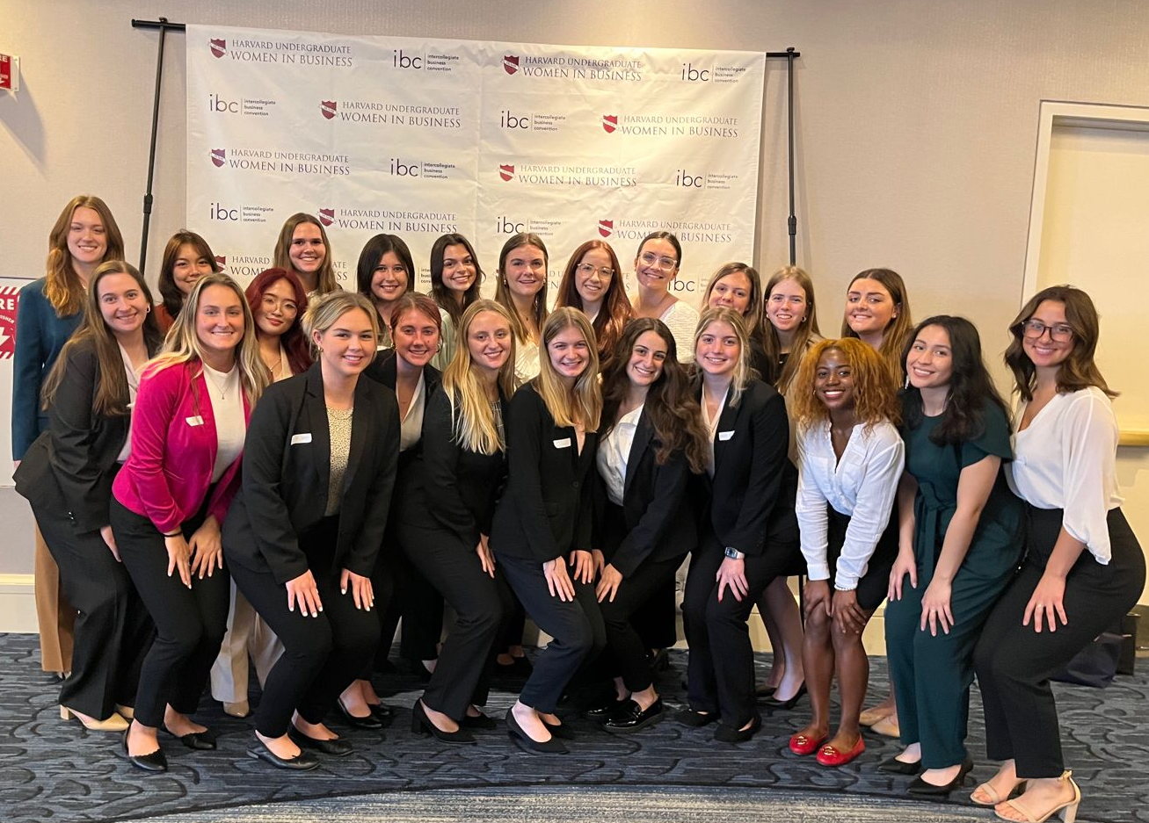
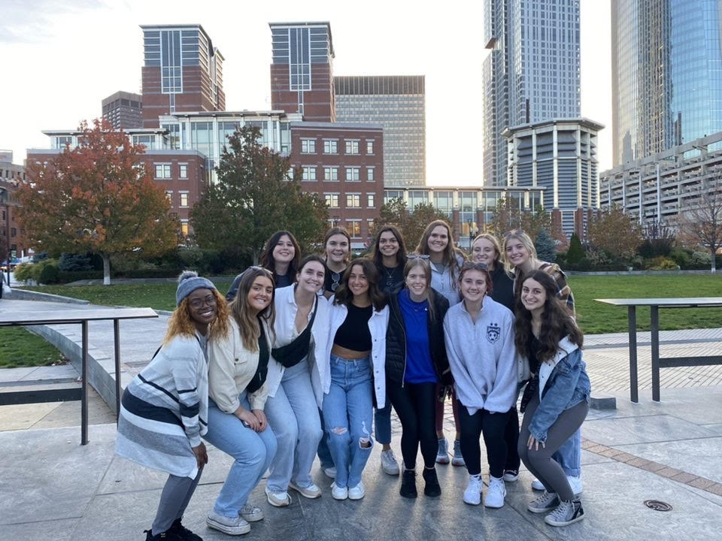
Harvard Intercollegiate Business Conference
The Harvard Women in Business Council puts on the annual IBC in Boston, MA. We have attended for many years, and are excited to be taking more members this year! Keep a look out for an application SOON!

Slide 12
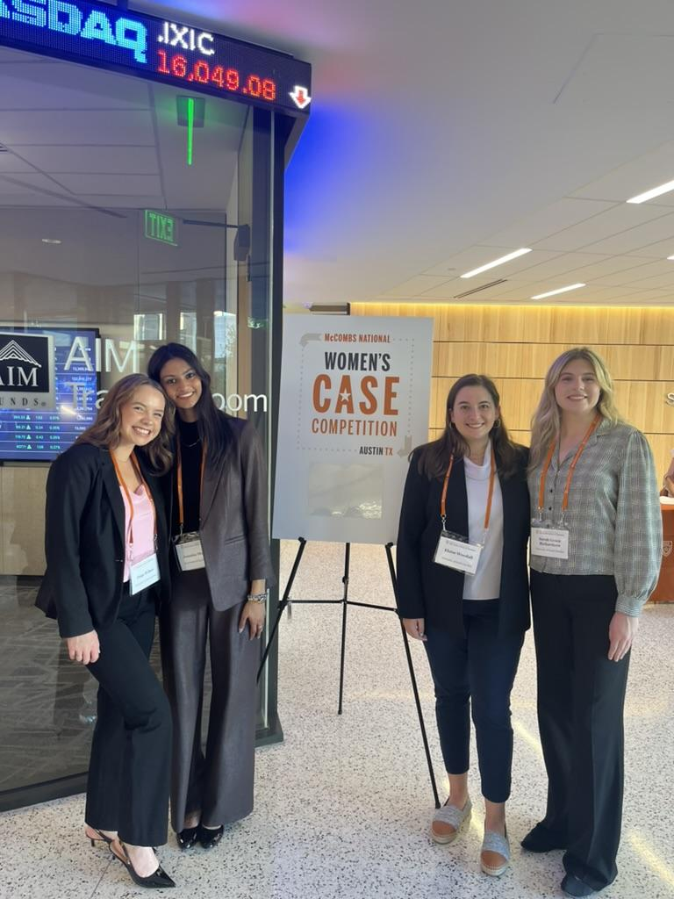
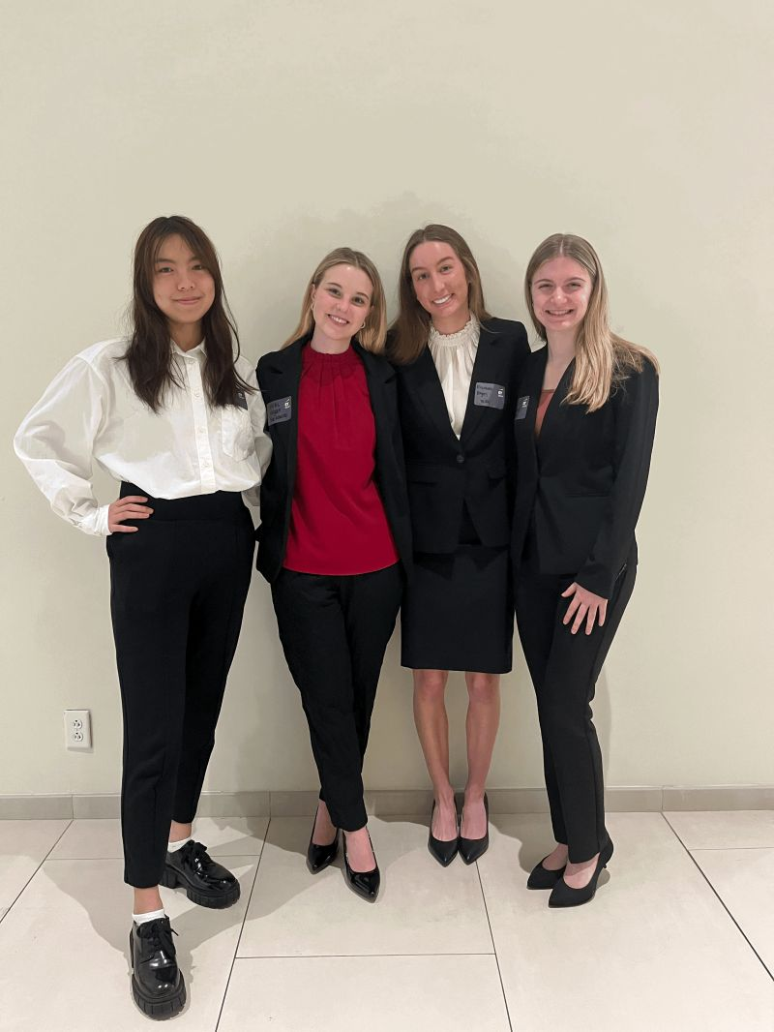
Case Competitions
In the past we had teams compete in case competitions including…
EY Case Competition at USC
Annual Women’s Case Competition in Austin, Texas

Slide 13














Where WIBC Works

Slide 14
Structure- Points System
New Members
Must obtain 16 total points
Attend at least 4 out of 5 WIBternship meetings
Attend at least 2 WIBternship/Mentorship social events
Participate in at least 1 event outside of body meetings
Returning Members
Must obtain 16 total points
Participate in at least 1 event outside of body meetings
All Members
Must attend at least 4 out of 7 body meetings
Free t-shirt at 16 points
  Top 3 point earners will receive a gift card at the end of the semester

Slide 15
TLDR:
New members can expect a meeting every Tuesday*
Returning members can expect a meeting every other Tuesday*
*Additional events not included
Points
Body Meetings–3 points each (5 body meetings + one social event meets your point requirement!)
Other events will count for 1-3 points depending on the event (Mentorship, social events, coffee and conversations, additional company speakers)
WIBternship Meetings do not count for points
The point requirement is not intended to be difficult to make!

Slide 16
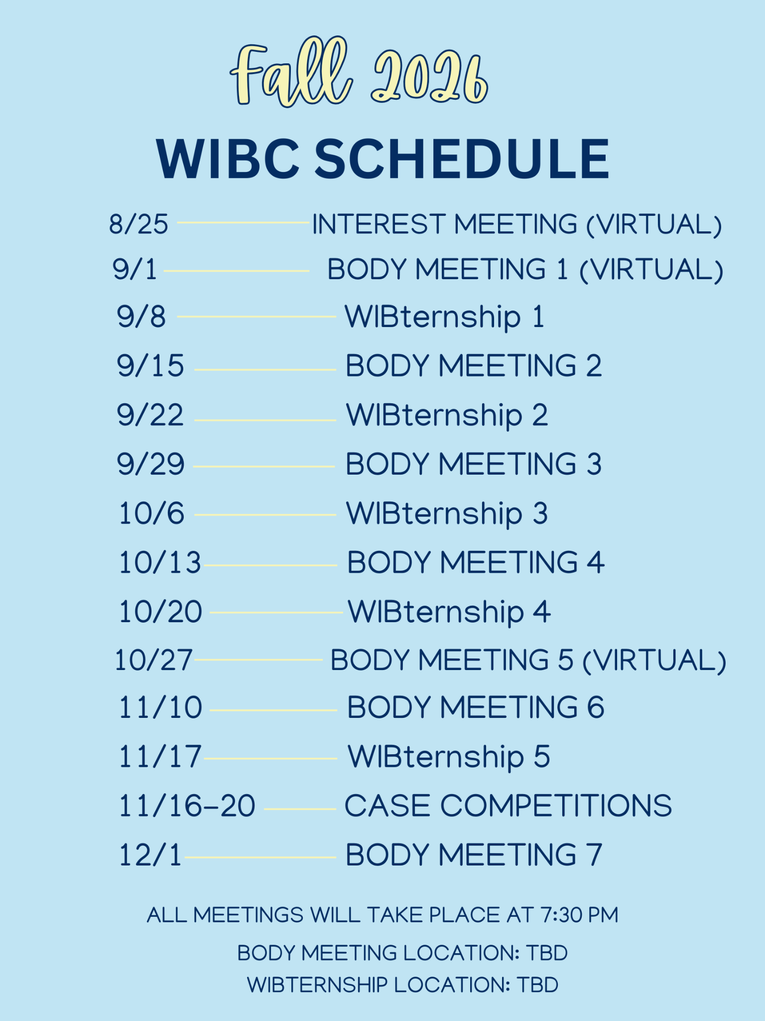
Fall 2026 WIBC Schedule

Slide 17
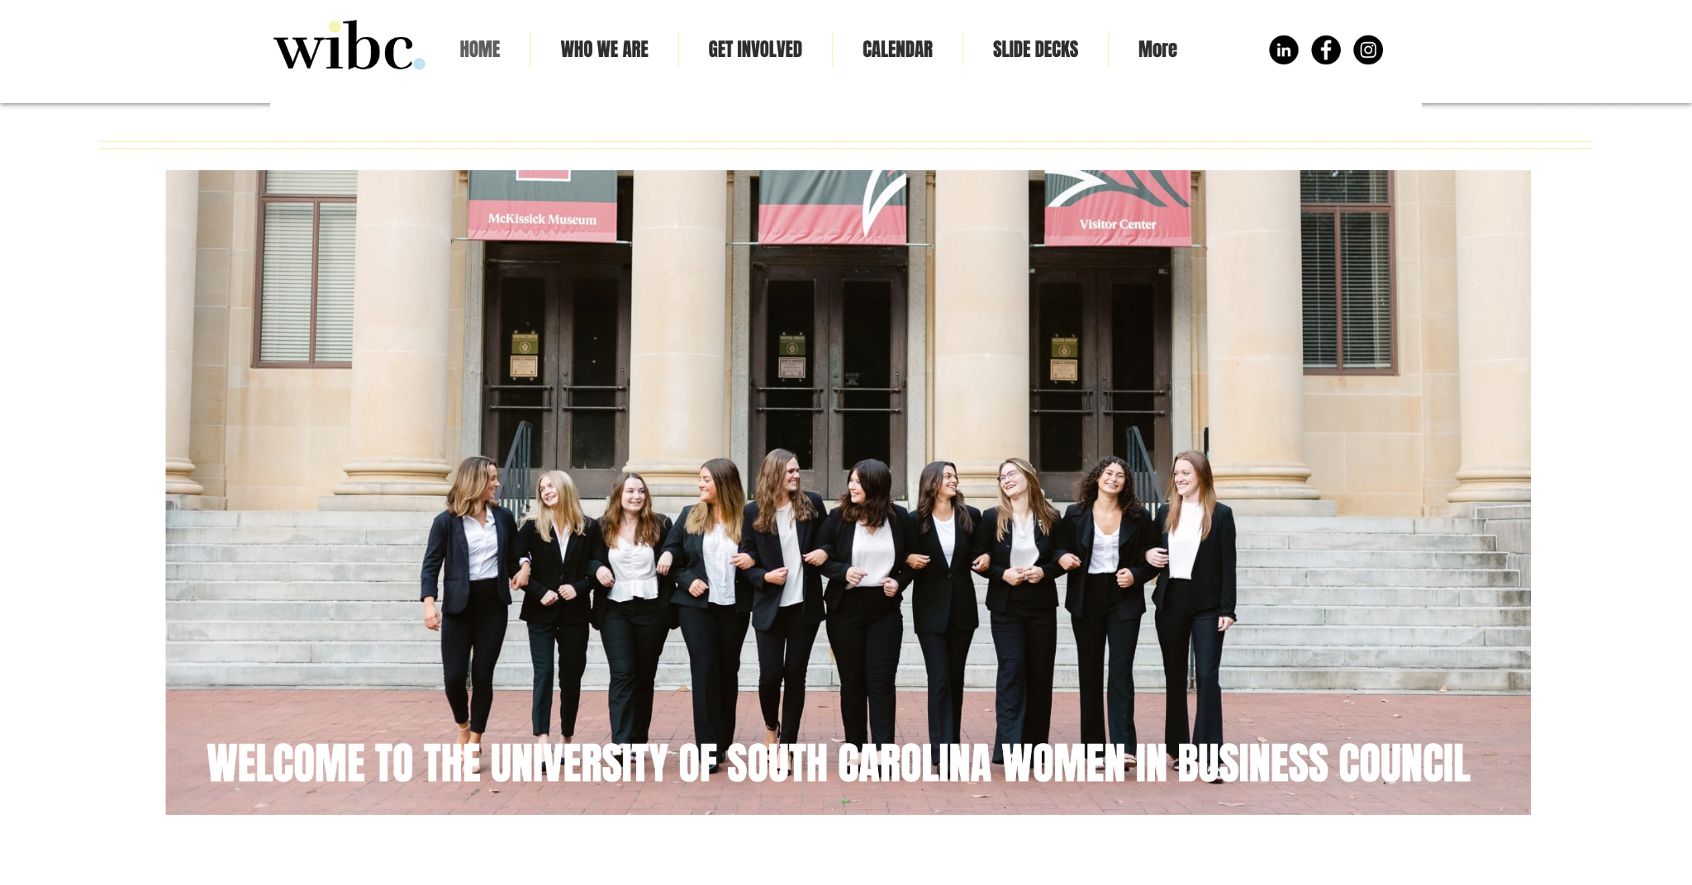
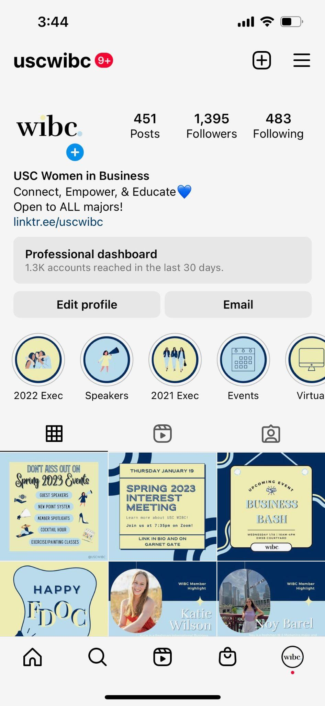
Where to Find Information
uscwibc.com
@uscwibc

Slide 18
How to Join
Ready To Join?
ZELLE $25 dues to uscwibc@gmail.com
  Due September 8th by 11:59pm
  Include your Name, USC email (WITHOUT the @email.sc.edu), PHONE NUMBER, and grade in the description
Request Membership on Garnet Gate
  We will only accept your request after you send dues

Slide 19
Body Meeting 1
"Off Campus: Alumni Panel.”
Our first body meeting will be Tuesday, September 1st, at 7:30pm VIRTUAL.

Slide 20
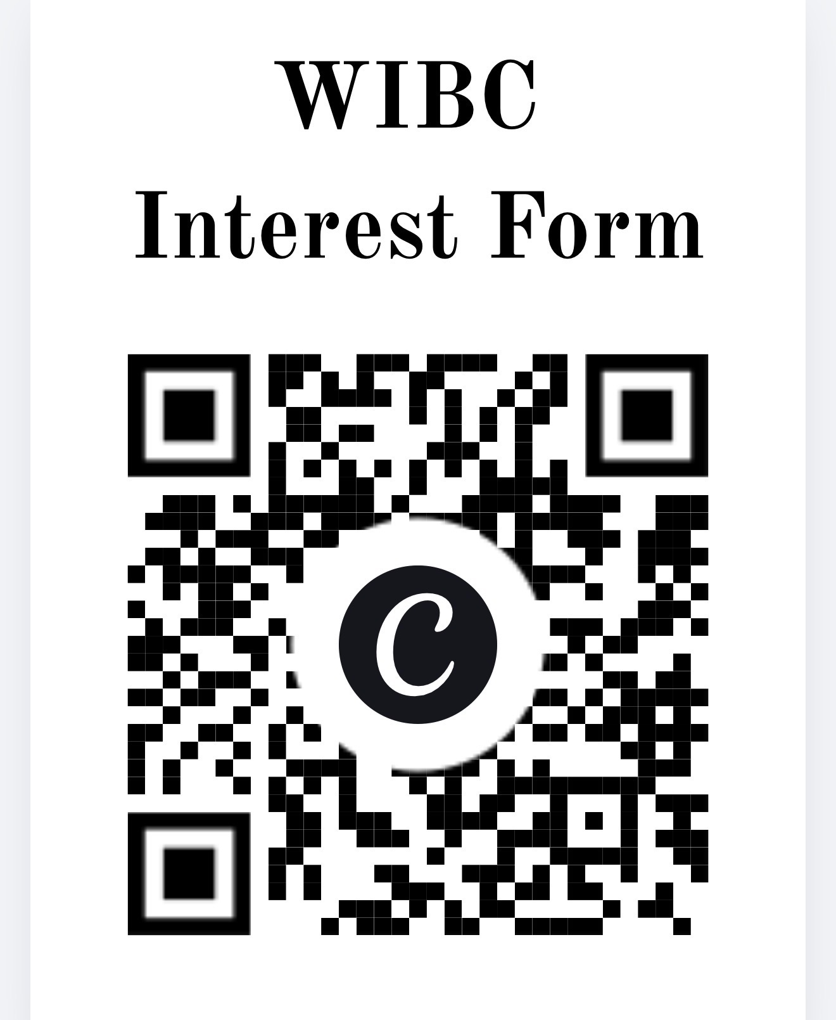
Interest Form

Slide 21

GroupMe

Slide 22
Thank you!

