Slide 1

Women in
Business Council:
Ace the Recruiting Process with Gartner
WIBC Body Meeting #2
9/15

Slide 2
WIBternship
What is it and why is it required?
WIBternship is our new member program for freshmen and sophomores (although any WIB member is welcome to attend any workshops).
We lay down the basics of employability in a low stakes environment, focused on learning and development.
Our speakers and contacts want hire our members, so it is important to employ our members with the necessary skills.
What is the time commitment of WIBternship?
Every other Tuesday at 7:30PM* (opposite weeks as the body meetings)
Is WIBternship a competitive/rush process?
No! All we ask is that you show up, are engaged, and do your best!

Slide 3
WIBternship Requirement
Tuesdays at 7:30PM
Location: mostly Jones 210 (if not, Currell 107)
Email: uscwibternship@gmail.com
We ask you make you best effort to attend all meetings as they will each teach an important skill! However we understand life happens so one (1) workshop absence is allowed. The case competition is required.
Once you complete the program - you’re an official WIBC member!

Slide 4
Next WIBternship
Next Tuesday September 22nd, 2026
Time & Location: 7:30 at Jones 210
Meeting Content: Resumes & Interviews
Dress code: Business casual
Please bring a laptop!!!
Next Social Event:
Wednesday September 23rd, 2026
Time & Location: 7-8 at Russell 315
Event: Resume Workshop & Dirty Soda
Dress code: casual

Slide 5
Social Event Policy
Policy to Social Events:
Members who register & don’t attend events (or cancel without warning) will receive a penalty.
Penalties:
1st Offense: Reminder & Warning
2nd Offense: 1 Point removed
3rd Offense: Restriction of events sign-up/registration

Slide 6


Outreach/R&R
The Hive Community Circle
WIBC is excited to partner with The Hive Community Circle this semester to support survivors in our Columbia community through hands-on service opportunities and fundraising.
Roast & Toast Fundraiser
Where: 2030 Gregg St.
When: Wednesday, 9/30 3-10 PM
Double Point Opportunity!
There's still spots available - reach out to me if interested!
cdewees@email.sc.edu

Slide 7

Outreach/R&R
PLAYA BOWLS PERCENT
Benefiting the Hive!
Where: Playa Bowls at 737 Gadsden St.
When: Friday, 10/9 @2-9PM

Slide 8
Mentorship
Mentor-Mentee pairings were sent out via email to Mentors at the end of last week. Please reach out to your mentees ASAP if you have not yet. Mentees please contact me (lenahanl@email.sc.edu) if you have not heard from your mentor yet. We’ll be sending out an email at the end of the week with topic ideas for you to cover in your first meeting. Our next event will be a paint & sip on October 7th so sign ups will come out in a few weeks!
Reminders for meetings:
Try to meet with your mentor/mentee three times this semester. Fill out the Google form every time you meet- the link was included with the email to mentors!

Slide 9

Next Body Meeting
Meeting Etiquette:
During body meetings (virtual & in-person), please be as respectful as possible to our speakers and your peers.
This includes: showing up on time & staying engaged throughout the meeting
From Campus to Career: Building Your Brand with PGIM
Tuesday, September 29th @ 7:30 PM Jones 210

Slide 10
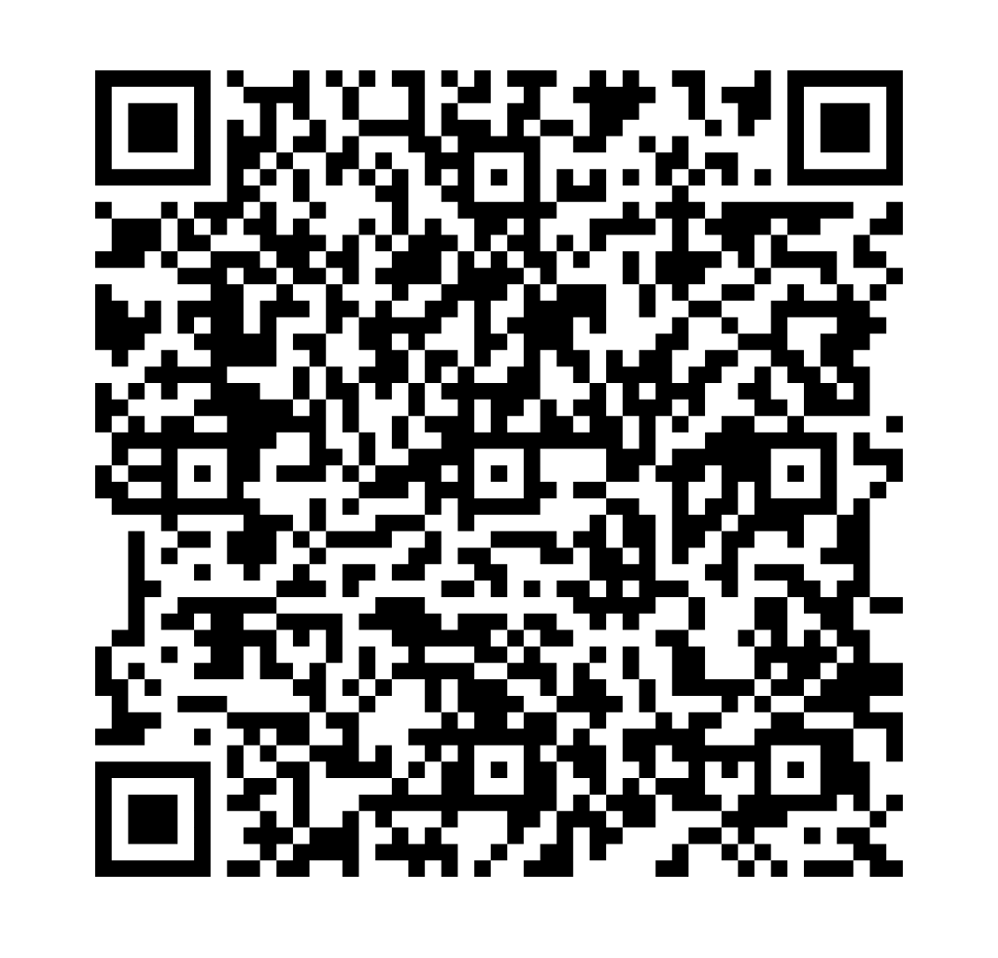
HARVARD CONFERENCE!
Each year, we send a group of members to attend the Harvard Women in Business Conference in Boston, MA. WIB pays for the flights, hotels, and tickets for each remember selected.
When: 11/6-11/8
***MUST miss Friday 11/6
This application is due on September 22nd at 11:59PM.

Slide 11
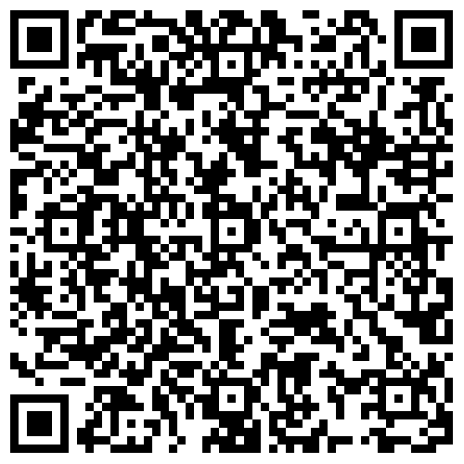
WIBC Emails
If you have paid your dues and are NOT receiving body meeting reminder/recap emails from “WIBC Exec Team”, please fill out this form!
Note: Check your junk/spam folder first!

Slide 12
Structure- Points System
New Members
Must obtain 16 total points
Attend at least 4 out of 5 WIBternship meetings
Attend at least 2 WIBternship/Mentorship social events
Participate in at least 1 event outside of body meetings
Returning Members
Must obtain 16 total points
Participate in at least 1 event outside of body meetings
All Members
Must attend at least 4 out of 7 body meetings
Free t-shirt at 16 points
  Top 3 point earners will receive a gift card at the end of the semester

Slide 13
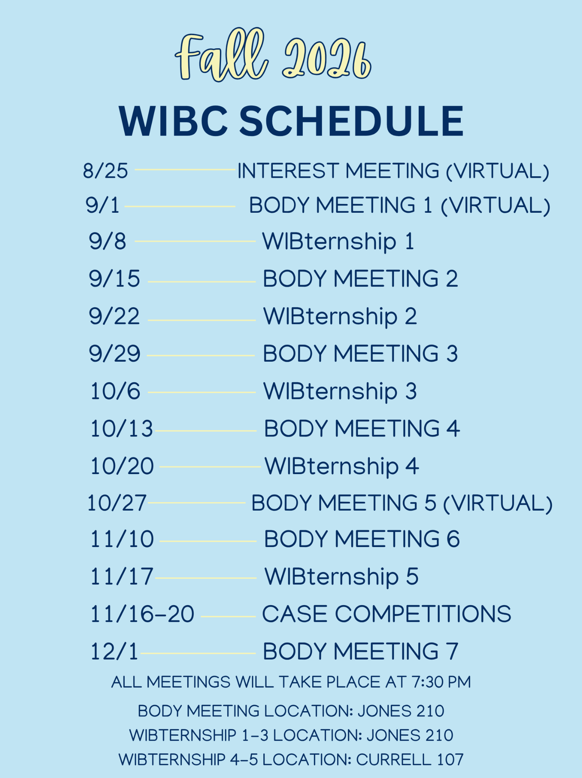
Fall 2026 WIBC Schedule

Slide 14

GroupMe - WIBC

Slide 15
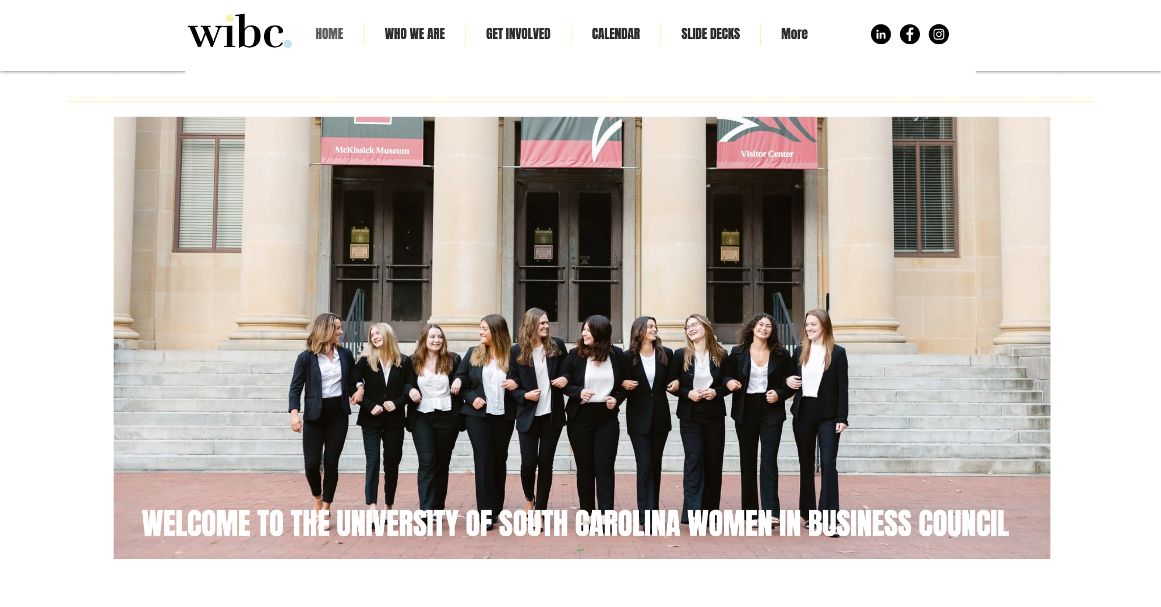
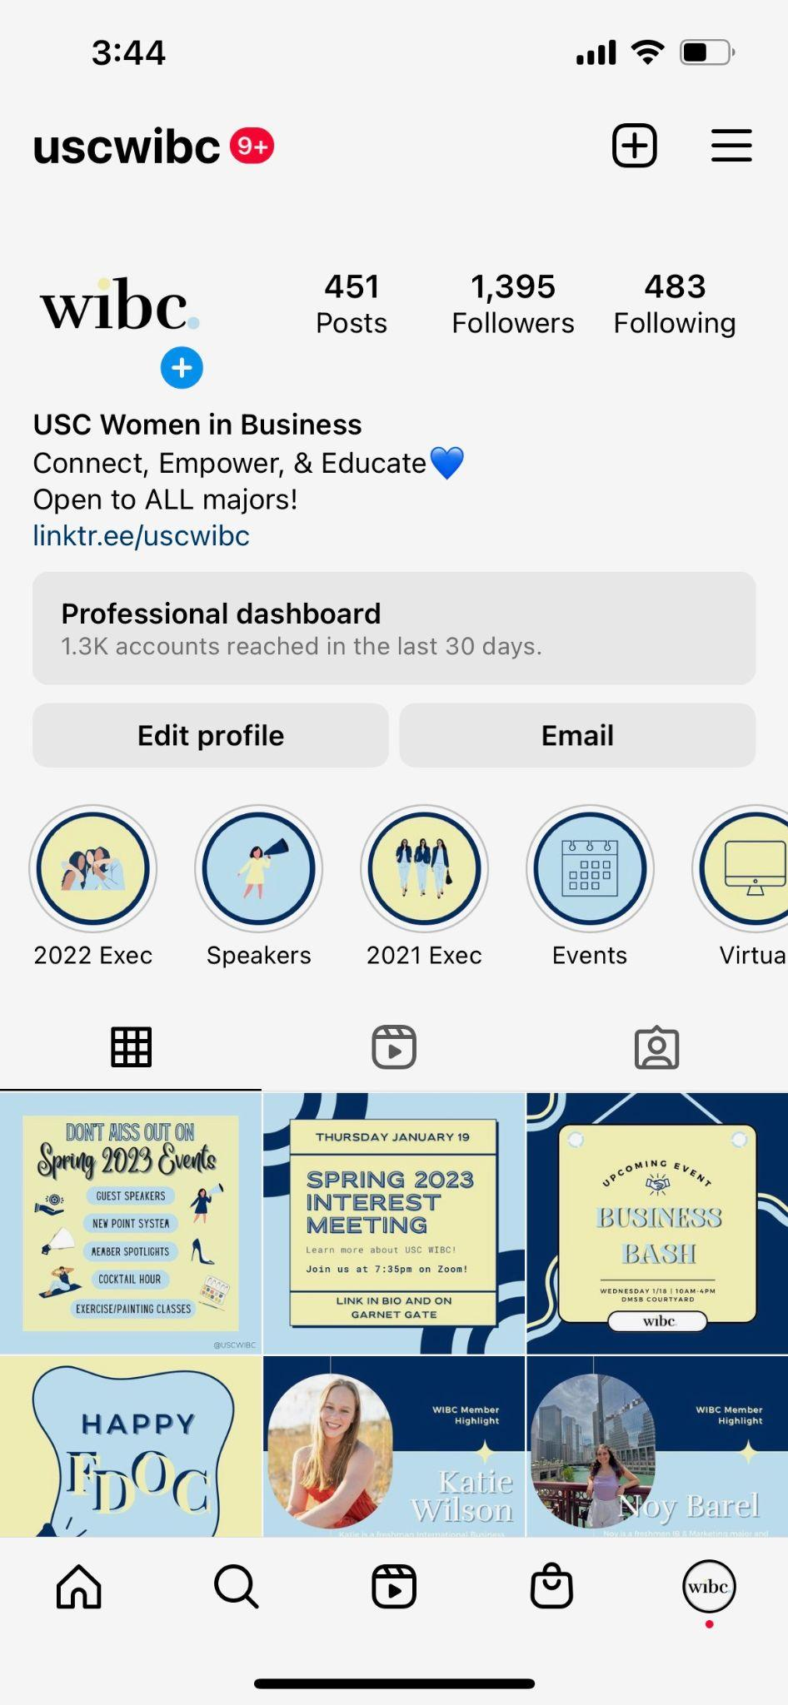
Where to Find Information
uscwibc.com
@uscwibc

Slide 16
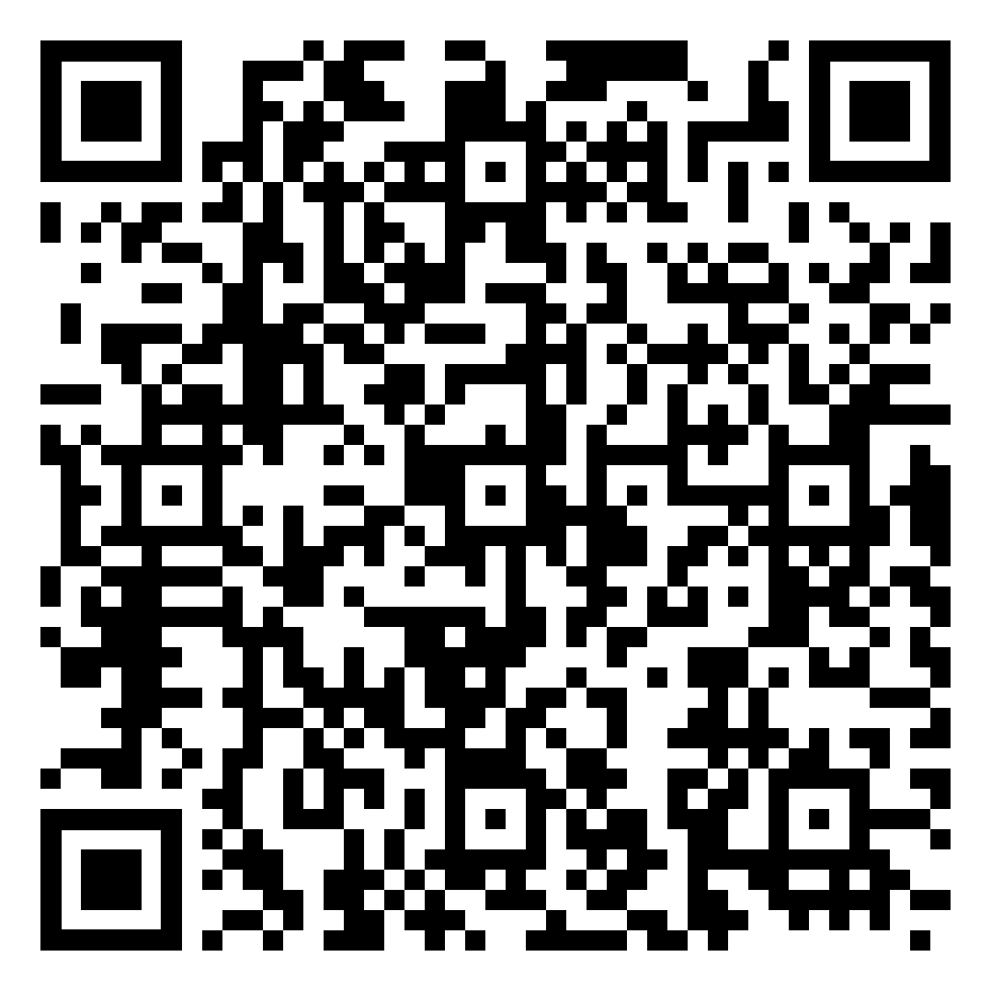
Attendance!

Slide 17
Thank you!

