Slide 1

Women in
Business Council:
Off-Campus Alumni Panel
WIBC Body Meeting #1
9/1

Slide 2
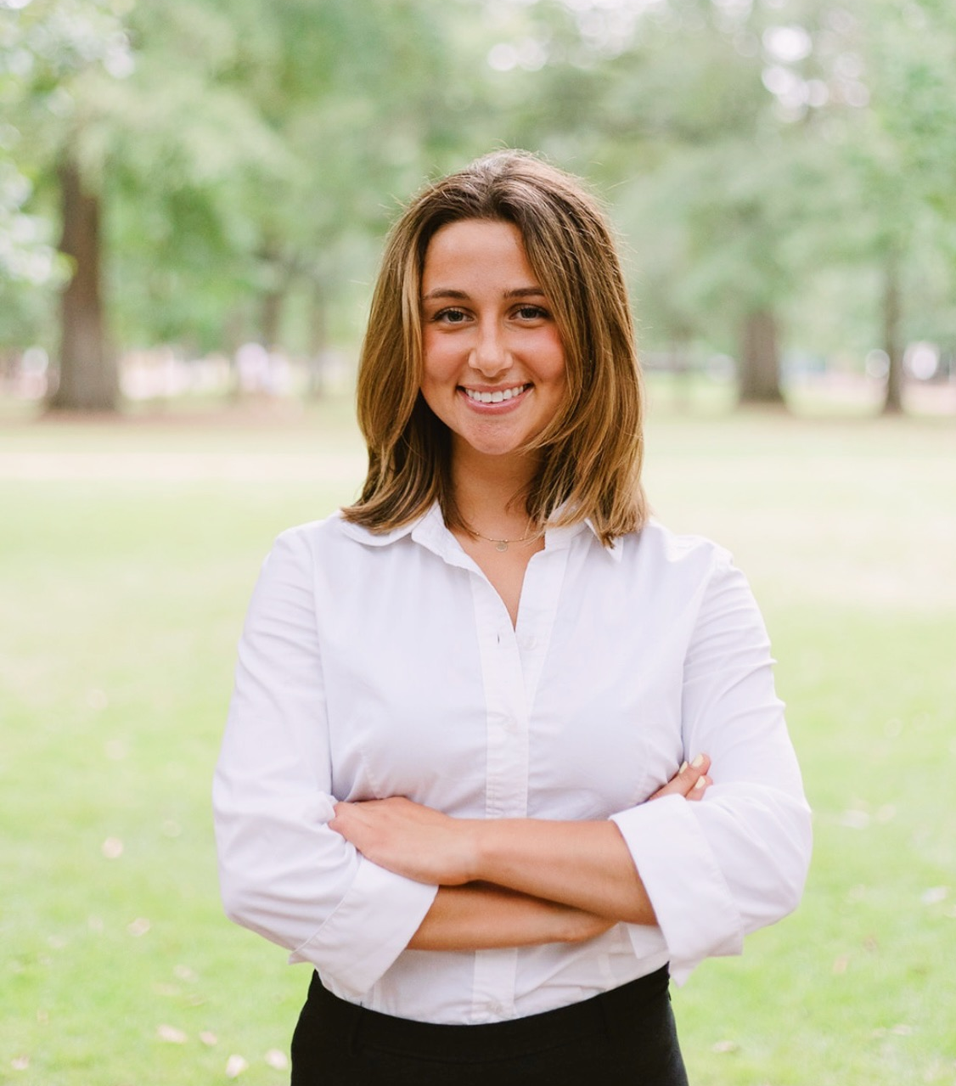
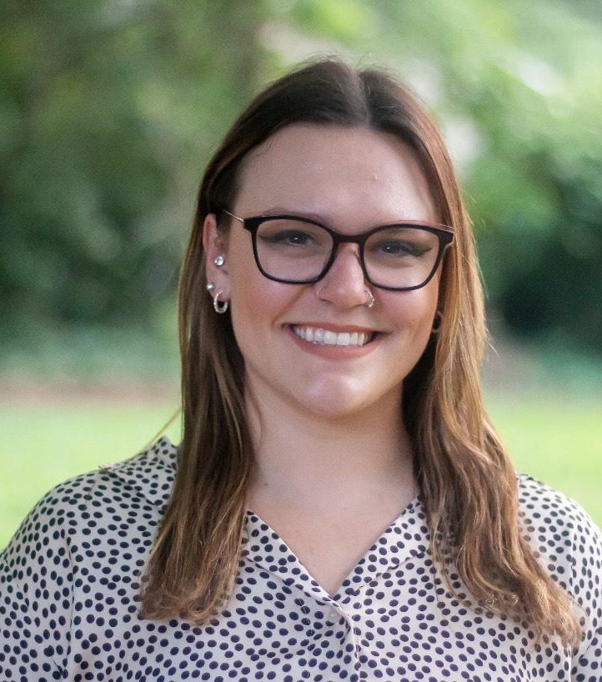
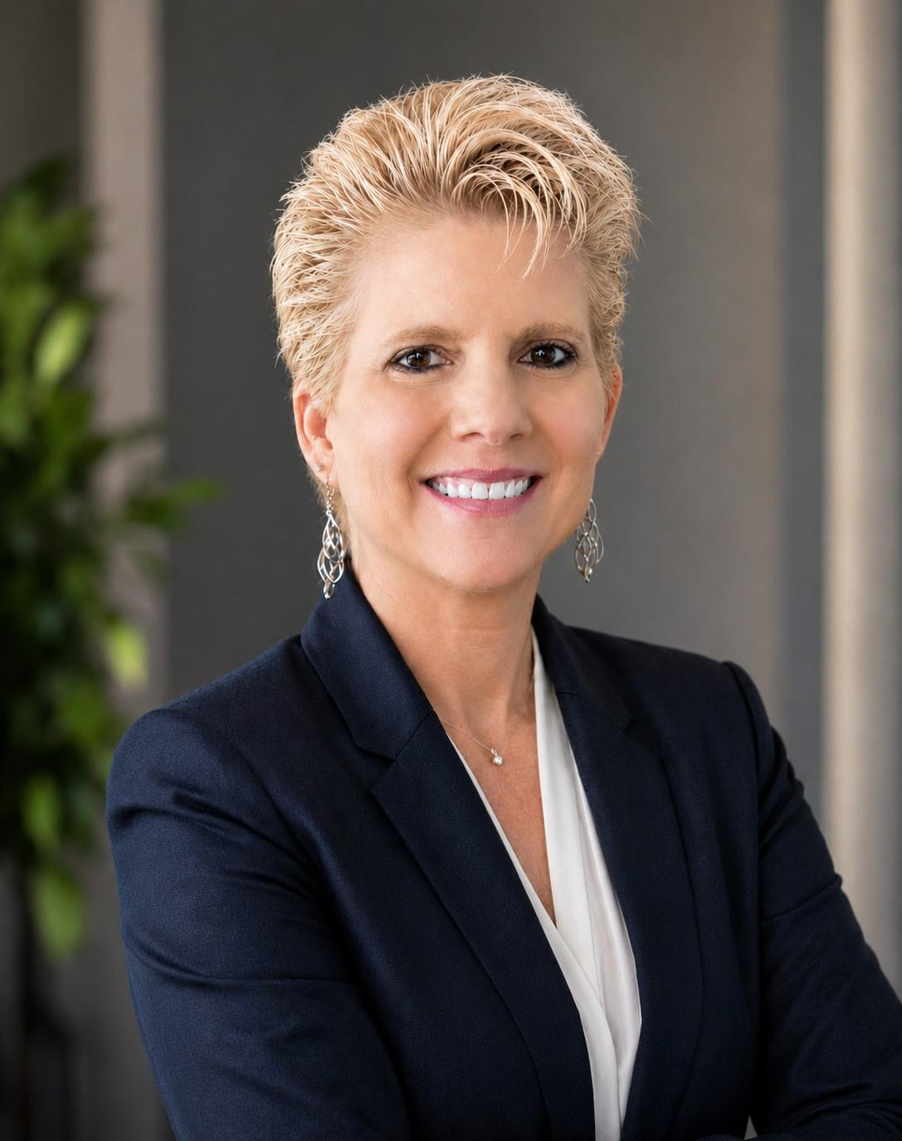
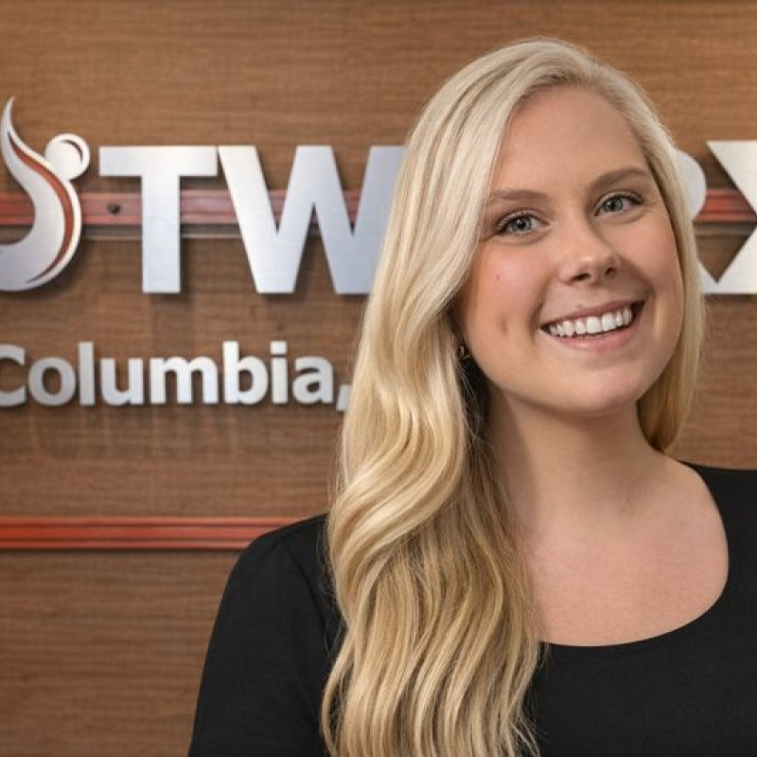
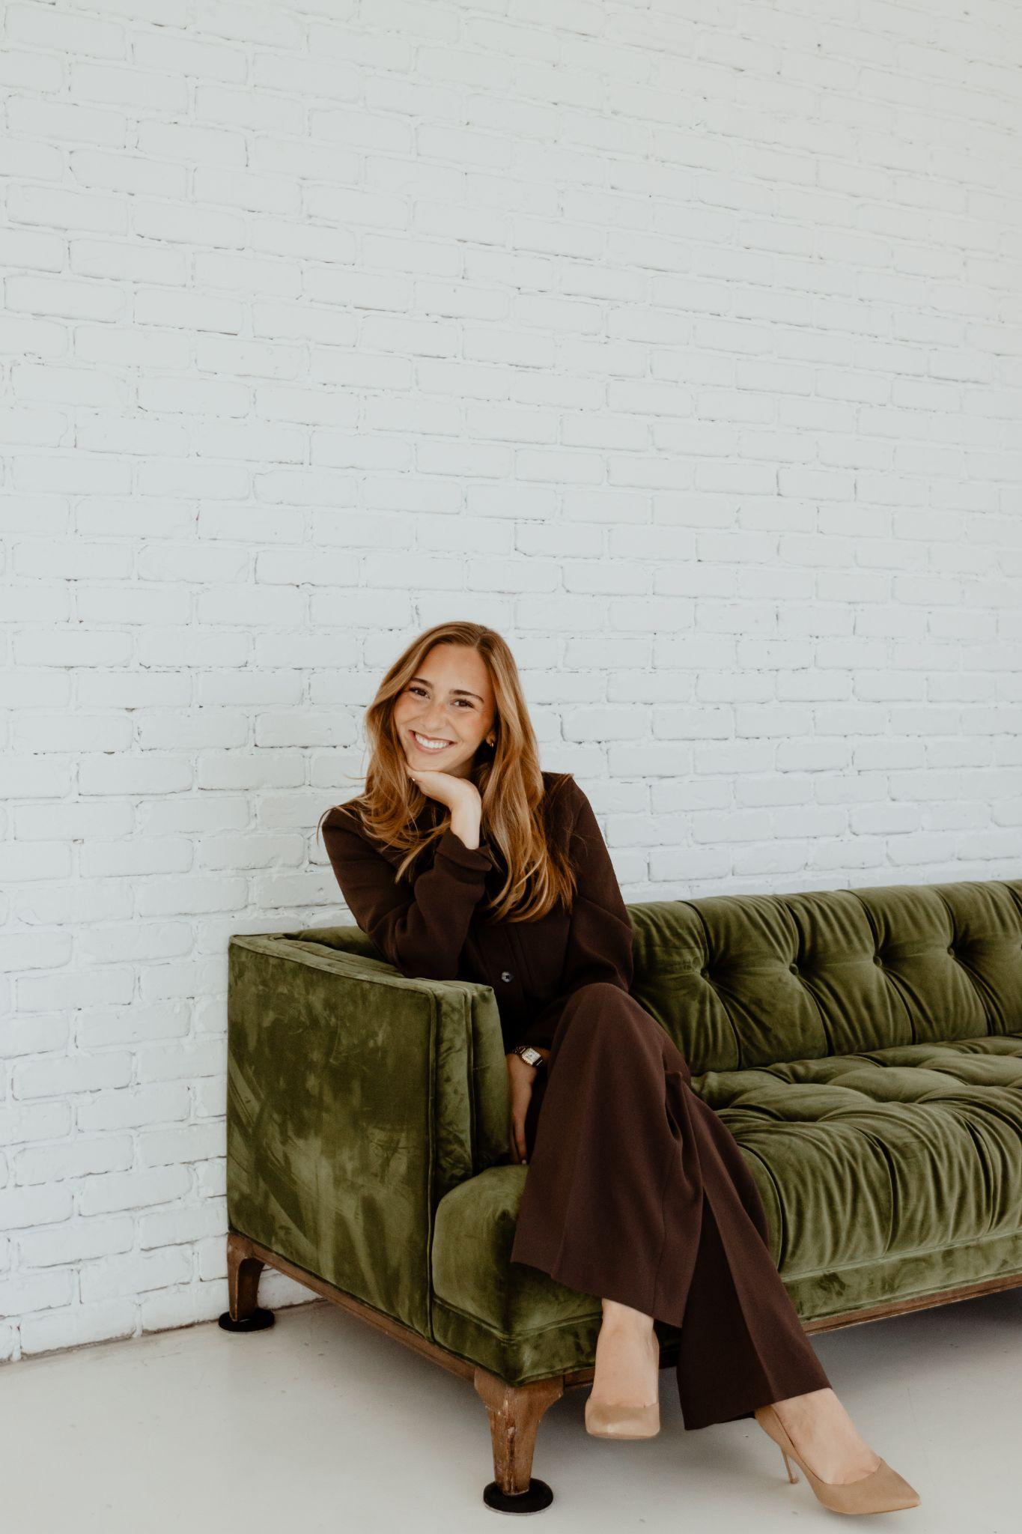
Our Panelists
Jill Schweizer ‘22
Abigail Hardee ‘17
Karena Bell, MBA ‘17
Sarah Luther ‘19
Sydney Halverson ‘25

Slide 3
Jill Schweizer
Jill graduated from USC in 2022 with a degree in Finance and Data Analytics. She began her career in SaaS sales at Oracle NetSuite in Austin, TX, working her way from Sales Development Representative to Account Manager, before taking a brief career break and moving into fintech.
She's now in San Diego, CA, working as an Account Development Manager at Mercury, a banking platform for startups, where she works with founders to expand their relationship and usage of the platform.

Slide 4
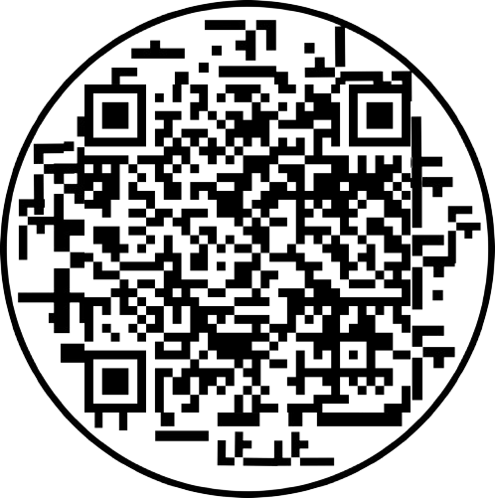
Sarah Luther
Sarah graduated from the Arnold School of Public Health at USC in 2019 with a degree in Exercise Science. Her career in health and fitness management began while she was still in college in 2015. During her time at USC, she set a goal to one day become a partner or business owner of a health and fitness company.
Now, ten years later, she is the Managing Partner of HOTWORX Columbia. The team opened its first location in February 2024, a second in June 2026, and is currently working on a third location. While she loves health and fitness, she is even more passionate about building teams, creating opportunities, and helping turn big goals into reality.
She is excited to share a little of her journey and hopefully encourage others to chase the goals they set for themselves—even when they may not have every step figured out yet.

Slide 5
Abigail Hardee
Abigail Hardee is a Sr. Global Procurement Contracts Manager at Krispy Kreme, where she leads complex indirect vendor negotiations, contract strategy, and cross-functional partnerships. Prior to Krispy Kreme, she held procurement and sourcing leadership roles at PwC and Vialto Partners, specializing in technology contracting.
She is a proud DMSB and Honors College graduate, where she earned degrees in Global Supply Chain & Operations Management (GSCOM) and International Business, with a minor in Chinese Studies. She also studied abroad at Fudan University in Shanghai, China as part of the IB program.
Outside of work, Abigail enjoys scuba diving, spending time with her boyfriend and cat, and is currently learning how to golf!

Slide 6
Sydney Halverson
Sydney Halverson is the Brand Marketing Specialist for Olydoe Golf, a Dallas-based golf apparel brand she helped successfully launch in October 2025. Before graduating from USC’s Darla Moore School of Business in May 2025, Sydney interned at Southwest Airlines, specializing in sports sponsorship and event activations.
She’s applied that experience to the Olydoe brand, where she's grown her expertise in go-to-market strategy, retail partnerships, and creative direction for a brand redefining golf apparel through natural materials. Her passion for brand building allows her to build authentic relationships in the golf industry and lead every project with clarity and intention.

Slide 7
Karena Bell
Karena Bell is the Founder and CEO of ProfitLinz®, a profit optimization and growth advisory firm that works with founder-led and mid-market companies to uncover the operational, financial, and strategic constraints that quietly erode profitability and limit growth.
Her career has been built around a simple belief: strong businesses aren't created by revenue alone. They're created by leaders who understand how decisions across operations, pricing, cash flow, people, and strategy ultimately translate into profit and enterprise value.
Beyond ProfitLinz, Karena is actively involved in business leadership, education, and executive communities. She serves in leadership roles with The Connective, a national B2B relationship and referral community, and currently sits on the Trident Technical College Foundation Board of Trustees, supporting stronger connections between education, business, and the broader community.
As a University of South Carolina alumna, Karena is especially passionate about helping emerging professionals understand that their first job doesn't determine their career, and their career doesn't have to follow a perfectly planned path. The ability to think critically, build meaningful relationships, solve difficult problems, communicate with confidence, and remain willing to reinvent yourself can become far more valuable than any single job title.

Slide 8
Our Panelists
Jill Schweizer ‘22
Abigail Hardee ‘17
Karena Bell, MBA ‘17
Sarah Luther ‘19
Sydney Halverson ‘25

Slide 9
WIBternship
What is it and why is it required*?
WIBternship is our new member program for freshmen and sophomores (although any WIB member is welcome to attend any workshops).
We lay down the basics of employability in a low stakes environment, focused on learning and development.
Our speakers and contacts want hire our members, so it is important to employ our members with the necessary skills.
What is the time commitment of WIBternship?
Every other Tuesday at 7:30PM* (opposite weeks as the body meetings)
Is WIBternship a competitive/rush process?
No! All we ask is that you show up, are engaged, and do your best!

Slide 10
WIBternship Requirement
Tuesdays at 7:30PM
Location: mostly Jones 210
Email: uscwibternship@gmail.com
We ask you make you best effort to attend all meetings as they will each teach an important skill! However we understand life happens so one (1) workshop absence is allowed. The case competition is required.
Once you complete the program - you’re an official WIBC member!

Slide 11
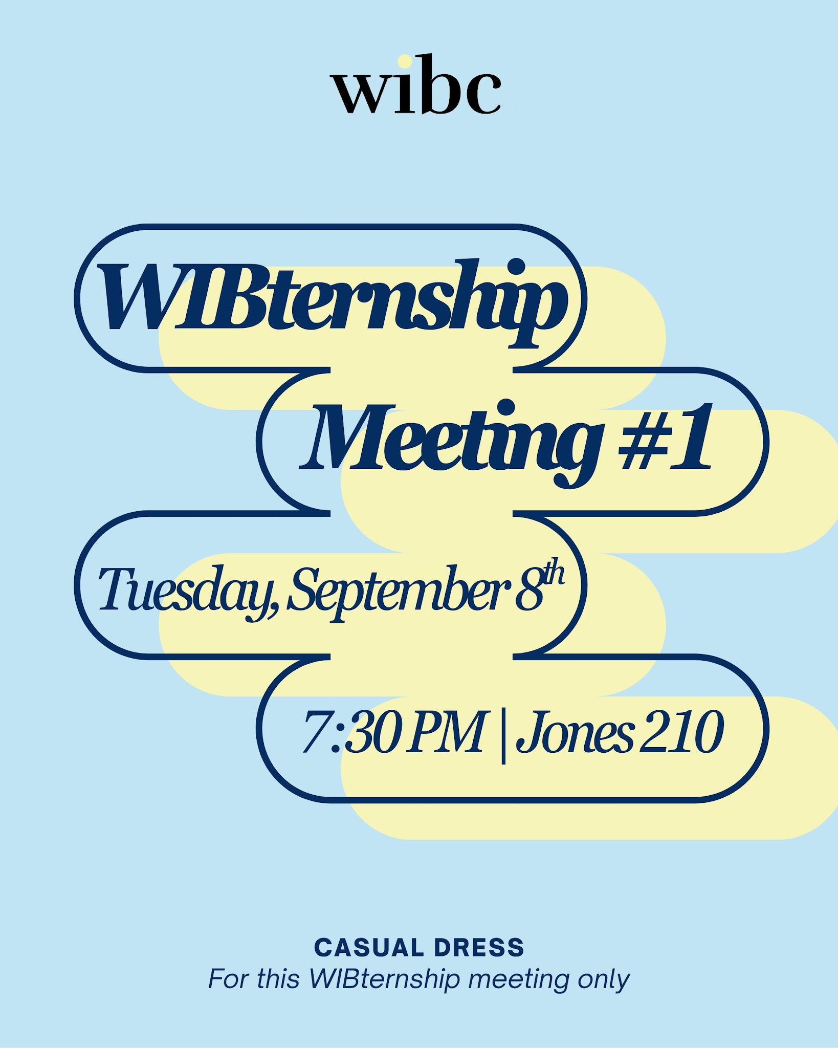
Next WIBternship
Next Tuesday September 8th, 2026
Time & Location: 7:30 at Jones 210
Meeting Content: Professional Dress & Networking
Dress code: Casual

Slide 12

WIBternship Looking Ahead
First WIBternship/Mentorship social event
Next Friday September 11th, 2026
Time & Location: 12-2 at Russell 302
Event: Write a letter to your future self and meet your mentor

Slide 13
Social Event Policy
Policy to Social Events:
Members who register & don’t attend events (or cancel without warning) will receive a penalty.
Penalties:
1st Offense: Reminder & Warning
2nd Offense: 1 Point removed
3rd Offense: Restriction of events sign-up/registration

Slide 14

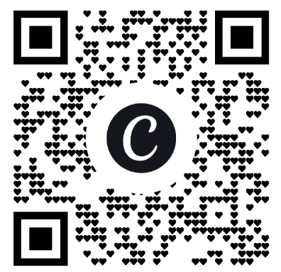
Outreach/R&R
Hometown Potuck
Come hungry for our Hometown Potluck! Bring a favorite food from your hometown, your background, something that represents you, or just a food you love! Expect lots of food, drinks, crafts, and a cozy night with WIBC.
Sign up coming in Groupme
Where: Russel 302
When: Monday, 9/14 at 8 PM

Slide 15


Outreach/R&R
The Hive Community Circle
WIBC is excited to partner with The Hive Community Circle this semester to support survivors in our Columbia community through hands-on service opportunities and fundraising.
Roast & Toast Fundraiser
Where: 2030 Gregg St.
When: Wednesday, 9/30 3-10 PM
Double Point Opportunity!
Look out for shift sign-ups in the Groupme

Slide 16
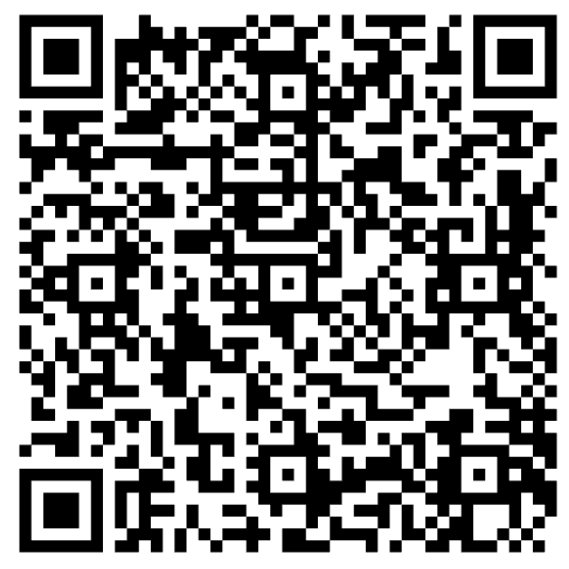
Mentorship
Join the Mentorship Program:
Mentors- anyone sophomore or older who has completed the WIBternship program
Mentees- any freshman or new members who have not completed the WIBternship program
* You do not have to have a ton of experience or an internship to be a mentor!
Requirements:
Try to meet with your mentor/mentee at least 3 times in the semester (FT, group, coffee)
Try to attend an event
Matching Form
Form is open until 9/8 after Wibternship- pairings will be sent out on 9/11 in the AM so you can attend the first event mid-day on 9/11

Slide 17
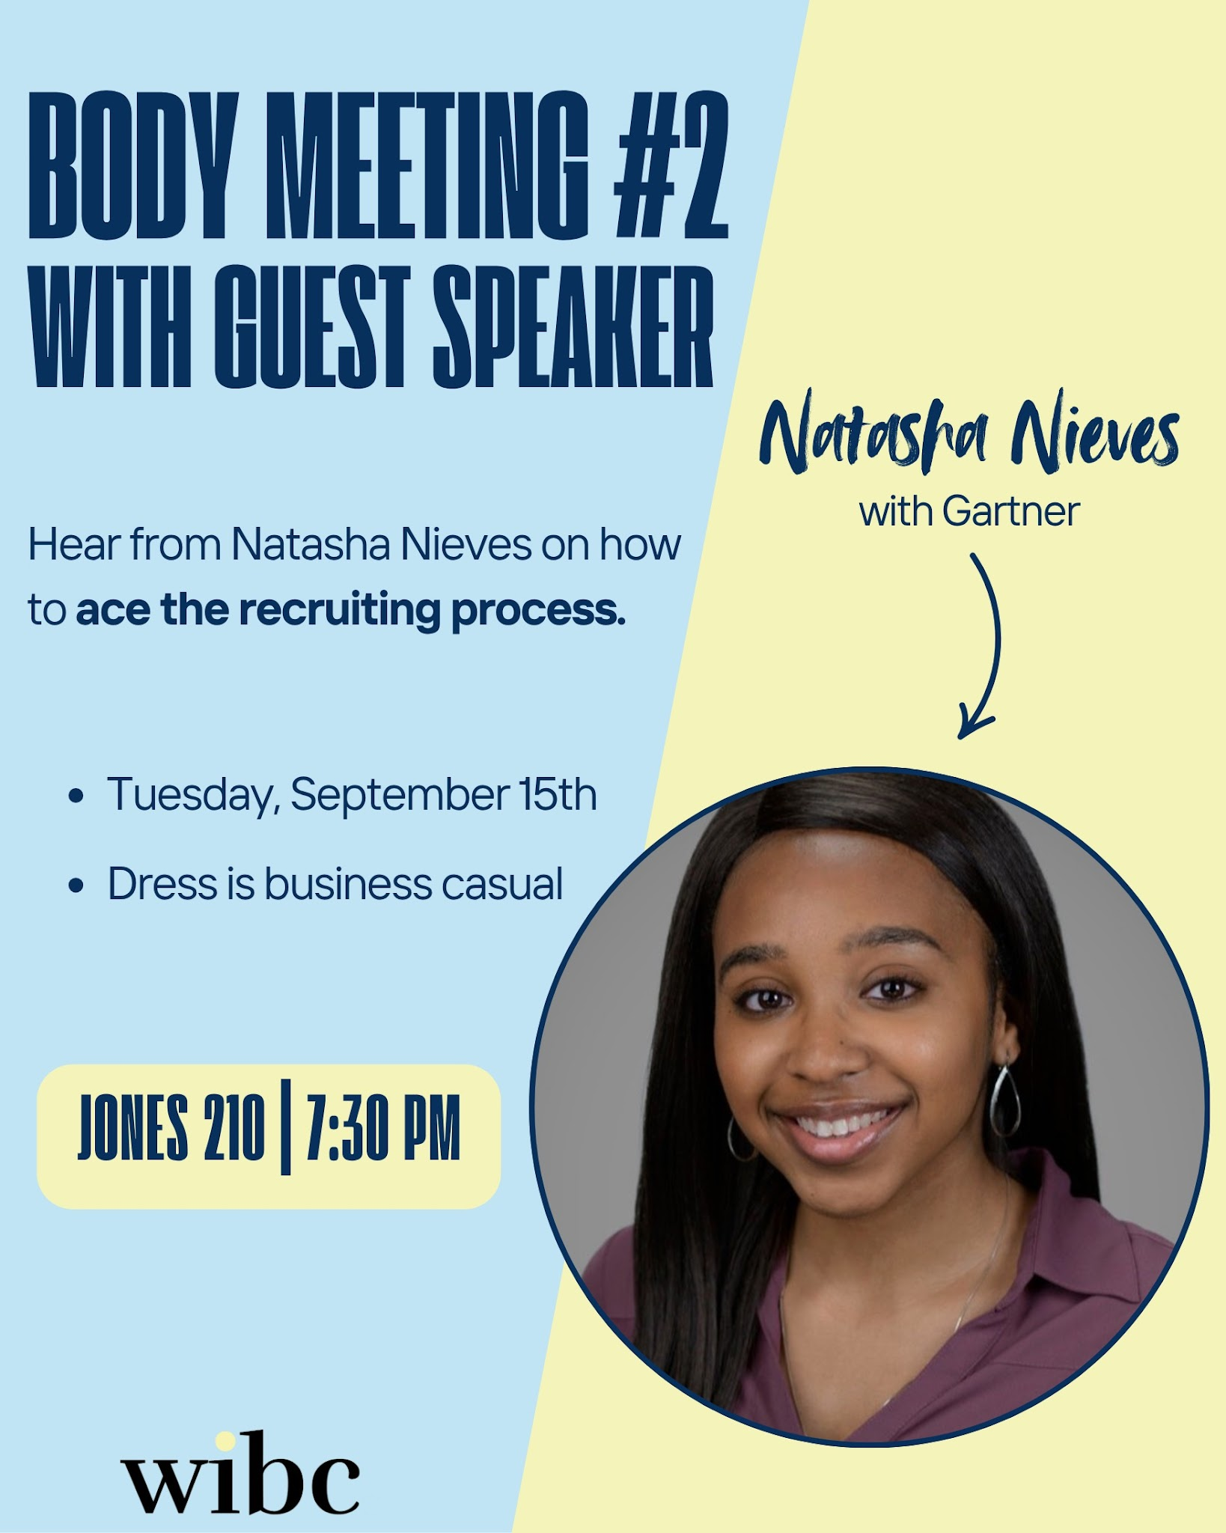
Next Body Meeting
Meeting Etiquette:
During body meetings (virtual & in-person), please be as respectful as possible to our speakers and your peers.
This includes: showing up on time & staying engaged throughout the meeting

Slide 18
How to Join
Ready To Join?
ZELLE $25 dues to uscwibc@gmail.com
  Due September 8th by 11:59pm
  Include your Name, USC email (WITHOUT the @email.sc.edu), PHONE NUMBER, and grade in the description
Request Membership on Garnet Gate
  We will only accept your request after you send dues

Slide 19
Structure- Points System
New Members
Must obtain 16 total points
Attend at least 4 out of 5 WIBternship meetings
Attend at least 2 WIBternship/Mentorship social events
Participate in at least 1 event outside of body meetings
Returning Members
Must obtain 16 total points
Participate in at least 1 event outside of body meetings
All Members
Must attend at least 4 out of 7 body meetings
Free t-shirt at 16 points
  Top 3 point earners will receive a gift card at the end of the semester

Slide 20
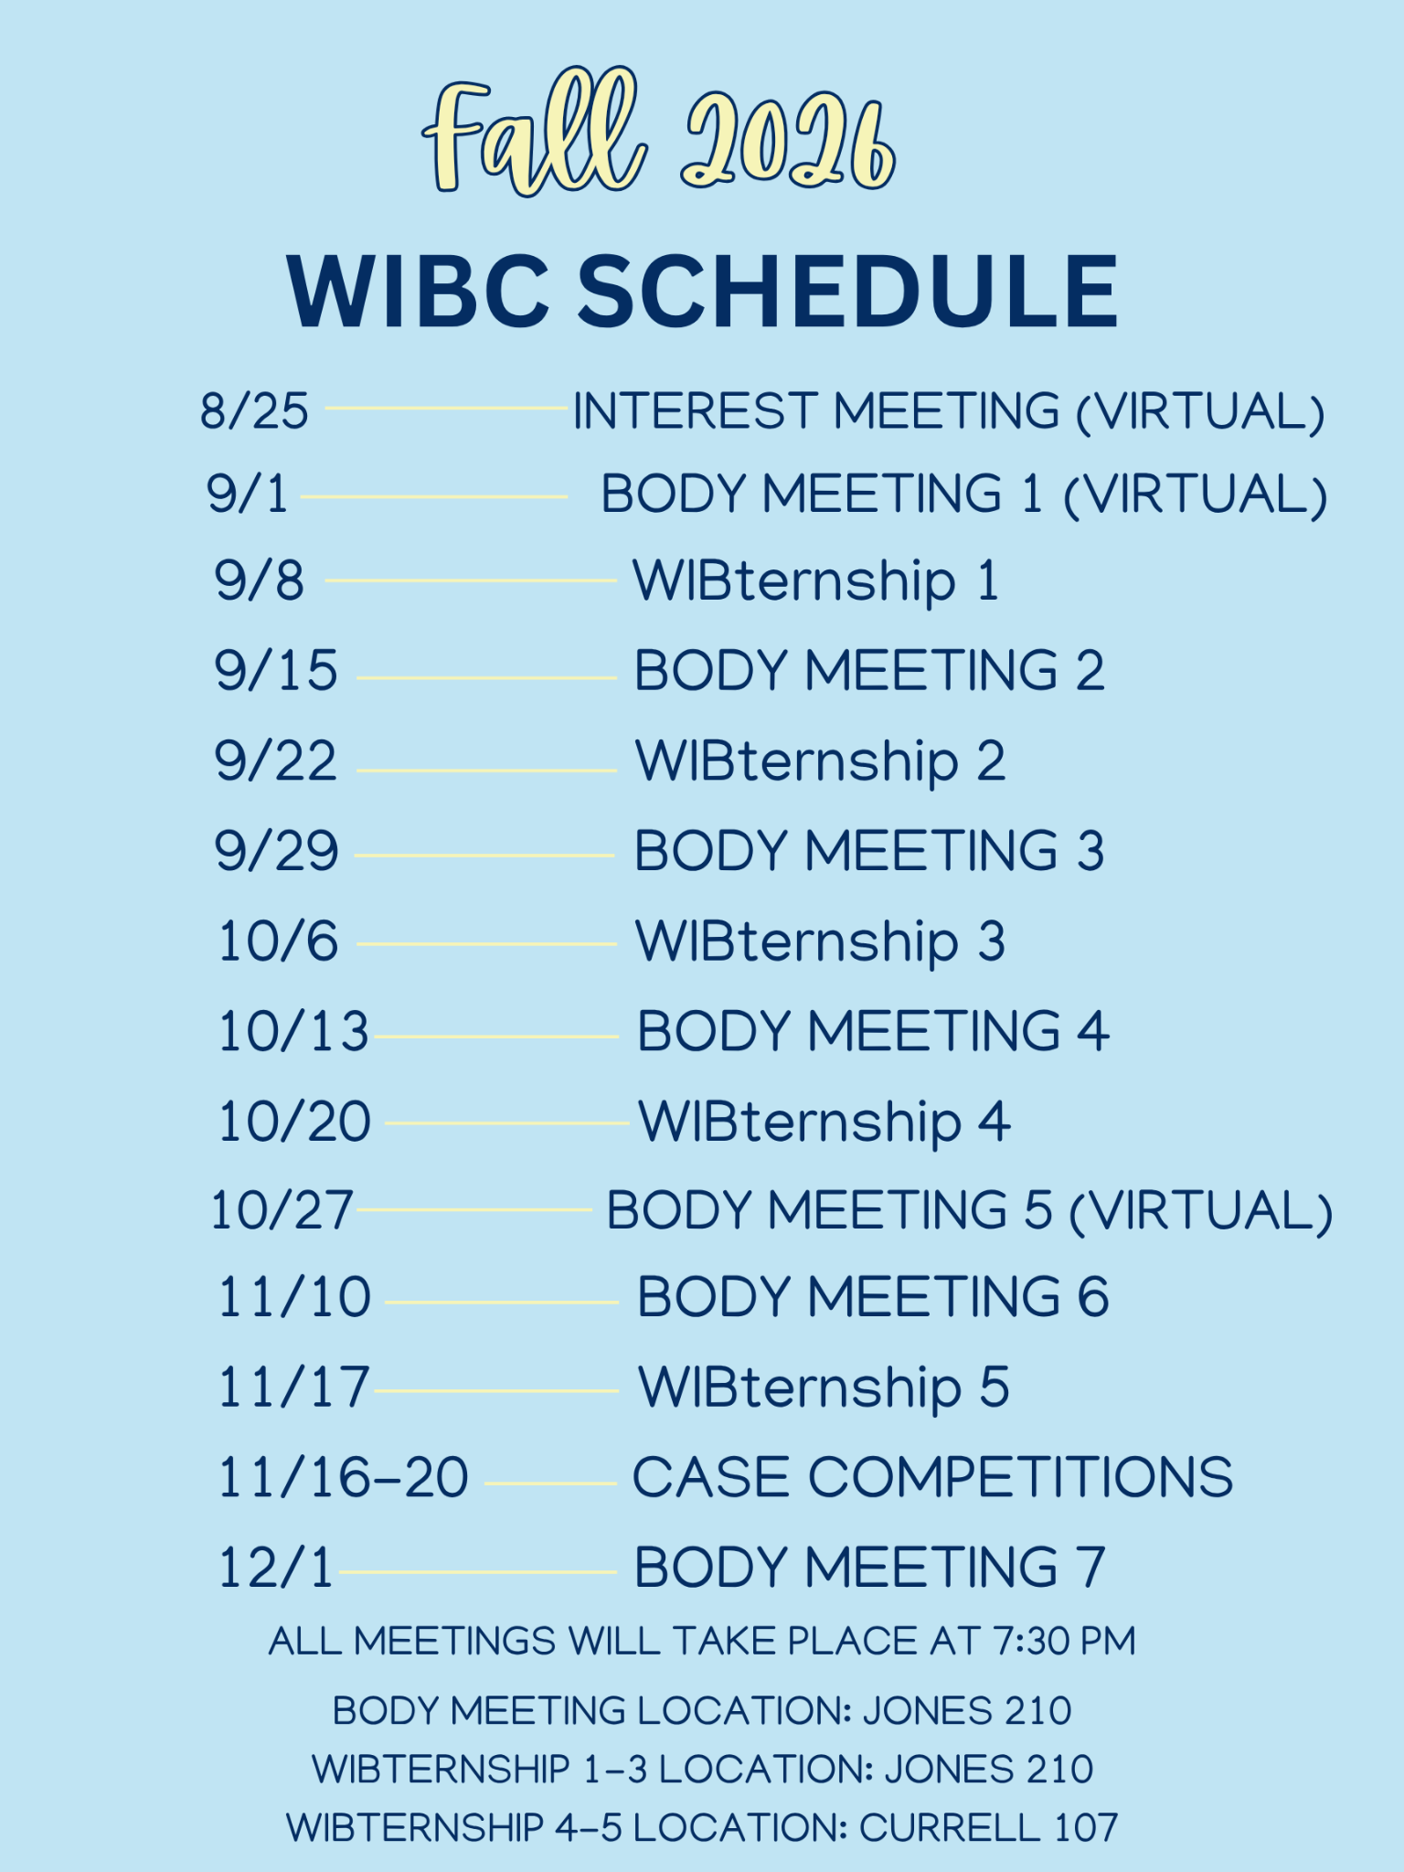
Fall 2026 WIBC Schedule

Slide 21

GroupMe - WIBC

Slide 22
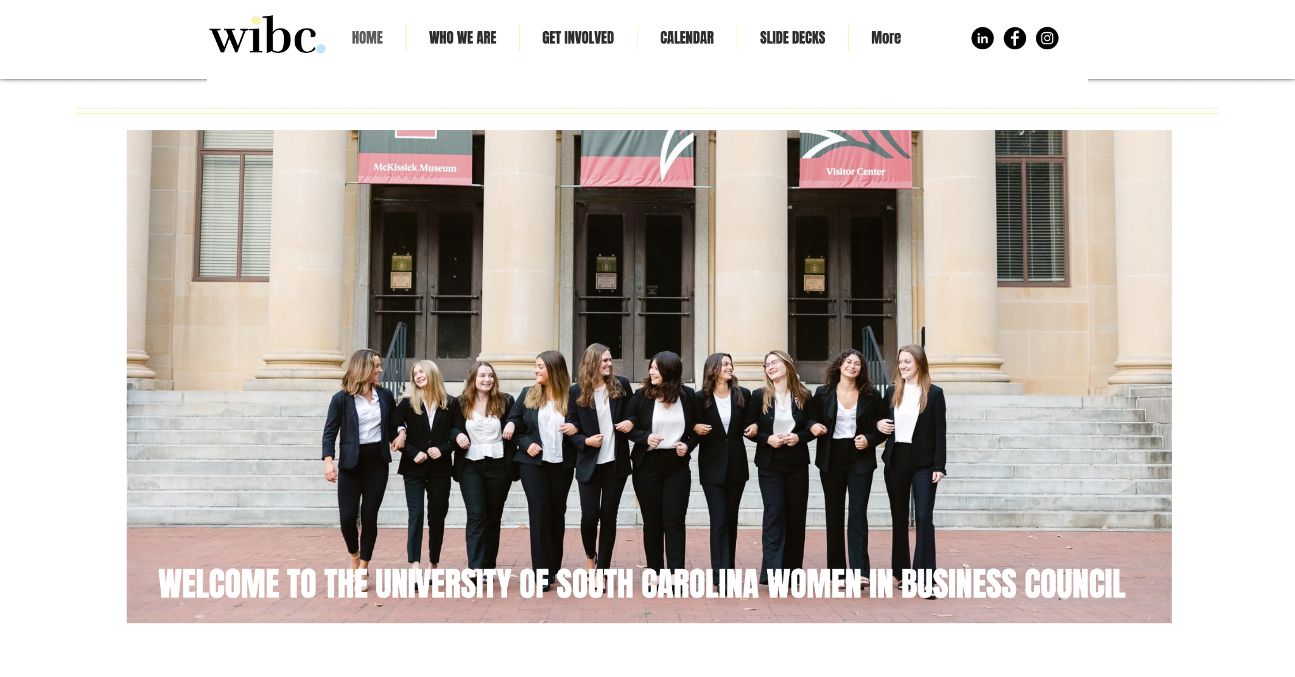
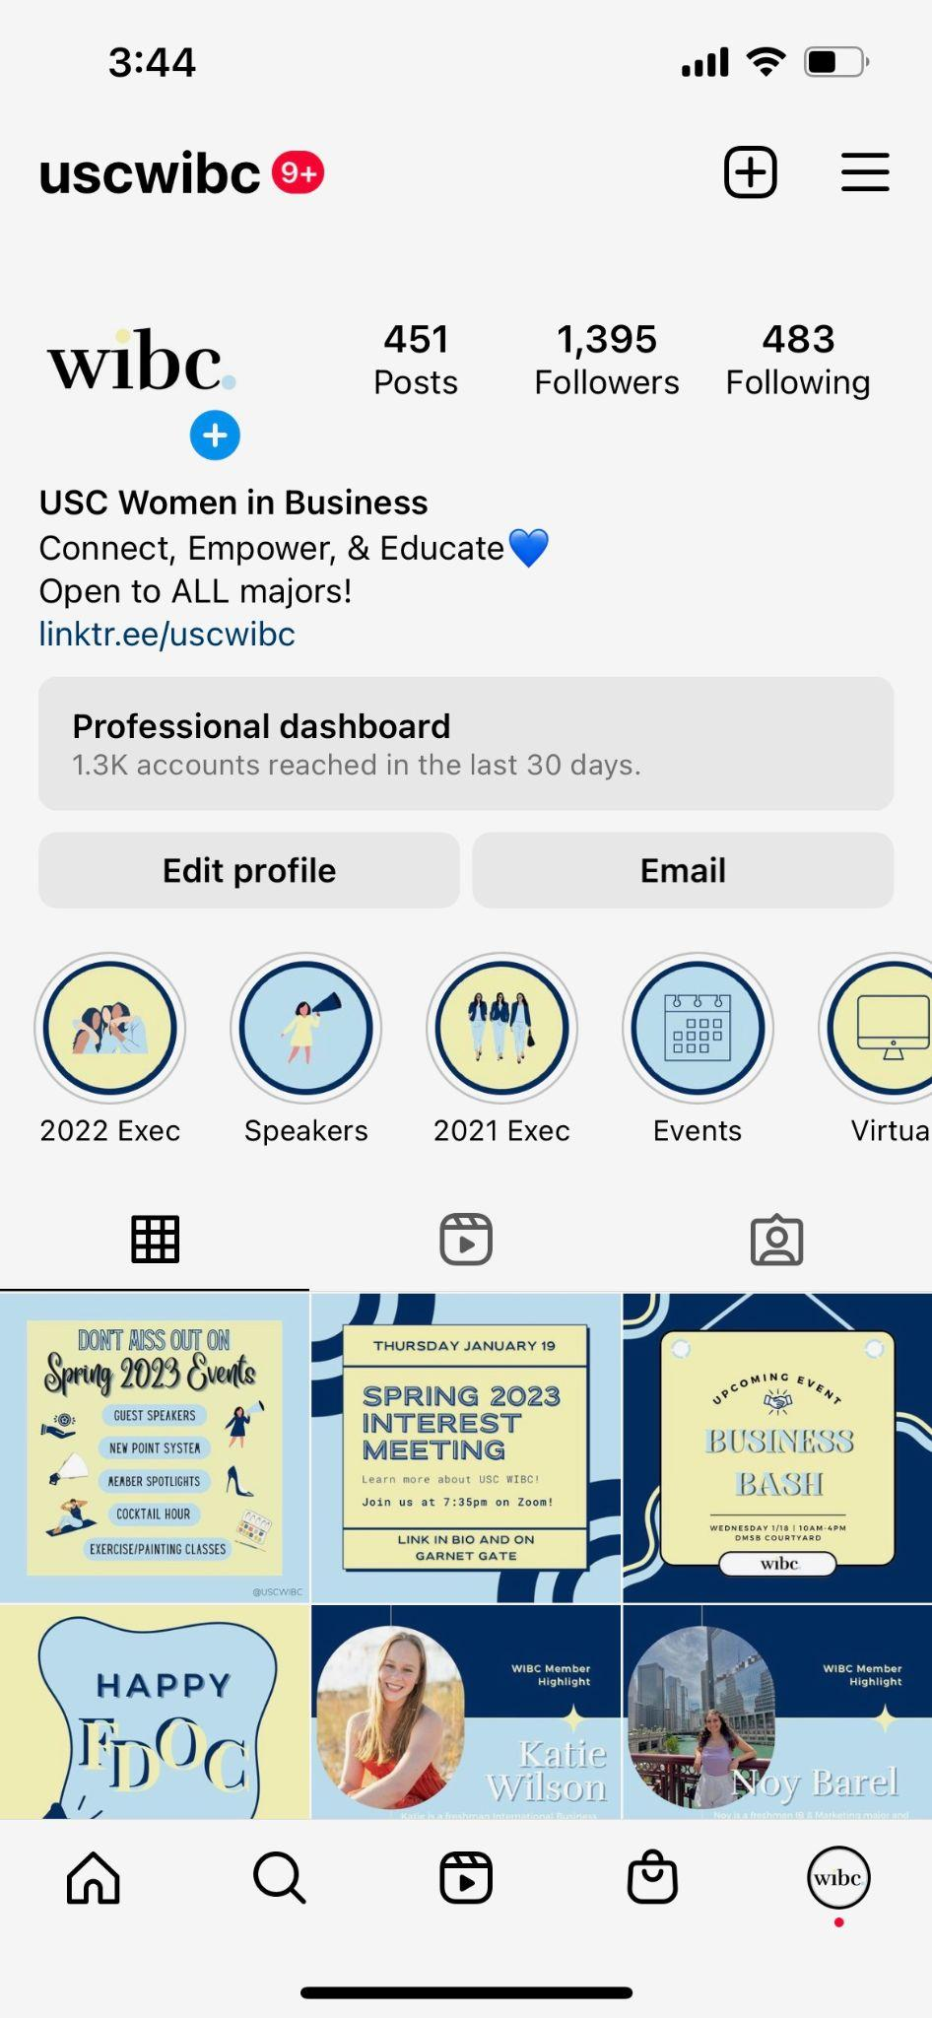
Where to Find Information
uscwibc.com
@uscwibc

Slide 23
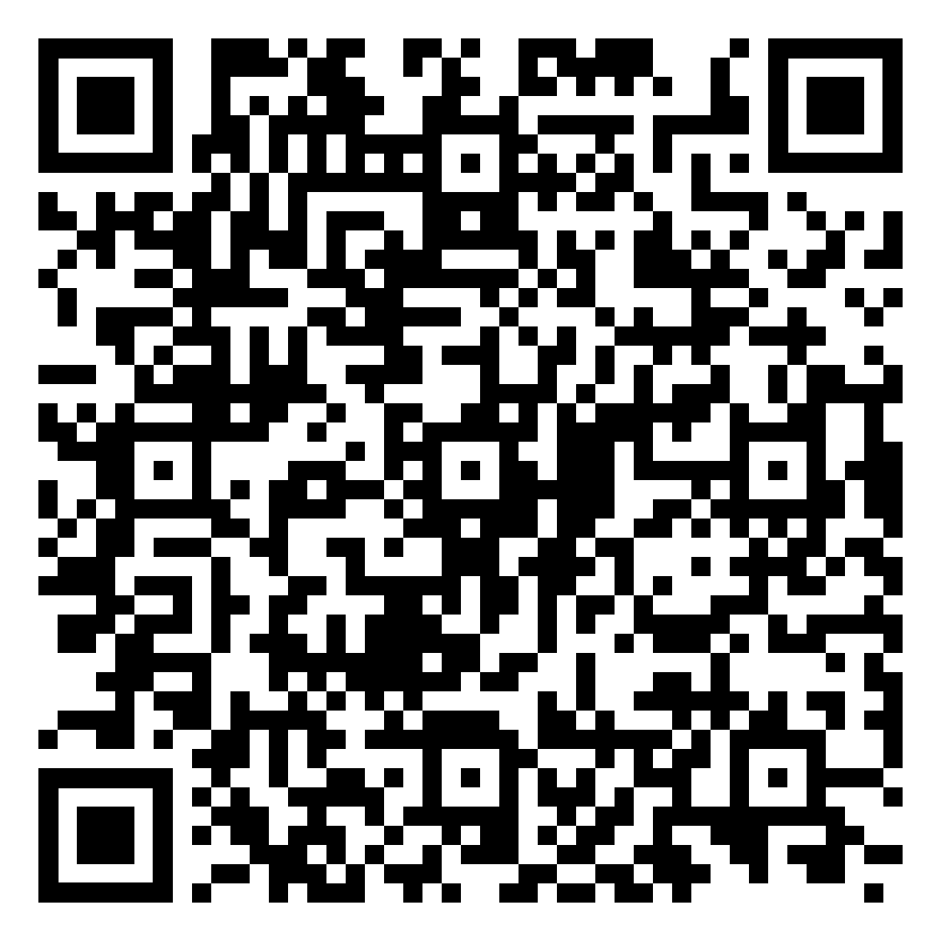
Attendance!

Slide 24
Thank you!

